Slide 2
Your challenge….
To create a game or games for your family to compete in!
Consider how challenging your game is, if you cannot complete it rethink how you can make it easier.
You must be able to “simplify” for each game
Allow a “Trial Run”for each game.
Where you have participants who may find the challenges more difficult can you make it even easier or allow more lives?
Each participant has 9 lives (unless you feel they need more)

Slide 3
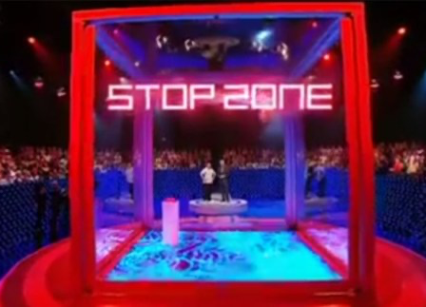
Examples:
12 tin cans with gaffa tape around the bottom half, placed in a line along a table. Kids have to invert each of them in a set time, only using one hand. We used empty coke cans and gave them 9 seconds to invert 12.
Swingball - a weight on a rope hanging from the ceiling, have to swing it round to the opposite side of the room to knock off a ball on a pole.
Walk the beam - piece of wood on its side - walk along the entire length
Balancing - balance on something for 20 seconds
Cylinder - The player must bounce a ball into a container in the middle of the Cube.
Dead Stop - Player must throw a weighted ball onto a raised platform, the ball must come to a complete stop without falling off the edge.
Equilibrium - The balance a small ball on a tile whilst making their way across the Cube, touching 4 red squares marked on the floor, and return without dropping the ball.
Aperture - Move 20 Balls from a tray to a box with a hole just big enough to take the balls within 30 secs.
Construction - Build a vertical column of 10 rods in centre of the Cube. Column must remain standing for 5 secs. We used duplo blocks and got them to build a tower of 14 in 30seconds.
Rebound - A table must be placed against a wall. A ball is rolled along the table so it bounces off the wall, and rolls back to stop between two lines.
Barrier - Use 2 chairs string between them at knee height, blindfolded player to step over it.
Can you beat The Cube?

Slide 4
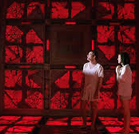
Marking Criteria/Rubric:
Excellent: You have 3 or more games or “levels” for your family to compete in. Each has a simplify option. You keep score on a tracking sheet that you record your participants, the game titles and the number of lives lost and the overall result.
Good: You have 2 games/levels for your family to compete in. You attempt to simplify. You record the scores on a tracking sheet.
Satisfactory: You have 1-2 games/levels the you take part in. You may not have a simplify option. Your score tracking is limited.
Poor: You have 1 game/level that you is not well explained and tracking of results is not present.

