Slide 1
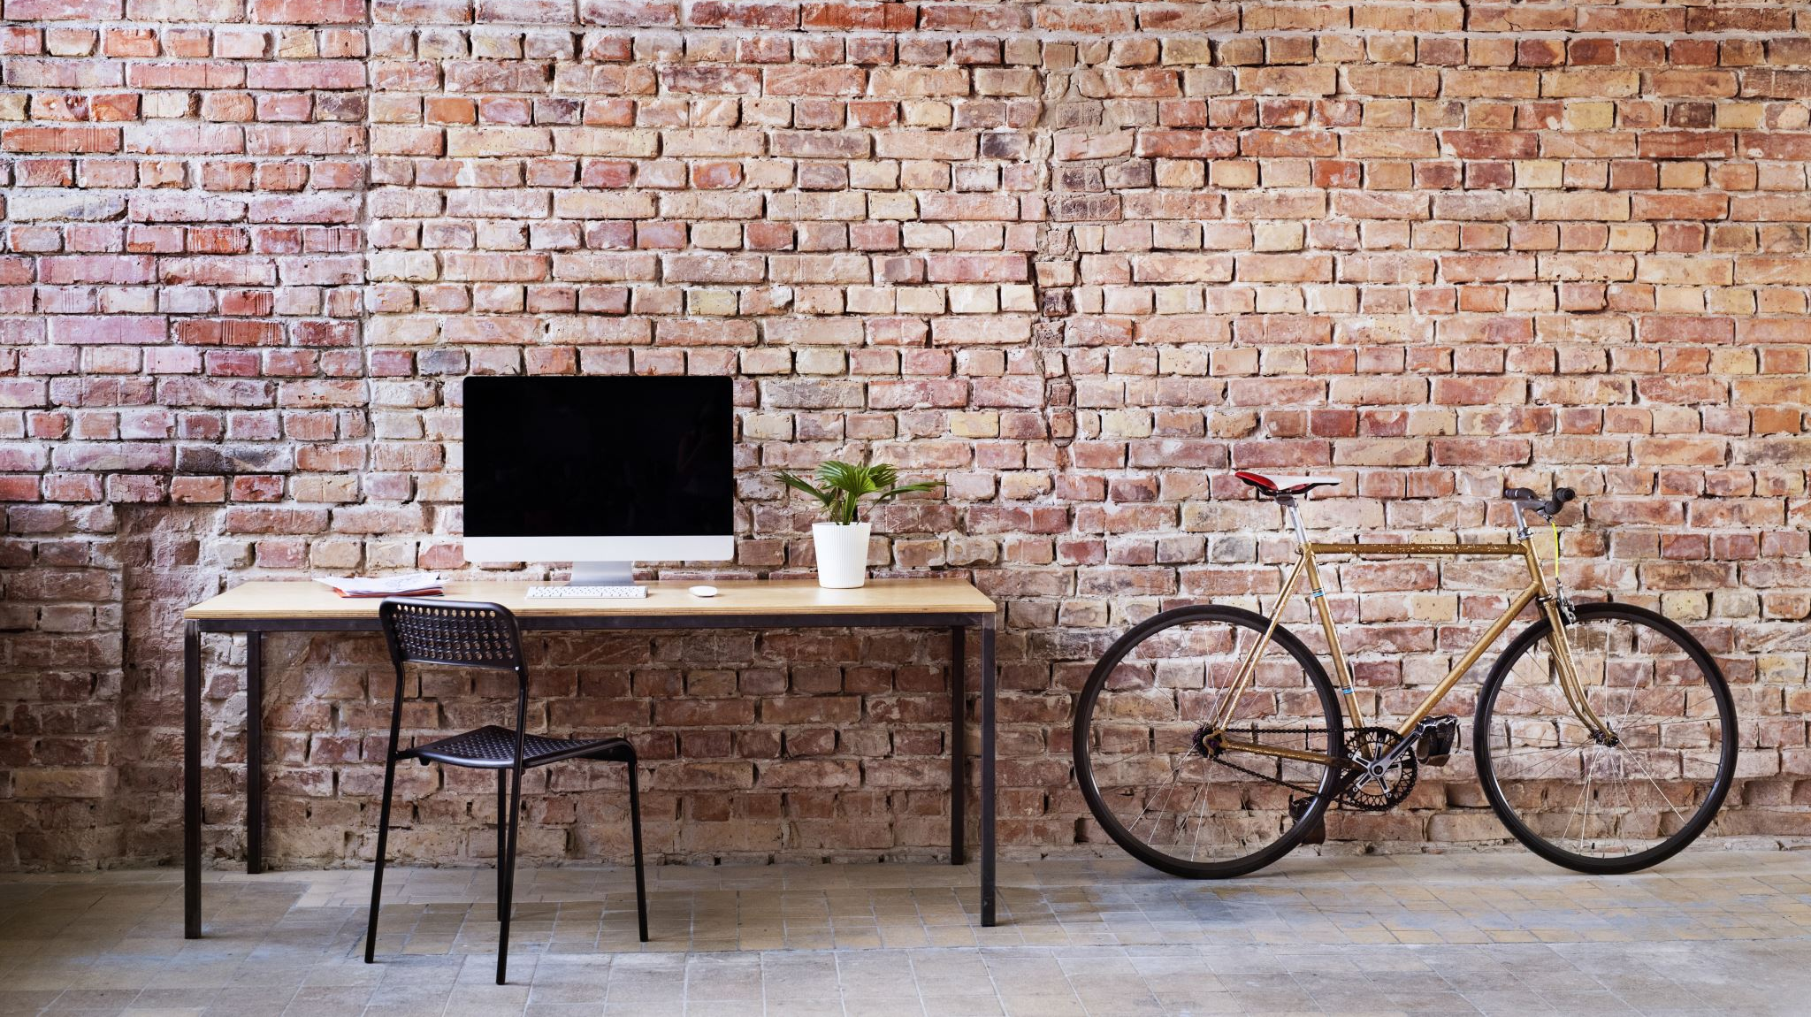
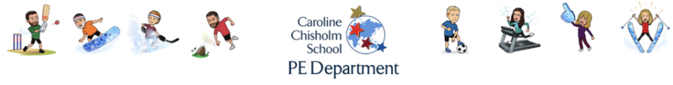
CCS virtual extra curricular - February to March 2021

Slide 2
Keep active in 2021!
Physical activity is so important for your physical and mental health, especially during lockdown.
Due to the ongoing COVID-19 pandemic, we cannot provide an in school extra curricular timetable (hopefully not too long to go now), but we still want you to be active after school hours so have a look at our virtual extra- curricular provision from post Feb half term to the Easter holidays.
Move it Monday- A challenge on a Monday to log how many steps or how far you have moved (walk/run/bike).
Time out Tuesdays- A link to a new weekly meditation video to focus on creating a positive and healthy mind.
Work out Wednesday- A variety of home based workouts designed by CCS pupils! A new workout every week that was created during the Pick N Mix PE challenge.
Finesse Thursday- Practice a skill of your choice at home in any given sport or activity. Record a video or send a photo to your PE teacher. Why not practice using the homecourt app that was a great success for home PE in the last week of term.

Slide 3
Week 1
Move it Monday- How many steps can you achieve?
Time out Tuesdays- Meditation- 10-Minute Meditation For Beginners - YouTube
Work out Wednesday- Pick N Mix CCS pupil workout 1 (on the next slide)
Finesse Thursday-Practice and show your skills

Slide 4
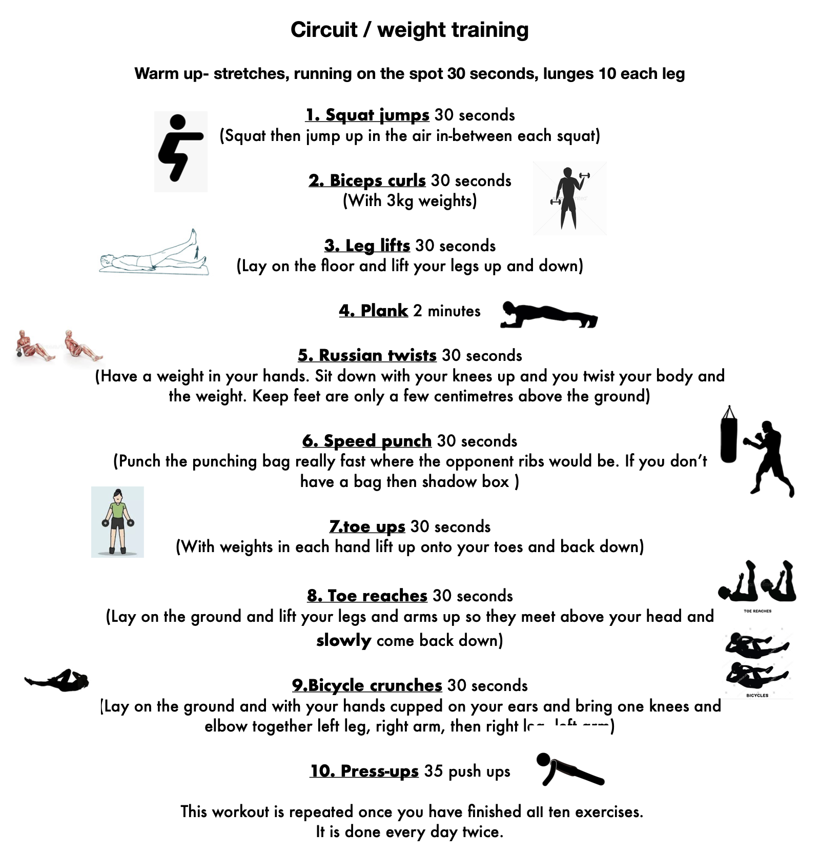
Pick N Mix CCS pupil workout 1
Try to complete 2-3 rounds

Slide 5
Week 2
Move it Monday- How many steps can you achieve?
Time out Tuesdays- Meditation- 10-Minute Meditation To Start Your Day – YouTube
Work out Wednesday- Pick N Mix CCS pupil workout 2 (on the next slide)
Finesse Thursday- Practice and show your skills

Slide 6
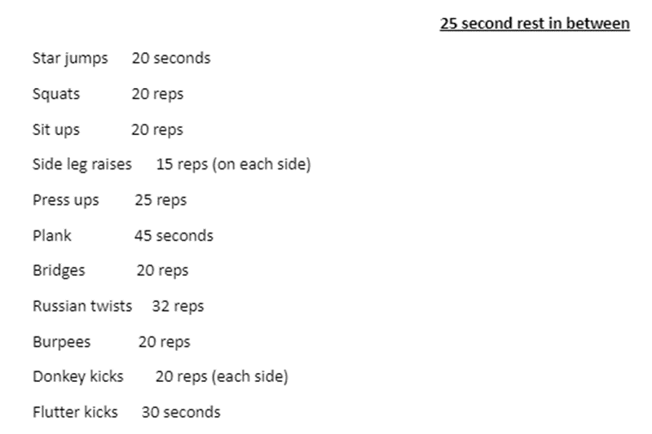
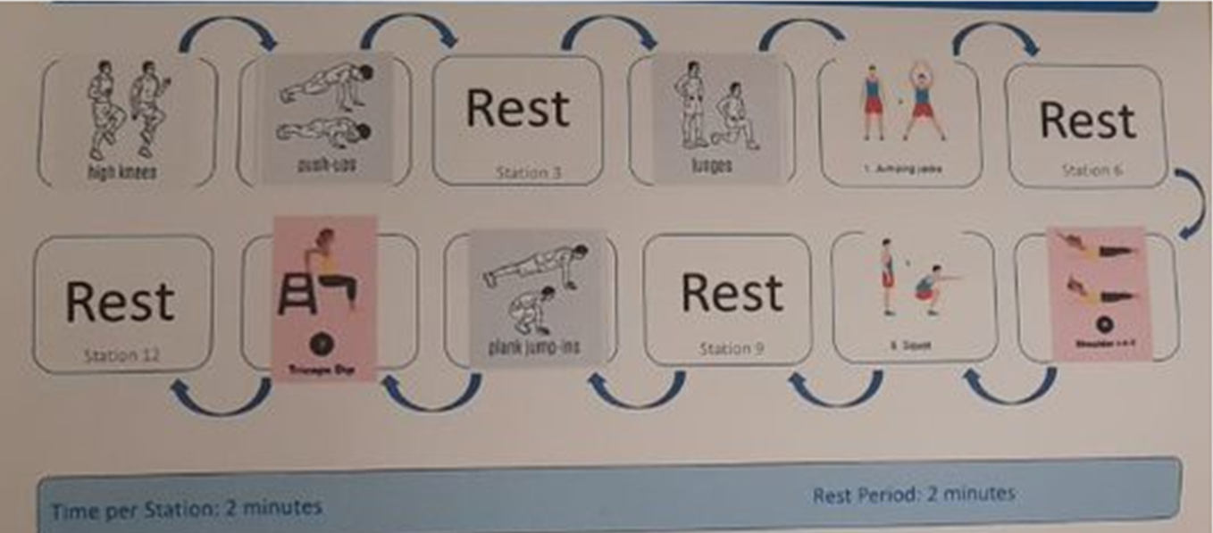
Pick N Mix CCS pupil workout 2
Two different workouts to attempt this week.
Try to complete 2-3 rounds or one of mix up both!

Slide 7
Week 3
Move it Monday- How many steps can you achieve?
Time out Tuesdays- Meditation- 10-Minute Meditation For Anxiety - YouTube
Work out Wednesday-Pick N Mix CCS pupil workout 3 (on the next slide)
Finesse Thursday- Practice and show your skills

Slide 8
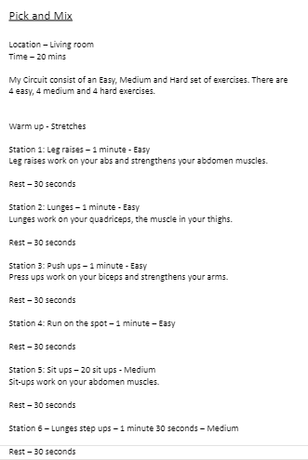
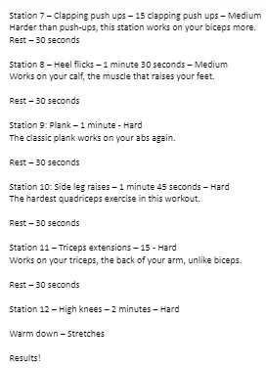
Pick N Mix CCS pupil workout 3
This should last 20 minutes and has a variety of different levels of exercises.

Slide 9
Week 4
Move it Monday- How many steps can you achieve?
Time out Tuesdays- Meditation- 10-Minute Daily Meditation - YouTube
Work out Wednesday- Pick N Mix CCS pupil workout 4 (on the next slide)
Finesse Thursday- Practice and show your skills

Slide 10
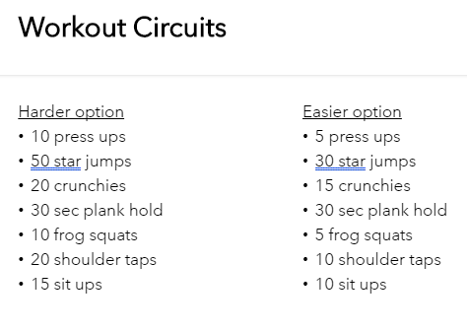
Pick N Mix CCS pupil workout 4
Try to complete either the harder or easier option for 20 minutes. How many times can you complete it in the time frame?

Slide 11
Week 5
Move it Monday- How many steps can you achieve?
Time out Tuesdays- Meditation- 10-Minute Meditation For Stress - YouTube
Work out Wednesday- Pick N Mix CCS pupil workout 4 (on the next slide)
Finesse Thursday- Practice and show your skills

Slide 12
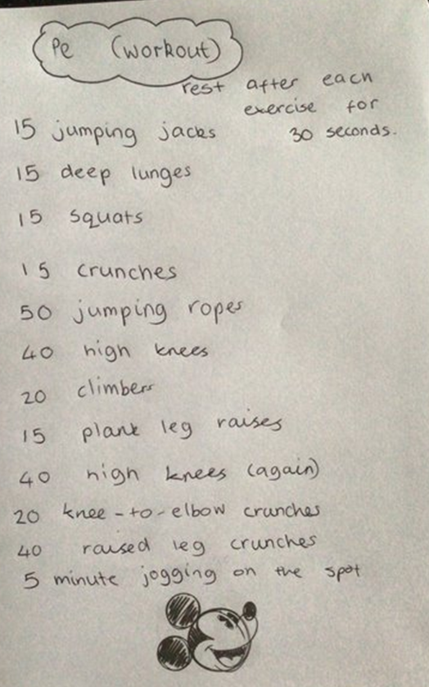
Pick n mix CCS pupil workout 5
Get this done and then look forward to the Easter holidays!

Slide 13

Rest - enjoy the Easter holidays!
Or if you fancy a bonus workout before you come back, have a look at the next slide!

Slide 14
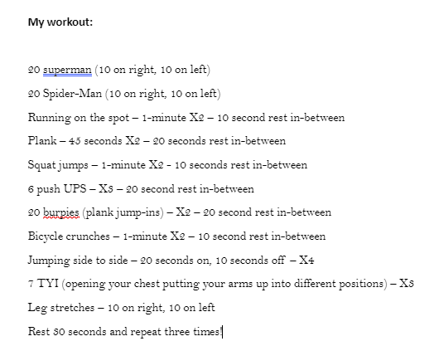
Bonus workout!

