Slide 1
HPL Student Training Session

Slide 3
HPL Champion/Leader/Pilot/Navigator/…
As form HPL…, you will:
Help your form with HPL activities (e.g. the tutor day coming up.)
Ask your teachers to explain the HPL for the lesson.
Notice ACPs and VAAs – support the Subject Leader for HPL.
Meet with the Teaching and Learning team.

Slide 8
Fleas in jar!

Slide 11
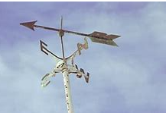
What’s in a name?!

