Slide 1
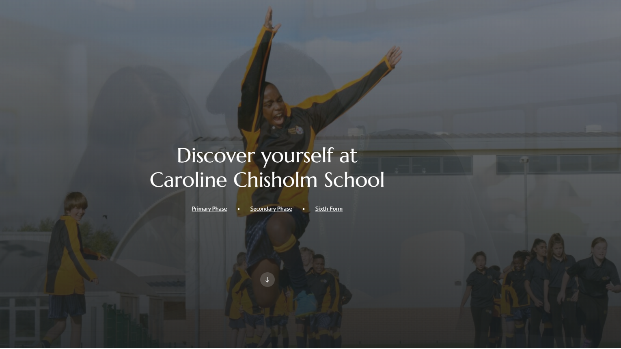
Teaching and Learning
What will the ‘new normal’ look like?

Slide 2
COVID impact on staff
Negatives
We’ve missed the face to face contact with the students!
We have been away from our colleagues
Juggle home schooling and/or challenging circumstances with trying to be an effective teacher
We’ve had to navigate CAGs and have the pressure of determining young peoples’ futures
We’ve all dealt, in varying ways, with the trauma of a pandemic
For many of us, and many more students, there will be trauma attached to this period, that still isn’t over

Slide 3
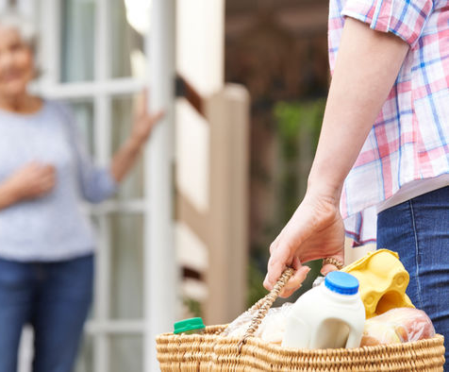
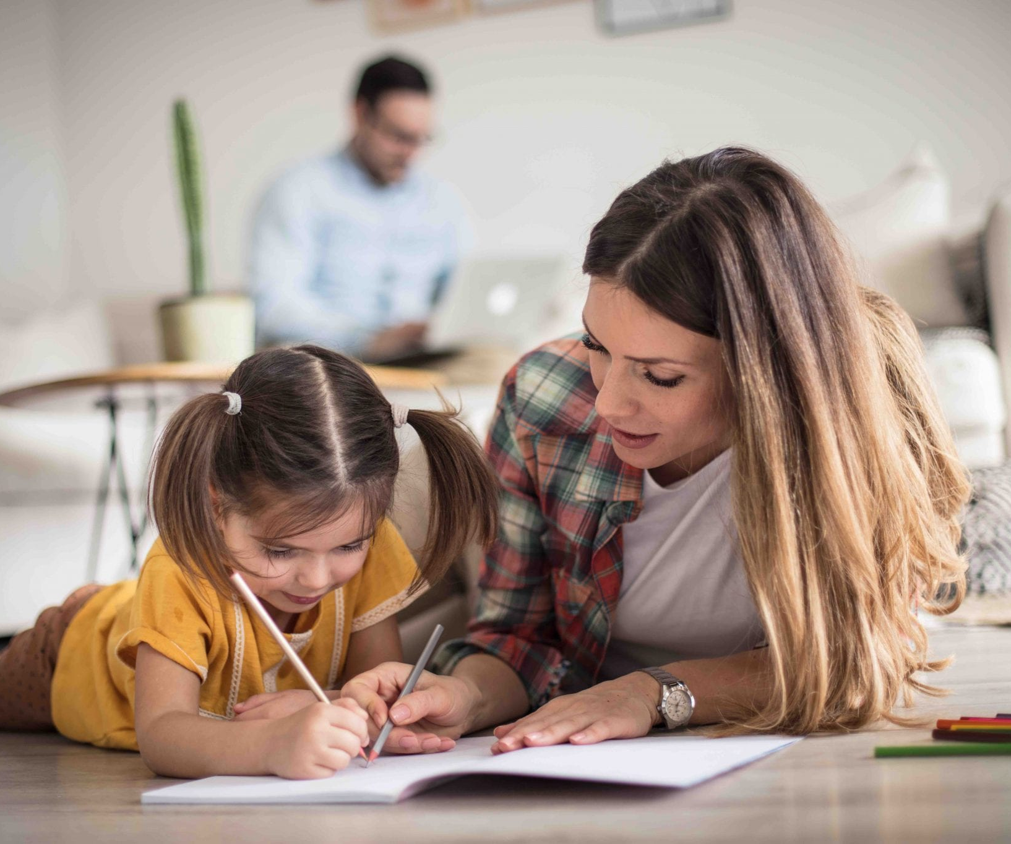
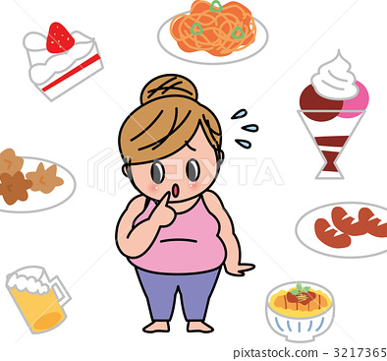
COVID impact on staff
Positives
Got to see our families (probably more than we wanted to at times!)
We discovered our levels of determination and resilience
We managed to self regulate
We were dragged kicking and screaming into the virtual world
We have all, as a community, been showing empathy (helping neighbours and families)
We’ve seen great examples of original thinking
We took on Teams, live lessons and home hair cuts!
In doing CAGs we’ve had to be logical and precise
We’ve worked in bubbles with staff we wouldn’t normally get to share so much time with
We’ve worked with different students on very different terms
We’ve been revolutionary in our thinking
We’ve been on a massive learning curve (especially the technophobes!)

Slide 4
COVID impact on students
Negatives
Lack of social interaction
Getting behind with work
Poor independence skills have been highlighted
Family circumstances
Fear of illness
GCSE & A level uncertainty
Not having closure (Year 6, 11 & 13)
Missed school (this is also a positive!)
Lost confidence (some of our high-flyers are the most behind)
Scared to return to normality
Cabin fever
Bereavement
Lack of routine
Sense of insecurity for their future
Time with their families
The quality of their education won’t have been as good as their face to face experiences
Separation anxiety.

Slide 5
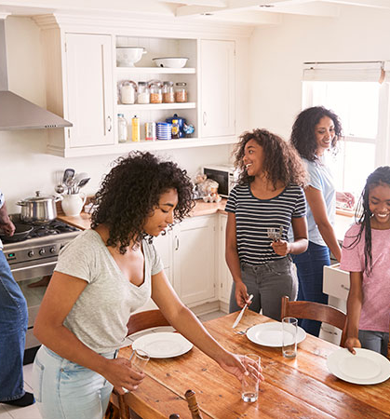
COVID impact on students
Positives
Time with their families
Chance to shine in the new way of learning
For introverts, this is a haven!
They gained a new appreciation for school and their teachers
They are grateful for our efforts
Their parents have become more proactive and supportive
They’ve grasped new technology (quicker than some of us!)

Slide 6
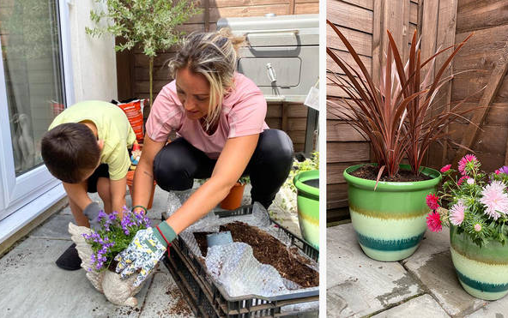
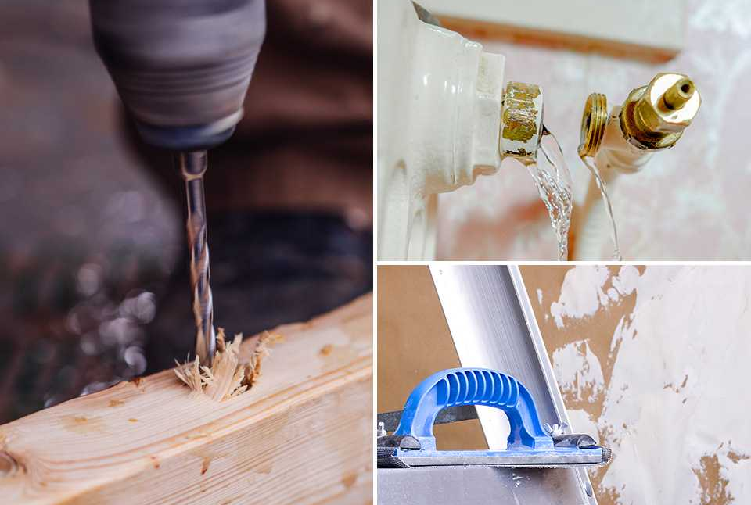
COVID impact on parents
Positives
Got to spend time with their kids
Down time (in some cases)
Home improvement

Slide 7
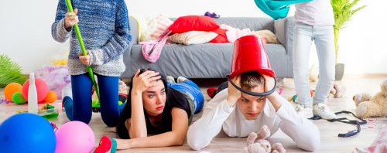
COVID impact on parents
Negatives
Got to spend time with their kids (!)
Work stresses
Financial Stresses
Afraid for their child’s social, mental and educational well-being
Bereavement
Concerned for child’s safety upon return to school
Separation anxiety.

Slide 8
Teaching in a COVID safe environment
Teachers lead by example and maintain social distancing
Students will need clear guidance and regularly reminders
Students need to face the front – group work could be done using technology
Can swap books with the one person sharing a desk (peer assessment)
Teachers should not handle materials to be passed to students or collect paper based materials in.
Teachers cannot rearrange the classroom layout
We cannot move students to different desks – if you believe a seating arrangement needs amending please liaise with relevant Progress Leader
Staff must maintain the 2m safe distance from the students – do not step over the yellow line (this is different in EYFS and some younger primary phase classes)
Teachers should log on SIMS via negative points, any student who doesn’t have equipment so that the progress team can chase it up.

Slide 9
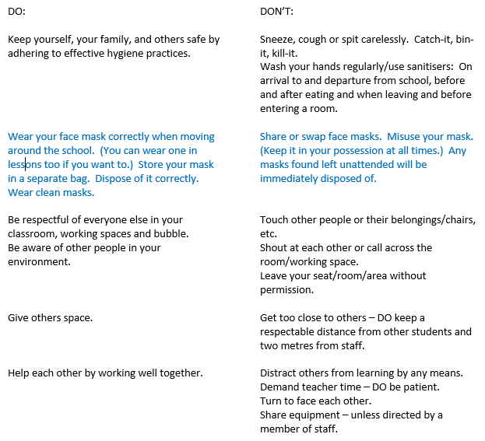
Information for students TO KEEP COVID SAFE:

Slide 10
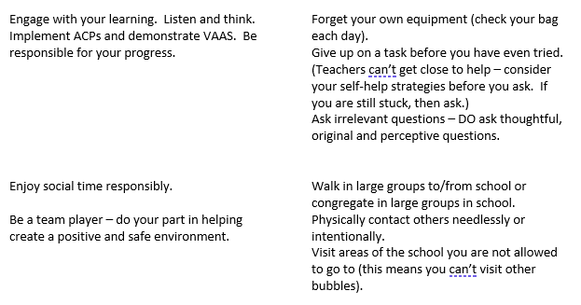
Information for students TO KEEP COVID SAFE:

Slide 11
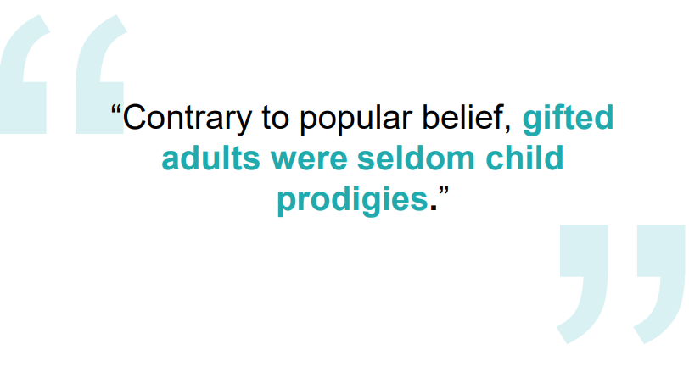
Big Picture Thinking – Intent

Slide 12
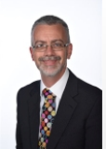
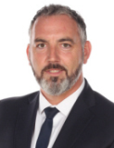
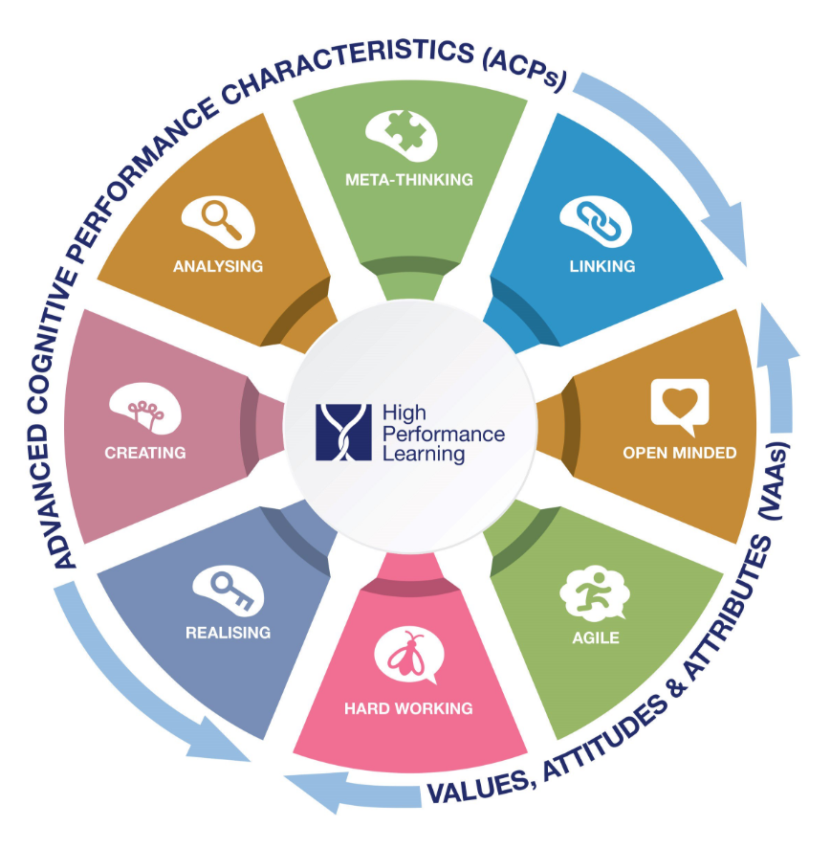
The Vision - Impact
We want motivational teaching and learning experiences that promote ambition, confidence and success. We want this for everyone –for all students, all staff and also through effective engagement of parents in the process.
We want this not only in every lesson, but through every opportunity in or out of school where we are able to learn.
We want students who are able to demonstrate effective independent learning skills across the entire range of curriculum subjects, who show resilience when confronted by new content and skills and who are able to apply these learning behaviours and attitudes in situations both within and out of school.(Teaching and learning policy.)
EMPATHETIC

Slide 13
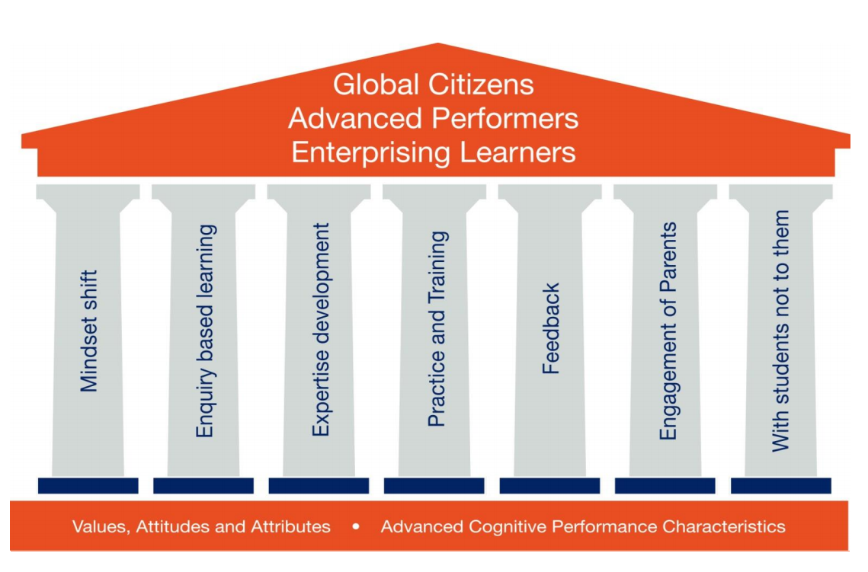
Staff
Students

Slide 15
What skills will youngsters need in the future?
Digital Literacy
Problem Solving Skills
Global Citizenship
Youth Entrepreneurship
Curiosity and a Love of Learning
Adaptability and Cognitive Flexibility
Accessing, Assessing and Analysing Information
Self-Knowledge and Emotional Intelligence Read more at: https://www.skillsyouneed.com/rhubarb/skills-young-people-need.html

Slide 16
How are we doing? Implementation.
Up-to-date pedagogy based on research:
Three years in progress.
Embracing a growth mindset philosophy.
World class school – ½ way through a 2 year programme
HPL
Assessment Essentials
In-house expertise
Ongoing CPD
Appraisal
One year in progress.
Embracing the value of formative assessment as intrinsic to student progress.
Combining seamlessly with HPL.
High expectations; utilising:
HPL lead and development of groups. Teach meets. Briefing agenda.
Quality assurance. Support.
Training days. Twilight sessions. Online courses. External courses.
Whole school targets. Reviews.

Slide 17
Next steps. Implementation
All staff are using assessment strategies to inform the planning of high quality lessons and to ensure interventions are rapid.
All staff are using and referring to the 30 ACPs and VAAs on a regular basis and promote their use within lessons. The concept of HPL is central to the underpinning pedagogy of the school. It is clearly evident in daily practise.
Students are able to use the language of HPL effortlessly.
Parents are supportive of the school’s drive towards high performance for all students. They understand the strategies we are using.
Opportunities for a range of enquiry-based learning across all phases and subjects are being looked at and implemented.
The Seven Pillars of High Performance are in place.
We achieve accreditation to demonstrate that we are ‘World Class’.

Slide 18
It is really important that we continue the hard work and progress made on the areas of focus last year: Assessment HPL All-Through Ofsted seems so long ago now, but we were making excellent progress before lockdown and although it will be challenging, we need to maintain momentum! We can achieve great things when we pull together!

Slide 19
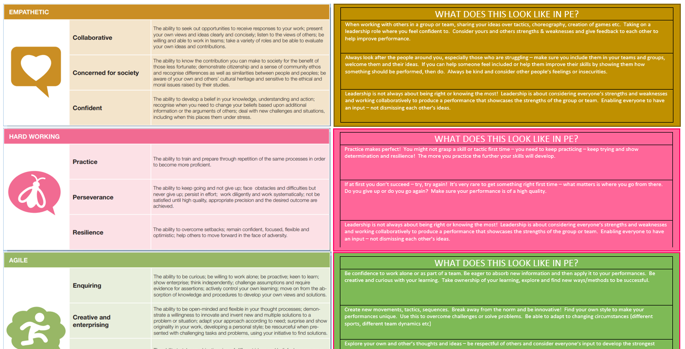
Build your teaching around HPL
The HPL strategies should not be a ‘bolt-on’ to our teaching and planning – they should be at the heart of it.

Slide 20
Support network
Teaching and Learning Team – share ideas and resources
Culture Champions for assessment
Our colleagues across all phases
Sharing of best practice with Teaching & Learning Gurus
Appraisal systems to support your development
CPD training throughout the year
HPL online resources

Slide 21
Immediate Actions
Extra faculty time today to enable you to respond to changes over the summer and in particular curriculum planning
Identifying and responding to the gaps
OneNote training
Specific Maths and Science training
Expectation that we are on board with vision, implementing Assessment Essentials and HPL strategies

Slide 22
EMPATHETIC

