Slide 1
HPL G: 15th October Presentations

Slide 2
Jenny Ideson

Slide 3
Task 3: Hexagons [GCSE Lesson Task]
You will be given 9 hexagons.
1. On each hexagon, write one of the characteristics of God and include an emoji to symbolise the meaning of that characteristic:
Benevolent
Omnipotent
Omniscient
Eternal
Immanent
Personal
Forgiving
Judgemental
2. Now put the hexagons together. Every time one side of a hexagon touches another, jot down the link between the touching characteristics. Stick these into your book once you arranged them effectively.
3. Now annotate your hexagon by drawing arrows to at least three different sides that touch and add a Bible verse to each.

Slide 4
[A LEVEL Lesson Task]: Starter -How did the reforms of Alexander II generate challenges to political authority?
On your five hexagons write:
Emancipation
Relaxation in Censorship
Education
Local Government
Legal Reforms
Then arrange your hexagons on the paper so that you make links between the different areas and how they led to challenges to political authority. Annotate around the hexagons so that you explain the links you are making.

Slide 5
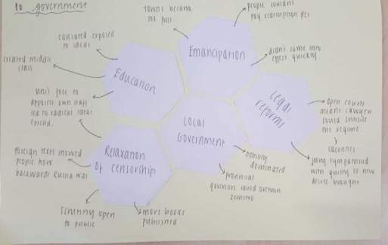
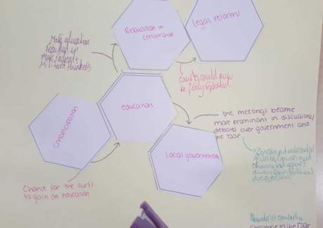
Student Work: Starter

Slide 6
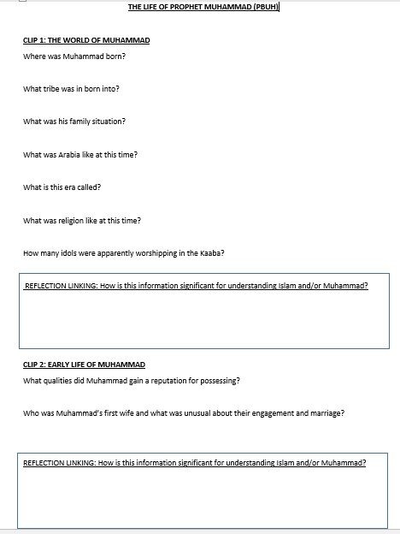
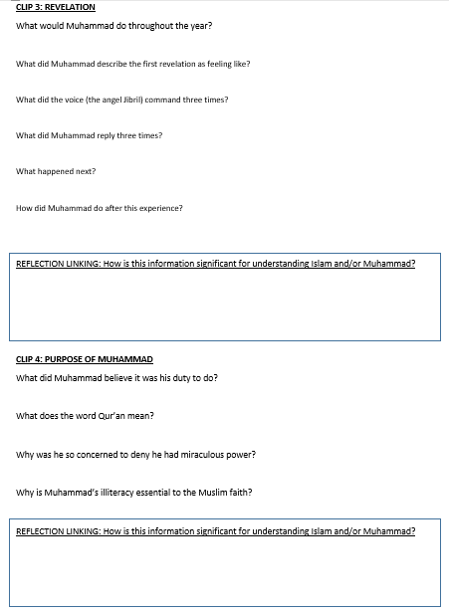
Reflection Boxes – quick tweak that focused on linking/ significance so that students can better understand and also apply information

Slide 7
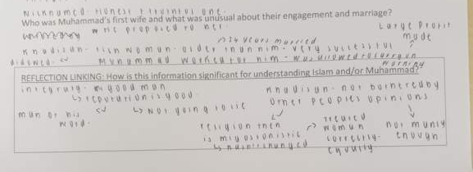
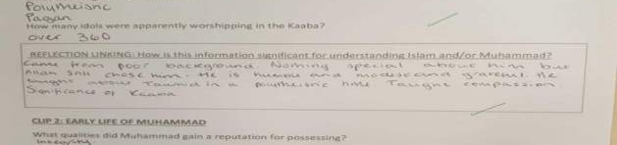
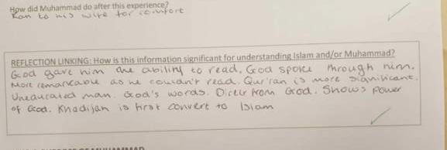
Student Work

Slide 8
Phil Ashton

Slide 9
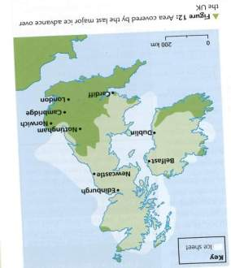
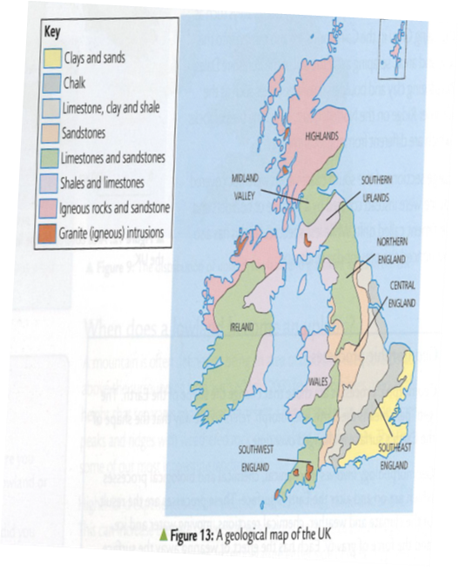
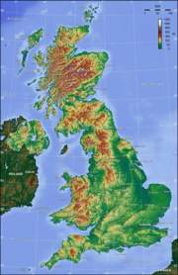
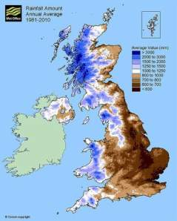

Slide 10
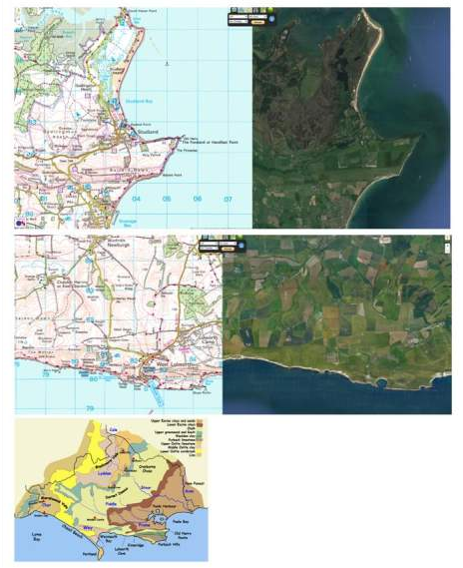

Slide 11
JURASSIC COASTLINE
EROSION LANDSCAPES
WEATHERING – CHEMICAL / BIOLOGICAL /
DESTRUCTIVE WAVES – CAUSES ETC
HEADLANDS & BAYS
CAVES, ARCHES, STACKS & STUMPS – DURDLE DOOR
LULWORTH COVE
WAVE CUT PLATFORMS – KIMMERIDGE BAY
INFLUENCE OF ROCK TYPE
MASS MOVEMENT
TRANSPORTATION
LONGSHORE DRIFT
DEPOSITION LANDSCAPES
CONSTRUCTIVE WAVES
SPITS – SANDBANKS

Slide 12
Lis Page

Slide 13
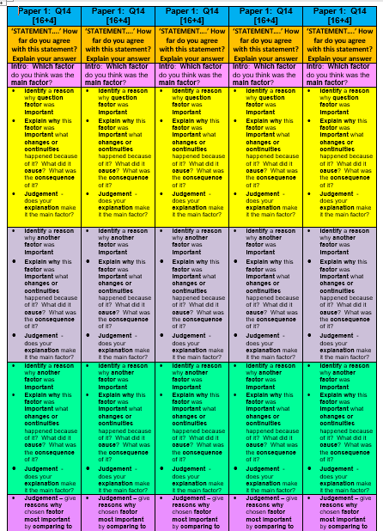

Slide 14
Caroline Grant

Slide 15
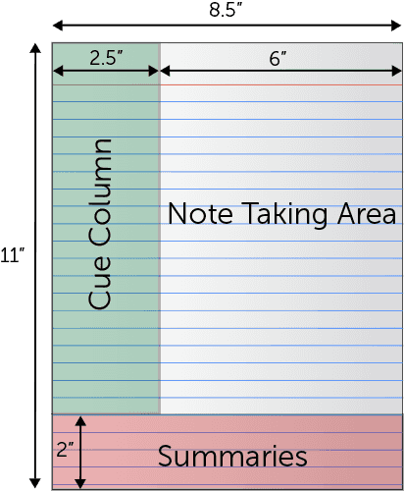
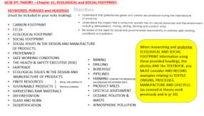
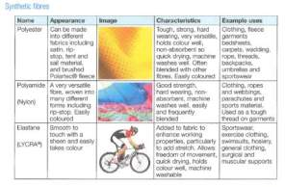

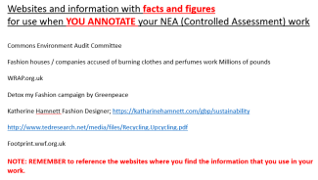

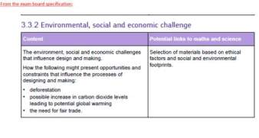
Cornell note taking technique
More able pupils can use their own method or the cornell note taking technique to record knowledge
Key words taken
From theory text
To prompt and
support
Key questions selected to check understanding at the end of the chapter of text
key
Higher ability pupils are directed to further research and study to enhance their understanding AND to find out higher level information which in turn feeds into their NEA work AND exam prep understanding.
Mid to lower level pupils are supported with the helpsheets and in turn directed back to prior, connected learning, which will now feed into NEA annotation work and Exam understanding
And also links to NEA

Slide 16
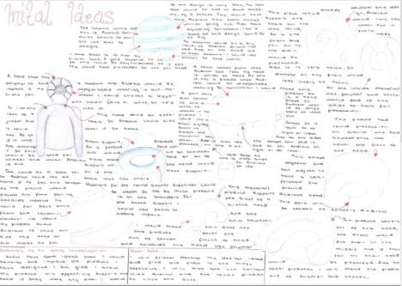
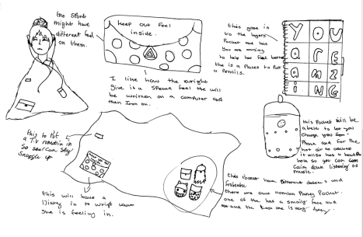
NEA Design sheets benefit from higher level annotation, linking theory learning to the NEA as well as exam questions

Slide 17
Yan Mallett

Slide 18
Rally coach
Disrupter

Slide 19
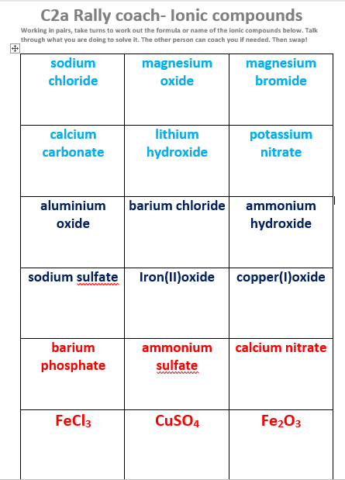

Slide 20
Teacher notes
Pair up students.
Works well if they are paired with someone they wouldn’t normally work with. (could use random sorter on Mintclass)
Students take turns to coach each other
More able students should be able to complete the task by just using their periodic table.
Some may require a list of ions (see slide 4)
Opportunity to remind students how they can use the periodic table to work out the formulae of common ions.

Slide 21
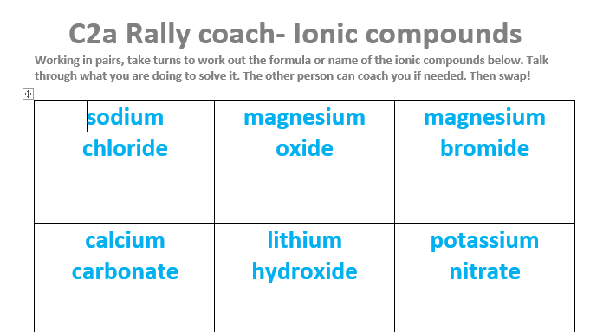
Paired activity. Take turns to coach each other.
Write your answer here

Slide 22
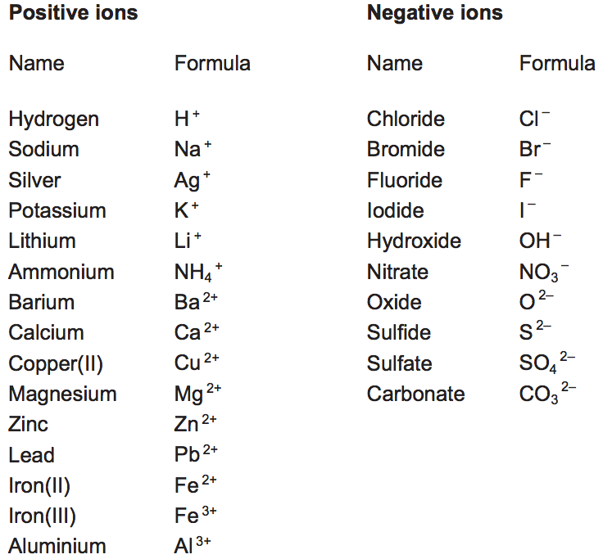
Phosphate PO₄³⁻

Slide 23
Answers
NaCl | MgO | MgBr₂
CaCO₃ | LiOH | KNO₃
Al₂O₃ | BaCl₂ | NH₄OH
Na₂SO₄ | FeO | Cu₂O
Ba₃(PO₄)₂ | (NH₄)₂SO₄ | Ca(NO₃)₂
Iron (III) chloride | Copper (II) sulfate | Iron (III) oxide

Slide 24
Bella Patel

Slide 25
I have this poster displayed in my room and refer to it everyday.
This is helps give them prompts to help them with their deeper understanding of topics and to help with multiple step questions.

Slide 26
What information do I have?
What information do I need?
How am I going to get it?
How do I answer the question?

Slide 27
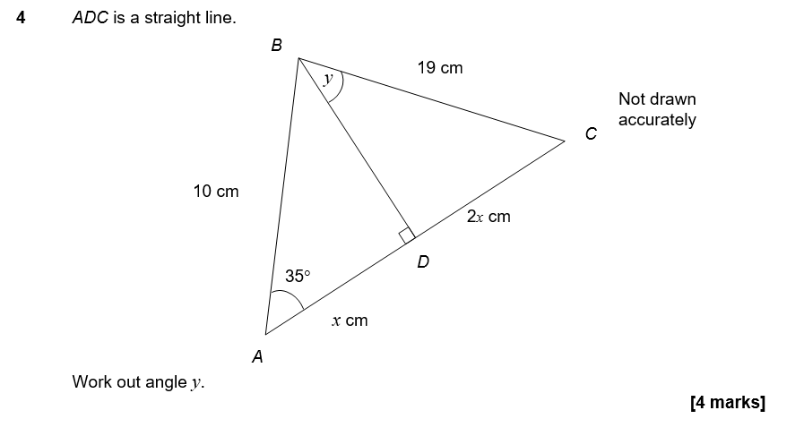
This is an example of a question I showed my year 10 class

Slide 28
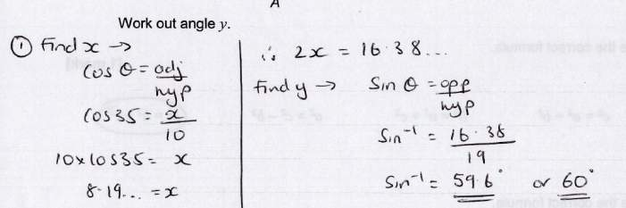

Slide 29
Mandy Evans

Slide 30
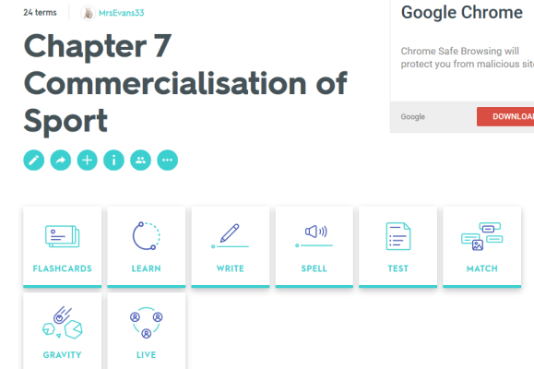
Quizlet
Designing flash cards that incorporate the topic we are on and the key terms that link with the topic of the previous year.
Used as a starter in lessons. Work in teams and very competitive. This is then followed directly by an exam question that links the key terms to the course and the exam paper material.
Students really enjoy it and are always recalling previous information with the new on regular basis.
Quizlet also give you break downs of terms often confused with others and which ones students are getting right/wrong on a regular basis.
Students can use this at home to practice and recall information through games on their device.

Slide 31
Joe Craffy

Slide 32



Starter
Prepare & discuss
You have 2 minutes to…
  Take out your stationary
  Put your bags under your table
In groups of 4 open up your plastic bag and arrange the contents into 4 piles
Carefully read the cards from each pile and as a group decide on a heading for each pile

Slide 33

Learning Objective (walt)
This is what we are going to be learning
We are learning to develop our understanding of the characteristics and applications of the different categories of textiles.

Slide 34

Textiles Categories
We are learning to develop our understanding of the characteristics and applications of the different categories of textiles.
Activity 1
Card Sort
Step 1: Match the Name and Appearance to the correct textiles sample
Step 2: Now match the Image, Characteristics and Example Uses
Step 3: Now match the red category name

Slide 35
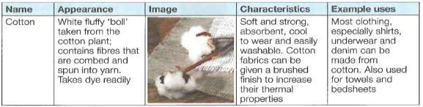
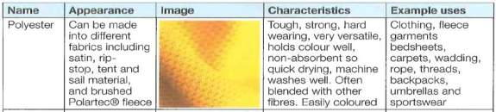
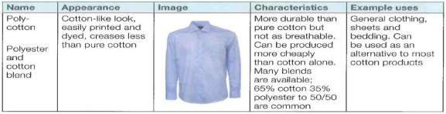
Textiles Categories
We are learning to develop our understanding of the characteristics and applications of the different categories of textiles.
Activity 2
Discussion
and Self Assessment
Natural
Fibres
Synthetic
Fibres
Blended &
Mixed Fibres

Slide 36
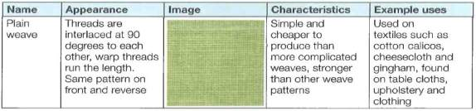
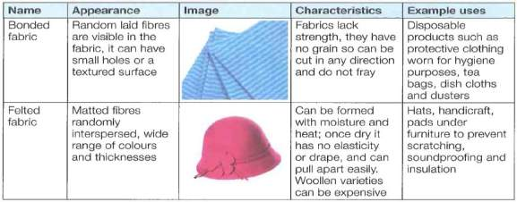
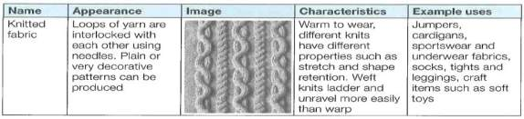
Textiles Categories
We are learning to develop our understanding of the characteristics and applications of the different categories of textiles.
Activity 2
Discussion
and Self Assessment
Woven
Textiles
Non-woven textiles
Knitted
Textiles

Slide 37
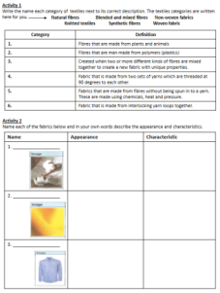
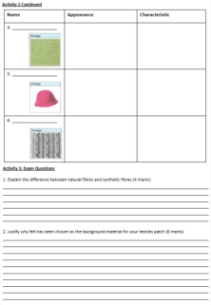
Textiles Categories
We are learning to develop our understanding of the characteristics and applications of the different categories of textiles.
Activity 3
Independently demonstrate your understanding by using your card sort to…
a) Match the different categories of textile to their correct description
b) Name each of the fabrics and in your own words describe the appearance and characteristics of each.
c) Answer the GCSE exam
style questions

Slide 38
Textiles Categories
We are learning to develop our understanding of the characteristics and applications of the different categories of textiles.
Plenary
How shall we check if progress has been made?
Discussion
Yes/No
Thumbs Up
Have you met the
Learning Objective?
RAG Cards
Show Me
Review Target

Slide 39
Laura Longstaff

Slide 40
HPL: Thinking and Linking in Maths
10 ‘quick’ questions on a variety of topics used as a starter/ plenary or just thrown in mid lesson (interleaving).
Linking topics so that their use is seen (both to other topics and to real-world uses). E.g. use of surds in Pythagoras to ensure accuracy not lost and calculators not needed.
Using multi-topic questions (e.g. within simplifying algebra use questions that involve finding a perimeter of a shape).
Using visual ideas to help make key info more memorable (e.g. when using fractional indices talking about ‘roots’ being at the bottom of a tree)

Slide 41
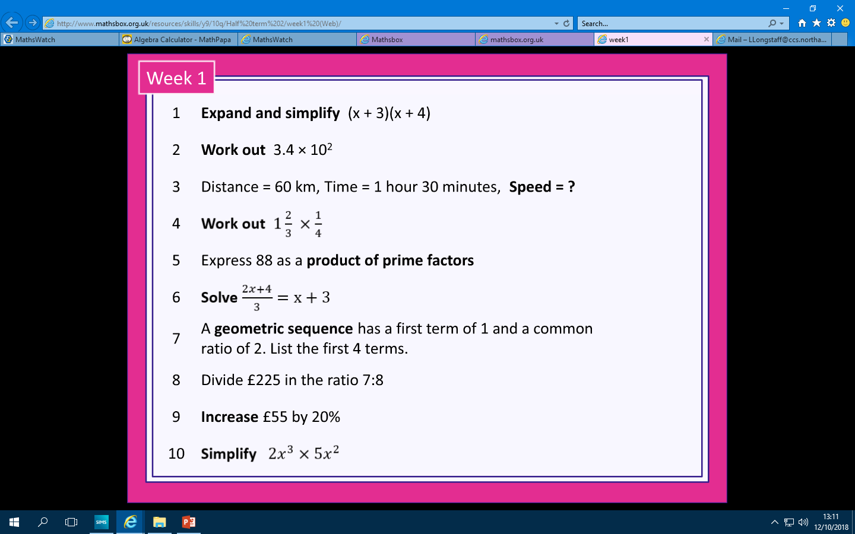

Slide 42
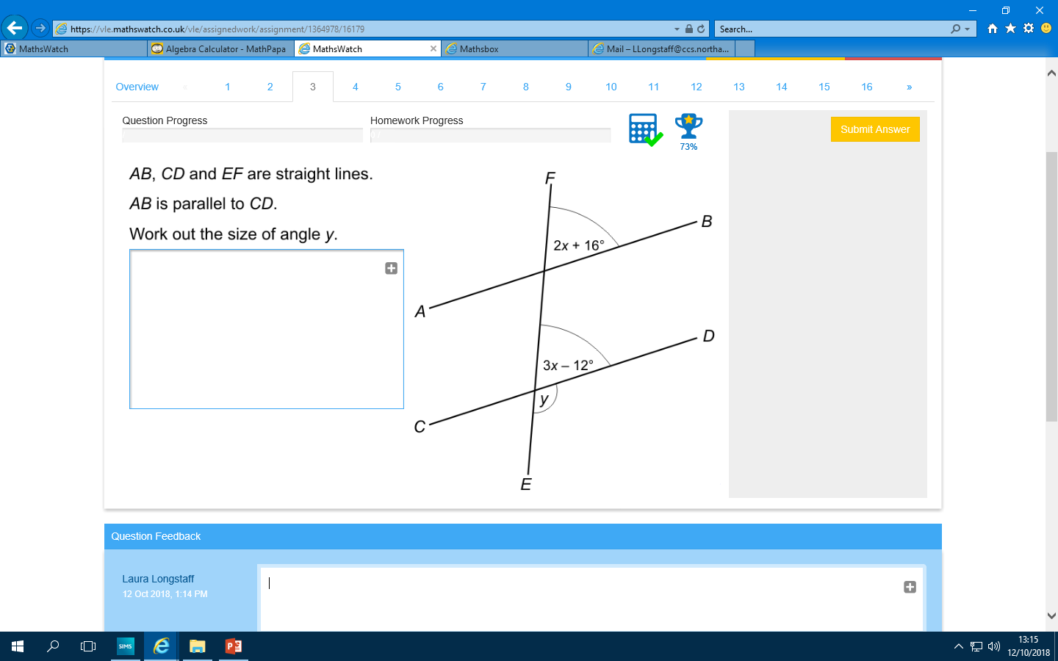

Slide 43
HPL – Thinking and Linking
Kat Wittich-Jackson
From Lis Page – Revision Clock
Tried this after Lis explained it on training day. Used it to recap the topic learnt just before summer for their first lesson back. Was brilliant. Will use again!
Revision Tools
Teaching them how to revise/recap.
Give them spec framework – they then have to add the meat to the bones on a mind map. Not allowed to look at book or notes until they can’t write anymore. Repeat in a subsequent lesson. All of them can recall more than first time
Ideas from Others That
I have tried successfully
From Adrian Colman – exam questions and markschemes
Paper folded over initially and then self mark straight after. Really useful as a 10 minute end to a lesson to apply learning to exam
My Ideas
Extended Questions
PEA (Point, Explain, Apply)
Make the students practice extending answers and then mark each others to give them feedback on whether they hit P,E and A and if they didn’t, explain why not. Share some samples with the class and ask them to discuss which ones they think they hit.
Transferring Knowledge onto Paper
After learning something new in class, always show an example of how that information might need to be recalled in an exam – format of questions, looking at how many marks to guide how much detail they need etc.
Applying Skills in a Game
When learning new skills (practical ones) thinking about HOW, WHEN and WHY they would be used in a game situation when under pressure e.g. which type of serve or shot in Badminton; why choose that particular one, what is the scenario, what outcome are you trying to achieve by playing that shot?

Slide 44
Scott Rose

Slide 45
Using UKMT Challenge Questions.
UKMT Challenge questions are available on Mathswatch and are grouped by topic. By selecting questions that require maths skills from existing knowledge blended with new topic knowledge means that students have to think and link in order to solve the problem. Although from the start there is no apparent link between the topics the fusion of multiple topics is necessary and highlights the way that although not always easily identifiable, most maths topics are linked and support others.
An ability to link multiple topics simultaneously to problem solve is a key skill required for the new Maths GCSE.

Slide 46
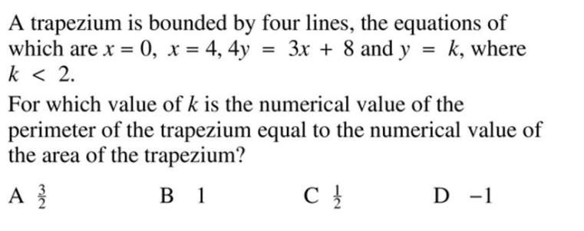
The example below covers key words such as, trapezium, area, perimeter and also requires knowledge of straight line graphs, formula for area of a trapezium etc.

Slide 47
Ben Ullmann

Slide 48

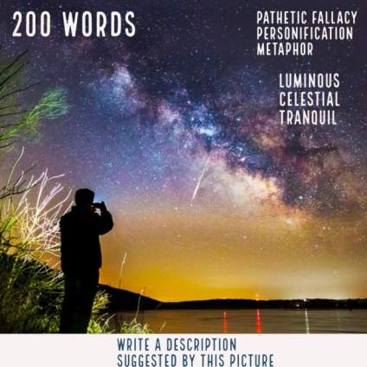
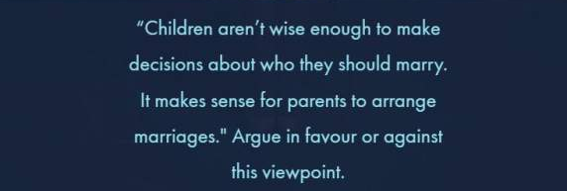
Spaced practice of different types of short writing challenges that engage themes of Lit texts and teach topic and technical vocab whilst practicing Language paper skills
Notes:
Select 5 pupils to share their work of varying abilities and confidence. As they read the other pupils need to note down 1 successful sentence. Popcorn feedback and poll those who agree. Ana – rep beg sentence, three clauses as a sentence repeating the opening phrase, hypophora qu/answer,

Slide 49
Knowledge Organiser and quote tracker to use in class with Othello.
Interleaves knowledge of methods with critical perspectives and makes students organise quotes they find into critical groups.

Slide 50
Filled example that we did as a class. Used as a Knowledge Organiser.
They use their first week’s filled version to self-assess against each week and set themselves targets of amounts to learn.

Slide 51
Paul Gooch

