Slide 1

Secondary briefing
18th September 2023

Slide 2
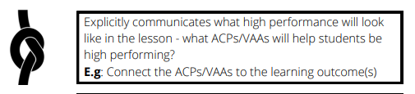
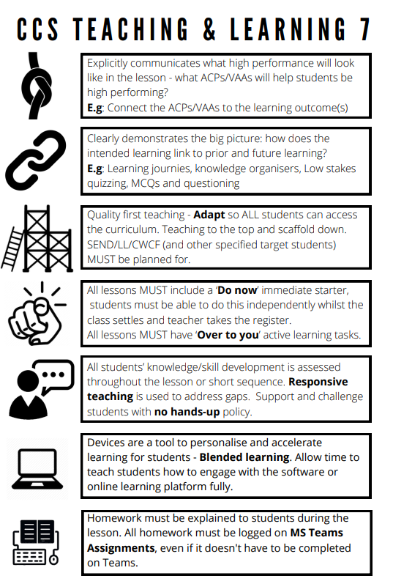





Teaching and learning
Year 8 lesson: Context of Frankenstein
What will high performance look like today?
High performers will be:
Enquiring – connecting prior knowledge to new knowledge.
Confident – ready to change old ideas for new ones
Year 10 cover lesson: How does the writer use language to describe the tyrannosaurus?
What will high performance look like today?
High performers will be:
Analytical – thinking critically – deducing/inferring using evidence
Persevering – work diligently to develop analysis beyond Band 1 - 2
Notes:
Liz Husband mentioned that printouts will be made available to all staff shortly.

