Slide 1
Assembly – Week Beginning 11th September 2023
“Empathy – Belonging, Respect, Citizenship”
Notes:
The banded template can be designed in any format to suit your needs/content of presentation – re-arrange text boxes/shapes etc. as you wish.
Please use the brand colours as much as possible Please ensure the logo is on the first /last slide

Slide 2
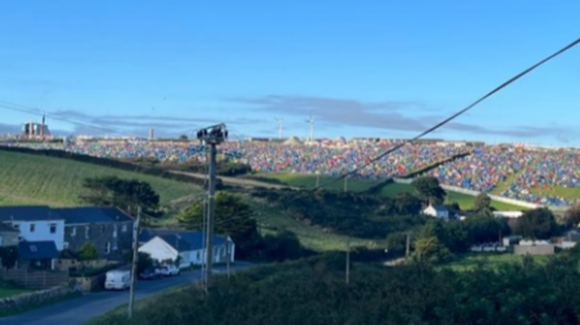
Boardmasters 2023

Slide 3
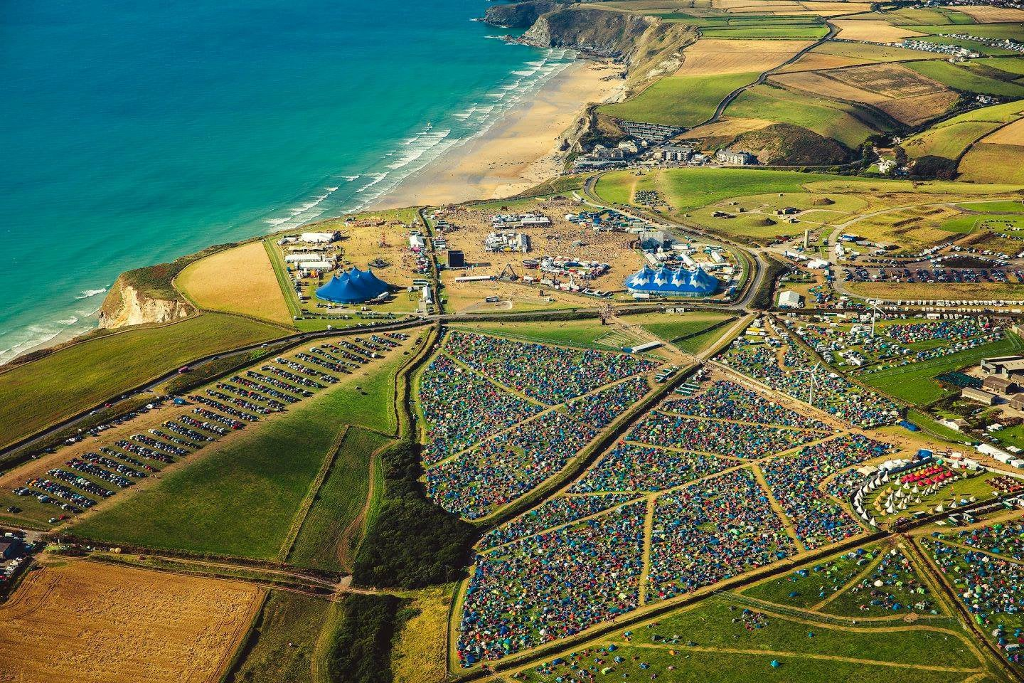

Slide 5
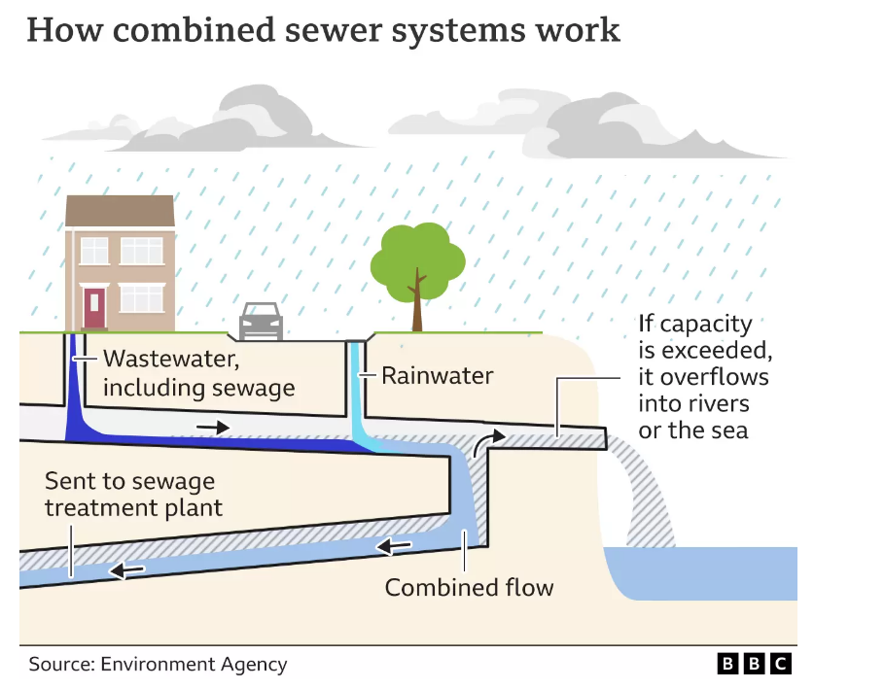

Slide 6
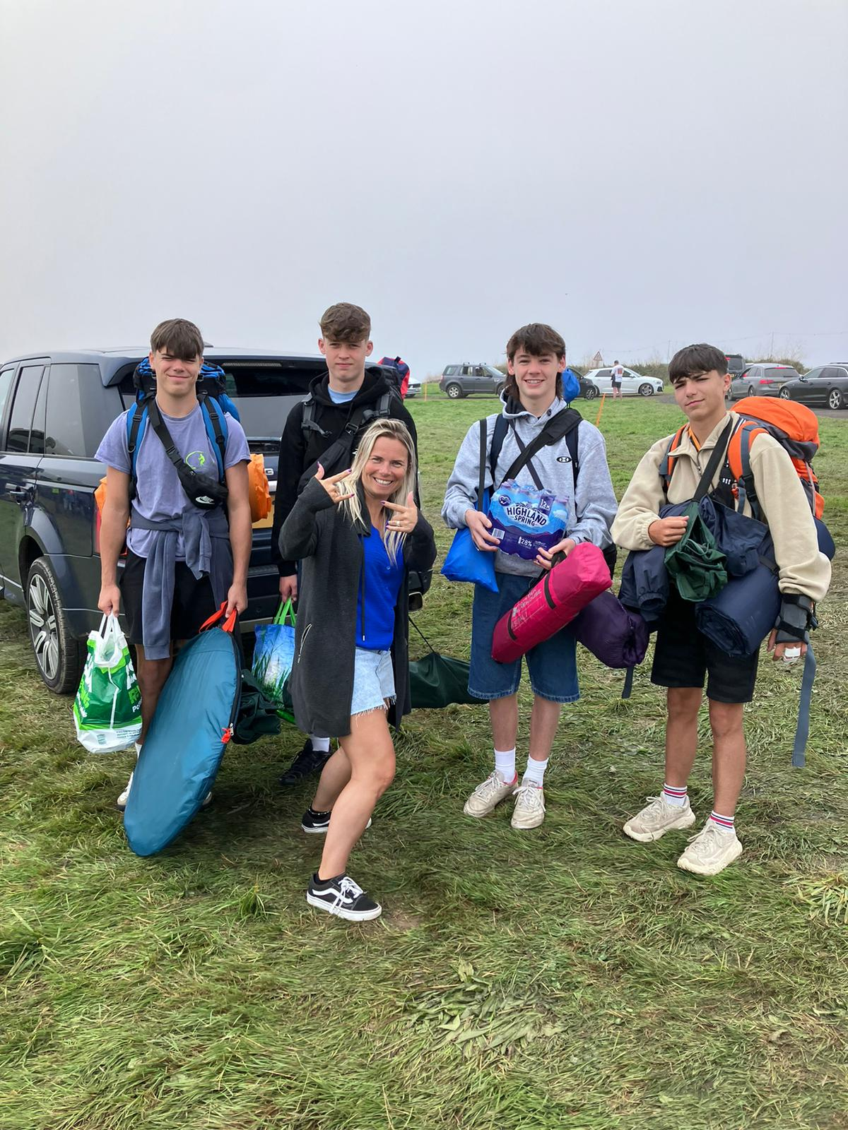

Slide 7
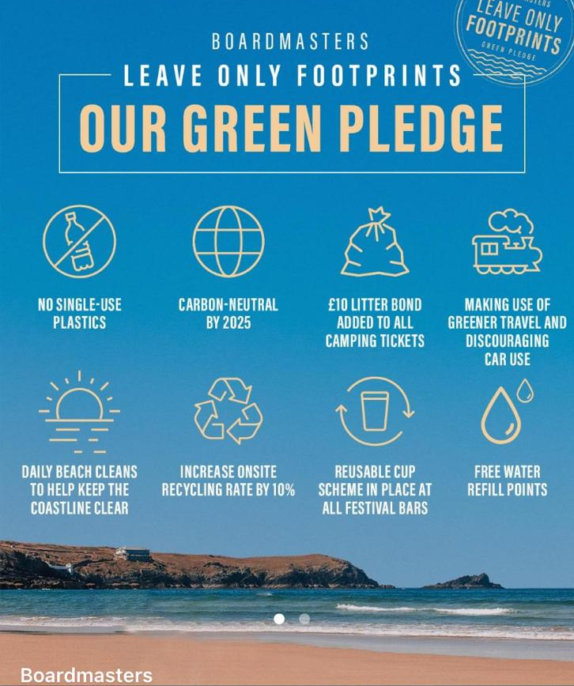
Notes:
Collective responsibility as part of that community for that week.

Slide 8
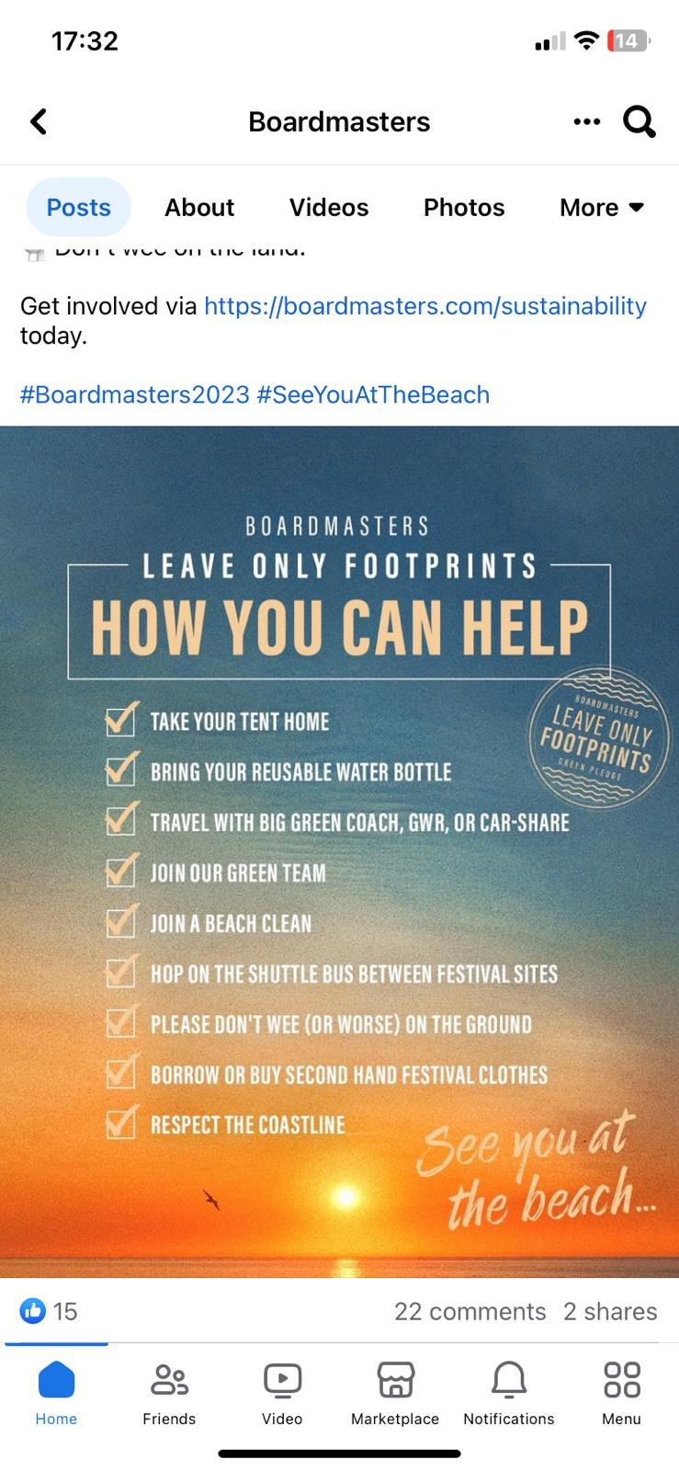

Slide 9
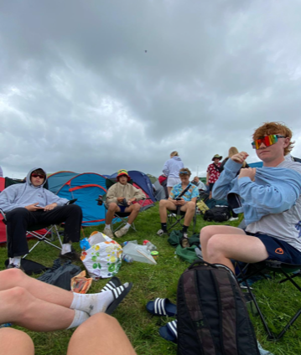
Notes:
Bought into being part of the Boardmasters Community for that week……. Clean up operation….left only footprints. Not all did, but a lot did and all they could do is their little bit to contribute.

Slide 10
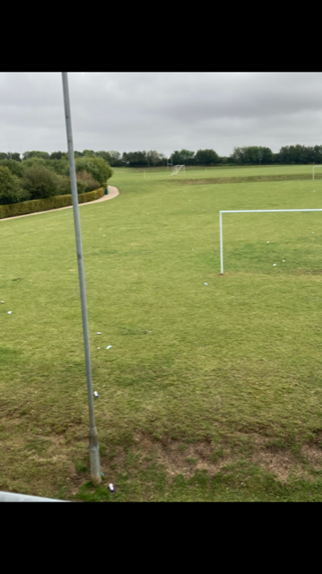
Notes:
We are lucky with the facilities we have in our little community that is CCS.

Slide 11
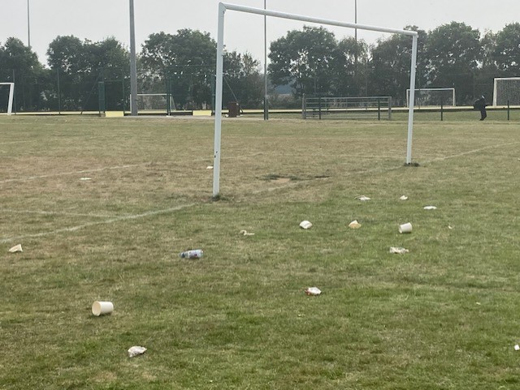
Notes:
Last Friday

Slide 13
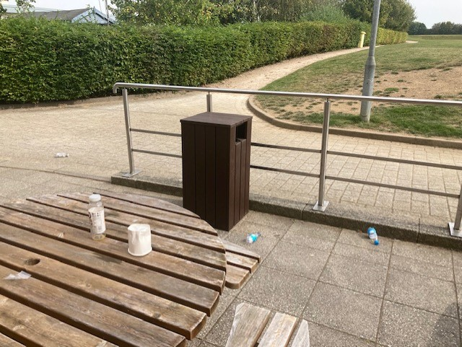

Slide 15
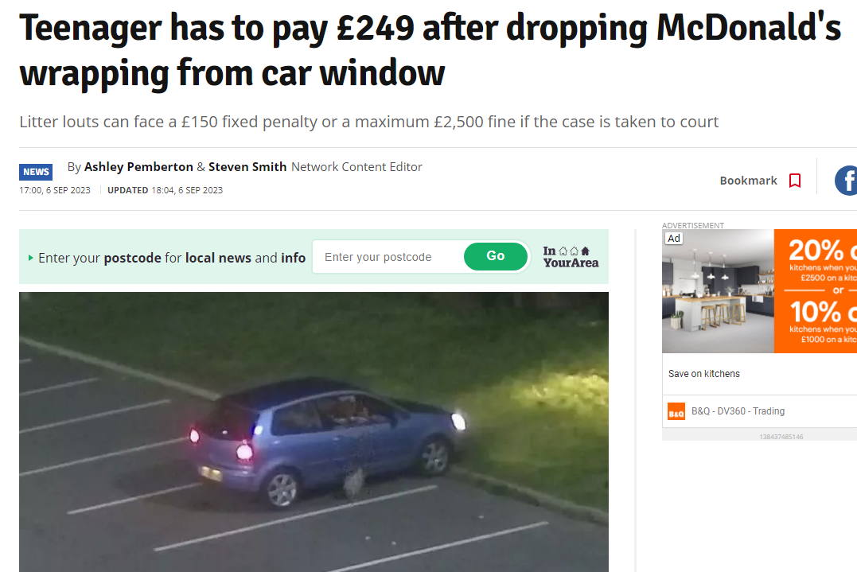

Slide 16
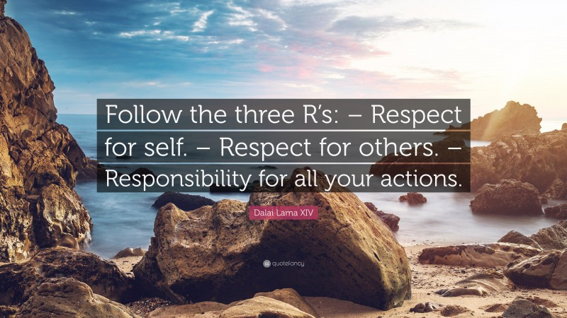
“Call out your mates!” “Leave only footprints!”

Slide 17
Be Hardworking. Be respectful. Be kind.
Notes:
Respectful and kind to each other and to the environment,

