Slide 1
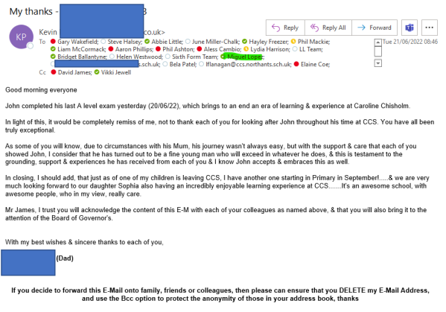
Performance Culture
Performance culture regarding parents and students
Reflection: This is a lovely e-mail from a grateful parent regarding the education of his vulnerable son at CCS. He was a Pupil Premium student who had a significant number of barriers in his learning. However, the ‘performance culture’ by everyone allowed this student to get to Year 13 and flourish .
Many teachers taught this boy in KS3 and also supported his learning via the Progress and PP Team).
The impact of our high expectations on our students is evident and most rewarding.

Slide 2
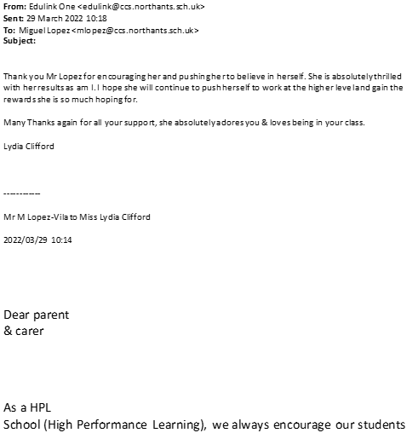
Parent thanking a teacher for high standards and expectations (This is another disadvantaged student)
Reflection:
Once again, the positive culture and building up positive relationships with our community are essential.
The impact of our HPL values – VAAs (e.g. being empathetic) not only on our students but also on the community always go a long way!
This student felt inspired and got some of the best end of year 10 results in Year10.

Slide 3
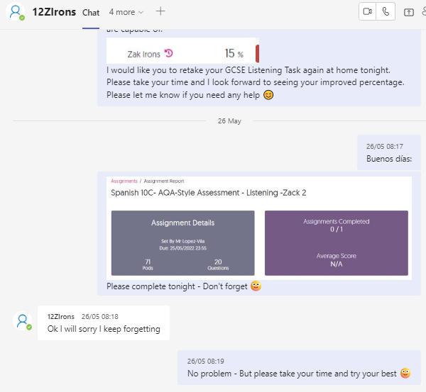
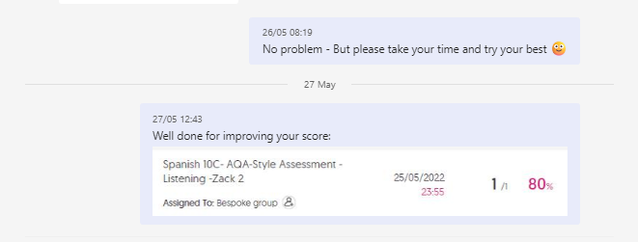
Student perseverance to improve outcomes
Context:
This student started the course in Year 10 lacking a great deal of confidence. Our HPL lessons and values (e.g. perseverance) allowed him to continue improving and he is currently entered for Higher Tier for Spanish in Year 11.
Impact: As a higher entry, he will be able to potentially achieve the highest grades now rather than a maximum of grade 5 in Foundation.

Slide 4
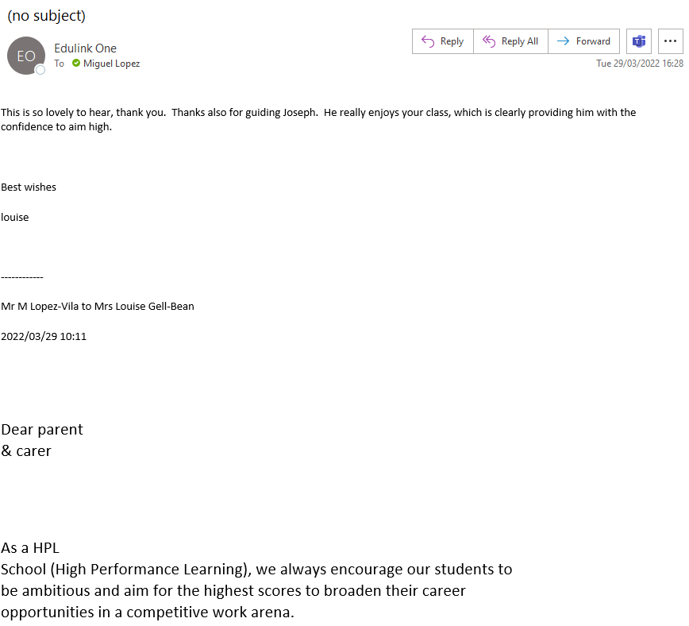
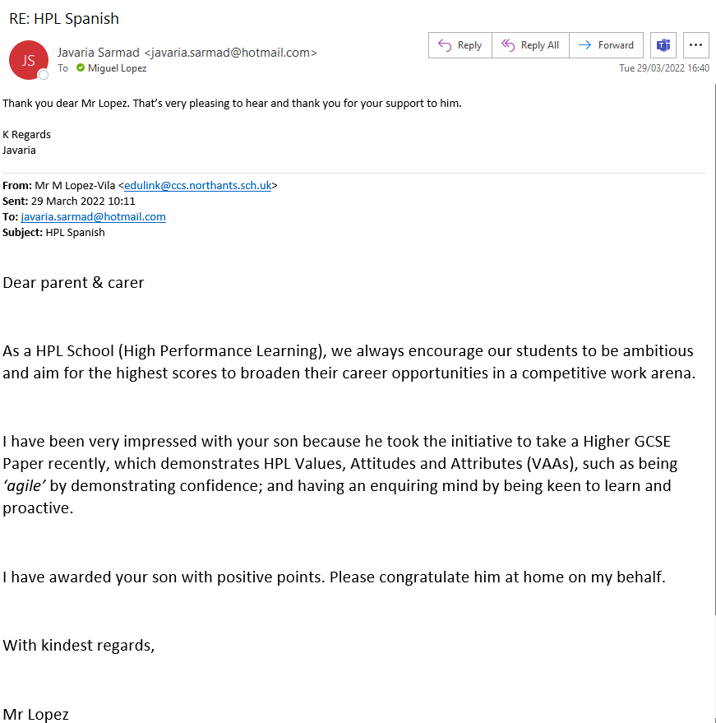
Additional e-mails from parents regarding HPL expectations and standards
Context:
Please see two examples of students whom we pushed to be entered for Higher entries even though their original targets were below grade 5.
Our HPL culture of high expectations in the team.

Slide 5
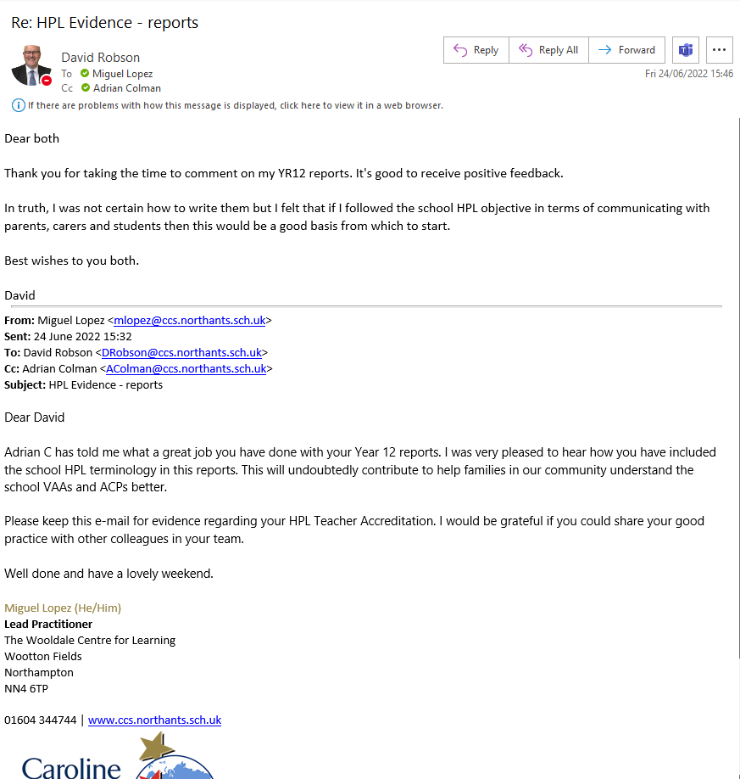
Impact on other colleagues. E.g. HPL terminology Yr 12 Tutor Reports.
Context:
Please see example of the work one member of the science team did following our advice to embed the HPL language in everything we do.
This science teacher is also a FT and he took the initiative to start using his own HPL language in his tutor reports, which he also shared with others in school.
The positive impact of this collaborative work in science started naturally translating onto other areas of the school life.

Slide 6
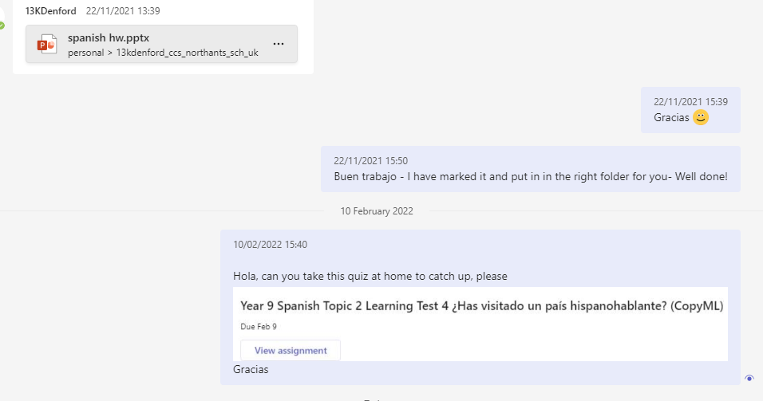
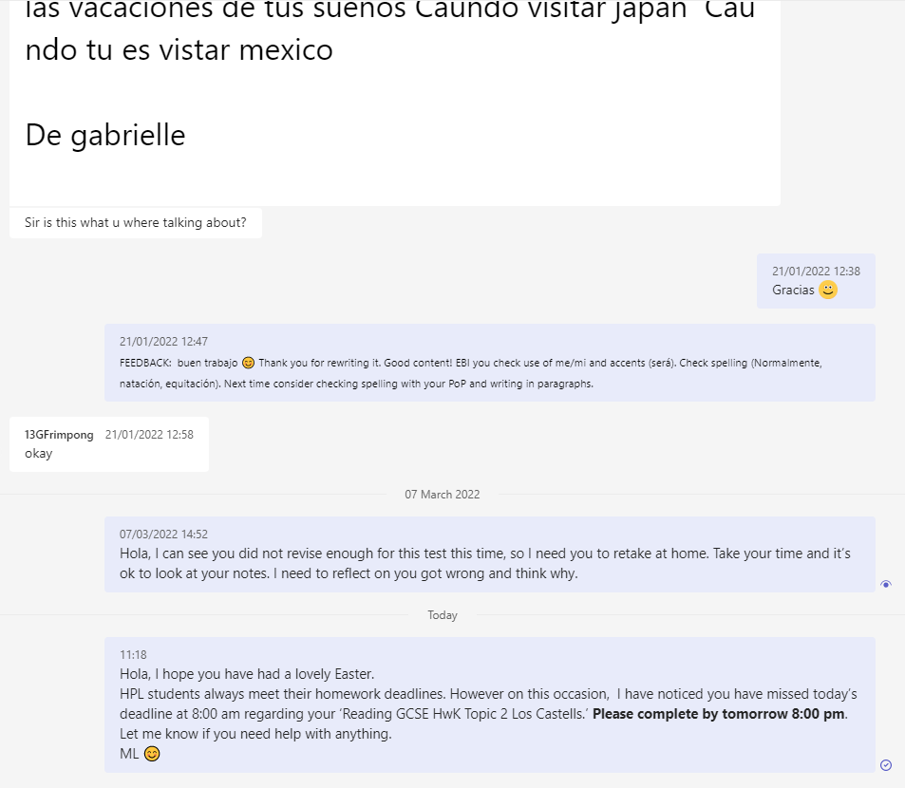
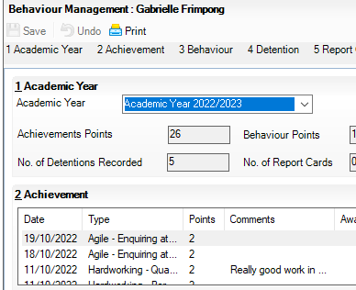
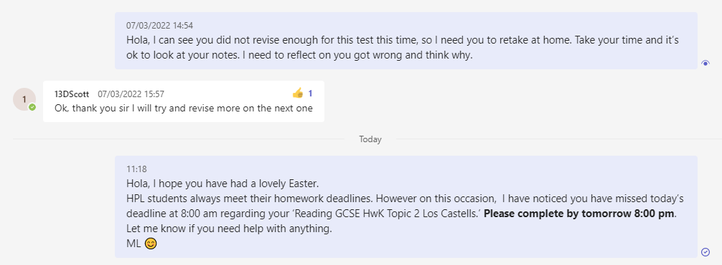
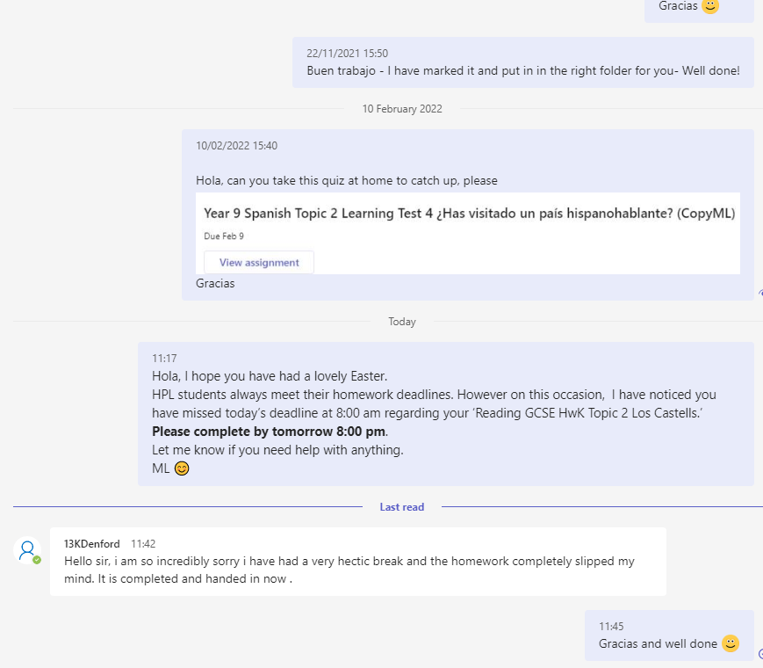
Multiple evidence HPL chat with students
Students are targeted and contacted to give them the chance to understand failure, persevere and put things right.
Rewarding students with HPL positive points.

Slide 7
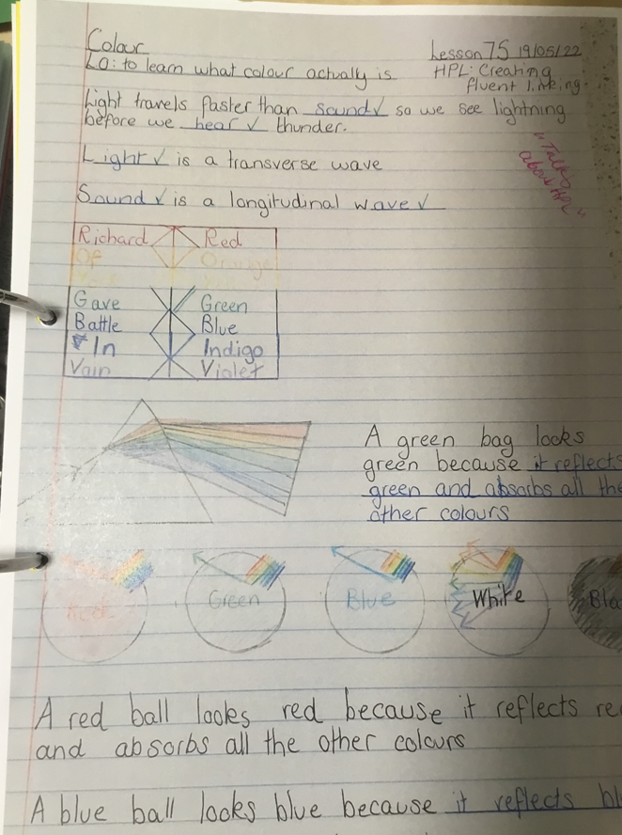
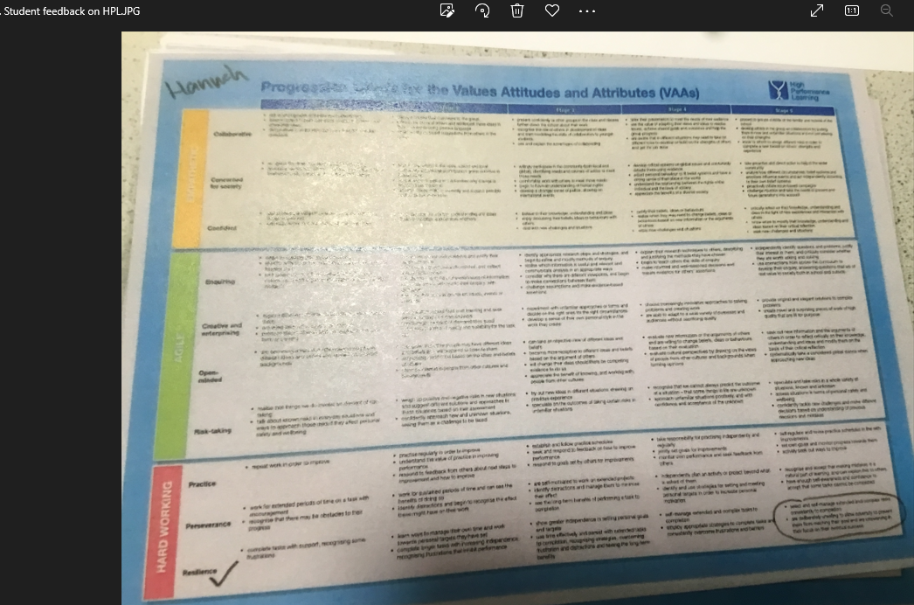
Example HPL student task
Student feedback on categorisation of task during lesson and notes.

Slide 8
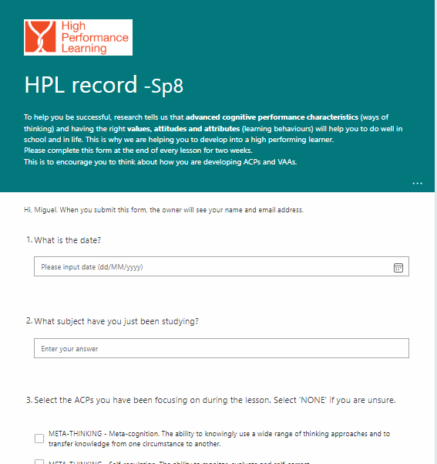
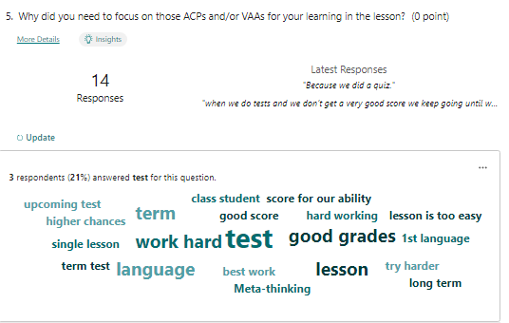
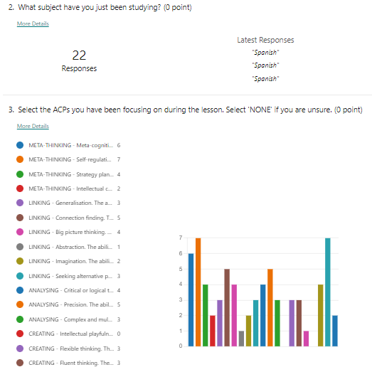
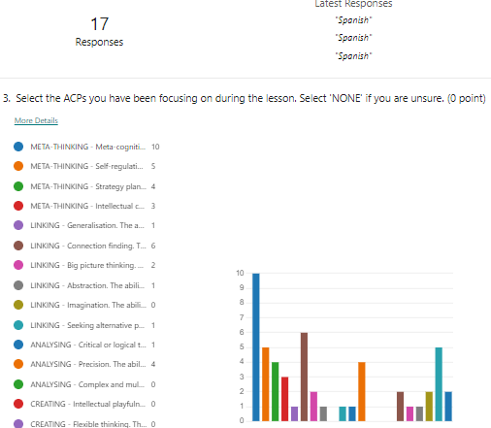
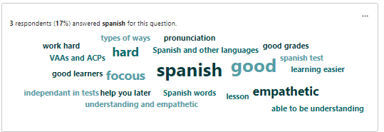
Student feedback on HPL discussion
As part of the student feedback on the lesson, pupils are asked needed to identify the relevant HPL VAAs or ACPs and explain why.
We encourage discussion small groups and values our pupils’ responses and perceptions, to continue improving our HPL lesson delivery.
Please see two recent examples of student feedback regarding the use of HPL in lessons.

Slide 9
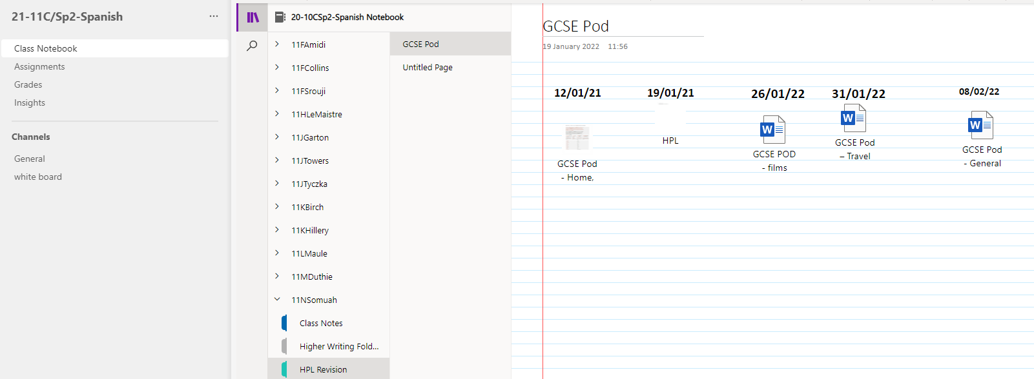
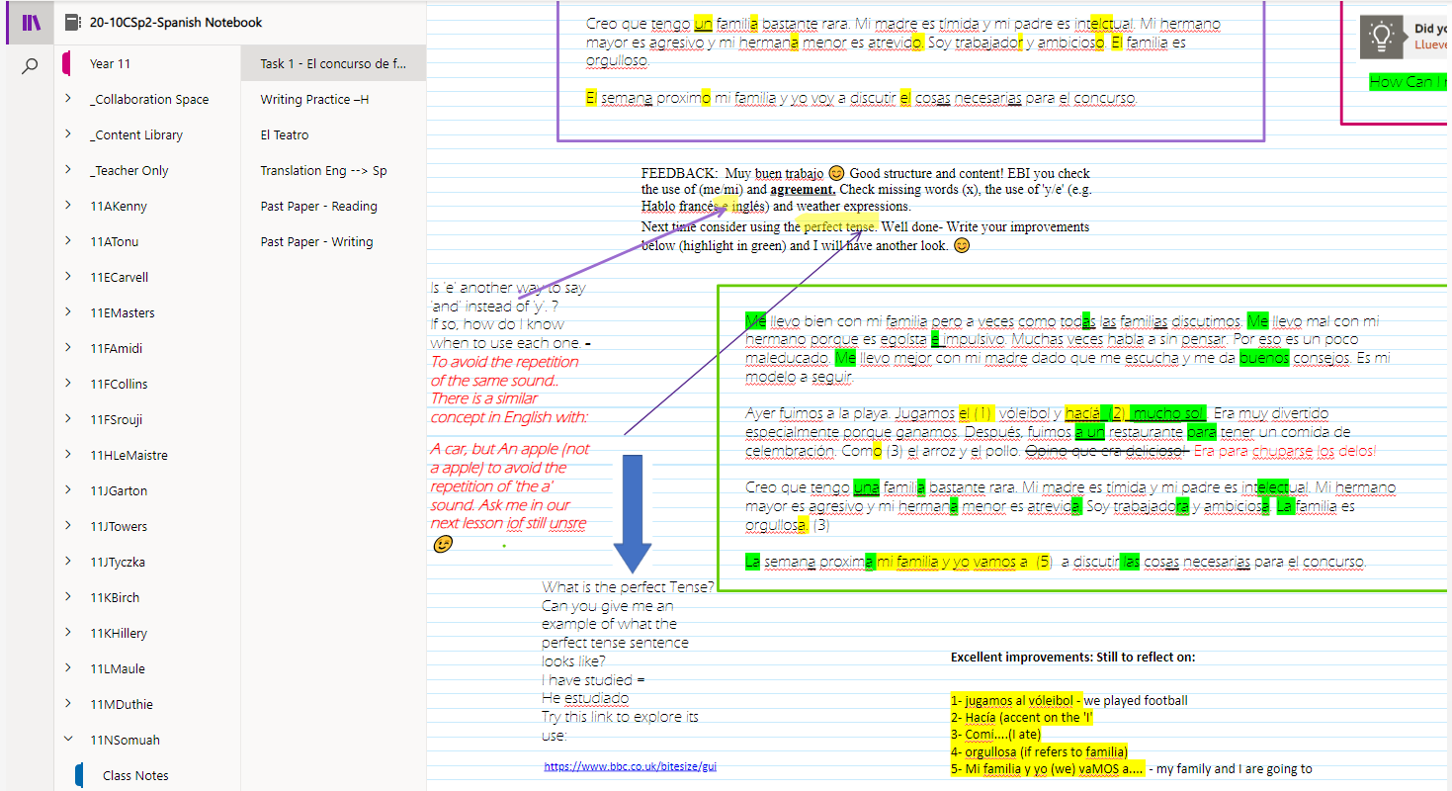
2Student HPL support via Microsoft Team and perseverance
Using different ways to support a student to move from Foundation to Higher Entry in Spanish.
On most occasions these interactions were reinforced with phone calls and praise communications home to reward the positive effort.

