Slide 1
Business Breakfast 2
Ambition, Confidence, Success
Friday 1st March

Slide 2
Introductions and apologies
Apologies:

Slide 3
What is High Performance Learning?
High Performance Learning is a research-based philosophy that sees everyone as a potential high performer.
It uses a unique teaching and learning framework to systematically develop the thinking skills, values, attitudes and attributes needed for lifetime success.

Slide 4
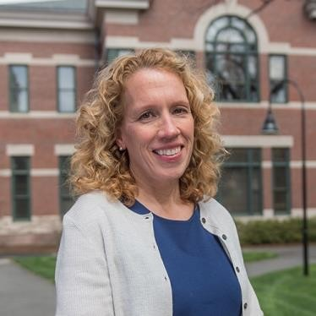
What is High Performance Learning?
The brain structure is not fixed and unchangeable.
It is exquisitely plastic, mouldable by experience throughout life
(Carol Wraga et al., 2006).

Slide 5
CCS believes that all our students are high performers
Everyone is a high performer
Takes some longer to get there
Talent vs hard work
It's not ‘I can’t. It's ‘not yet’
The Power of ‘Yet’
Notes:
We have to Nurture them to get there

Slide 6
Why is high-performance learning important?
Our students are heading into a world we don’t yet know. The pace of change is rapid, and knowledge is no longer enough on its own.
Discussion
What skills would a young person need to to be successful in your workplace?

Slide 7
High Performance Learning
Advanced Cognitive Performance (ACPs)
Values Attitudes and Attributes (VAAs)
High-Performance Learning (HPL) identifies key characteristics and attributes that prepare young people to succeed in learning and in life

Slide 8
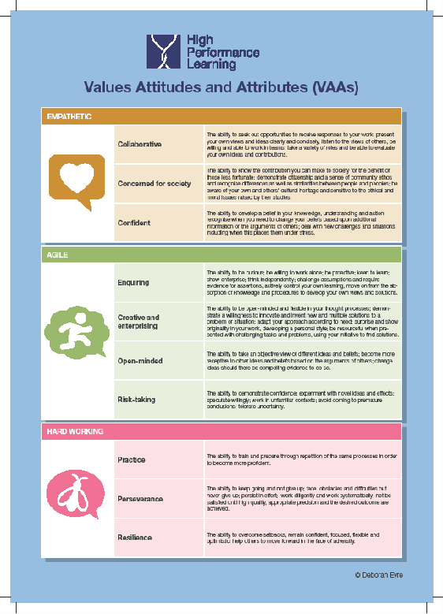
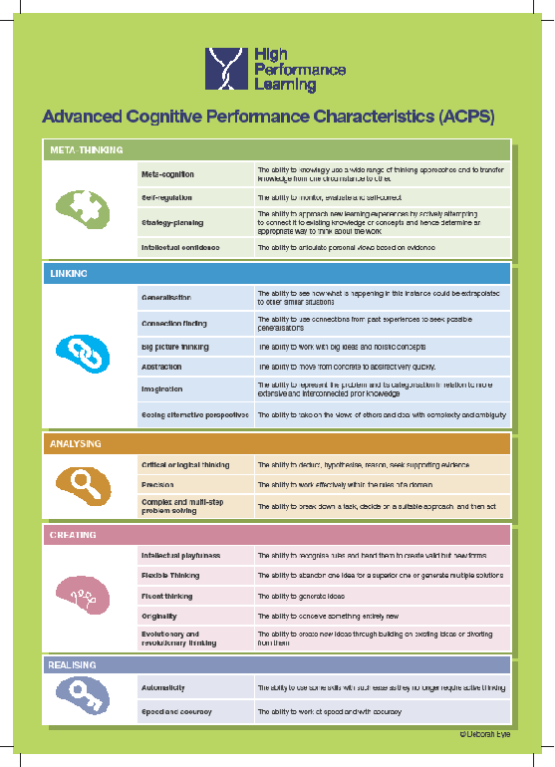
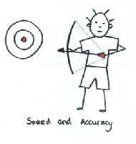
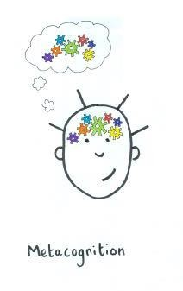
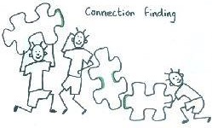
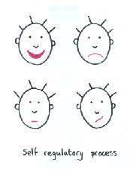
HPL builds ‘Advanced Cognition’
Cognition is conscious and unconscious processes that knowledge is accumulated
Notes:
Most Advanced Cognitive Process? · Reasoning · Decision making · Problem solving · Creativity · Metacognition · Attention · Perception · Language processing.

Slide 9
How do High Performing Learners behave?
CCS explicitly teach these skills, and the students will be able to demonstrate these behaviours:
Collaborative
Concerned for society
Confident
Enquiring
Creative and enterprising
Open-minded
Risk-taking
Practice
Perseverance
Resilience
Empathetic
Agile
Hardworking
“My colleagues who interviewed her were very impressed. She stood out amongst all the candidates” feedback from a local business

Slide 10
Collaborative local partnership
2025 opportunities at Barclaycard - ideas for others
Opportunities for questions

Slide 11
Sixth form volunteering/work experience
All year 12 students are expected to volunteer/work experience once a week - during independent study, free periods or weekends
Consistent slot each cycle – e.g. Monday week A at 11:30 and Friday week B at 14:00
Take place throughout this academic year – contract with dates provided
Organisation must send evidence of their Employers Liability Insurance (ELI) on Unifrog
Parents also sign the contract to agree to the volunteering schedule
Must be approved by the sixth form team on Unifrog

Slide 12
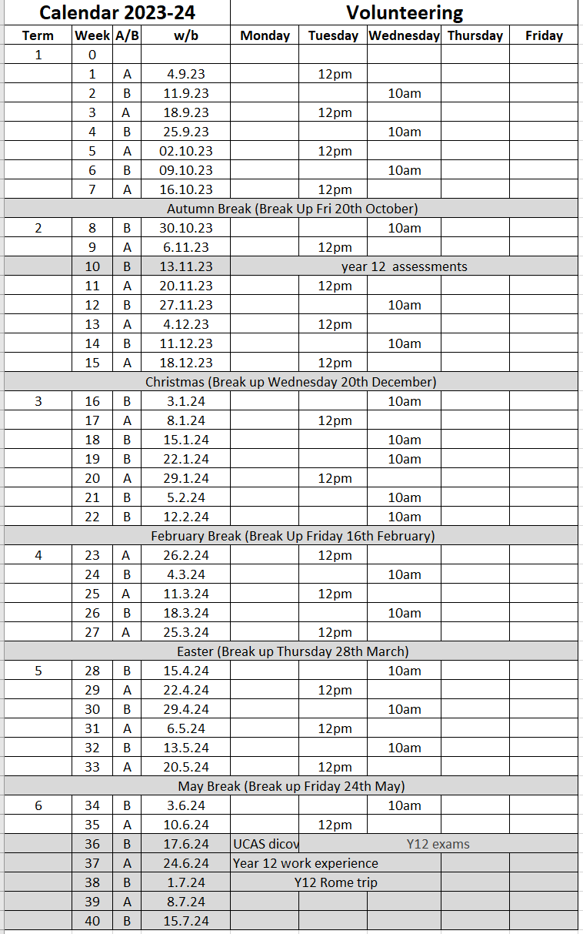
Example of volunteering/work experience schedule
This is included in students' volunteering contract
Greyed-out dates students will not be at the placement
The company will know when to expect students
Parents will know when students are not on-site
Volunteering ends on 14th June 2024 for this academic year

Slide 13
Collaborative local partnership
How the scheme works
Student testimonials
NHS Northampton to speak about their experiences working with CCS and our students
Opportunities for questions

Slide 14
I have found that being in a ward has helped me understand the daily demands when working in a hospital which is what I would like to pursue my career in. I have also been lucky enough to be a Runner which at the start of the day is given a checklist of tasks to complete which takes me all across the hospital in all departments from picking up medicines from the pharmacy to taking blood to pathology. I have found it very interesting when understanding how many things have to be done in order to keep a hospital running. I am looking to become a paediatric nurse or paramedic so being able to be surrounded by professionals who can answer any questions I have has been extremely beneficial.
One of the most fulfilling aspects of volunteering at NGH is the profound impact you can have on elderly patients. Even a simple conversation can brighten their day, and witnessing their gratitude is incredibly heartwarming. Knowing that our efforts have contributed to improving someone's life is truly rewarding
It's incredibly rewarding to connect with such a diverse range of individuals and to truly feel that you're positively impacting their lives. Engaging in rehabilitation activities with patients—such as reading, writing, and playing memory games—can be immensely fulfilling, as these activities play a vital role in helping them reclaim a sense of normalcy in their lives.

Slide 15
NHS partnership – how it works
NHS Northampton attend the year 12 taster day to explain volunteering within Northampton Hospital to the students
Interested students can apply over the summer – successful candidates then have checks and training
NHS attends another assembly in September – another application window is provided
NHS will attend the sixth form open evening in January
Parents and students sign contracts which detail the mornings/afternoons which students will attend

Slide 16
Gatsby Benchmarks
Non statutory framework to support schools to provide students with the best possible careers education, information, advice, and guidance.

Slide 17
The 8 Gatsby Benchmarks
A stable careers programme ​
Learning from careers and labour market information ​
Addressing the needs of each student
Linking curriculum learning to careers
Encounters with employers and employees
Experiences of workplaces
Encounters with further and higher education
Personal guidance

Slide 18
Collaborative local partnership
Mutually beneficial relationship between local businesses and Caroline Chisholm School:
Raising the profile of your company, industry or particular job roles
Greater access to potential candidates from post-16
Advertising jobs and events on the school website – students and parents
Greater community engagement – potential to increase sales through awareness
CPD opportunities for staff

Slide 19
Encounters with employers and employees
Multiple opportunities to learn from employers about work, employment and the skills that are valued in the workplace.
Develop strong links with local employers:
Host breakfast meetings: October, March and July each year.
Strengthening our alumni
Visiting speakers – assembly talks and smaller workshops
Mentoring schemes for year 12 students
Career fair/ mock interviews
Open doors – workplace or site visits

Slide 20
Experiences of workplaces
Every student should have first-hand workplace experiences through work visits, work shadowing and/or work experience to help explore career opportunities and expand their networks.
CCS would like to create flexible schemes to enable volunteering over longer periods for students, e.g. one afternoon/morning per week:
- NHS Northampton volunteering

