Slide 1


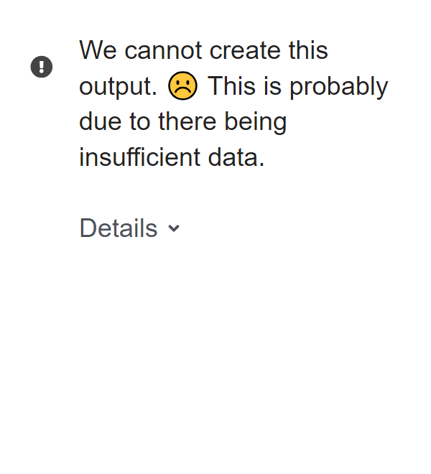
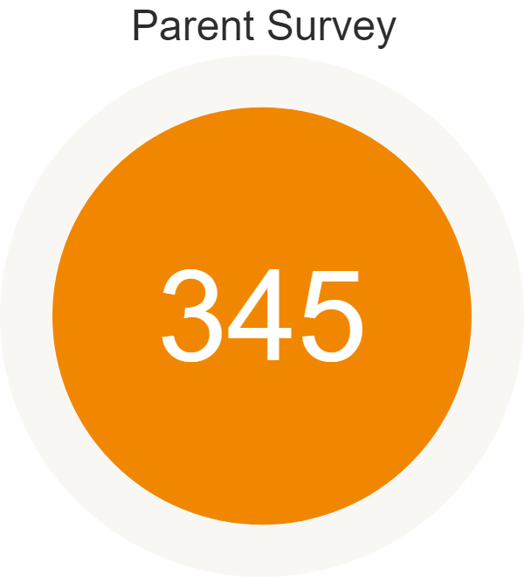
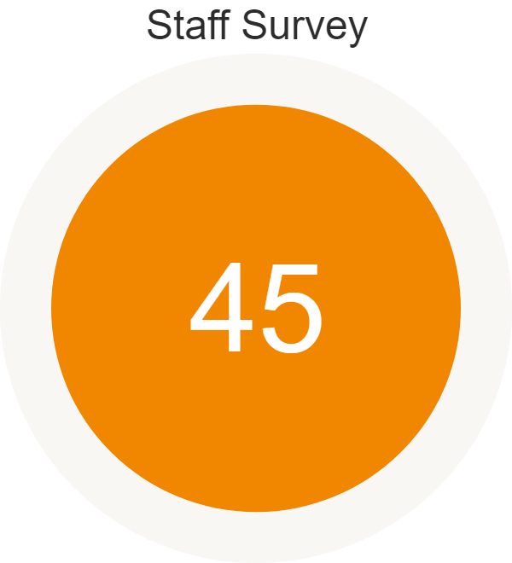
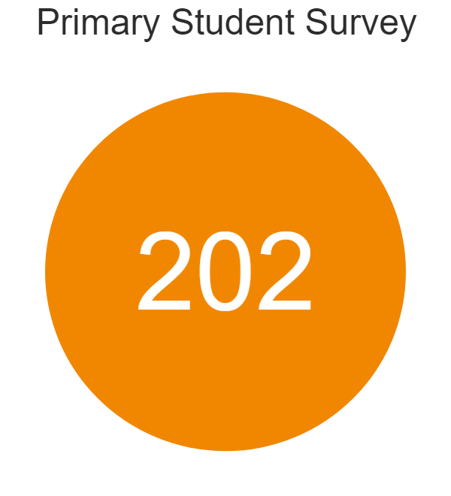
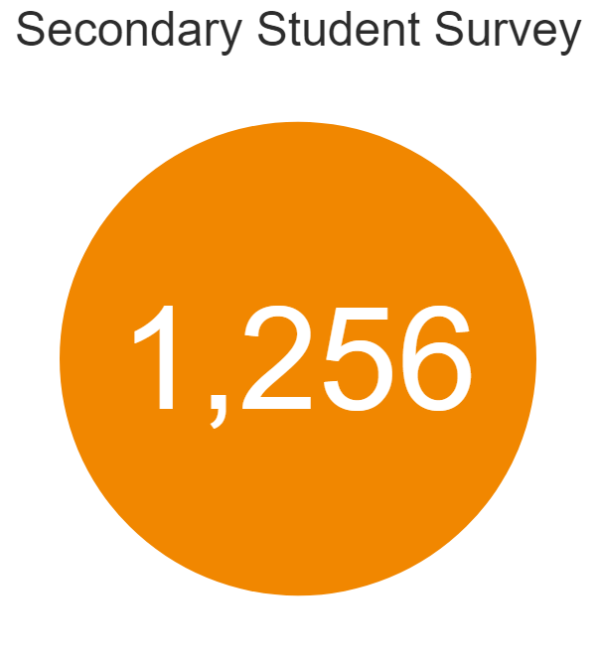
HPL - Comparative School Surveys Report
WAVE 1
Caroline Chisholm School
WAVE 2
Total Responses: 1848

Slide 2

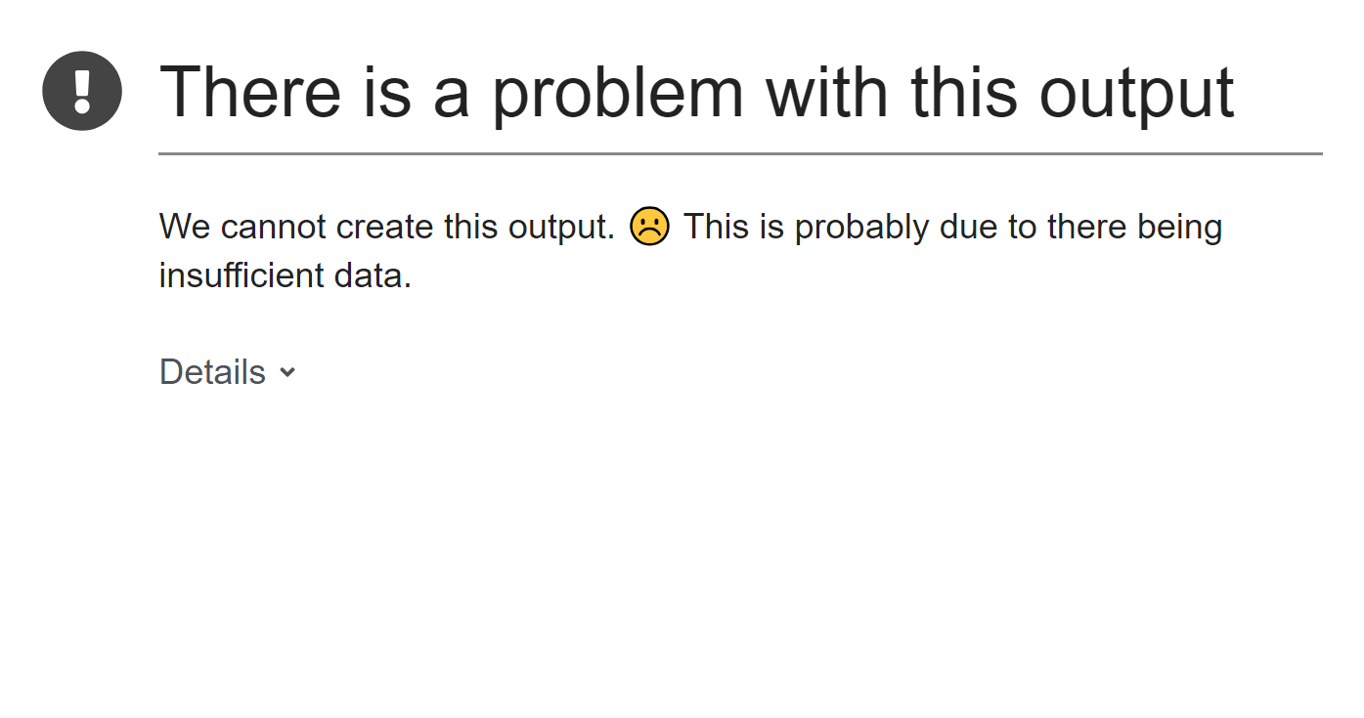
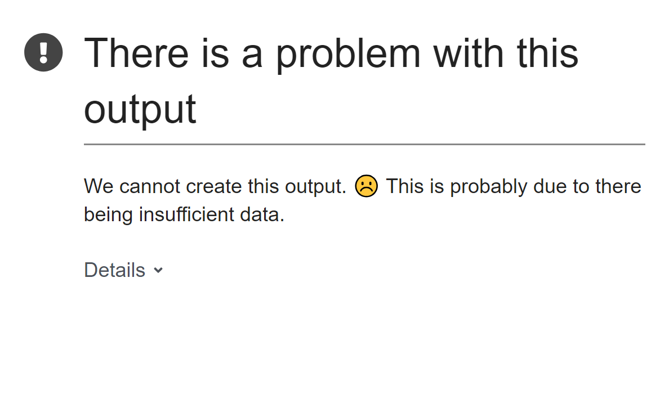
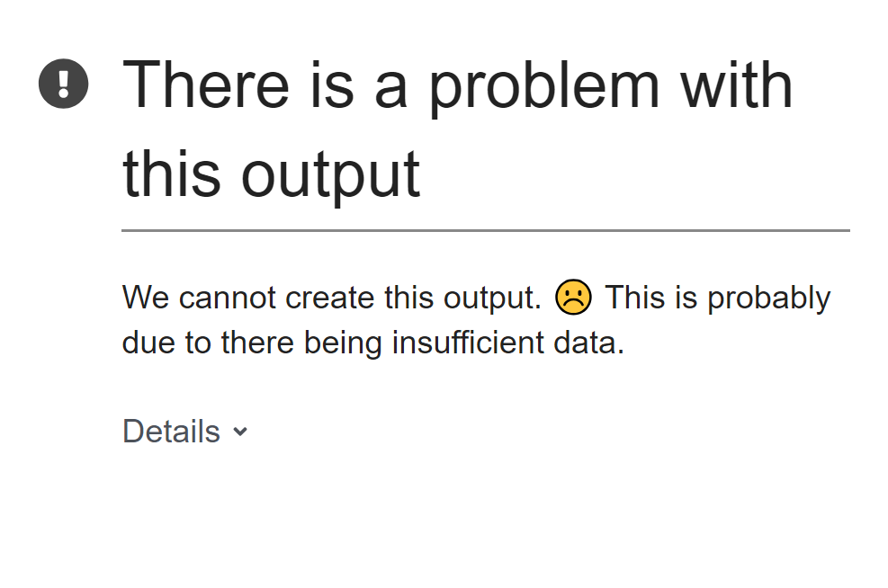
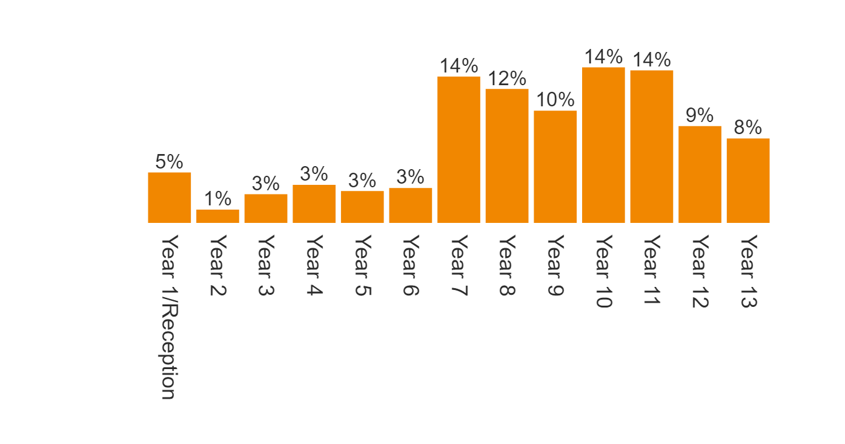
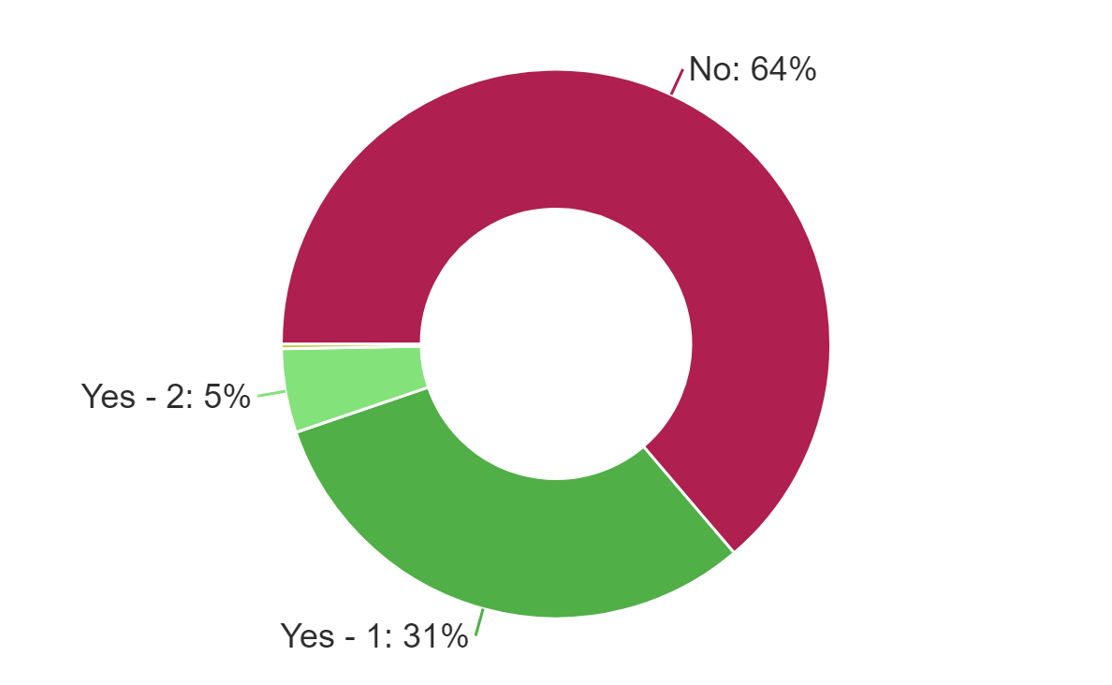
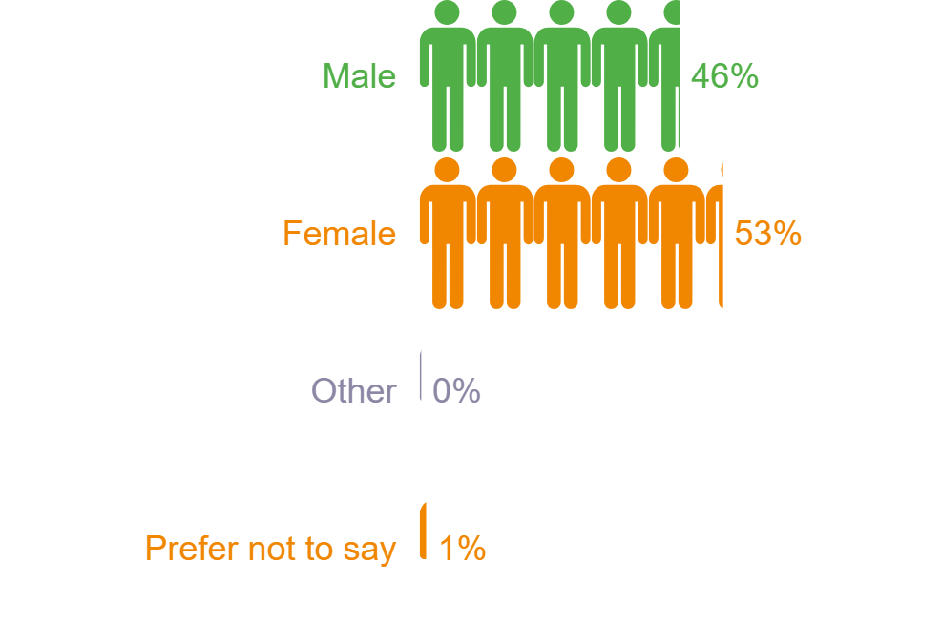
HPL - Comparative School Surveys Report
Student gender
WAVE 1
WAVE 2

Slide 3

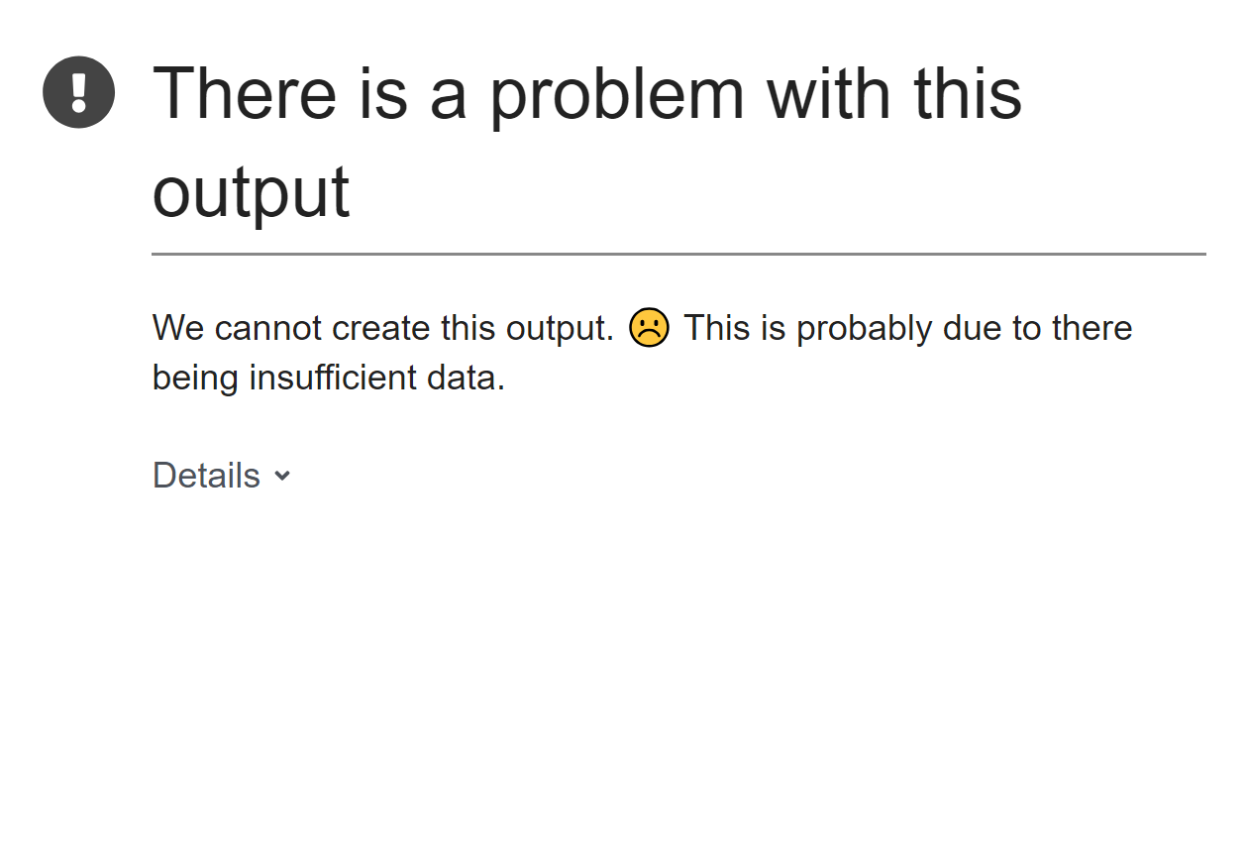
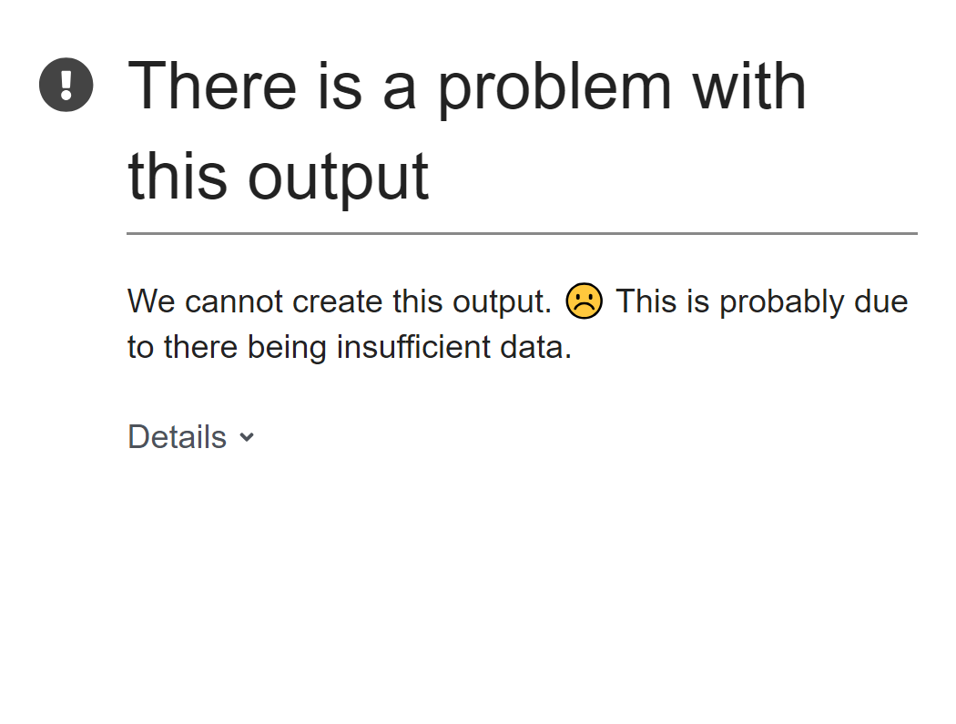
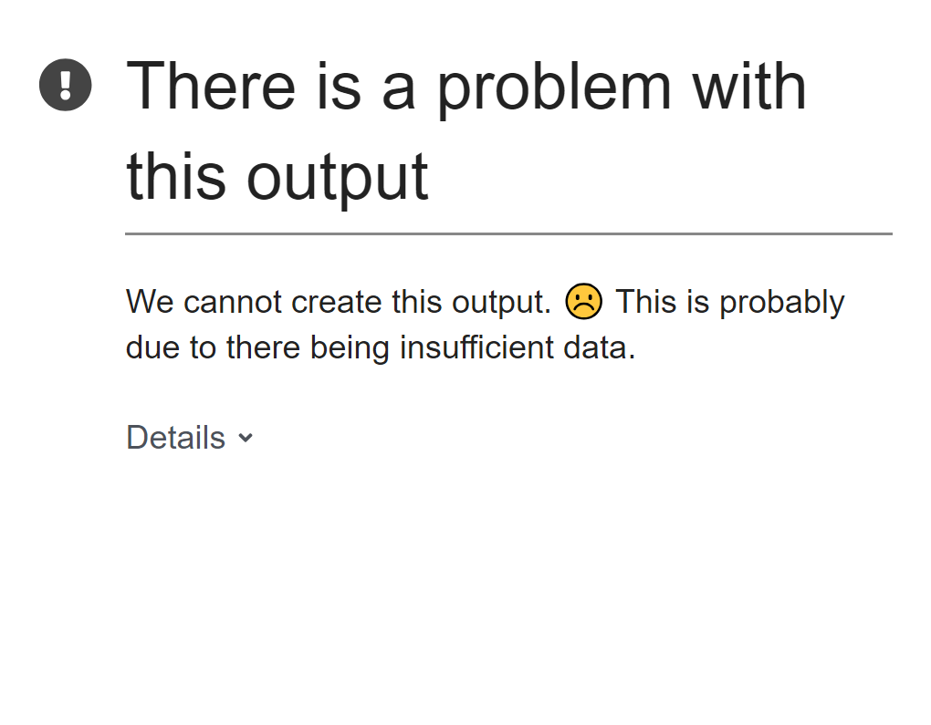
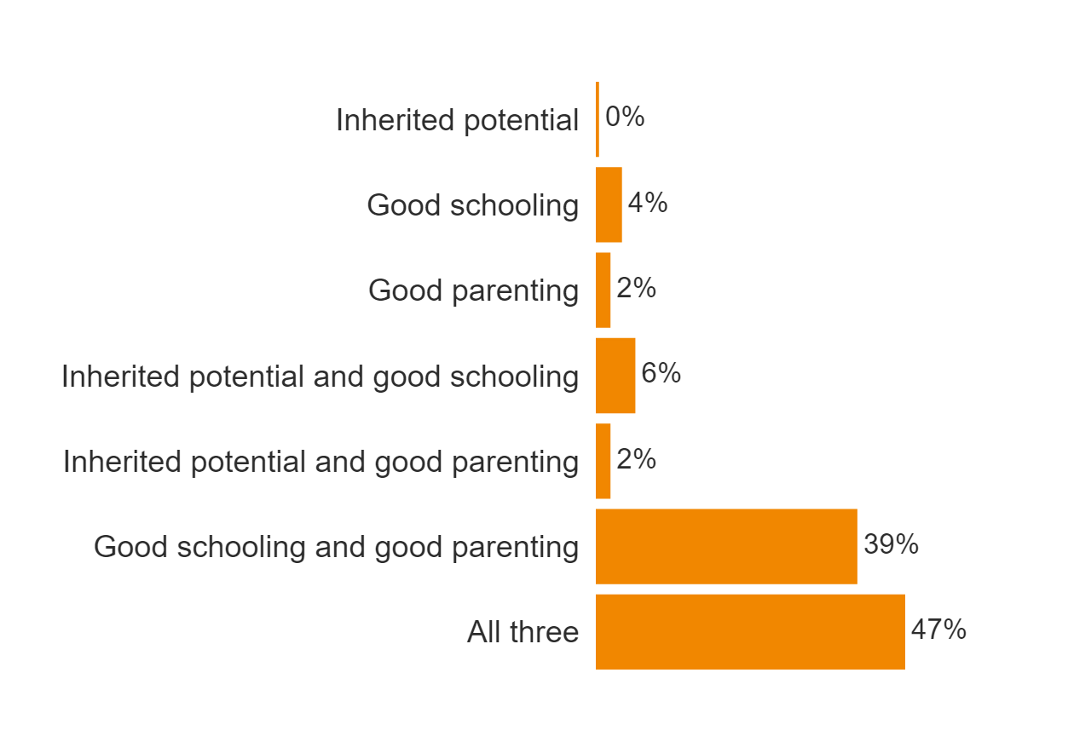
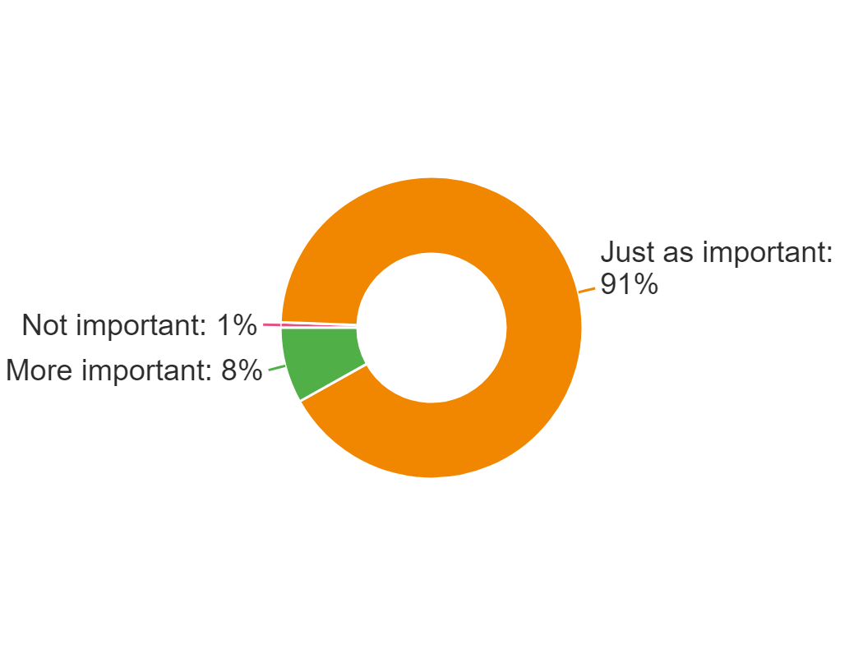
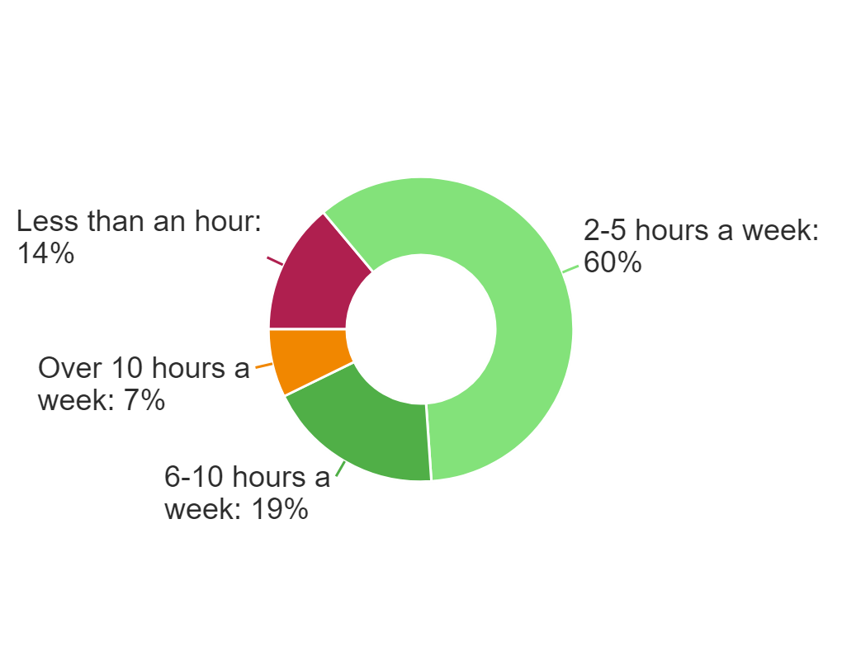
HPL - Comparative School Surveys Report
WAVE 1
WAVE 2

Slide 4


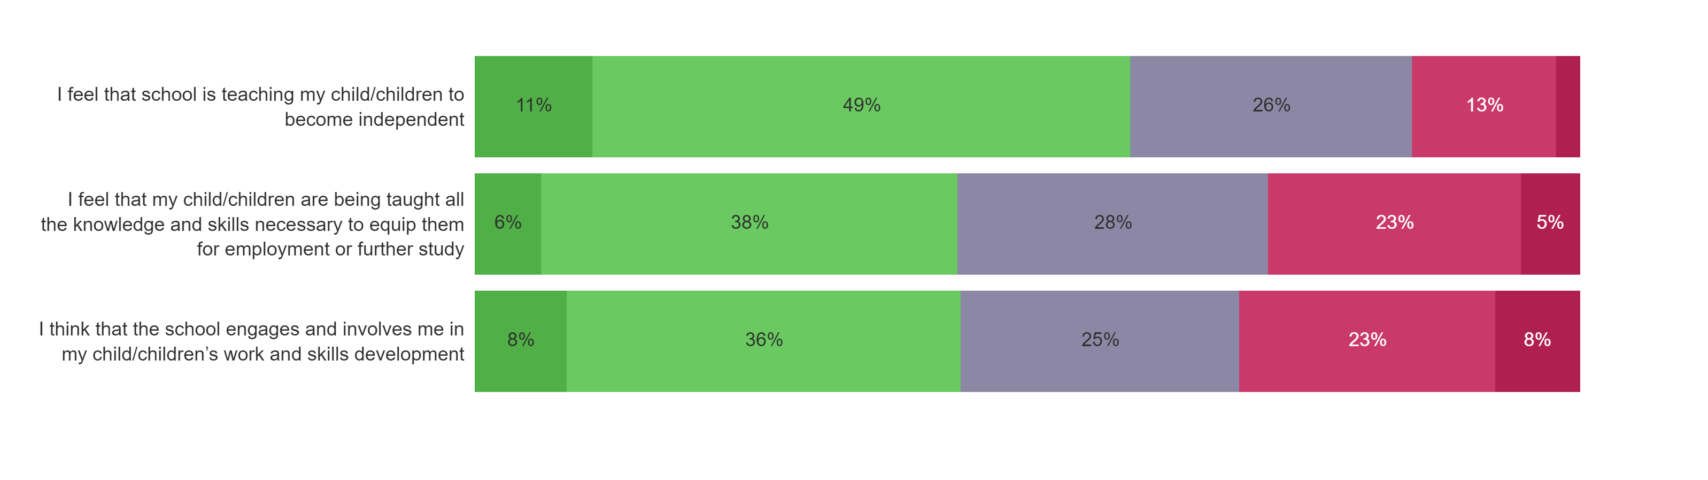
HPL - Comparative School Surveys Report
WAVE 1
WAVE 2

Slide 5
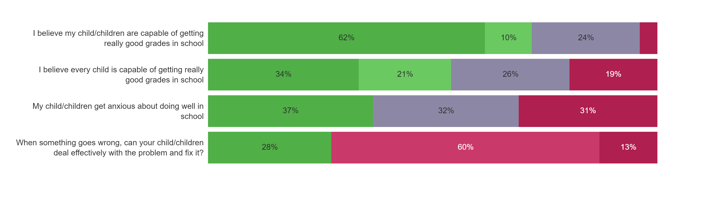
HPL - Comparative School Surveys Report
WAVE 1
WAVE 2

Slide 6
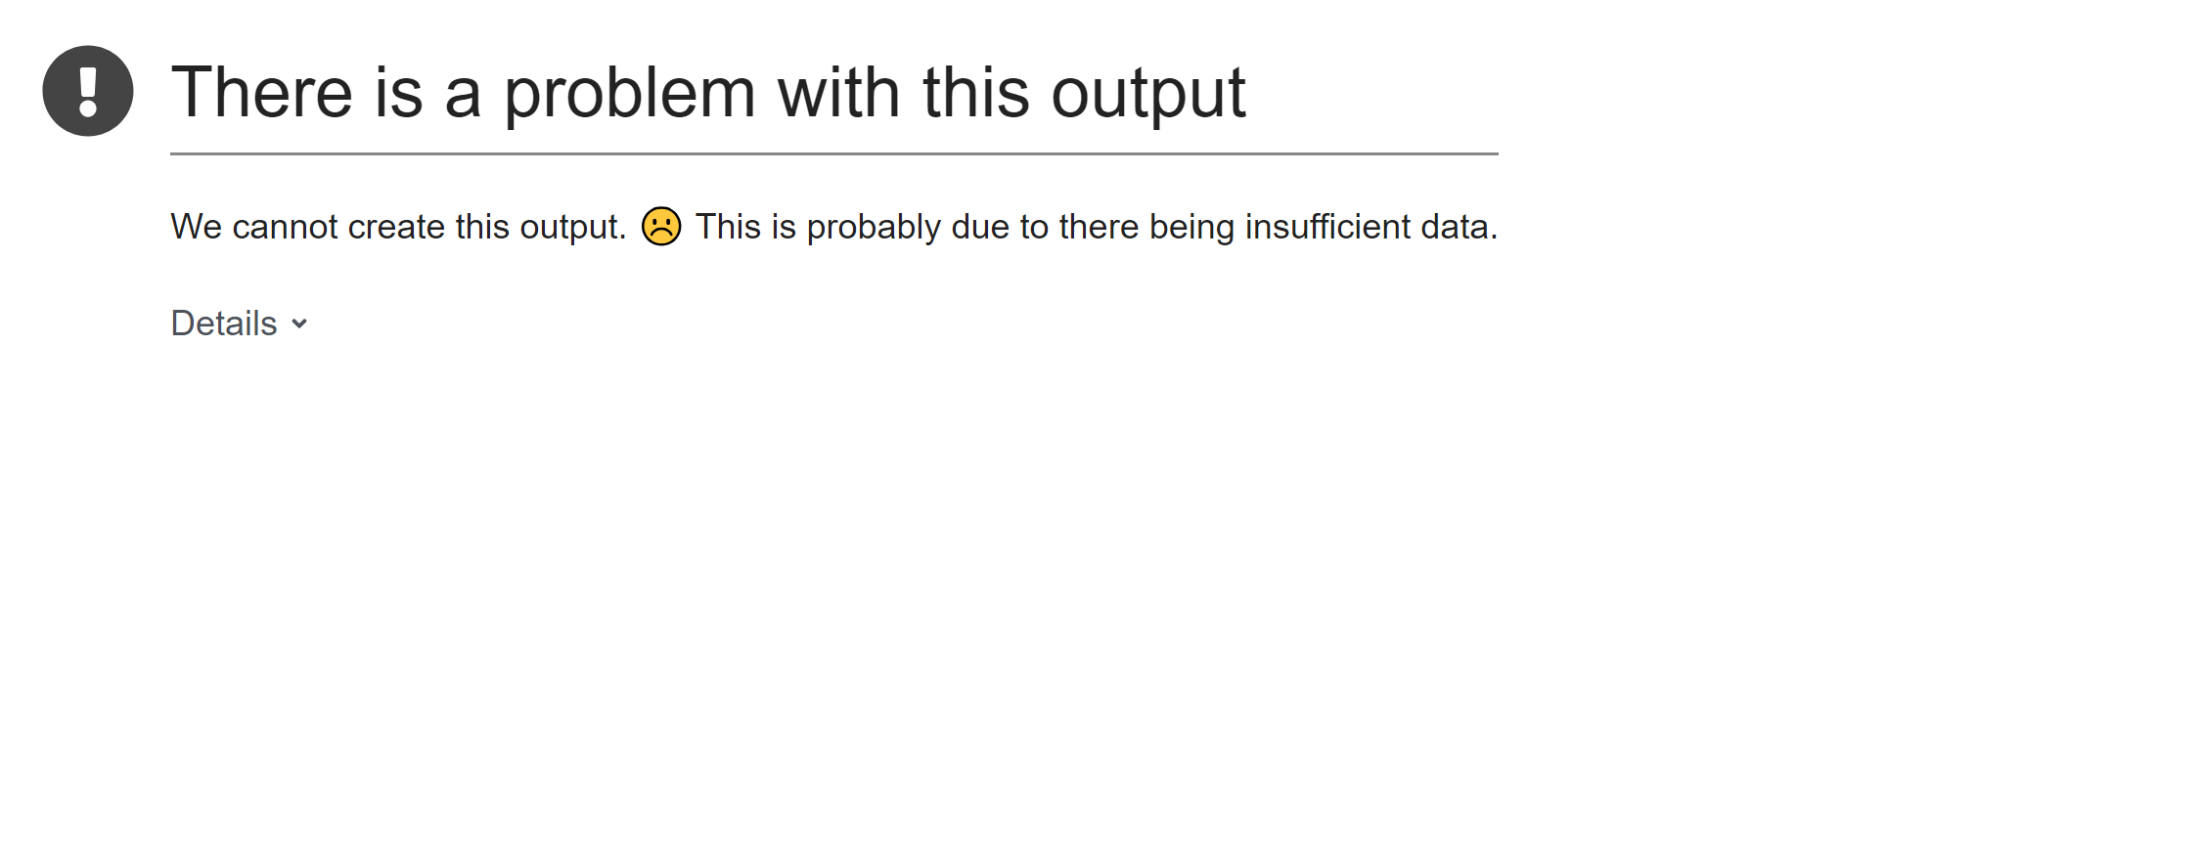
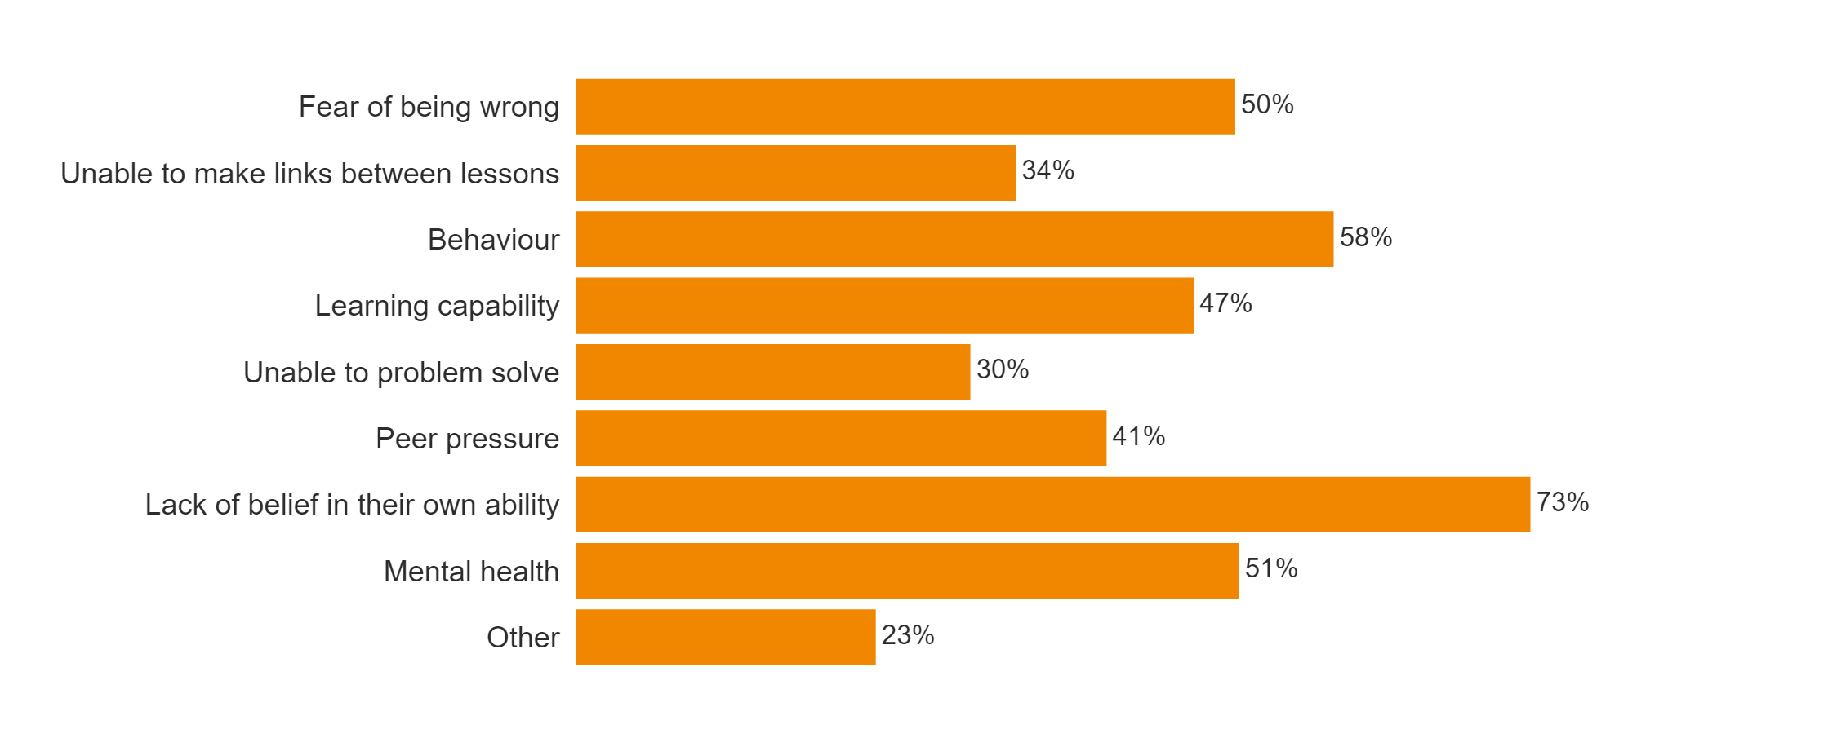
HPL - Comparative School Surveys Report
WAVE 1
WAVE 2

Slide 7
HPL - Comparative School Surveys Report
﻿

Slide 8

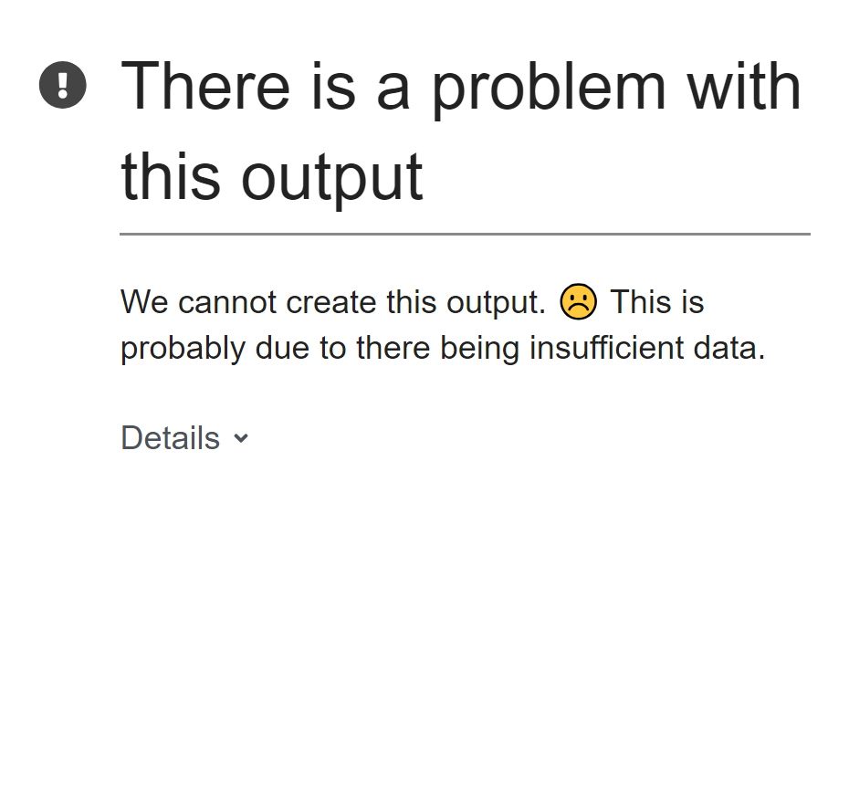
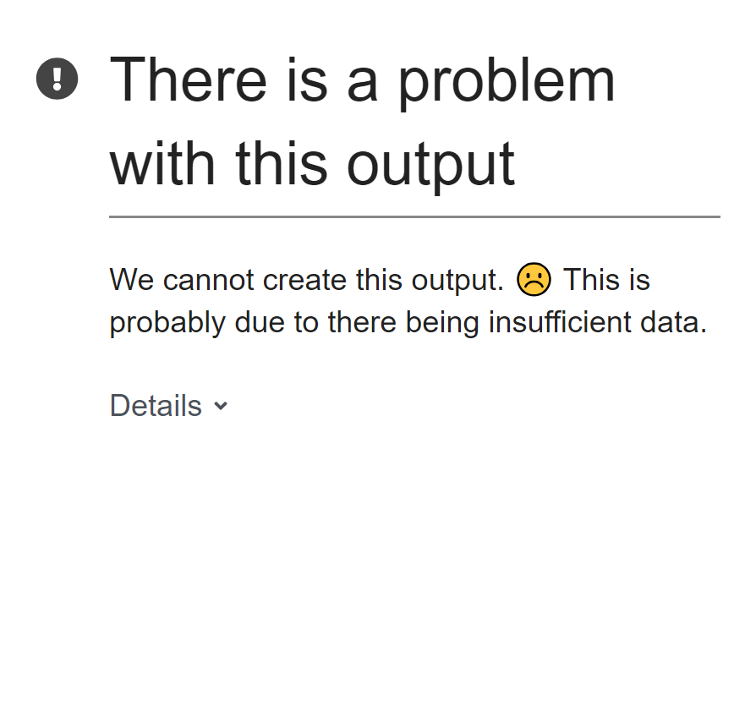
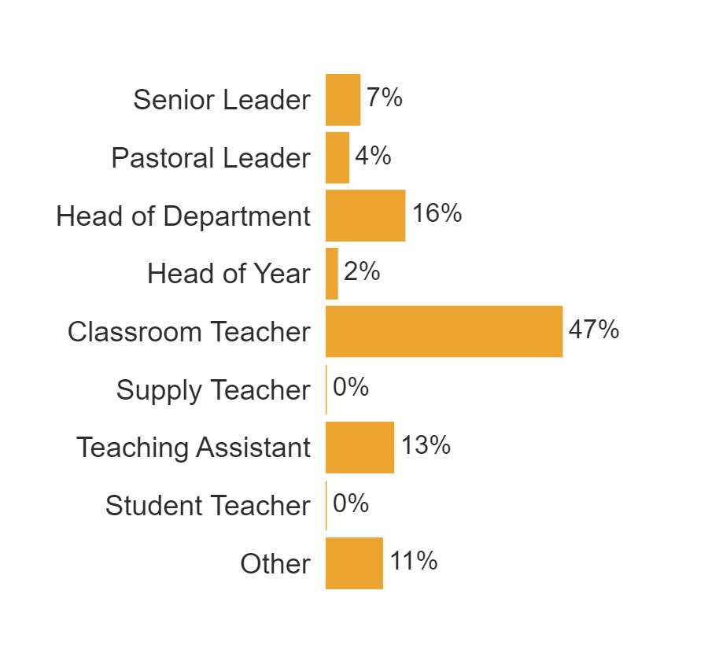
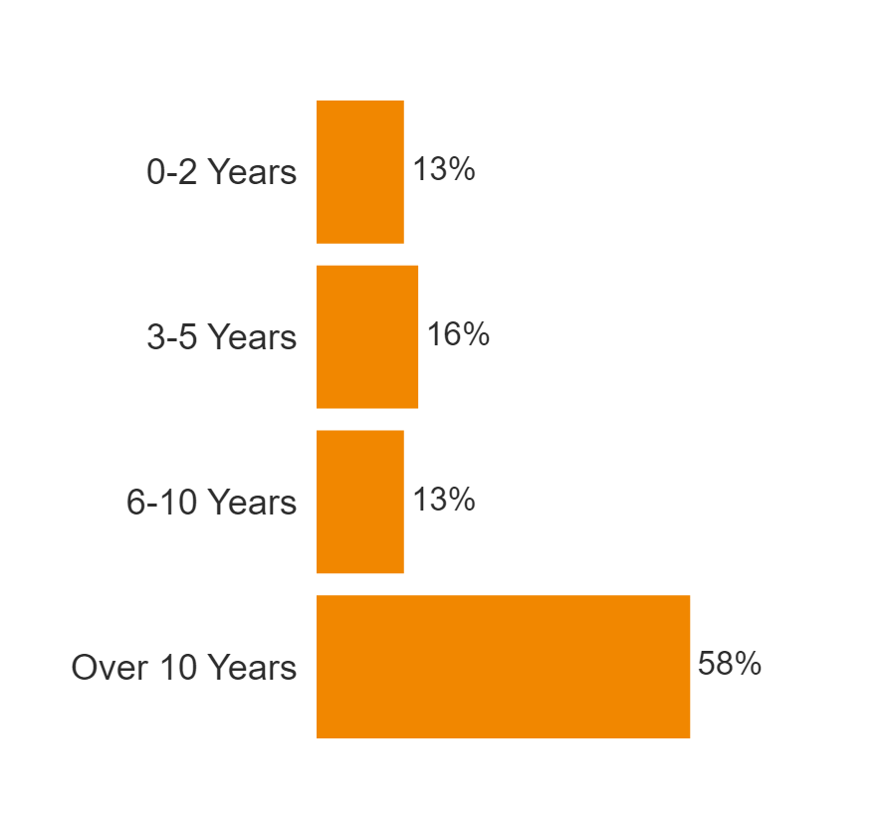
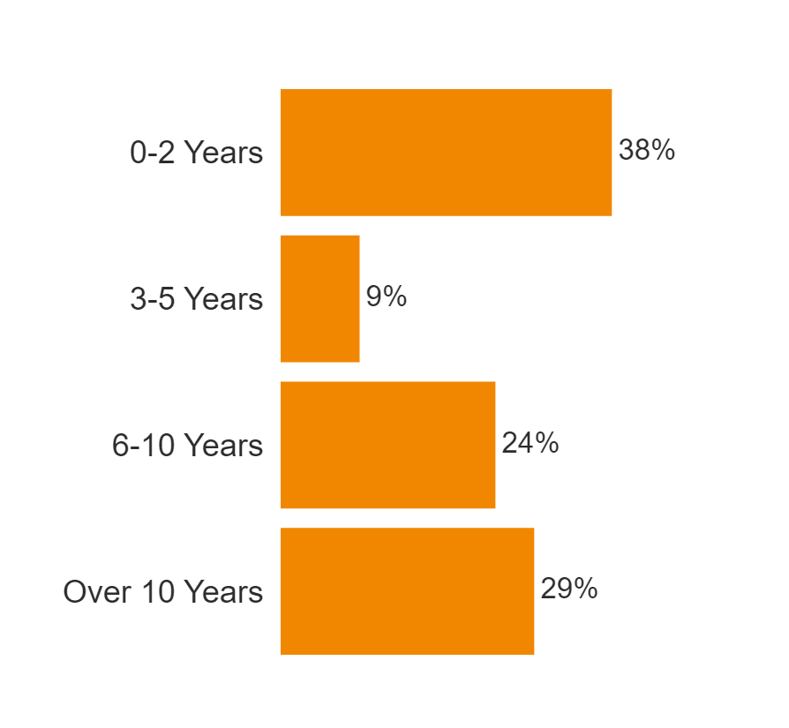
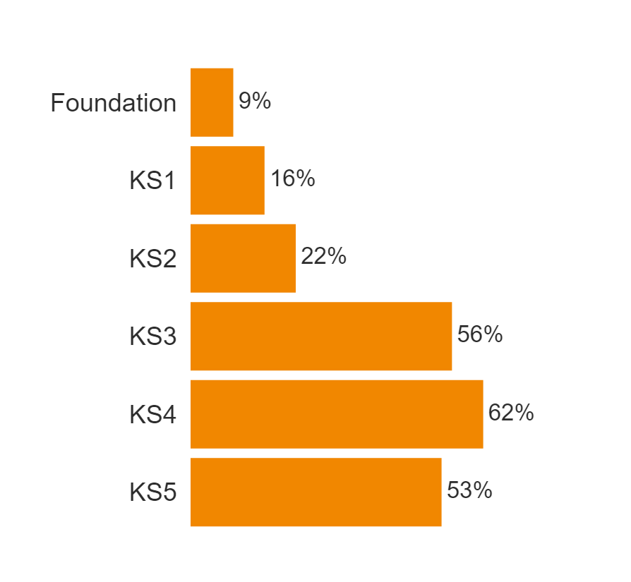
HPL - Comparative School Surveys Report
WAVE 1
WAVE 2

Slide 9

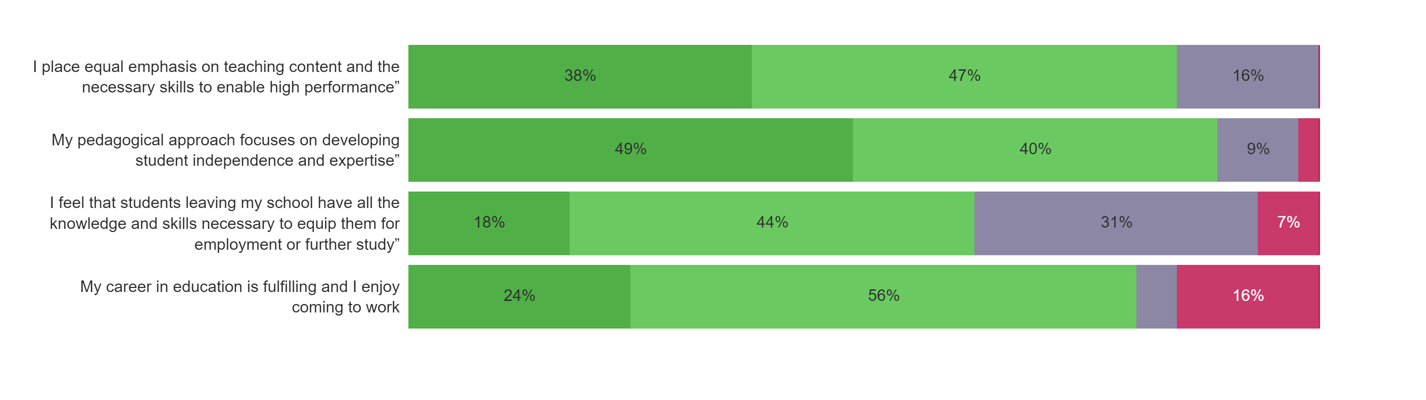
HPL - Comparative School Surveys Report
WAVE 1
WAVE 2

Slide 10
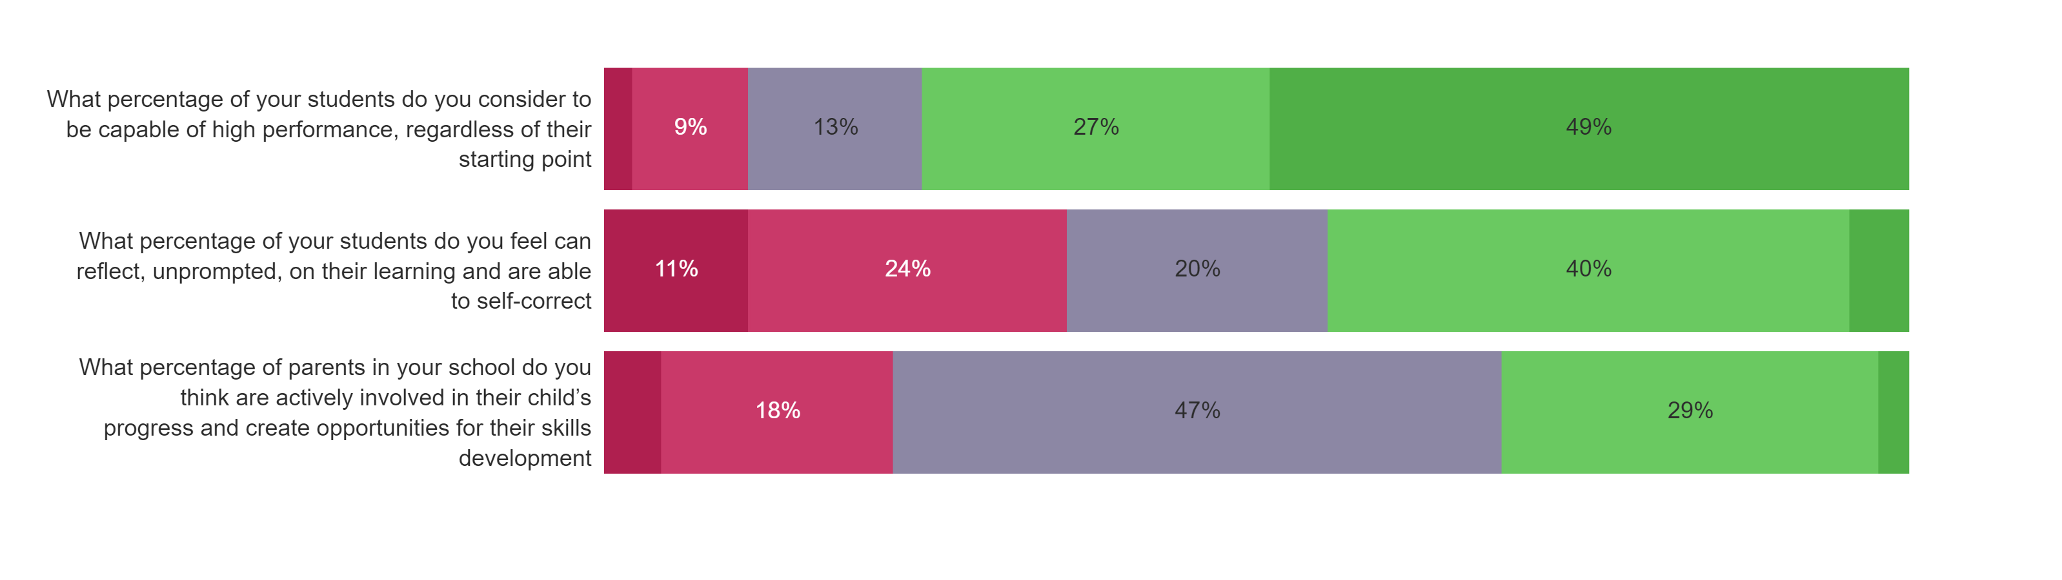
HPL - Comparative School Surveys Report
WAVE 1
WAVE 2

Slide 11

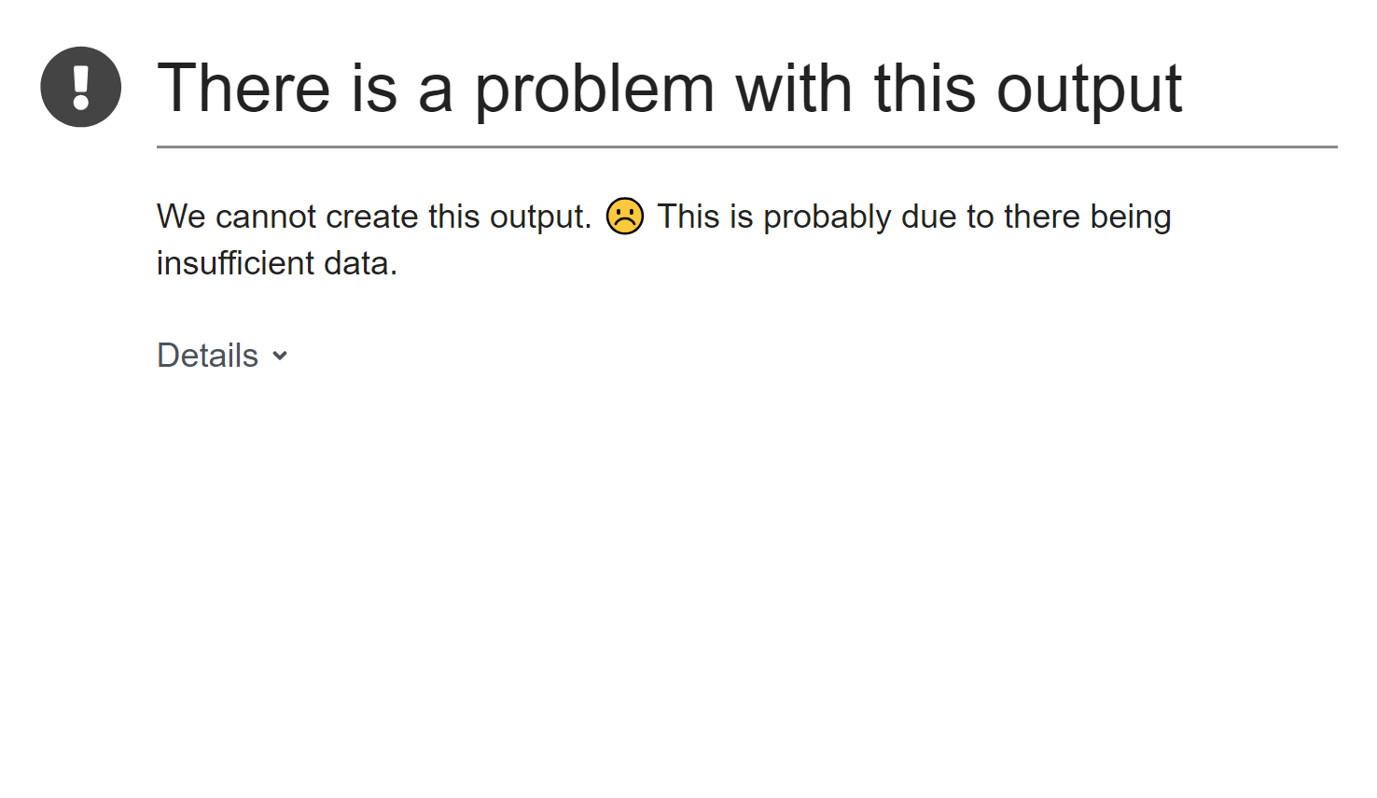
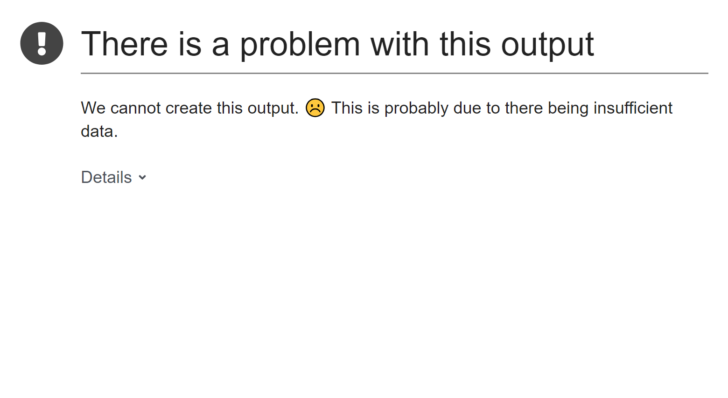
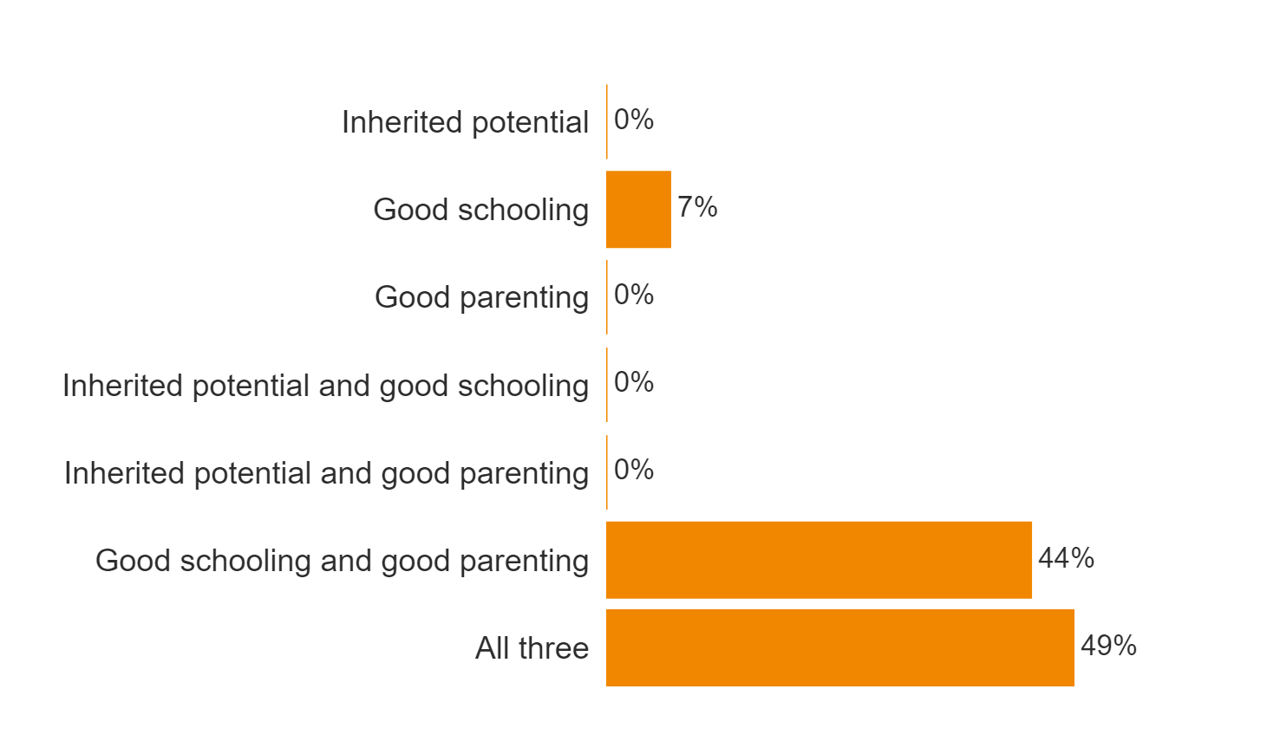
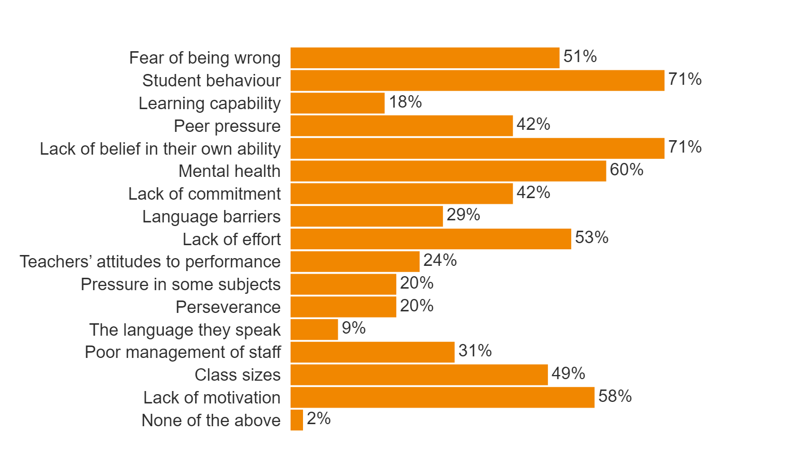
HPL - Comparative School Surveys Report
WAVE 1
WAVE 2

Slide 12
HPL - Comparative School Surveys Report
﻿
Text | Please feel free to add any general comment you wish to make relating to high performance in your school:
29550 | Although the philosophy is understood the lack of time does not allow for HPL to develop in all students.
29574 | For the previous question, I believe that all of the above can at different times have an impact in why students and schools may underachieve. I don't think we have all of these things going on all of the time but they all feature in some degree.
30102 | Behaviour is becoming a significant problem which is resulting in less progress of the whole class. The behaviour system lacks consistency, ownership and poorly time managed. Sanctions are in place on average a week - two weeks after they have been given, this has very little impact.
30298 | I also think the the constant focus on exam performance and therefore taught content that sometimes other skills can be overlooked.
30422 | None
30552 | My main concern is behaviour outside of the classroom. Students which behave so well in the classroom can become feral in their free time. Students are scared to go to the toilet at break. Behaviours such as littering, vandalism, swearing and talking back to staff have become the norm. All the hard work teachers do in the classroom to create a safe, harmonious and happy learning environment unravels at break and lunch as students observe, what other students seem to get away with. More support is needed for Pastoral so they can deal with inappropriate behaviours quickly so these behaviours are not tolerated. We will then create a more positive learning community in the classroom and out!
30808 | Students really rise to the challenge and most are excited by their learning.
31580 | Most good teachers inherently aspire for their students to be high performance but the method in which it has been implemented in school does not necessarily mean students are performing at a high level. It should be activity led rather than icons.

Slide 13

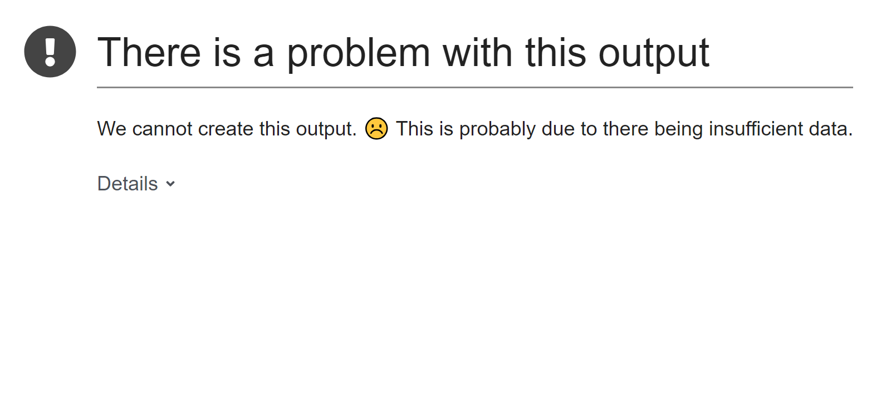
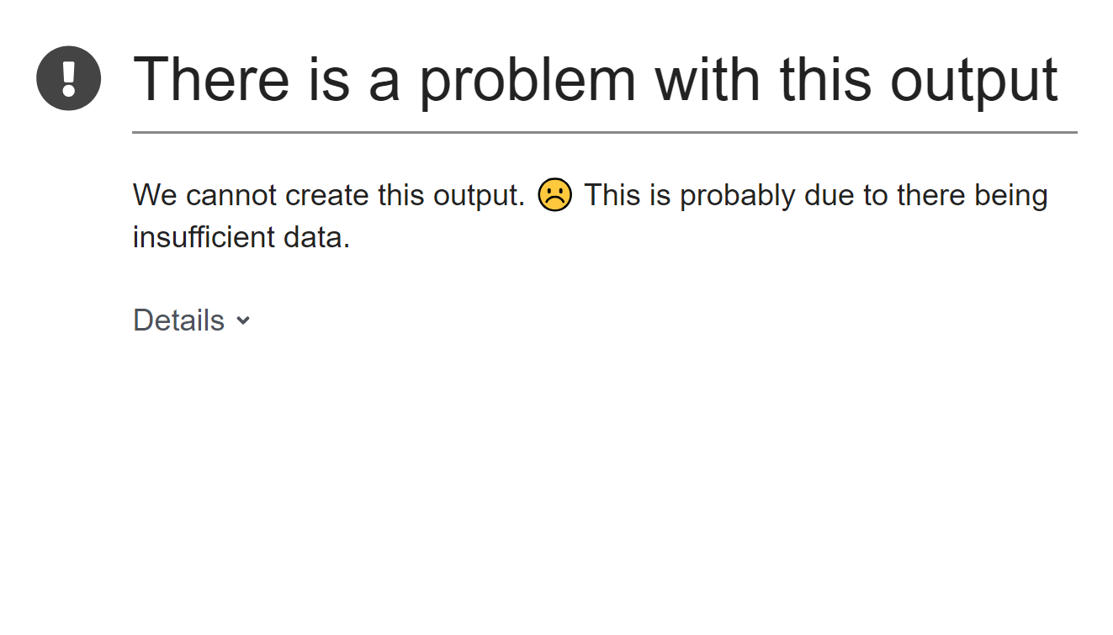
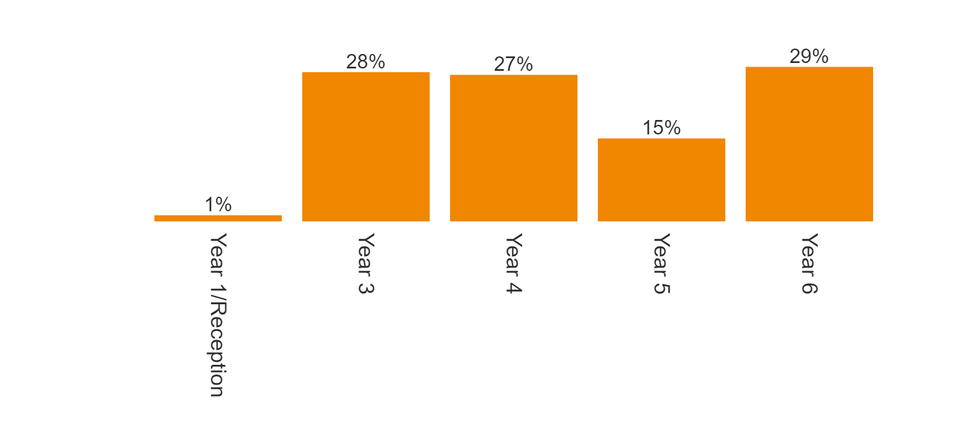
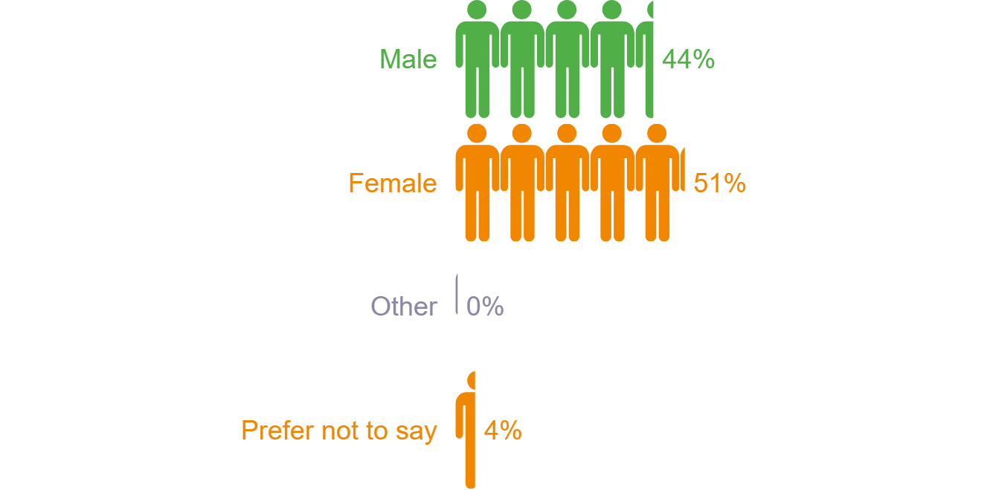
HPL - Comparative School Surveys Report
Student gender
WAVE 1
WAVE 2

Slide 14

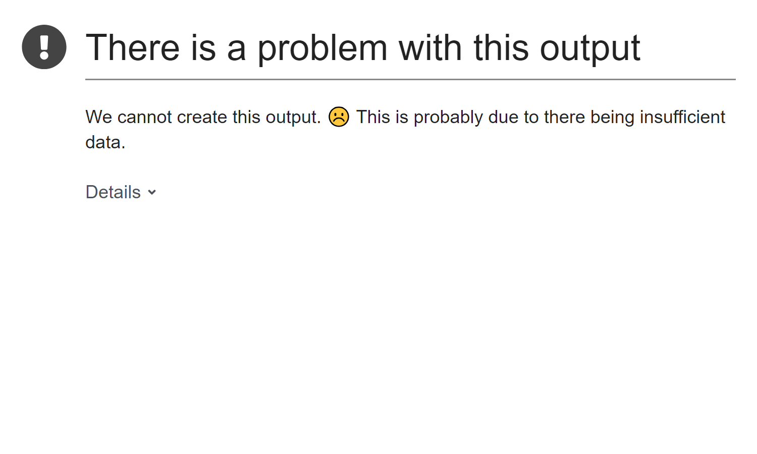
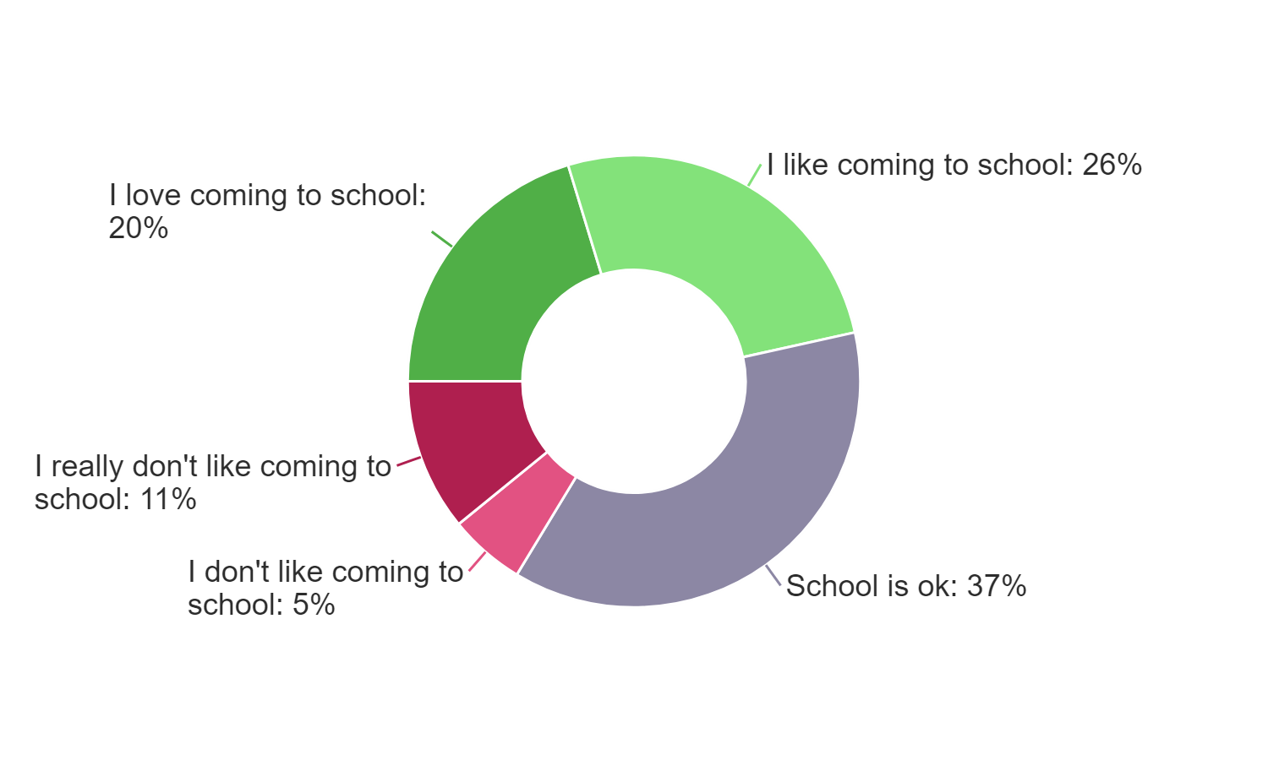
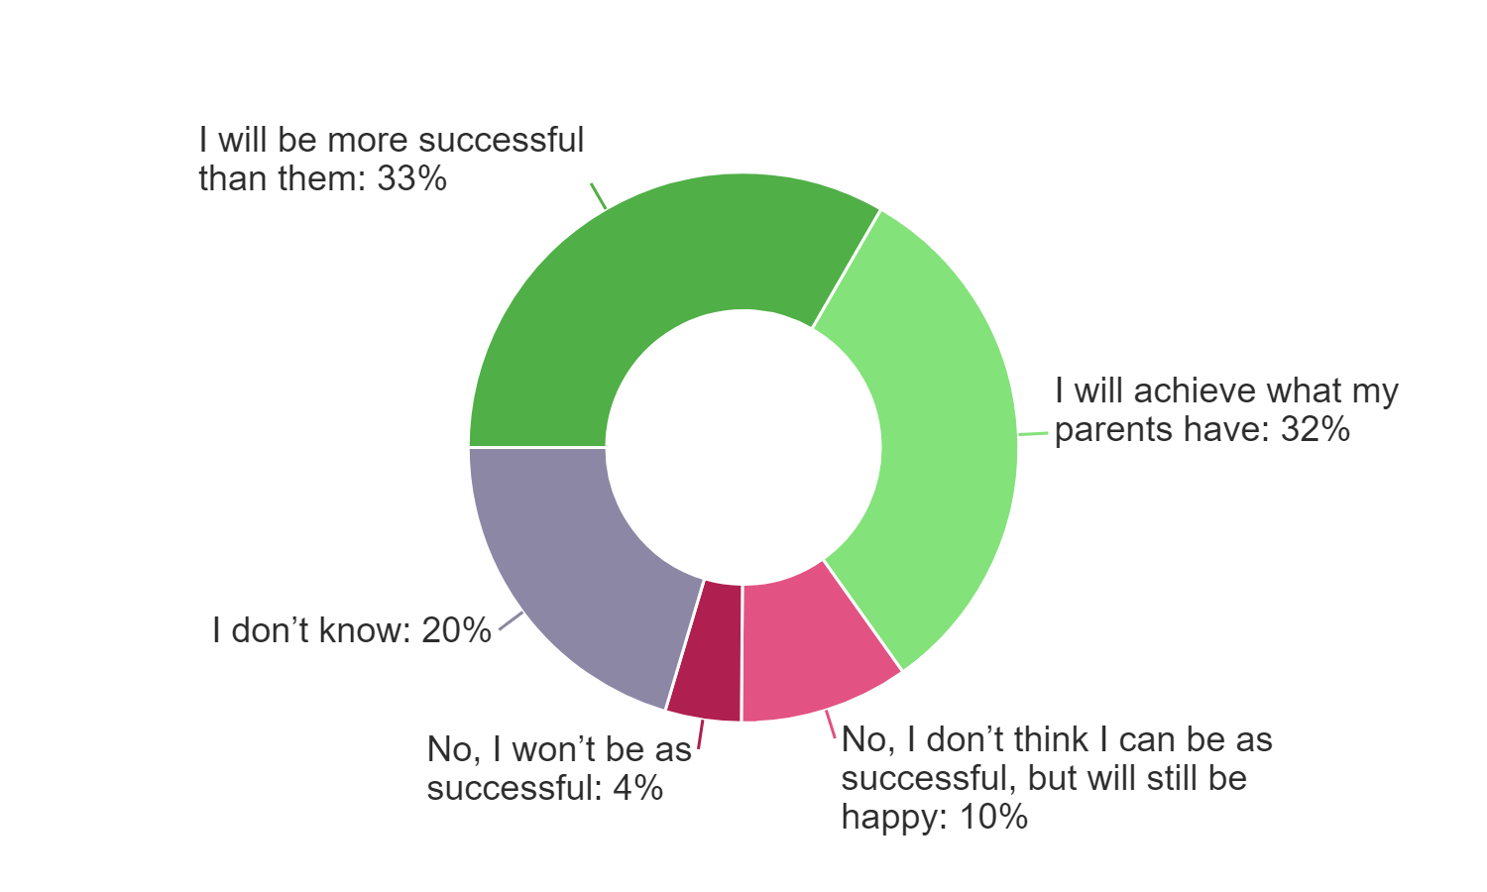
HPL - Wave 2 School Surveys Report
WAVE 1
WAVE 2

Slide 15

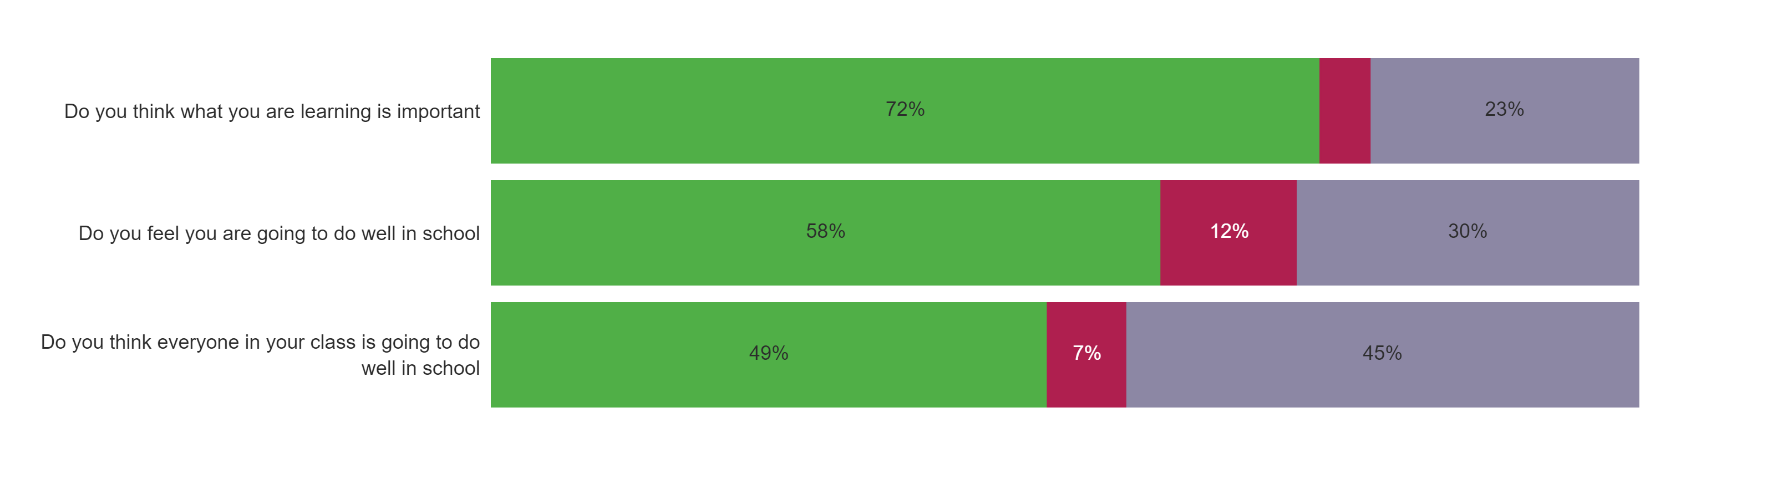
HPL - Comparative School Surveys Report
WAVE 1
WAVE 2

Slide 16

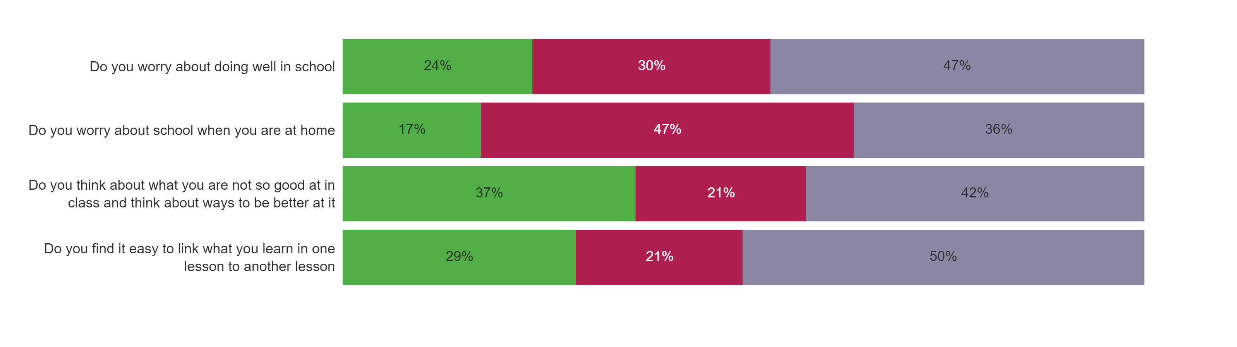
HPL - Comparative School Surveys Report
WAVE 1
WAVE 2

Slide 17


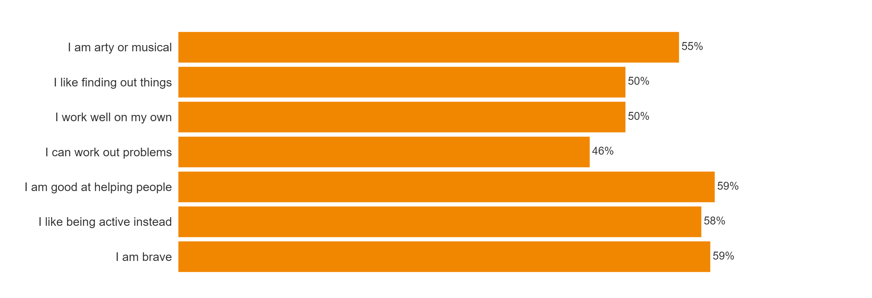
HPL - Comparative School Surveys Report
WAVE 1
WAVE 2

Slide 18

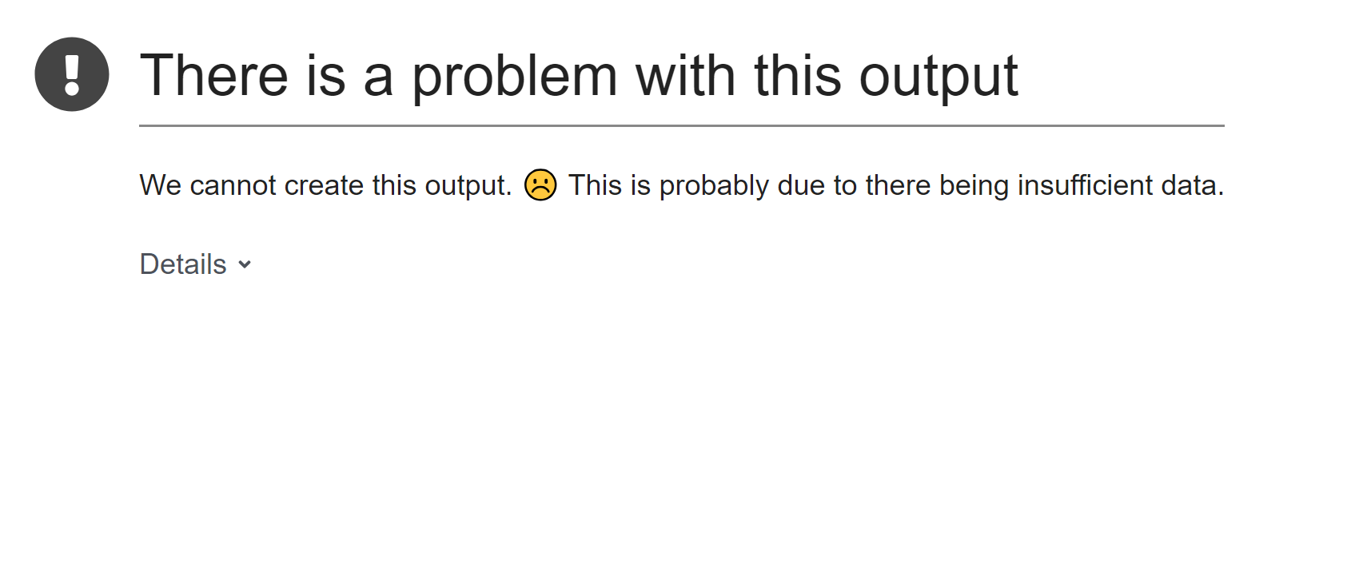
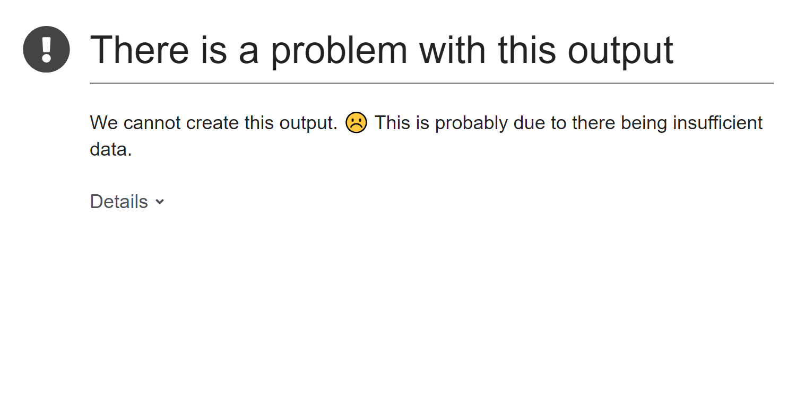
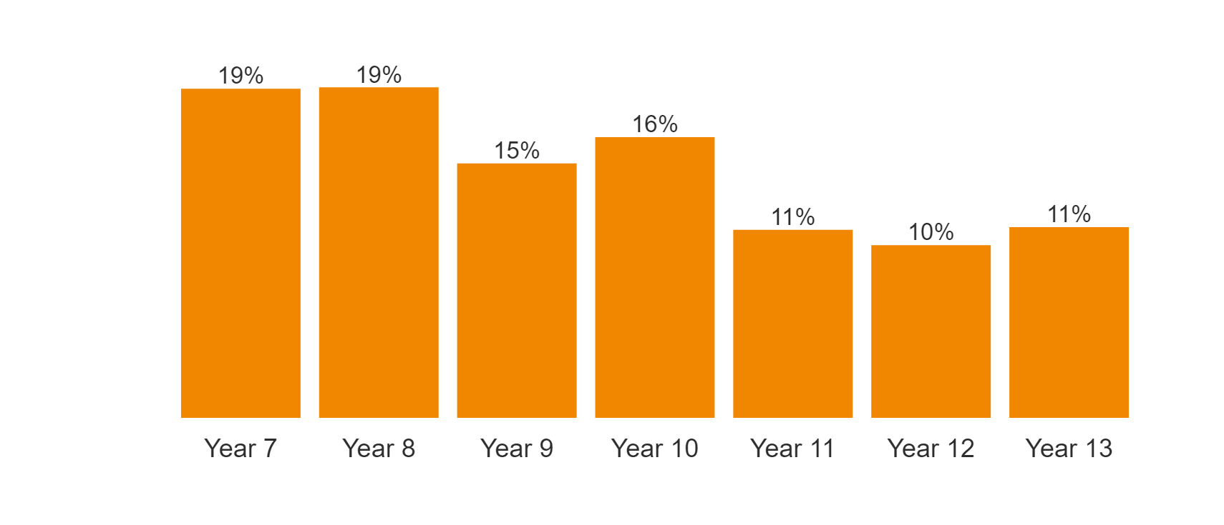
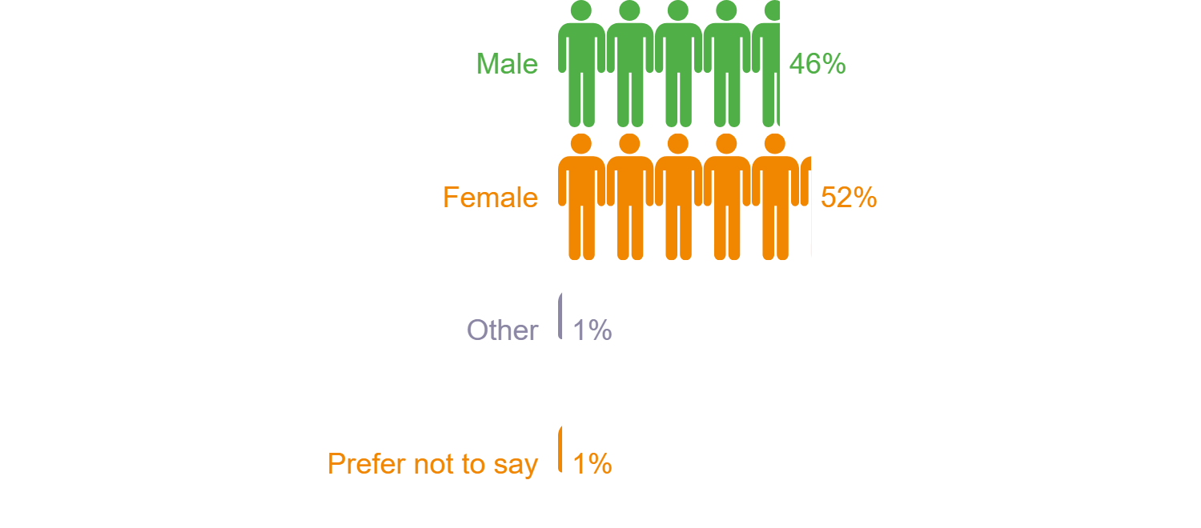
HPL - Comparative School Surveys Report
Student gender
WAVE 1
WAVE 2

Slide 19
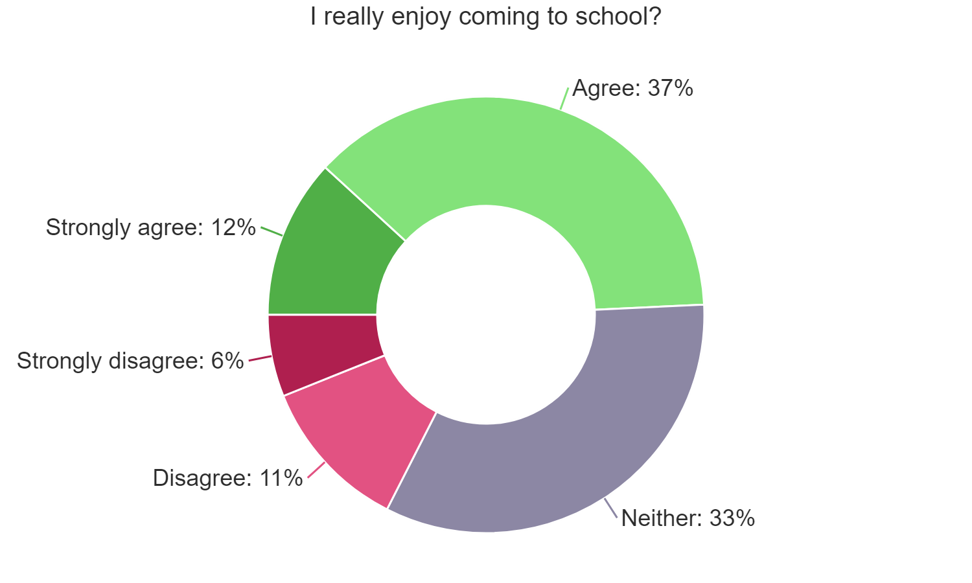
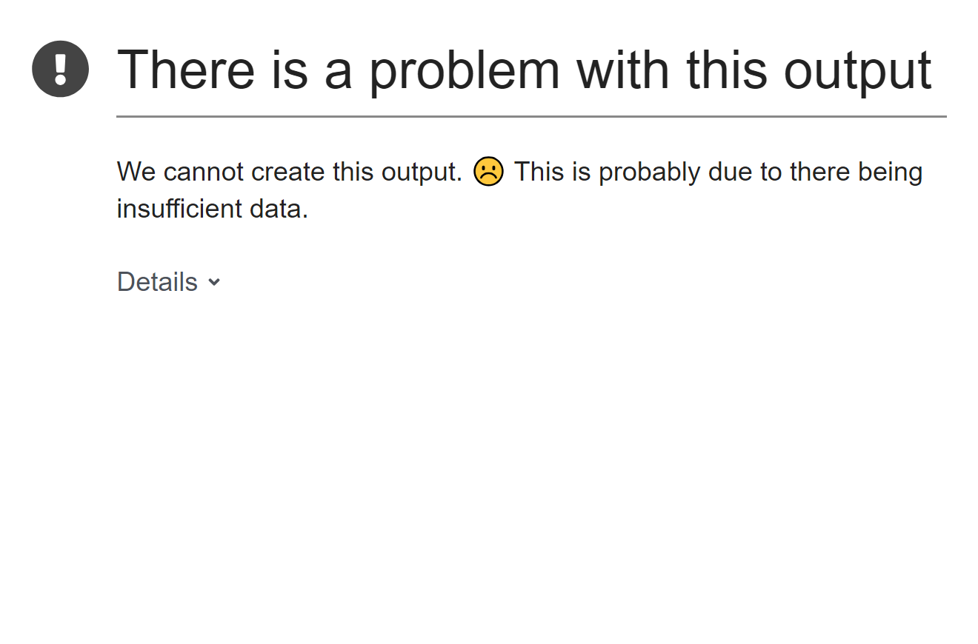
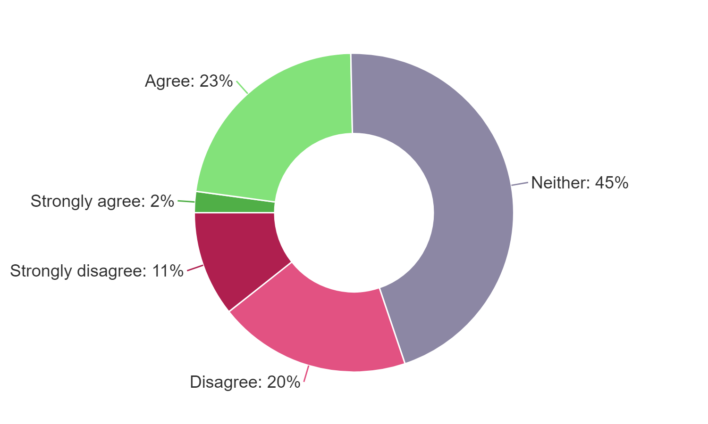

HPL - Wave 2 School Surveys Report
WAVE 1
WAVE 2

Slide 20

HPL - Comparative School Surveys Report
WAVE 1
WAVE 2

Slide 21

HPL - Comparative School Surveys Report
WAVE 1
WAVE 2

Slide 22


HPL - Comparative School Surveys Report
WAVE 1
WAVE 2

Slide 23
HPL - Comparative School Surveys Report
﻿

