Slide 1

High Performance Learning 3 (April 2018)
“Linking”

Slide 2
HPL 3:- “Linking”
As we begin our third HPL "course", it is worth pausing to remind ourselves of how much great work we have already done in developing our understanding of "meta thinking" and how effective we have been in identifying, sharing and implementing strategies to increase the "thinking opportunities" we have provided to our students within more of our lessons and the impact that has had on levels of student understanding.
HPL groups have met to share ideas in a supportive, non-judgmental environment and colleagues within phase and subject teams have been bouncing ideas off one another. This has been evidenced in the high quality HPL “submissions” to date. Many of us have benefitted from the Teachmeet events co-ordinated by Joe Rich and we are collectively recognising the importance of continued collaborative work, both within teams and between teams. This will continue throughout the summer term.

Slide 3
How HPL
Creating these "thinking" opportunities through skilled questioning, peer discussion, student self-regulation and strategy planning should remain an important aspect of pedagogy for all teaching colleagues, even as we move on to the next HPL topic.
It is also important for all teachers to be clear about the link between this "continual" professional development (HPL), where the focus is very much on the development excellent practice, and our overall teaching and learning aims for the academic year, i.e. improving the level of challenge, scaffold and engagement within all areas of the school.
Thank you for engaging with the HPL CPD so far this year, and thanks in advance for continuing to embrace these approaches within your teaching.

Slide 4
“So how do the Advanced Cognitive Performance Characteristics of Meta-thinking and now Linking fit in with the bigger picture of what we are trying to achieve at CCS?”
I am hopeful that the next slide goes some way in providing staff with an outline of how this is starting to fit together within the HPL overview.

Slide 5
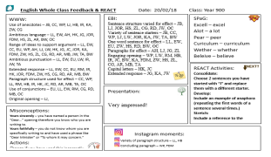
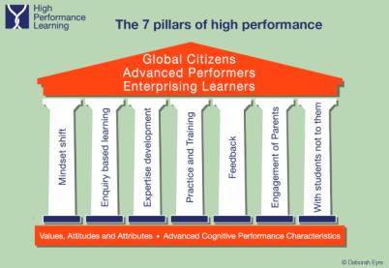
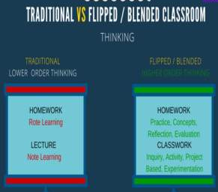
High Performance Learning: The Bigger Picture!
Collective Mindset
A New Vision;- “Ambition, Confidence, Success”
“Everyone Every Lesson
Every Opportunity”
Collaborative HPL Groups
Habitual “Sharing of effective practice” within teams and between teams
Teachmeet Events
New KS3 assessment and reporting
Whole Class Feedback approach.
Opportunities given for students to respond and improve work following feedback
Assembly Programme
House System Launched
Role of the Tutor
CCS Values
CCS Electronic Newsletter
Parent Questionnaires.
Parent Voice Group
High Performance Teaching and Learning.
HPL 1 and 2 = Meta-Thinking:- (Meta Cognition, Strategy Planning, Self Regulation and Intellectual Confidence)
HPL 3 = Linking;- (Retrieval Practice and Elaborative Rehearsal)

Slide 6
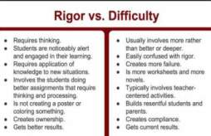

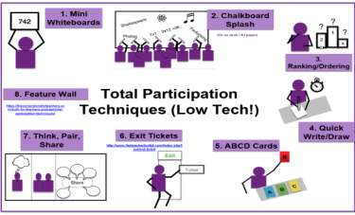
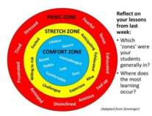
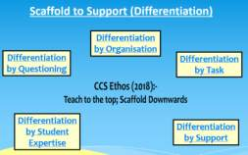
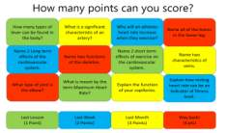
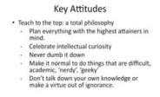




Applying Challenge / Scaffold / Engagement at CCS (2017-2018) :- (Resources in the Whole School 2018 T and L Folder)
Challenge
Scaffold
Engage
Engaged V’s Just On Task
Often confused with on task Students are having to use their minds, think and problem solve. Students are paying attention and participating in discussions Students are more interested in the learning than the “grade” It’s a culture of commitment to learning / developing, rather than a culture of compliance to adults. Student behaviour issues are at a minimum. Students rarely shut down early. | Often confused with engaged. Students are quiet, well behaved but potentially “tuned out”. A few students participate. Students frequently ask for grade / score “Why are we doing this?” Students shut down early. Student behaviour issues can emerge. Culture of compliance to adults. On task is needed, but we cannot stop there; it’s not enough!
SWAN Network
Huddle

Slide 7
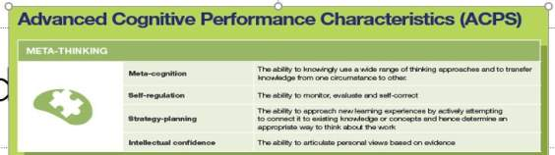
A little “retrieval practice” from the work during HPL2!
…. Please consider some of the following questions relating to meta-thinking and the “Challenge / Scaffold / Engage” work to date and bring to the first HPL Groups Meeting as an opening discussion.
How many of these (or other) Challenge / Scaffold / Engage strategies did you put into practice last term to encourage deeper thinking in lessons?
How successful were these strategies? Which didn’t work for you / your class and why?
What was the general response from the students when you tried these ?
Was there any noticeable impact on “outcomes”? Examples?
If you didn’t try many of the aforementioned ideas, why not? (Is it not part of being a truly reflective practitioner?)

Slide 8


Easter Training Day 2018;-
(Steve Sheehan Presentation)
Many thanks again to Steve for putting the following together!

Slide 9
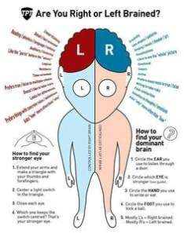


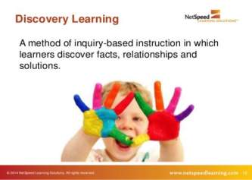
The field of education seems particularly susceptible to the allure of plausible but untested ideas and fads (especially ones that are lucrative for their inventors).
Henry L. Roediger, III
Washington University in St. Louis
This is starting to change

Slide 10


The Science of Successful Learning
(Staff copy now available in LRC!!)

Slide 11
A brief introduction to the science of memory
Attention
Elaboration
Retrieval

Slide 12
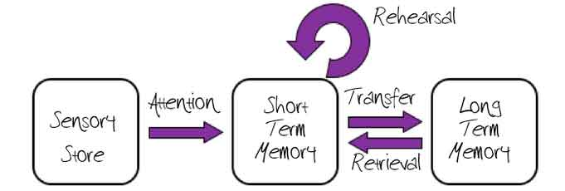

Slide 13

Attention!

Slide 15
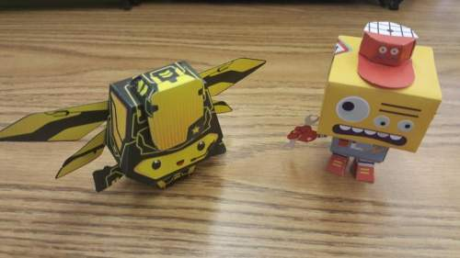
Transfer to Long Term Memory: Repetition
- Glombots, who looked durly and lurkish, were very fond of wooning.
- Glombots, who looked durly and lurkish, were very fond of wooning.

Slide 16
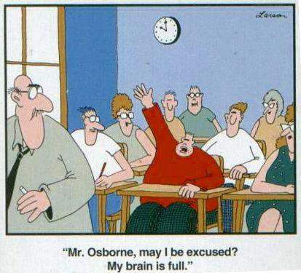
Problems with Repetition

Slide 17

Transfer to Long Term
Better than mechanical repetition is:
Elaboration is the process of giving new material meaning by expressing it in your own words and connecting it with what you already know.
The more you can explain about the way your new learning relates to your prior knowledge, the stronger your grasp of the new learning will be, and the more connections you create that will help you remember it later.

Slide 19

Retrieval Practice
Practice at retrieving new knowledge or skills from memory is a potent tool for durable learning.
Repeated retrieval not only makes memories more durable but produces knowledge that can be retrieved more readily:
information is at your mental fingertips

Slide 20
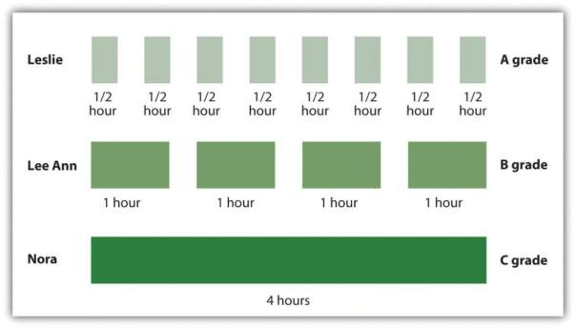
Distribution and ‘interleaving’
Retrieval practice is most effective distributed (rather than in massed sessions) and interleaved (switching between different topics)

Slide 21

Retrieval Practice is best when ‘effortful’.
After an initial test, delaying subsequent retrieval practice is more potent for reinforcing retention than immediate practice.
The greater the effort to retrieve learning (provided that you succeed) the more that learning is strengthened by retrieval).

Slide 22
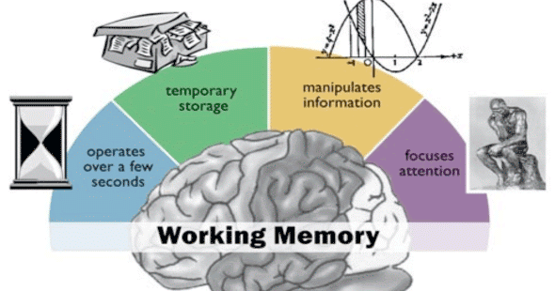
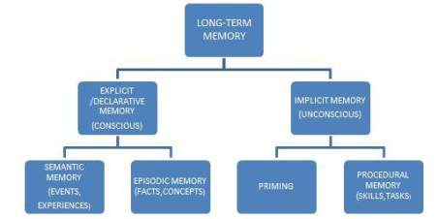
Always working
Limited Capacity
Sometimes hard
to access
Unlimited
Capacity

Slide 23
Quick test!
El_bo__t__n is the process of giving new material meaning by expressing it in your own words and connecting it with what you already know.
What’s the missing first word?
Why is this NOT a good application of retrieval practice?
……it’s not effortful!!!!

Slide 24
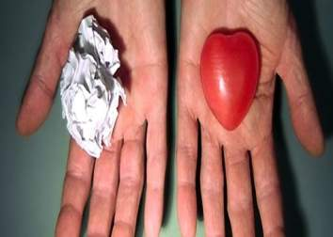
Cognition and emotion
Cognition and Emotion have a two way interaction
Learning depends on: Motivation, Self esteem, Belief, etc. of the student.
Which in turn can be affected by:
Teacher’s relationship with student
Interventions
Safeguarding
Assessment feedback
Learning Support
Parental contact etc. etc. etc. etc.
But most of all a teacher in a good positive state of mind

Slide 25



The Harvard Study of Adult Development
Looking back on their lives, people most often report their time with others as the most meaningful part of life, and what they’re proudest of.
It seems that we are hard-wired for social connections.
Relationships with high conflict and negativity are ‘toxic’.
Quality relationships: based on trust, encouragement and cooperation, are the best predictor of physical and mental health. So…

Slide 26
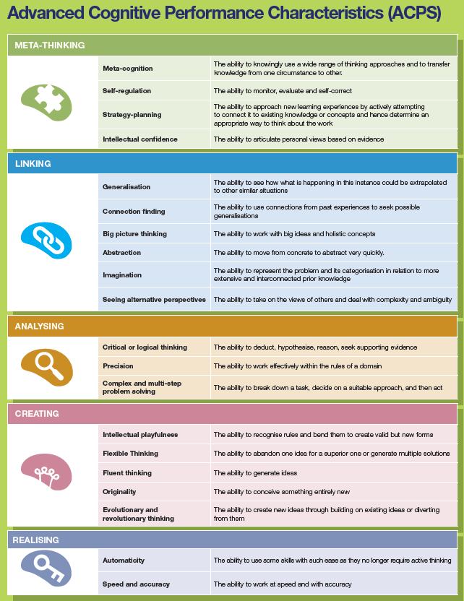
With thanks to Steve, I will attempt to elaborate!………..We now need to consider applying the concept of “Linking” within more lessons, more often.
How? “By developing learning through retrieval practice and elaborative rehearsal” through………
Attention:- Ensuring attention levels are high which are crucial for working memory to be effective.
Elaboration;- giving new material meaning by expressing it in your own words and connecting it with what you already know.
Effortful Retrieval Practice (Repeated retrieval) not only makes memories more durable but produces knowledge that can be retrieved more readily
Retrieval that is Distributed spread out over time and Interleaved with other topics.

Slide 27
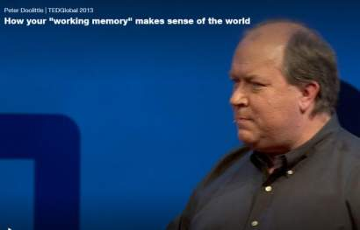
Well worth the watch……. a nice explanation on “working memory” (click hyperlink).
https://www.ted.com/talks/peter_doolittle_how_your_working_memory_makes_sense_of_the_world?utm_source=tedcomshare&utm_medium=email&utm_campaign=tedspread

Slide 28
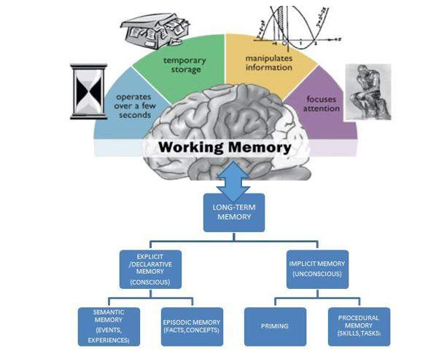
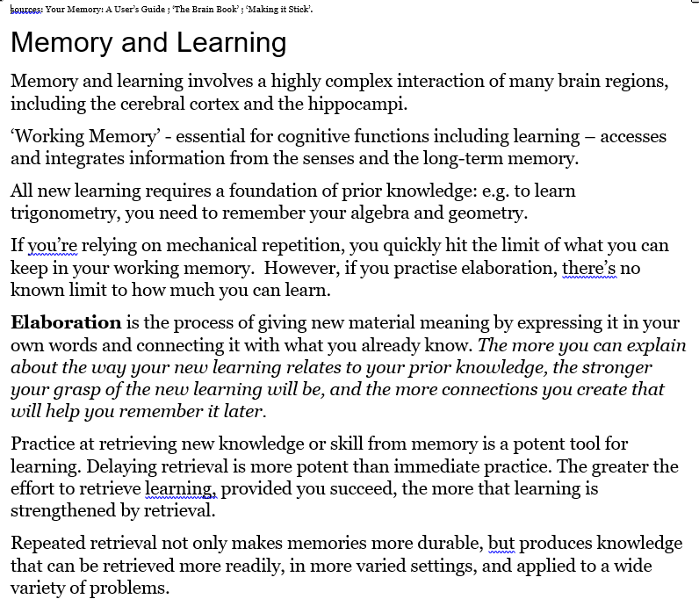

Slide 29
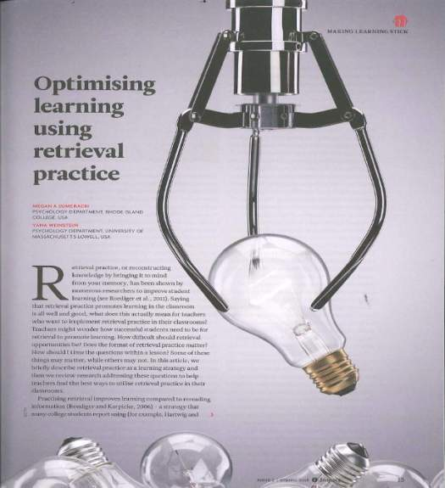
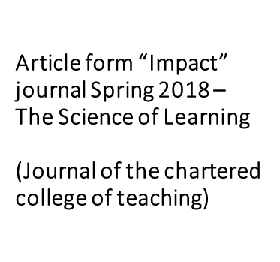

Slide 30
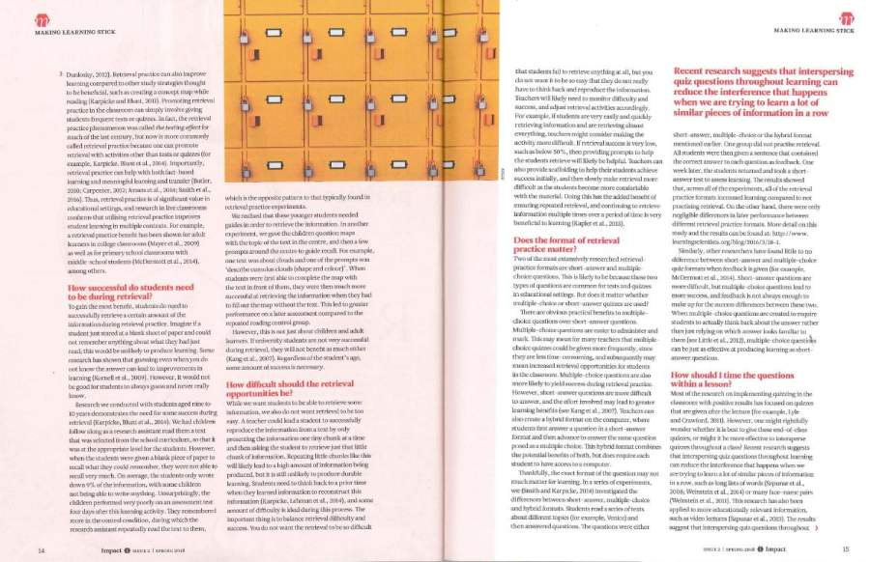

Slide 31
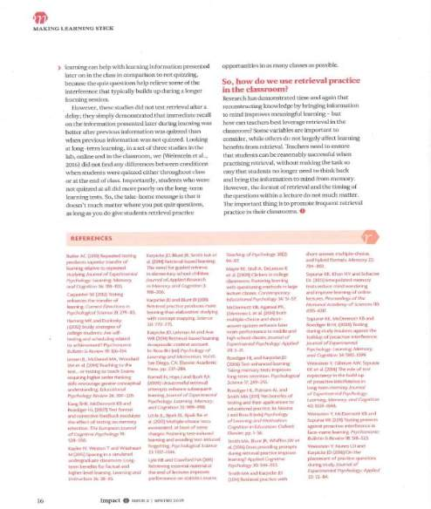

Slide 32
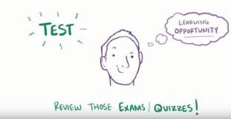
Student friendly promotion of “Retrieval Practice”.
(This clip will have been viewed by KS3 and KS4 students via tutors by the time you’ve seen this!)
https://www.youtube.com/watch?v=_wqG7g1kZUo&feature=youtu.be

Slide 33
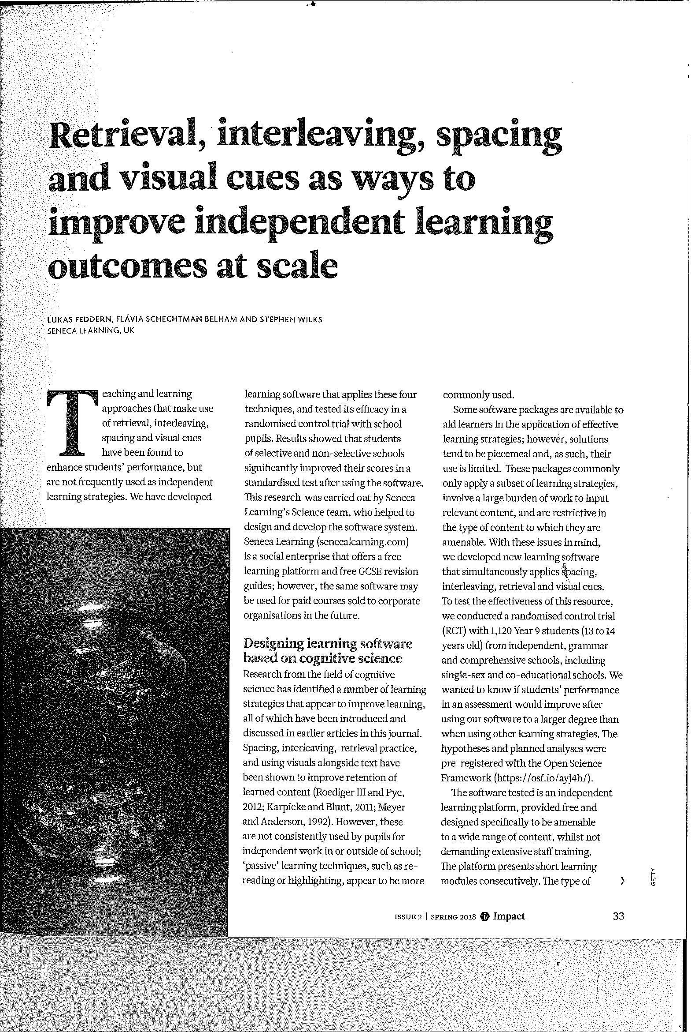
Article form “Impact” journal Spring 2018 – The Science of Learning
(Journal of the chartered college of teaching)

Slide 34
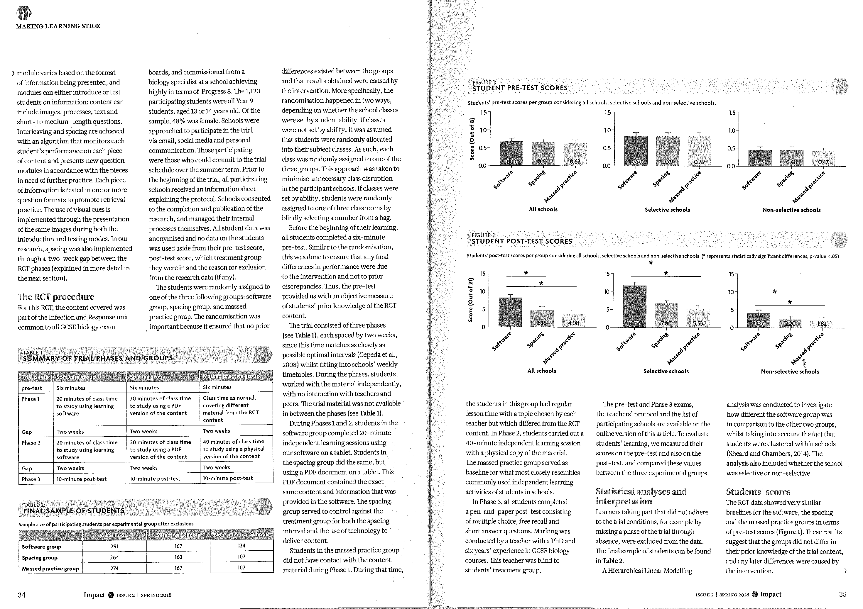

Slide 35
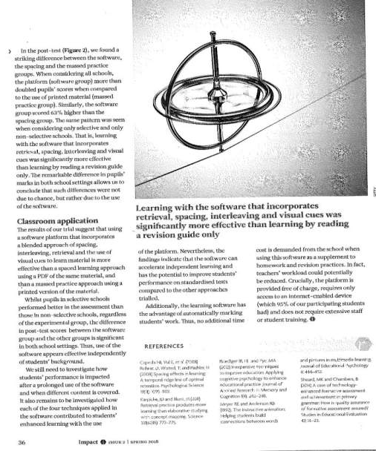

Slide 36
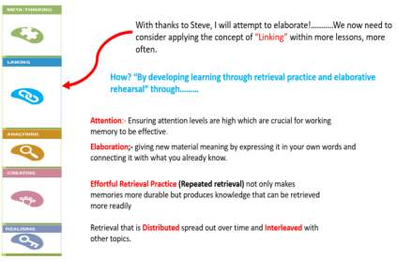
HPL 3 “assessment” (23rd April – 29th June 2018)
Demonstrating how you have developed student learning through retrieval practice and elaborative rehearsal during the summer term with at least 3 classes (secondary); or with 3 different areas of learning (primary).
Expectation:-
1. All teaching staff to attend a 30 minute HPL Group meeting early this term (next 2 – 3 weeks after digesting the theory) to:-
a) reflect further on HPL2 and the reflective questions (Slide 7 )
b) discuss the concept of “Linking”, particularly the theory provided by Steve Sheehan, the video content, the articles and the key words (Attention, Elaboration and Effortful Retrieval Practice)
c) begin to consider how elaborative rehearsal opportunities can be implemented and EFFORTFUL retrieval practice applied.
2. Attend a 30 minute HPL group meeting after May half term, to discuss and share
effective strategies implemented to date and to consider points 3a / b and 4 below. (We are Magpies!).
3. Either:-
a) Use Iris to record “effortful retrieval practice” in action with a group or groups and share clips via Iris connect with your
HPL group and HPL LT Link.
Or
b) Email your LT link with 3 different strategies you have used with different classes to encourage
elaborative rehearsal / retrieval practice. (Please include the resources developed where applicable).
4. Email HPL LT Link a 200 word evaluation of the impact this approach has had on your students’ learning over the
summer term. Points to consider may include:-
How did students respond to the opportunities you provided to elaborate / retrieve?
How did you ensure that strategies were interleaved, distributed and effortful?
Were any of the strategies more effective than others and why?
Did you notice an improvement in knowledge retention of the students over time?

Slide 37

…….and finally, to be effective, don’t forget to look after yourself too!!
https://www.ted.com/talks/robert_waldinger_what_makes_a_good_life_lessons_from_the_longest_study_on_happiness

Slide 38
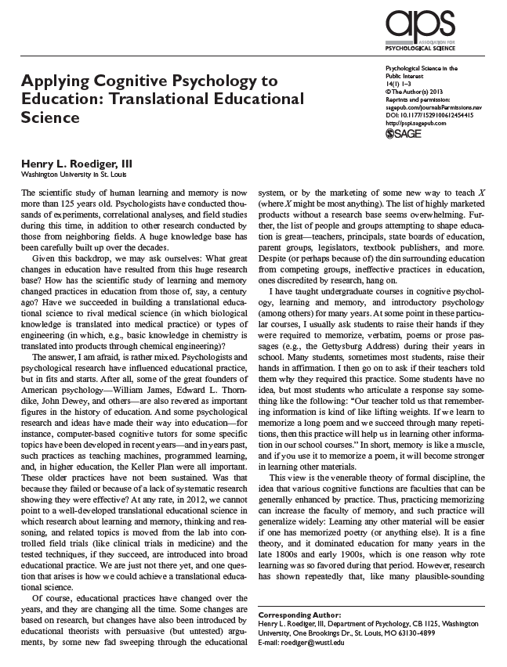
Further Reading
(as recommended by Steve Sheehan)

Slide 39
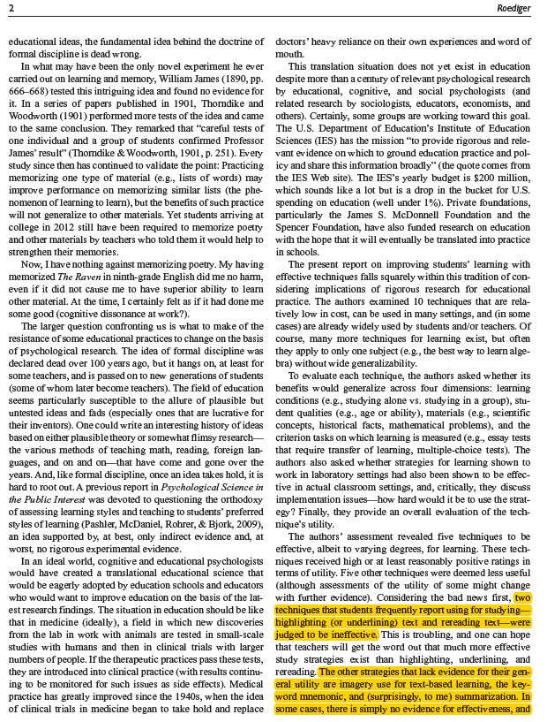

Slide 40
