Slide 1
CCS Remote Learning Guide
Being a High Performing ‘Remote’ Learner
Make the most of your online lessons:
Prepare
Respect
Engage
Self-help
Seek help
Warning:​​
Inappropriate, disrespectful or disruptive behaviour during a live lesson could result in you being removed from the lesson and your parents informed.​
​
The lesson will be recorded for the purpose of sharing with absent students. Do not allow yourself to be recorded doing/saying something inappropriate.

Slide 2
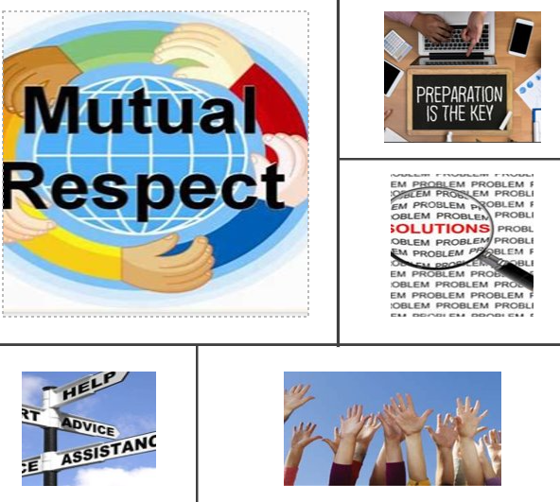
CCS Remote Learning
Being a High Performing ‘Remote’ Learner
Make the most of your online lessons:
Prepare – camera off, on mute, have equipment ready.
Respect – behave appropriately.
Engage – do your best.
Self-help – peresevere and use self-help strategies.
Seek help – ask another student or the teacher for help if you are stuck.
Warning:​
Inappropriate, disrespectful or disruptive behaviour during a live lesson could result in you being removed from the lesson and your parents informed.
The lesson will be recorded for the purpose of sharing with absent students. Do not allow yourself to be recorded doing/saying something inappropriate.

