Slide 1
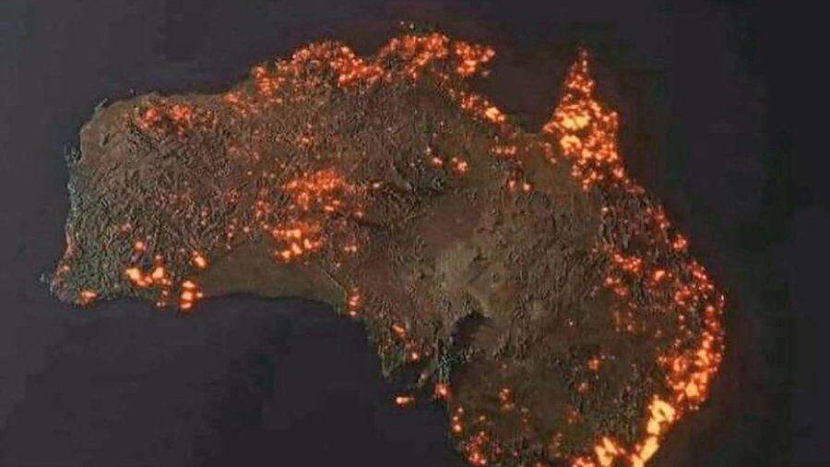
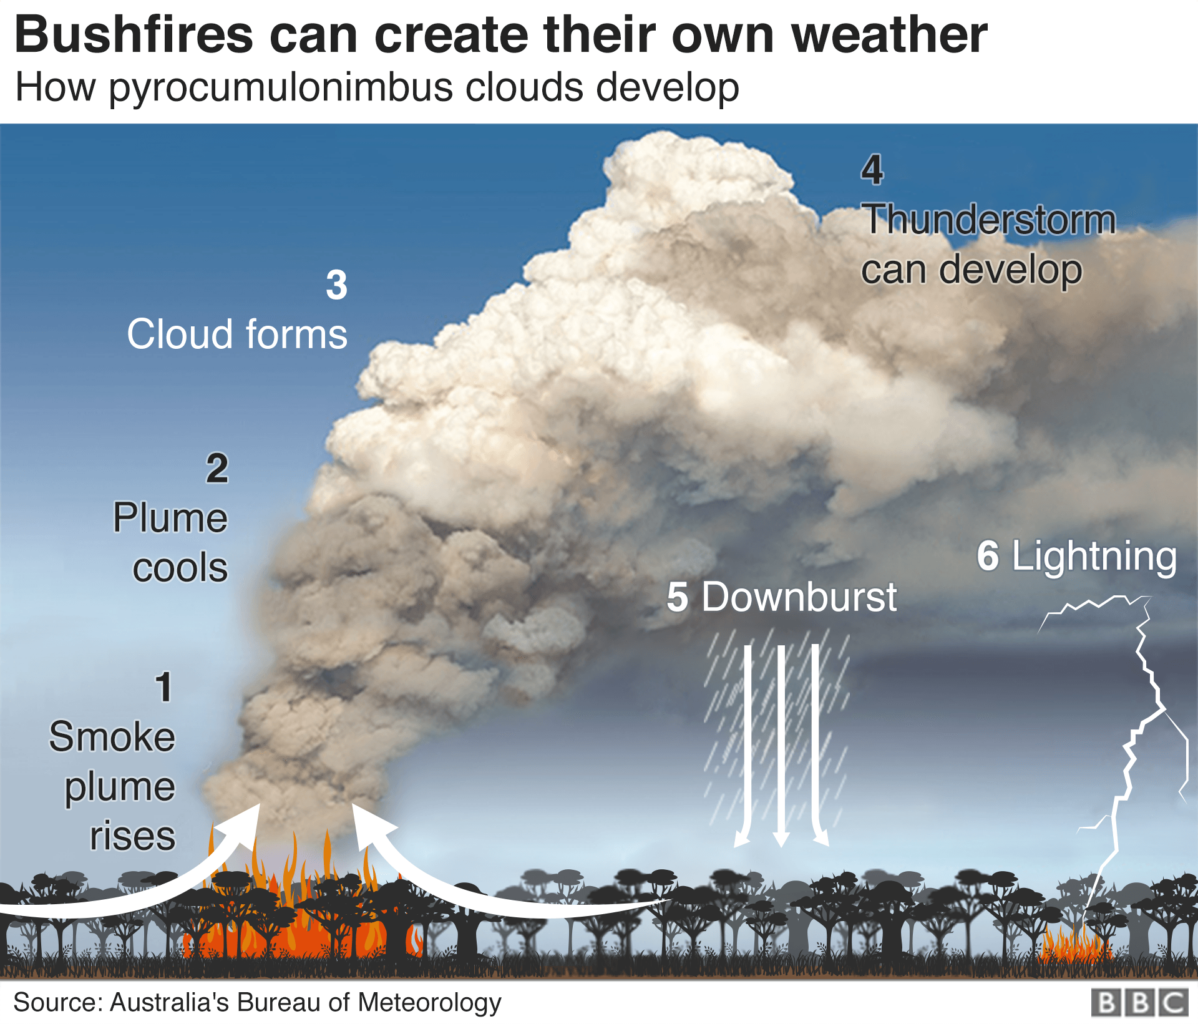
Australia
Needs Us!

Slide 2
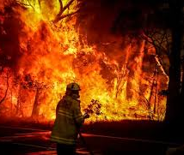
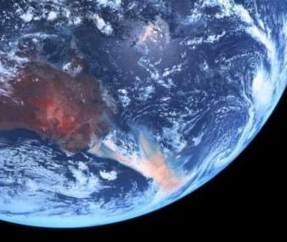
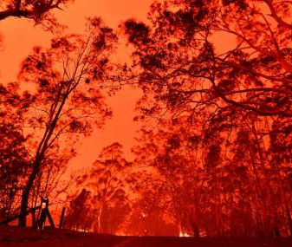
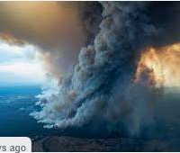

Slide 3
Headlines
At least 24 people have so far been killed - including three volunteer firefighters - and more than 6.3 million hectares (63,000 sq km or 15.6 million acres) of bush, forest and parks have been burned.
In the worst-hit state, New South Wales (NSW), fire has affected almost five million hectares, destroying more than 1,300 houses and forcing thousands to seek shelter elsewhere
"We've estimated that in the three million hectares of New South Wales alone that were burned up until about 10 days ago probably as many as 480 million mammals, birds and reptiles would have been affected by the fires," Prof Dickman said.

Slide 4
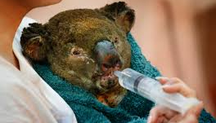
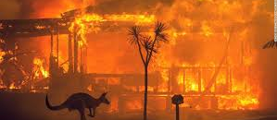
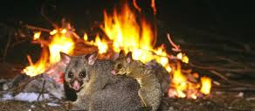
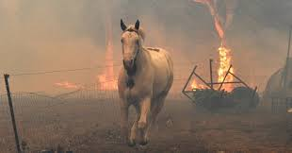

Slide 5
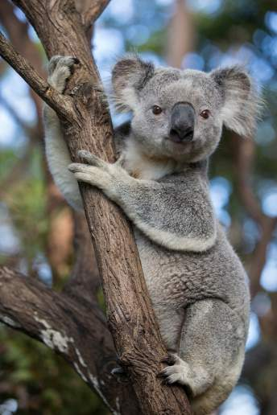
An estimated 480 million animals have been killed in the New South Wales alone
Koalas Were Already on the Brink in Australia – there isn’t enough numbers to support the next generation
Kangaroo Island bushfires: grave fears for unique wildlife after estimated 25,000 koalas killed

Slide 6
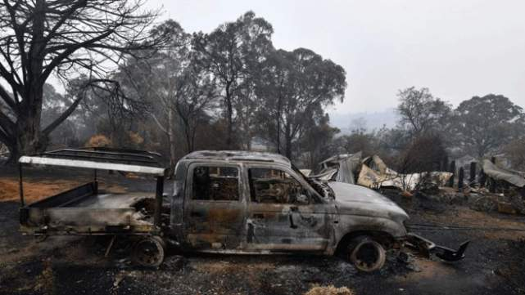
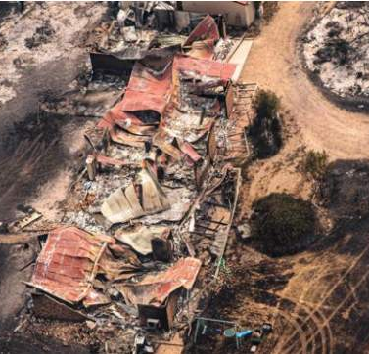

Slide 7
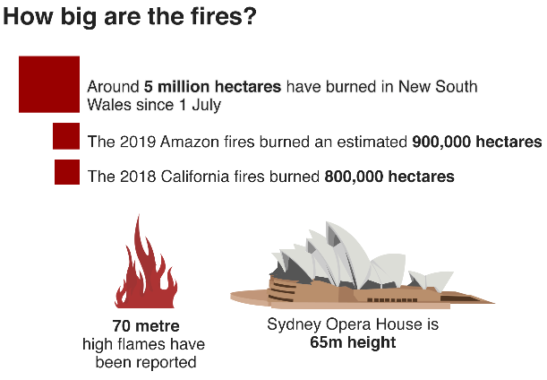

Slide 8
How can we help?
You are all being challenged to raise £2 each by completing
5 miles of running and/or walking
during our
‘Charity Week’

Slide 9
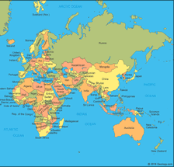
Why 5 miles?
Northampton Sydney = 10,556 miles
2,000 students at CCS 2,000 x 5 = 10,000
250 staff at CCS
250 x 5 = 1,250

Slide 10
Our Target
£4,000

Slide 11
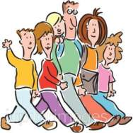
Activities 27th-31st January
On Monday 27th January
(official ‘Australia Day’) the WHOLE school
will be completing a 1 mile walk
During PE lessons that week, EVERYONE
will be completing another mile which
you can either run or walk
On Friday 31st January Primary are
being challenged to ‘Dance All Lunch’
at a disco in the Primary Hall.

Slide 12
So that’s 2 of your 5 miles completed!
How can I do the other 5 miles?
Walk to and from school all week
Walk your dog (if you have one!)
Go to Salcey Forest
Walk around the nature trail at lunch times

Slide 13
Sweets & Aussie Themed Cakes
Monday 27th
Friday 31st

