Slide 1
High Performance Learning: The World Class School’s Award
3rd January 2020
Melanie Saunders, Anne Howells and Carrie Beech
Notes:
Key messages at the start:
I work for a social enterprise that works with schools to move from good to great. We work on a philosophy based on my academic research which provides a basis or framework. Its not a programme, it is a lens or structure through which to think about your school
At GEMS schools you are ambitious and that is wonderful – I hope this talk may help you in your quest to be great.
I am going to introduce some demanding ideas and challenge some orthodoxies. But most of all I am going to ask you to think about students and their learning.

Slide 2
This Morning’s Programme
8.50 – 9.20
Revisiting the Principles of HPL
A presentation to refresh for those who know and clarify for those who are unsure.
9.20 – 10.00
Visioning the Future
An interactive exercise to think about what benefits we expect from HPL for our students and ourselves.
10.00 – 10.30
Break
10.30 – 11.30
Focus on one ACP Group
Exploring some practical applications of the Metathinking or Linking ACPs in class
11.30 – 12.30
Focus on one VAA Group
Exploring some practical applications of the Empathetic or Hardworking VAAs in class
12.30 – 13.00
Lunch

Slide 3
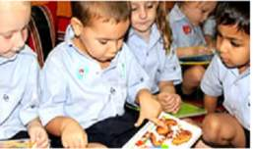
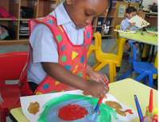
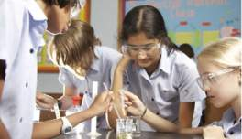
What is High Performance Learning?
High Performance Learning is a research-based, pedagogy-led philosophy that sees everyone as a potential high performer.
It uses a unique teaching and learning framework to systematically develop the cognitive skills, values, attitudes and attributes needed for lifetime success.

Slide 4
High Performance Learning: the basics…
High performance is an attainable target for everyone.
We can systematically teach students how to be ‘intelligent’ and how to succeed in school and life.
We need to develop, methodically, the cognitive competencies associated with cognitive success and make them the DNA of our teaching.
There are 30 generic competencies students need to develop and these can be grouped into 8 sets. The more competent students are in each of these the better they will do.
Although these are generic competencies they are best developed through subjects.
This is a teacher agenda. It happens in the classroom in the hands of a skilled teacher. It is not a one-size-fits-all ‘programme’ to be followed.
Hence schools need to foster a professional community of practice among their educators – no quick-fix, governance model, instructional technique or technology can substitute for this.
Notes:
Set 1 – we know its possible so that is our goal
Set 2 – we know how and need to establish this methodology in our classroom/s and embed it
Set 3 – it’s a teacher’s responsibility to work out how to best develop these competencies as a part of their day to day practice what holds back individuals from achieving this competence.

Slide 5
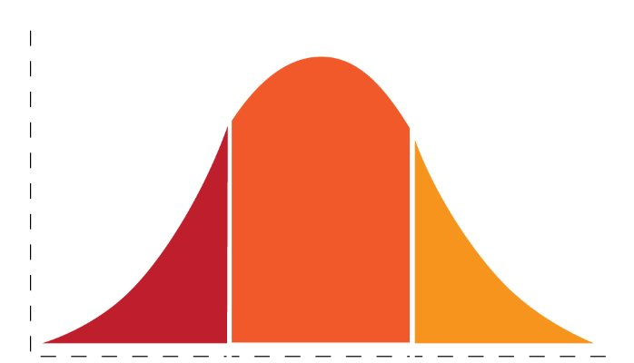
Let’s Banish the Bell Curve Away from the Classroom
Low ability Average ability High Ability
Notes:
So lets banish this old fashioned thinking from our minds and instead…

Slide 6
Life moves on…
“Imagine telling a parent now that their son is pre-ordained to do better at school in ‘hard’ subjects, or indeed any subject, than his sister because of some kind of natural law.
The truth is that schools and parents have changed their perspective and expect girls to do as well at school as their brothers, if not better, in all subjects. And that has happened in a single generation.
The same is possible for children of all kinds regardless of their social starting point.”
Parents and schools simply have to act on it and expect no less.
Notes:
If you think its difficult to imagine the unimaginable think gender

Slide 7

What does research tell us?
Its possible for almost all
of us to achieve highly
Notes:
Want to start by saying that….. Not sure we have altogether realised the implications of this but some teachers have and it is changing their practice.

Slide 8
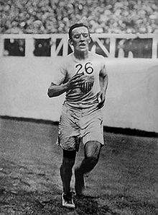
What do we know about human capability?
In 1908 Jonny Hayes ran the marathon in 2.55.18 – A new world record
London 2018 – who beat Jonny Hayes time?
1,319 people
Including 35 women
And Angharad Mair, a presenter on S4C, in a time of 2.54.49
She’s 57 years old

Slide 9
What explains this?
People understand the importance of diet, rest, psychology
We know how to train … the long run; tempo training, intervals, hill work … and so on!
Its what people do, they see other people do it, they have higher expectations of themselves and of others
They prepare and plan for success
They believe that hard work will help them to improve
They have the support and encouragement of others who believe in them
Why, then do we struggle to believe the same for academic high performance?

Slide 10
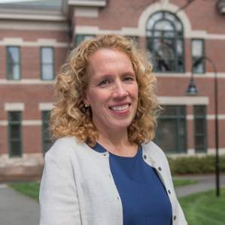
“
We can grow our intelligence
“
A key breakthrough in our knowledge of the brain in this century is that brain structure and function is not fixed and unchangeable, and not the same irrespective of context or culture.
It is, in fact, exquisitely plastic, mouldable by experience throughout life. It is also ‘permeable’, responding to social attitudes and expectations, as is shown by brain-imaging studies of stereotype threat.
(Wraga et al., 2006).
Notes:
We can improve intelligence because the brain is mouldable and more plastic than we thought. (Thanks Neuro-science for demonstrating why we can make people more intelligent).
Think about that for a moment… what does that imply for us in education

Slide 11
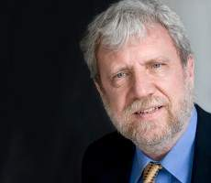

How ambitious should we be?
Takes some longer to get there…
K Anders Ericsson
“Talent” is grotesquely overrated. Deliberate practice is the secret to excellence?”
Its not ‘I can’t. Its ‘not yet’
Notes:
Well according to Angers Ericsson everyone can be a high performer. He has proved that you can take random groups of people and train them to be experts in any domain of your choice.
So maybe we could all be high perfromers.

Slide 12
“We need to move from ‘some students learn at high levels to ‘all students learn at high levels’.”
Andreas Schleicher OECD
Notes:
Want to start by saying that….. Not sure we have altogether realised the implications of this but some teachers have and it is changing their practice.

Slide 13
HPL Student Profile

Slide 14
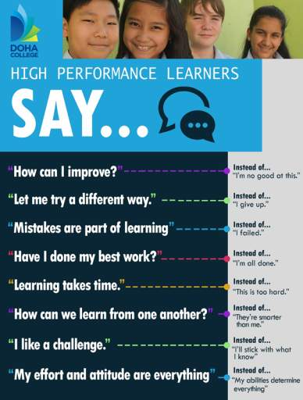

Slide 15
Creating High Performance Learning classrooms
Notes:
Want to start by saying that….. Not sure we have altogether realised the implications of this but some teachers have and it is changing their practice.

Slide 16
The 7 Pillars of High Performance
Notes:
So if we bring this all together….
As we talk this through you will probably think I am doing some of this already and that is correct but the key is that this is like the picture on the front of the jigsaw box. You already have some pieces in place but this helps you understand what is missing and when you put everything together you have a wonderful picture and that is what is needed if you are to actively create more high performers.

Slide 17
Flow - Csikszentmihalyi
Anxiety
In the zone
Centred
On a roll
On fire
Flow
Flow
In the groove
Wired in
high
Challenge
Apathy
Boredom
low
low
Skill
high
Notes:
Striving brings more satisfaction than just doing the easy work

Slide 18
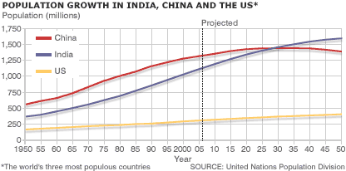
The Harder Path?
We could ask….
Write a short report to describe what the graph is showing
What might explain the projected decline in the population in China from 2015?
What else?
Why?
What could we ask?
What was the population in India in 1990?
Which country is projected to have the largest population by 2035?
Closed comprehension

Slide 19

Students who know what it takes will become high performers ….
Performance mindset
Knowing I can do well
Seeking out challenge
Valuing my strengths
Requesting and giving feedback
Knowing I have the potential
Assuming I will achieve my goal
Realising success comes from effort
Notes:
Click to pull up the first list and ask for comments from delegates. Do they accept these statements as evidence of a Growth Mindset and how do they encourage this in their classes?
Click to pull up the second list. What are the differences? Do they think the second list is achievable? Desirable?

Slide 20


The key competencies to be developed
Notes:
So lets drill down to some detail. In HPL there are two types of competencies you need to help pupils develop and pupils need to develop them through regular and frequent practice in their normal lessons.
The two types are mutually reliant. Like the double helix, one is no good without the other. We need to enable pupils to develop the full range. Both ‘Thinking’ and ‘Behaviours’.
They have been proven to be the basis of advanced cognitive performance.

Slide 21
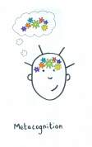
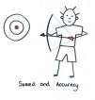




HPL builds ‘Advanced Cognition’
Notes:
We do it through systematically developing advanced cognition

Slide 22
ACPs and VAAs: the basics…
They are the result of a meta analysis of research into how people become successful – the central tools of HPL.
2 types and they are equally important.
These competencies can be developed through teaching.
They are located in subjects/phases - not taught independently.
Must be systematically and overtly embedded through frequent and regular practice.
6. 30 of them grouped into 8 thematic sets.
7. Progression in each deepening over time. Not age related.
They create the shared language to understand and replicate
high performance.
Notes:
Talk the group through these one at a time. Not a ‘pick and mix’ set of competencies and habits but a set that need to be developed in its entirety. Using the different competencies should not be confusing, difficult or onerous.

Slide 23
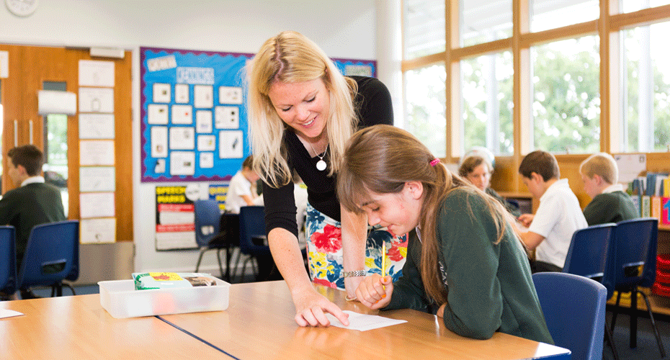
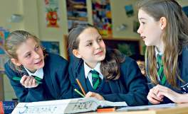
Growing Minds
Deliberate and systematic teaching
Frequent and regular practice

Slide 24
How to escape the Black Death
‘Think like a Historian’
The impact of immigration over time.
What if Germany won WW2?
Creating
Meta-thinking
Linking
Realising
Analysing
Meta-cognition
Connection finding
Critical or logical thinking
Automaticity
Precision
Complex and multi-step problem solving
Generalisation
Imagination
‘Big picture’ thinking
Seeing alternative perspectives
Abstraction
Intellectual confidence
Evolutionary or revolutionary thinking
Originality
Fluent thinking
Flexible thinking
Intellectual playfulness
Self-regulation
Strategy planning
Speed and accuracy
The importance of history in modern European politics
Precise, accurate reasoning to understand and present an argument
Wide general knowledge
Decision making exercises
Grasp of examples and detail
Notes:
Might look a bit daunting but it isn’t really. You know all this – we are just putting it all together.
24

Slide 25
Lets play BINGO…

Slide 26
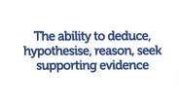
ACPs (Ways of thinking)
1
2
3
4
5
6
7
8
9
10
11
12

Slide 27

Growing minds involves…..
Introducing and using the high performance concepts
Removing the mystery
Establishing the performance mindset
Teaching the idea of concepts
Naming and using the concept language – making it visible
Grouping the concepts
Show and tell when using the concepts
Planning curriculum and lessons that use the concepts
Rewarding the use of the concepts
Notes:
Click to pull up the first list and ask for comments from delegates. Do they accept these statements as evidence of a Growth Mindset and how do they encourage this in their classes?
Click to pull up the second list. What are the differences? Do they think the second list is achievable? Desirable?

Slide 28
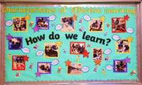
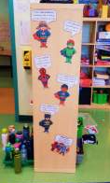
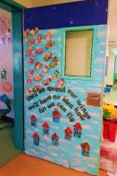
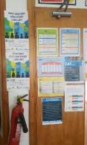
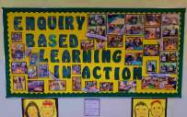
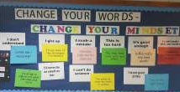
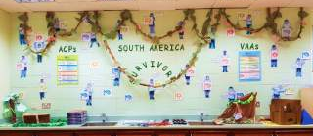
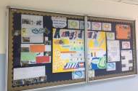

Whole-School
Visual Presence
HPL has evidently been made part of everyday learning by our teachers in the form of:
1) Strong visual presence with HPL corridor, door and classroom displays; creatively connecting curriculum content to HPL.
HPL VAAs and ACPS also present across Secondary classrooms, with corridor and door displays underpinned with HPL learning.

Slide 29
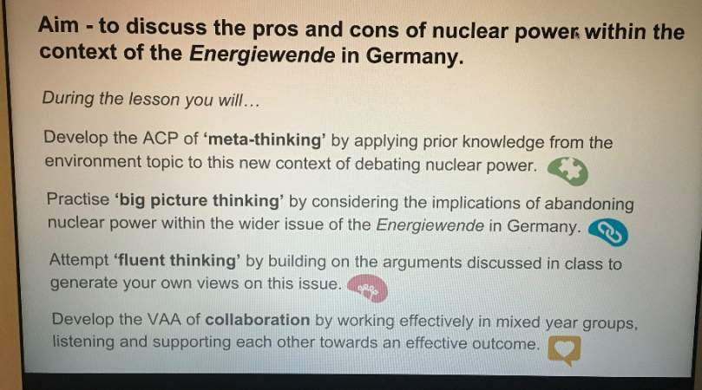
Through Teaching…

Slide 30
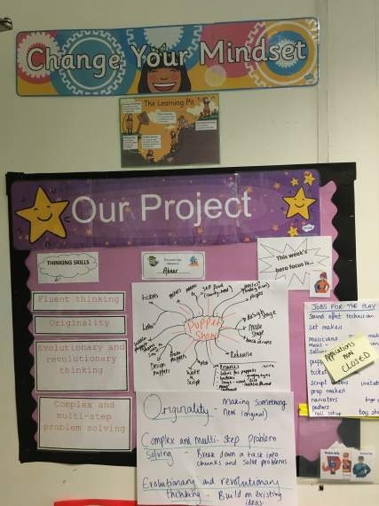
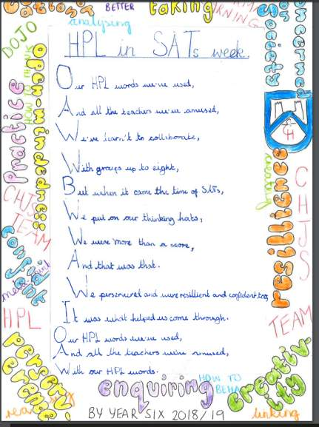
Castle Hill Primary School
Year 4
Year 6

Slide 31
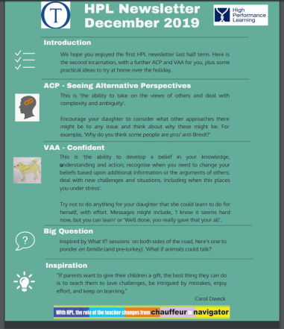
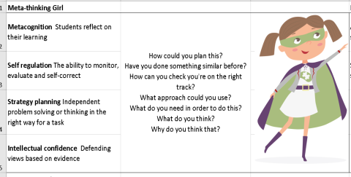
Tormead – Parent Newsletter
Engaging Parents
Westbourne House – Cards for Parents

Slide 32
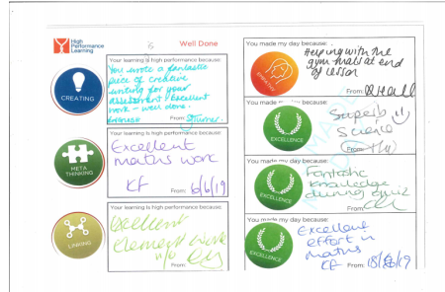
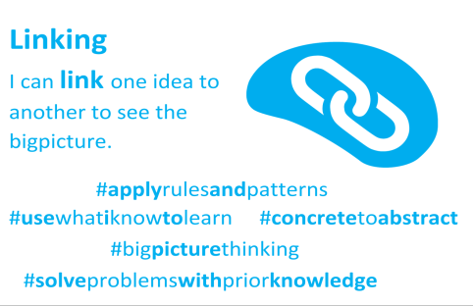
With Students….
Mount’s Bay – Pupil Passports
St Swithun’s - Hashtags

Slide 33
Visioning the Future

Slide 34
What changes in an HPL school ……..
Professional practice
Teacher
Beliefs
Student outcomes
Students
Self-belief
Approach to learning

Slide 35
Task
Visioning the Future
Put the heading Adults on one piece of paper and the heading Children on the other
On individual post-its, write what you will see when HPL is fully embedded in your school.
Stick all the post-its on the relevant page and lay them out on the table
Take four coloured dots and put them on the four things you think are the most important indicators of success
Which of these are you seeing (or beginning to see) in your school?

Slide 36
What will we see when HPL is working?
Re-invigorated teachers and teaching
Excited about developments in the classroom
More varied/risk approaches being taken in the classroom
Shared language to describe learning and better sharing of ‘what works’
Common room chat about achievement rather than failure
Evangelists for HPL
Higher expectations of all children
A common language (ACPs/VAAs) spoken everyday
Sharing ideas about how to teach and where to start ‘The Big Picture’
No fear of making mistakes
Better feedback and responses
Cakes and wine on Fridays
Adults

Slide 37
When HPL is working…
Improved academic outcomes
More happy, confident children
Fewer children who ‘opt’ out, won’t engage
‘Stickability’
A wider enjoyment of intellectual pursuits
They are better at learning by self-regulating
Students will feel confident that they can work through whatever challenge faces them
No fear of working on mastery of basics
Student who can make links between subjects and between extra-curricular & curriculum
More active participation in lessons/ownership
Student believing the can do anything in any subject
Students love their subjects- All of them
Student who don’t panic when a question on the exam paper is one they haven’t prepared for
Students who think beyond their school/town to consider global or national issues
A tangible joy of learning from staff and students
Students

Slide 38
Break
Group A – Metathinking & Empathetic
Group B – Linking & Hardworking

