Slide 1
High Performance Learning

Slide 2
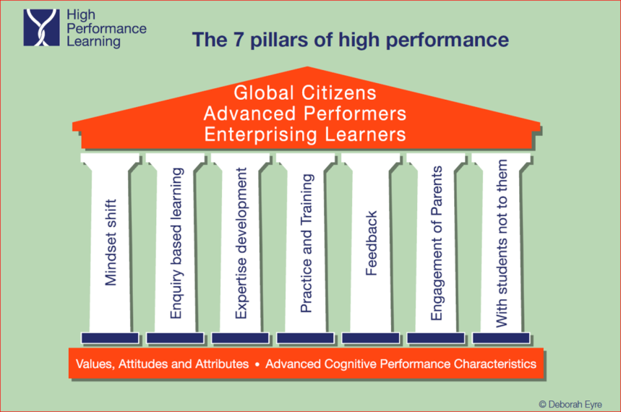
Notes:
ACPs and VAAs form the language and basis of high performance there is a range of factors that help to ensure that when building strong Cognitive Performance (ACPs) and Behaviours – Values, Attitudes & Attributes (VAAs) the best possible climate for success is created.
These are called Supporting Pillars - 7 Create the climate (how it feels within/part of the organisation)
Pillars – At first glance many resonate strongly with existing pedagogy – no surprises, focused on learning, familiar (we each may have particular understanding/experiences of each one – good and not so good?) Pillar metaphor/story to example significance of firm, supportive framework for developing cognitive performance and instilling positive values and attitudes. Rome wasn’t built in a day! Committing to building our world class school together. A pillar at a time! Starting with the fundamental key to success – mindset that with right opportunity, support, teaching, student effort– all can achieve higly Link with ACP Meta-thinking /Cognition
* MINDSHIFT – Familiar, we have already begun to invest in considering the importance of mindset and the growing research evidence that suggests that basic abilities can be developed - Experts are not born that way, but can be made. Fixed/Flexible mindset. HPL assumes that almost all children and young people can achieve highly. We know that shift happens ….. Do we believe this? When you change your mindset , adjust your expectations and come to believe that everyone can be a high performer – doesn’t happen by chance. Right educational opportunities – may not all achieve the top during pri/sec experience but all have had the opportunity – no limits learning. Support, help and encouragement Commitment and effort – hardwork Good teaching – essential (What does a Mindset Shift mean to you- Reflection card?) Do we really believe this and are we prepared to take the risks of mindset shift , a willingness to break way from the language of ‘strong’ & ‘weak’ cohorts, once a low achiever, always a low achiever etc. etc. – if not then perhaps this is not the right place for you??? Link with VAA Agile/Enquiring
*ENQUIRY BASED LEARNING ( Not endless projects …… I hear some groan!) Not a question of ‘what’ is taught but ‘how’ it is taught. Not just knowledge but pedagogy. EBL – addresses how the knowledge is secured Curriculum must be demanding and knowledge is vital . Limited knowledge = can’t progress - googling is slow and unable to make connections with existing knowledge to solve problems and aquire new/original ideas Demanding learning begins with a question - the teacher is attempting to encourage the learner to be CURIOUS Not intended as a single pedagogic approach in developing cognitive HPL (phew!) – but using it regularly really helps, encourages reflection Pr EBL Problem based learning – Small scale investigations – projects and research
EXPERTISE DEVELOPMENT HPL is not just about passing assessment tests/ exams – although this is a positive that occurs as a result. Enables students to develop a level of mastery (not new concept) so they can operate independently. Expertise is not just covering the curriculum = habits and behaviours associated with expertise. Thinking like a mathematician, historian, scientist etc. All children and young people are on a journey from NOVICE to EXPERT . Some students will progress more quickly and some may never reach the higher levels. If we can identify the characteristics of expertise in specific areas/subject domains we can consider how best to nurture it. (Ericsson 05)
PRACTICE AND TRAINING When we have route map of expertise leading to high academic performance, how do we ensure that greater numbers of people complete the whole journey? Superior performance can be taught- extended Deliberate Practice plays a significant role. (Ericsson) Experts are experts because they are prepared to put in the work! Perseverance /motivation. Focus on effort and practice not natural ability – Growth Mindset Practice is not the same as experience and doing something repeatedly – Practice is about focussing on improving specifics /weaknesses. Not just practice but the right practice
* FEEDBACK Effective practice is related to good feedback. Need to know what to practice in order to improve. Feedback is not a new idea – becoming much sharper focus since Hattie’s effect work which identifies FB as single most effective classroom intervention. Ineffective feedback is damaging. So what’s different in the HPL framework? HPL feedback must be centred on high expectations, not merely good progress. Students might have made good progress but they still haven’t reach the standard! Feedback is focussed on enhancing cognition (ACPs) but in HPL we must be concerned with character and personality (VAAs) Feedback must also enhance confidence and well – being Incremental growth – not too much too soon to instil confidence not crush it. ( to what extent does our current Feedback policy and practice address HPL high expectations and confidence and well-being?) HPL Feedback can be a real driver for fast progress
ENGAGEMENT OF PARENTS Strong parental engagement is a feature of the best schools. Having parents and school working in harmony can significantly improve the chance of success. HPL stresses the benefits of parental involvement in their own child’s learning at all ages, not just in the school. HPL framework of ACPs and VAAs makes it simple to involve parents in their child’s learning – clear and straight forward. Helps parents to understand and identify barriers.
WITH STUDENTS NOT TO THEM Schooling must be an active partnership between the teacher and the learner – each fully aware of the part they play. Not about about what the teacher does – about what student learns Do we explain the purpose, methods, assessment and their role. Opportunities for students to take control of activities and learning, leading learning Opportunities for decision making, leadership roles
Possibly most challenging pillar? Stifled by external pressure/test/exam led approach
Where does this lead all lead? HPL sets out to create children and young people whose profile includes traditional academic success but it also creates young people who will be further education ready, work place ready and life-ready. Equipped for life and what the future holds. CCS - Thriving and striving school that is always looking to do that little bit better. EXCITING to read that as an All - Through School we are ideally placed because the longer the student is exposed to HPL framework in school the greater the effects are likely to be. !

Slide 3
Notes:
ACPs Advanced Cognitive Processes required for HPL
* Meta – Thinking is ‘thinking about thinking’ Starting with Meta thinking To be successful academic learners you need a repertoire of ways of thinking to make sense of information. Thinking is about being critical, logical, creative
Linking Actively making connections with what you already know, what has worked in in similar circumstances, finding less obvious connections – outside the box
Analysing Reflecting on what information tells you, logical in dealing with it, question ideas and assumptions, taking your time- digging deeper, keep working to build confidence in your findings
Creating Not about whacky off the wall ideas, more about seeing things differently. Every subject is creative (not just creative arts) Essential components include curiosity, openmindedness, imagination and problem solving. We are all creative.
Realising Realising your skills and capabilities within each of the other 4 ACPs so that they become automatic and performed with speed and accuracy and as a result used to optimal advantage.

Slide 4
Notes:
VAAs are the behaviours that link closely to the ACPCs. Research has shown that school will tend to focus on the cognitive learning skills only In order to be effective with HPL the two need to weave together. Empathetic – Collaborative, Concerned for society, Confident. Agile – Enquiring, creative and enterprising, open minded, Risk taking (Interesting recent feedback on school’s lack of risk taking) Hard Working – Practice, Perseverance, Resilience
Some are values that sit within our CCS Values; others are attitudes and attributes that we need to adopt in order to not only become High Performance Learners ourselves but also to guide our students to be High Performance Learners.
*Agile Learning is our first focus. Ability to manipulate knowledge /apply effectively/thinking outside the box. The VAAs under this section complement our work on Meta Cognition and the Pillars

Slide 5
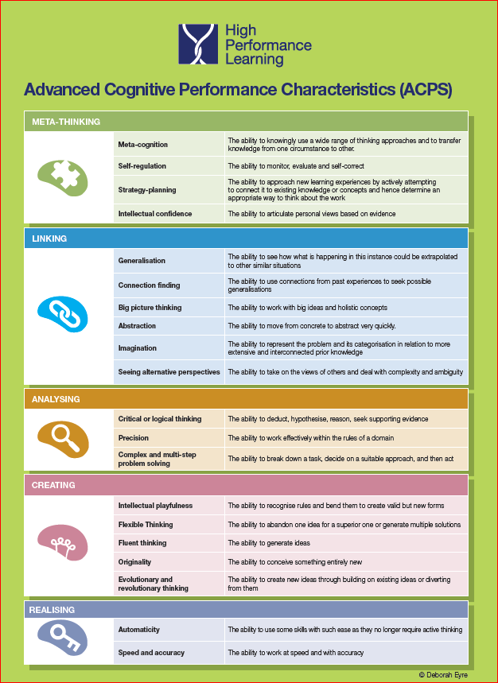
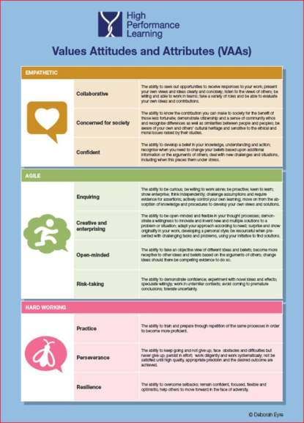

Slide 7
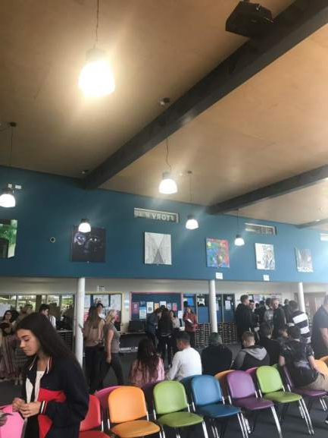

Slide 8
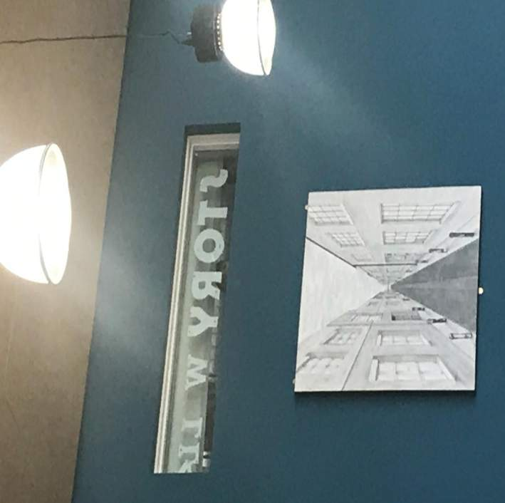

Slide 9
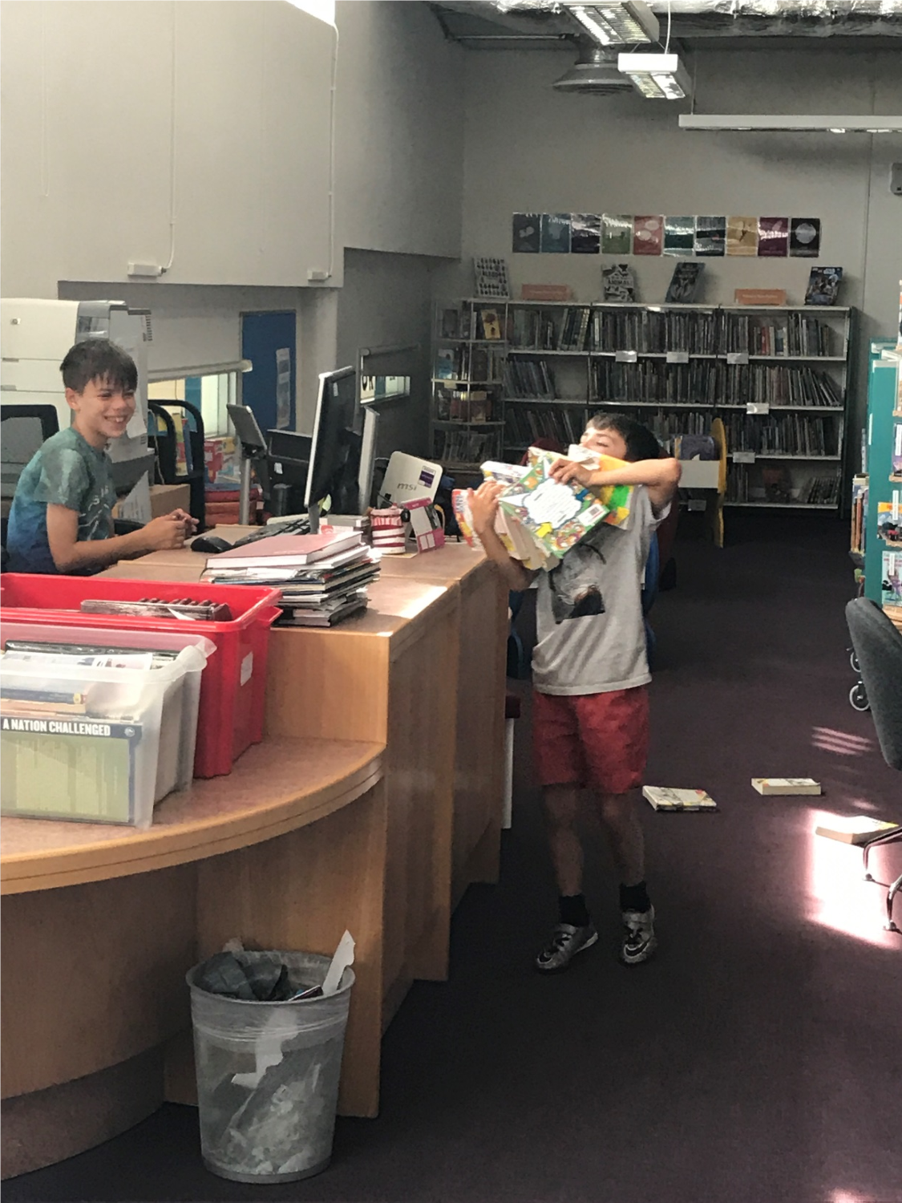
Notes:
Results Day;- So many good news stories.
A high performing Comprehensive School

Slide 10
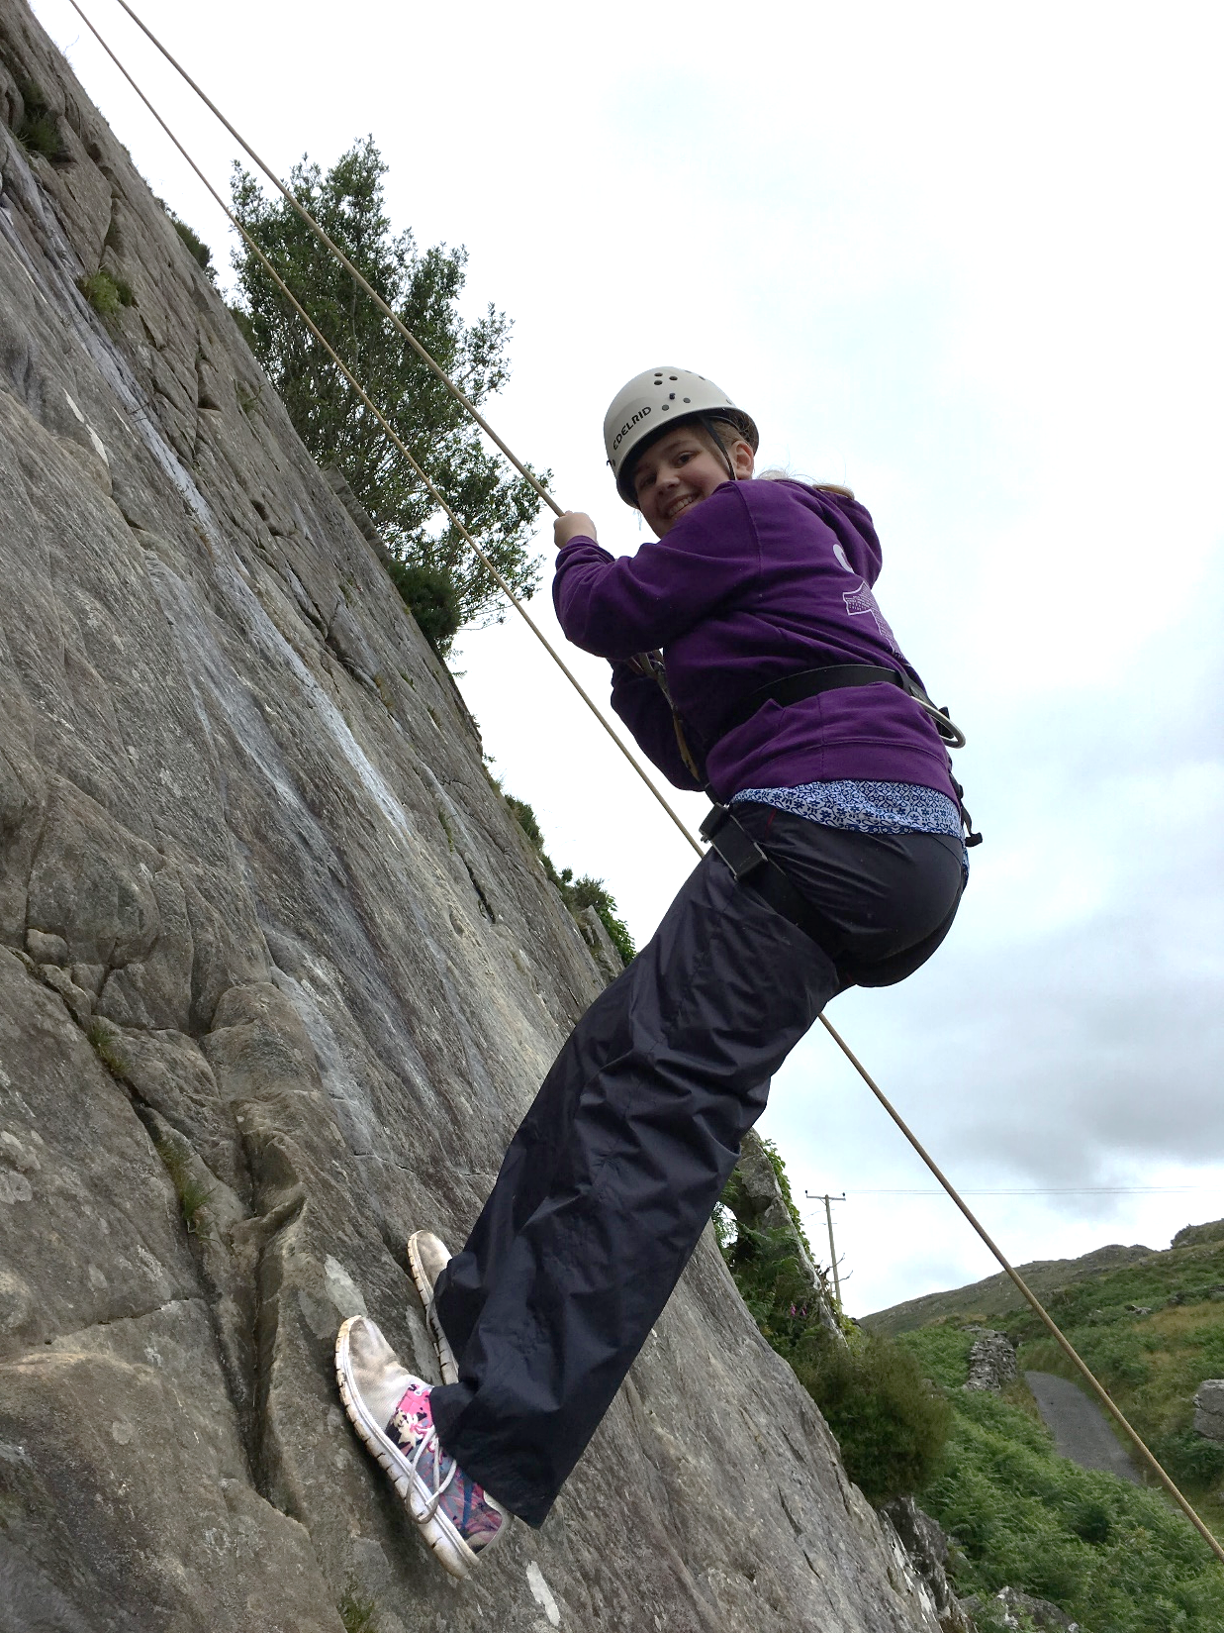
Aimee Scott-Kennedy (PP/LAC) Y6 Background of neglect and abuse. Low/Mid Prior Attainer KS2 Attainment- Excellent Higher standard / Greater Depth in Reading Maths and Writing. Progress – Outstanding

Slide 11
Ollie Pardoe and Scott Pollock
Maths 6 Maths 6
Eng Lang 5 Eng Lang 5
Eng Lit 5 Eng Lit 6
Science B Science B
Sc Add) C Sc (Add) B
PE B PE A
L and T B Art A*
Geog C Geog A
D and T C Bus St. A

Slide 12
Jack White Yr 11
(and mum, Kerry)
Subject | “Prediction” Dec 2015 | “Actual” August 2017
English Language | 4 | 5
English Literature | 4 | 5
Maths | 4 | 4
ICT | D | A
History | D | C
Computing | C | C

Slide 13
Low Ability (Weak) | High Ability (Strong)
Low Prior Attainers | High Prior Attainers

Slide 14
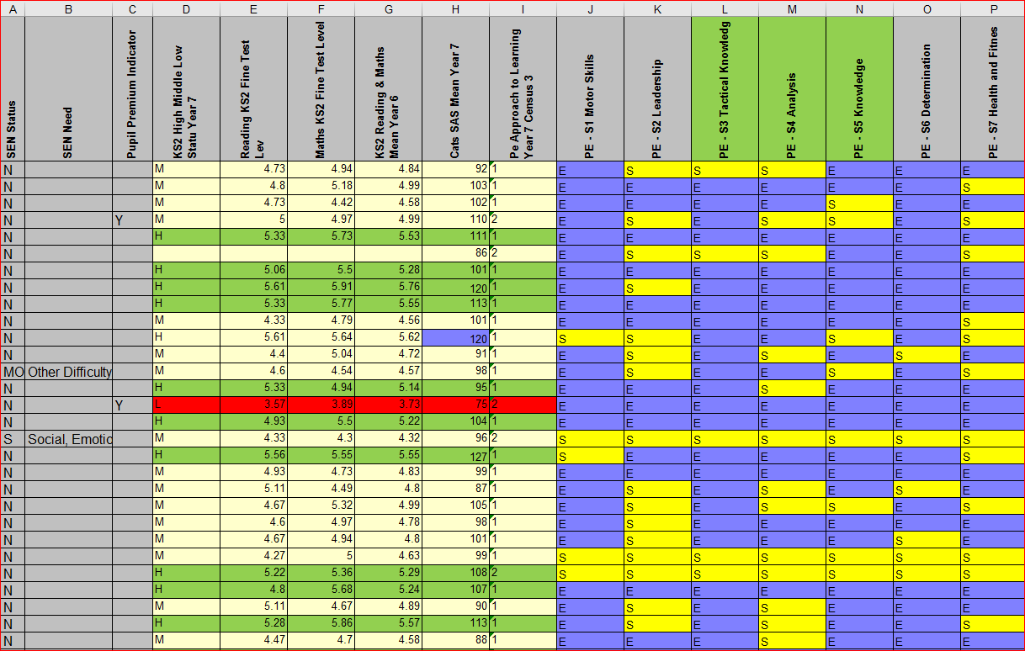
Notes:
Yr 8 “High Ability”….. After reading up on Meta Thinking I Tried extending them well beyond my usual Yr 8 lesson content.

Slide 15
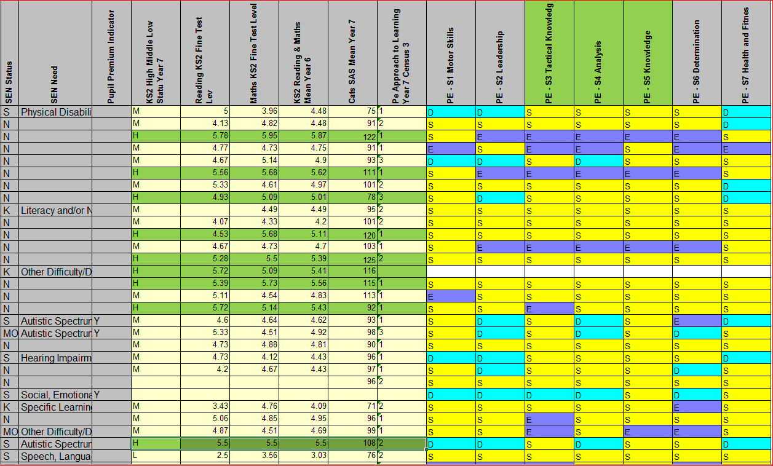

Slide 16
Is our CPD / Professional Learning Programme Effective? Do the PLP sessions have a great impact on the Quality of Teaching and Learning at CCS?
“Too many educators we entrust with the learning of our children do not themselves have high quality learning opportunities.” (Sutton Trust)
Powerful professional learning helps children succeed and teachers thrive. Yet teachers in England and Wales spend less time on CPD than in many other countries. The research evidence is clear that the most important action that schools can take to improve outcomes for students is supporting their teachers to be more effective, and the most reliable way to achieve this is to develop a professional culture where teachers are continually adapting and refining their skills and methods. (Teacher Development Trust 2015)
“More opportunities for collaborative work” (CCS Staff – April Training Day 2017)

Slide 17
Online Learning
The Challenge is how to engage 130 teachers with HPL effectively?
Traditional CPD models are not effective – however research using online learning communities coupled with face to face small group work can have far greater impact.
We have put in place our own online learning platform – using the same technology used by Harvard, MIT, Stanford to deliver their MOOC programme and internal online material.
More interactive than Moodle
Uses video and discussions as its main medium
Teachers can access resources and media and discuss and develop their HPL knowledge
Staff can develop their online portfolio effectively.
We expect the learning platform to be highly effective in working with staff. A parallel system will be set up for students.

Slide 18
We are developing the online course to try to use as much HPL theory and practice as possible – so that the online course itself helps teachers develop their understanding of HPL from a learners front.
Course will be timed – with new content released as we move forward. There will be professional assessed sections.
LT members will work with each HPL group through moderating and promoting discussions on the platform.
Groups will be encouraged to develop content for the course so that best practise is shared.
Unit completion will result in the production of a certificate.

Slide 19
CCS PLP:- HPL in Action 2017-2018
HPL
Groups
Secondary Staff in HPL Groups of 7 – 9 (mixed within “houses”).
Action Research
HPL Groups expected to meet at least twice per half term for 20 minutes; once towards the beginning of a new term and once towards the end of that term.
Submission of Responses
All staff complete and submit their “response” section of each HPL on-line module before the last day of each term. An assigned Leadership Team colleague signs off the responses for one HPL group.
Meeting 1 to discuss the HPL theory and plan potential implementation of the theory within identified lessons.
Meeting 2 to discuss the outcomes of the implementation to date, share experiences and evaluate any impact on teaching and learning.
All modules are linked to a specific Staff Appraisal target for this academic year.
Primary staff in HPL “triads”.
All staff work through a HPL Professional Learning Module during each term (6 – 8 weeks) – Individual logins to be provided.
Each module links to one of the 5 APCs (Advanced Cognitive Performance Characteristics) or 3 VAAs (Values, Attitudes and Attributes).
Staff receive an electronic certificate of completion after each module.

