Slide 1
Winners are grinners!

Slide 2
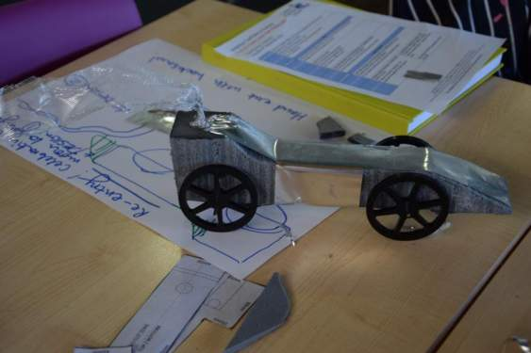
Award for “speed”
Fluent thinking – generating a successful idea
Intellectual playfulness – bending the rules to create a new form
Stephen and Emma
A slimed down design. The narrowest car on the track!

Slide 3
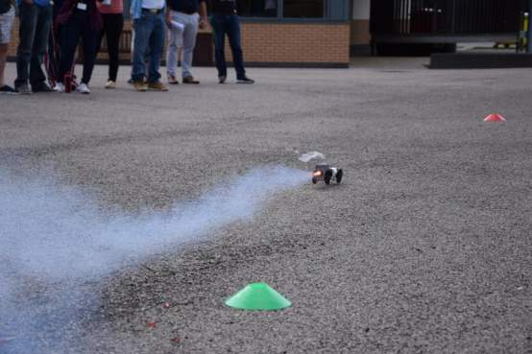

Slide 4
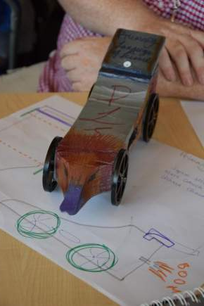
Award for “aesthetics”
Originality – conceiving something entirely new.
Evolutionary / revolutionary thinking – building on the existing idea and diverting away from it!
David’s pick:-
Ushma, Mark and Sophie
The duck billed design!

Slide 5
A special mention for this design and addition of a driver!!

Slide 6
VAAs Award
“Collaboration and perseverance” – Overcame adversity (cutting off the exhaust end of the block), then starting from scratch and managing to get a finished car to the
A special mention to the 3 wheeled effort of Phil and Alex – for those who are not aware, Phil is a member of Leadership and Alex is our new head of Design and Technology! (see video clip!)
Bloopers.mp4
Carolyn, Kirsty and Claire

