Slide 1
Please sit with your fellow “rocket car” builders!
September Training day 2019

Slide 3
Week 4 – Intention, Implementation and Impact
How to connect curriculum, teaching and assessment.
Curriculum constructs (what are students learning)
How do you assess the curriculum constructs?
Responsive teaching – (formative assessment) adapting your teaching as a result of student feedback
Progression model – what is taught specifically to get to end goals.
Assessment is focusing on what is happening in the classroom.
Collaborative conversation:
We asked you to identify two curriculum constructs and then work out how you would assess the extent to which a student knows, understands or could do these things. What were the challenges of doing this?
How, in your current assessment workflow, do you decide which specific parts of the curriculum to target?
How do you currently use assessment to evaluate the impact of the actions and decisions you take in the classroom?

Slide 4
Suggested programme
3.9.19 Week 1: Introduction and perspectives on assessment
10.9.19 Week 2: Making the invisible (learning) visible
16.9.19 Week 3: Harnessing assessment as a powerful learning event (33%)
1.10.19 Week 4: Intent, implementation and impact
8.10.19 Week 5: Assessment process in your context (Reflection task)
15.10.19 Week 6: Using key assessment theory to guide practice
5.11.19 Week 7: Fairness in assessment
12.11.19 Week 8: Theory into practice: selecting and designing assessments
26.11.19 Week 9: Theory into practice: selecting and designing assessments (pt.2)
3.12.19 Week 10: Embedding great assessment in your classroom (Reflection task)

Slide 5
Week 5 Assessment process in your context
Task – to review current assessment practice.
‘Please note that the information you enter here is for your own record, to guide you about thinking about current practice and as such will NOT form part of any assessment of this course.’
It will however be used as part of the school’s appraisal process. When you submit your assignment, you should also save it in the evidence section of your SchoolIp account which is linked to the teaching and learning objective.

Slide 6
Assessment decisions made by others
Throughout the academic year some decisions about assessment are made by middle and senior leaders in line with the school and department policies.
The assessment processes which result from these decisions act as fixed points in the year (e.g. end of year exam). How many of these processes are there for the class you’ve selected?
Answer ____________________________________________________________________________
For each assessment process that you use, consider the following:
1. What type of assessment process is it?
e.g. A set of 30 multiple choice questions
2. Why is this process used?
e.g. To summarise learning throughout the academic year
3. When is the process implemented?
e.g. Once, at the end of the year
Please enter your assessment practice information – if you have more than one assessment process then just repeat the questions making it clear for you when you refer to this in week 10.

Slide 7
Assessment decisions made by you
Throughout the academic year there will be decisions on assessment that are made by you.
How many of these processes are there for the class that you’ve selected?
Answer __________________________________________________________________________
Again, for each assessment process that you use, consider the following:
What type of assessment process is it?
e.g. A set of 30 multiple choice questions
Why is the process used?
e.g. To summarise learning throughout the academic year
When is the process implemented?
e.g. Once, at the end of the year
Please enter your assessment practice information – if you have more than one assessment process then just repeat the questions making it clear for when you refer to this in week 10.

Slide 9
HPL at CCS
1. Why – We are ambitious! We want all students to succeed.
2. How - A consistent approach to teaching and learning within every phase, subject and lesson with the HPL ACPs as the foundation.
3. What – CCS students reaching their full potential, irrespective of prior attainment. (2018-2019 results!)

Slide 10
Provisional KS4 2018 P8 figures - DfE
Progress 8 score = +0.14 ….. this is an increase from +0.06 last year. (figures may go up or down as the DFE have messed up!)
HPA P8 score = -0.02 (HPAs performing roughly in line with expected progress on average – still room for improvement!) MPA P8 score = +0.29 LPA P8 score = +0.33
English P8 = +0.08 (Lead Learners +0.22) Maths P8 = +0.10 EBACC P8 = +0.13 Open P8 = +0.20

Slide 14
Analysing
Critical / logical thinking
Precision
Complex and multi-step problem solving

Slide 16
Linking
Generalisation
Connection finding
Big picture thinking
Abstraction
Imagination
Seeing alternative perspectives

Slide 18
Meta-thinking
Meta –cognition
Self-regulation
Strategy planning
Intellectual confidence

Slide 20
Realising
Automaticity
Speed and accuracy

Slide 22
Creating
Intellectual playfulness
Fluent and Flexible thinking
Originality
Evolutionary and revolutionary thinking

Slide 23
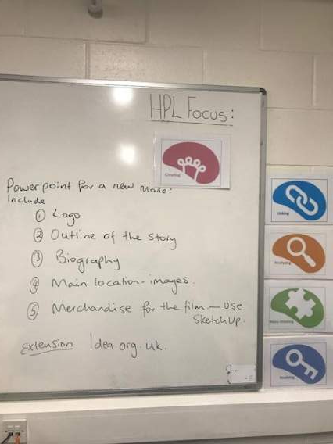
Habitual use of HPL icons and terminology “Every lesson. Every opportunity”
HPL “Bites” – tweaking our delivery to ensure the onus is on the students to think more, do more, analyse more and link their learning.
Learning Scientists study skills (complementing the HPL ACPs).
Also linking to Assessment essentials ‘assessment of process vs. assessment of learning’

Slide 24
English:- Free! Pre reading. L.Q. Can I select a learning task so that I can show my talents in discussion, or vocabulary, or creativity, or debating?
During this unit, we will be studying a drama text – Free! By David Grant.
Before we start reading, you have a list of activities to work through in your pairs. These will help get you thinking of the different characters, plot and themes we are going to study.
In your pairs work through the different tasks and be prepared to feedback one at the end of the lesson.

Slide 25
Visual Art (Photography)

Slide 26
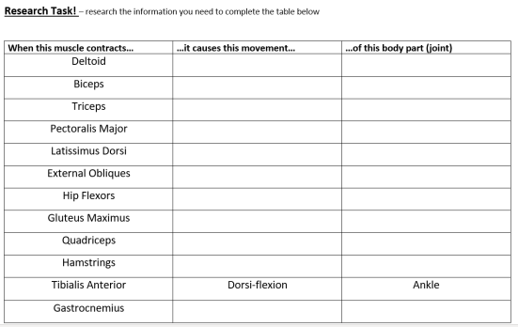

Slide 28
HPL Creating in action……………
Share one of your HPL “creating” resources / tasks /example of student work that you’ve produced / facilitated this term with the colleagues in your group.
Reflections to consider:-
How different was this approach to your usual method in delivering that topic / lesson content?
What impact did task / resource have on the learning of the student’s in your class? How did your learners respond?
Any differences in outcome or levels of understanding to the norm?
- Did the approach allow you to assess the learning taking place? – considering the assessment academy work to date.
- Were there explicit links to other HPL ACPs within that lesson or subsequent lessons?
- Would you use this task / resource / approach again? (why / why not, as applicable).

Slide 29
Shared planning…………
Consider one brief topic / lesson brief content from a current scheme of learning / topic / specification, that you need to teach in the next 2 weeks.
Discuss potential HPL “creative” approaches that could be adopted in the delivery of that lesson / content (from a fresh perspective!).
Can we arrange to make those 44 steps and / or movement to other faculty areas?

Slide 30
Open evening (secondary phase).
Timings –
4:15pm first tour for a 5:30pm presentation
5pm second tour for a 6:30pm presentation
6pm third tour for a 7:30pm presentation.
Route – 6th form centre sign in (Performing Arts based in 6th form centre) . Tour follows route through Lower E, upper E, Upper D, Lower D, Upper C, Upper B, PE department, main hall. Dining Hall available for refreshments.
Faculty Activities – (High student and staff engagement please;)
Facilities shown off in their best light.

