Slide 1
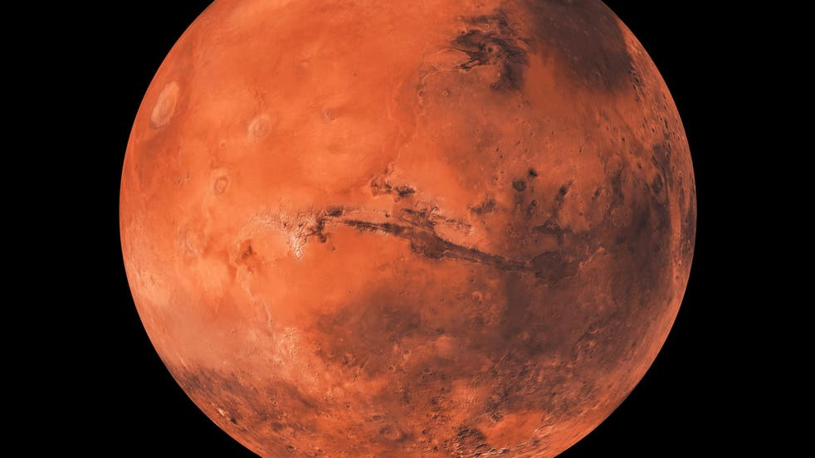
Mars Space Trip

Slide 2
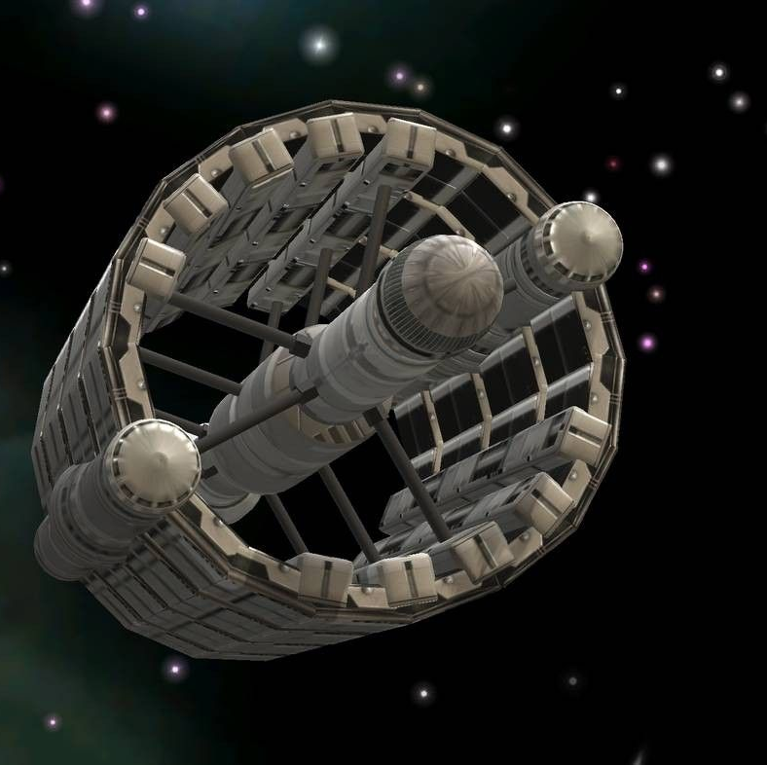
How To Slow Down?
As we approach Mars will release our outer ring (protecting our shuttle) , friction will slows down over 90% but not enough to land safely. We will safety enter the Mars atmosphere and release a parachute to reduce our speed significantly, we will then deploy landing legs and retro rockets this will make us safely land on Mars safely.
Our Spaceship Design?
As a group we have designed our functional space shuttle what will use to get to Mars. This design will be able to transport around 160 people. This number is very special as it is the repopulation number, this will help to colonies Mars. Our ship will contains hundreds of rooms all serving a different purpose, such as: a command post, hydroponic farms, research module, housing, designing room, fitness area and rooms to relax in.
The command post will have control of the ship and make sure everything runs smoothly. They will also make sure that However, the hydroponic farms will be used to help grow food for the colonies. The research module will be used for the astronaut to search up and contact Earth. The design room will be used to build and create objects such as: solar panels, weapons, land rovers and what ever the astronaut’s request or need.

Slide 3
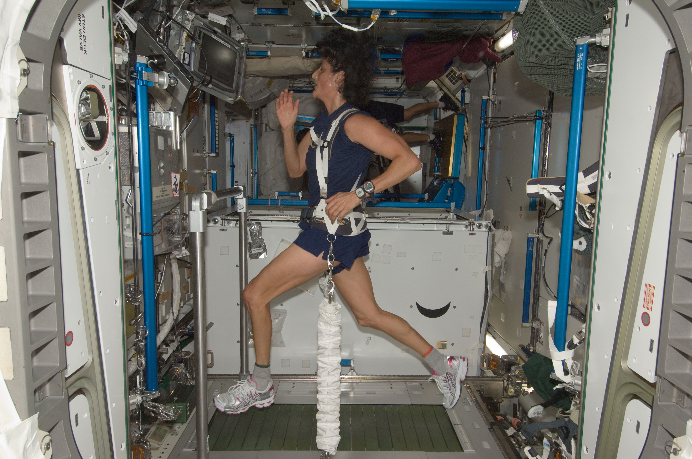
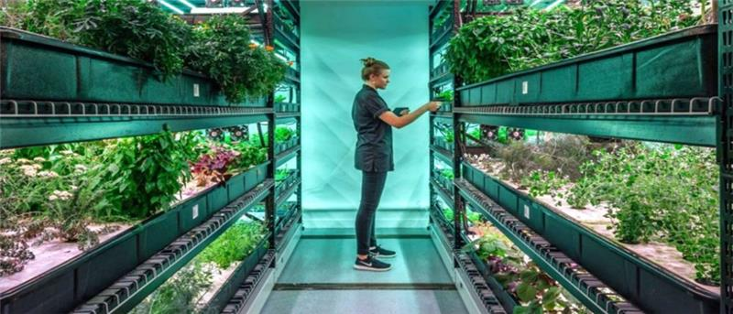
Resources
Almost everything we need is already on Mars meaning we don’t have to send water and materials to have a habitat on mars it could be more cost effective if we send automated robots to harvest resources from the Martian surface and atmosphere in preparation for the arrival of humans. You will need hydroponic farms to grow food. To have clean water we will need to dig up soil that contains ice crystals into heater, so it turns into a liquid. In case of any injuries, we will need to take a first aid kit.
Mental & Physical Wellbeing
Growing weaker ( due to the decrease of gravity) and eye problems (because of fine particles floating round the deck) are 2 of the physical changes you can experience while on Mars. To keep fit on Mars we will need to get the RED –resistance exercise device- system. It is lightweight, portable SpiraFlex technology which creates resistance by storing and delivering mechanical power.

Slide 4
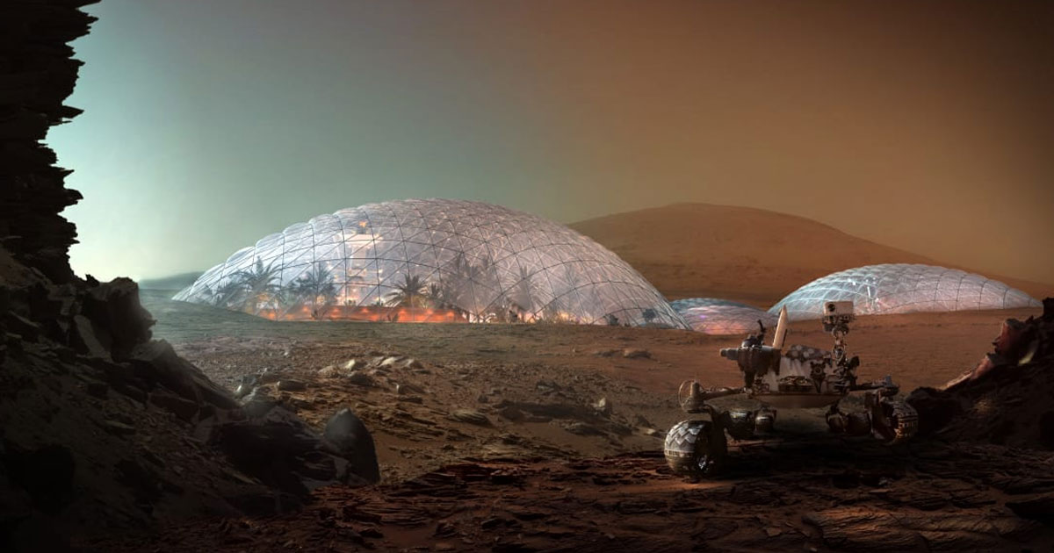
Habitat resources
The main structure of the circular dome that will be our main habitat should be built out of a magnesium alloy, 86% magnesium and 14% silicone carbide particles. This is the worlds strongest and lightest metal and it’s also resistant to corrosion and resistant to dust and sand. The circular structure of the habitat is a sphere so we plan to dig a semi-circle into the crust of mars and place the habitat half into the ground making it resistant to earthquakes and high wind, and the dust storms won’t effect the magnesium alloy. The inside of the habitat will be layered in Styrofoam and then fiberglass to insulate the habitat and keep the heat in. This is because Mars’s average temperature is -60 degrees C.

Slide 5
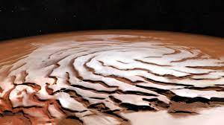
Oxygen/water
We would use an electric current to split the bonds between the hydrogen and oxygen atoms of water, releasing hydrogen and oxygen gas. We would melt the ice at the poles on mars until we have H2o, you would then split the bonds between the hydrogen and oxygen atoms, releasing hydrogen and oxygen. Plants also release oxygen so we could make a plant dome near our main habitat. We would also melt the ice and collect water to purify and drink.

Slide 6
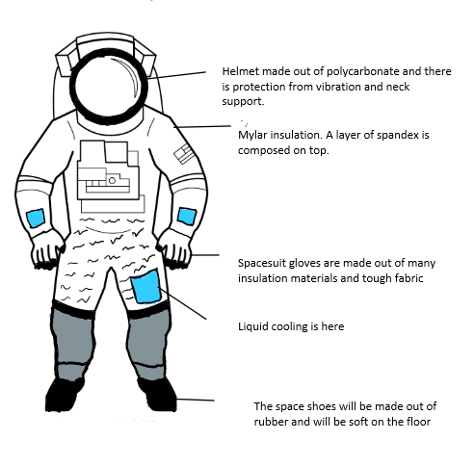
Space Suit

Slide 7
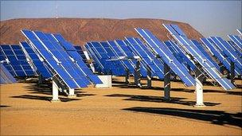
Fuel/energy
When we melt the ice and get oxygen and hydrogen we will collect the oxygen for breathing and collect the hydrogen and burn it later on as a secondary power source. The main source of energy will be solar panels. Solar panels are going to be our main power source. Solar panels consist of silver and silicon. Silicon is found abundantly on mars but silver would have to be brought with us since it is very rarely, if at all found on mars.

Slide 8
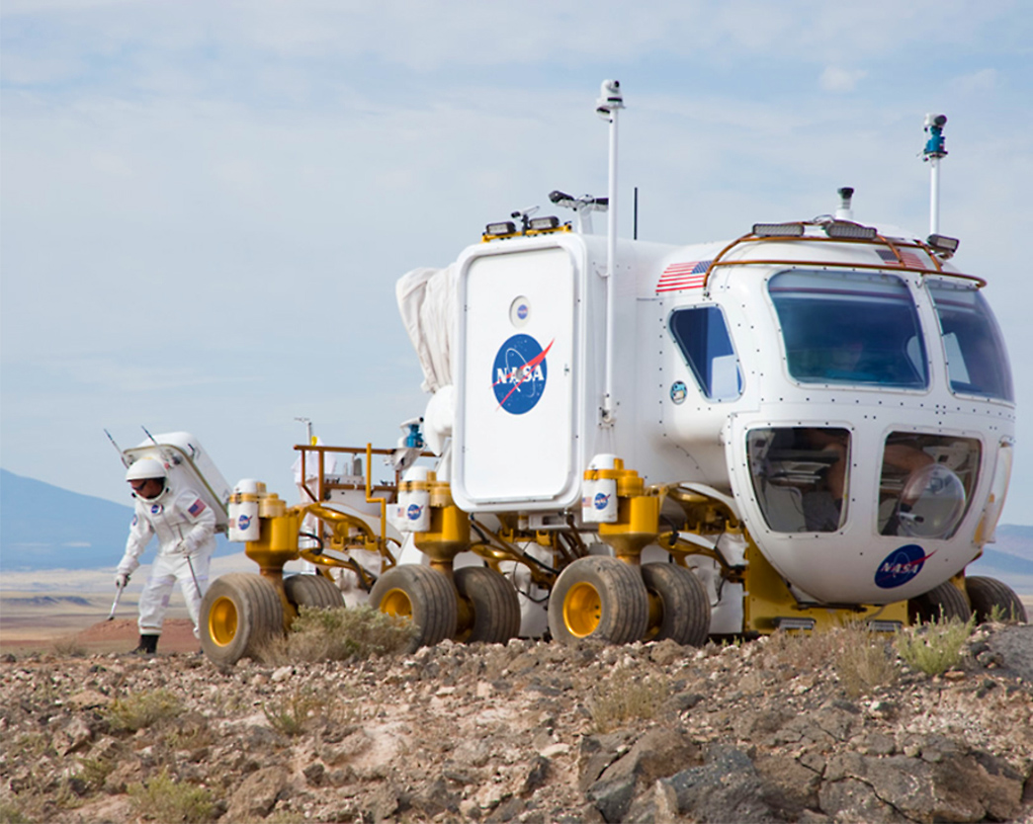
Space rover
Our space rover will be similar to curiosity. We will send it in advance and it will be solar powered so it won’t lose power. It will scout out a suitable location for our main habitat. This location must be near the poles for easy access to water and oxygen. This rover will have cameras and a small drill to collect small samples of mars rock and other things which will be analysed when we arrive later on.

