Slide 1
HPL – student forum
Notes:
Please download this presentation template, do not directly edit on the file in Teams.
If you would like to add a different slide template, go to Insert > New slide drop down > Choose an appropriate template.
Please feel free to delete any slides that you no longer need.

Slide 2
HPL ideas for students, from students.
Remote learning edition

Slide 3
We asked…. What ACP is most difficult to work on whilst learning remotely?
Creating and Analysing were identified as being most difficult to develop.
Possible reasons for this:
Students lacked confidence to ask for guidance when an analysing task was set. The isolation makes it hard to think.
Analysing when a new topic was introduced was most challenging.
Lack of independent thinking skill added to barriers – with the confidence to trust their own judgement or be willing to ‘get it wrong’.
Lack of time to generate ideas.
Lack of resources required for some creative tasks.

Slide 4
What can you do to improve your analytical thinking?
Privately chat with your teacher. They are there to help.
Talk to/contact a study buddy – a friend in the class or in another class. If there is someone at home, maybe run some ideas past them.
Suggest a break-out room or request some time to discuss the concept/theme/idea/character in the lesson.
Be brave! Your interpretation or exploration may not be shared by others. That’s okay.

Slide 5
Analysing prompts…

Slide 6
How to improve your creative thinking.
Make notes, create a spider-diagram, use collages of ideas.
Be open-minded.
Ask to plan with someone else to help you get started.
Trust in yourself and your imagination.
Use a different perspective – look at the issue/topic from a different point of view. (Got to write a poem about ‘Snow’… write as if you are snow!)
Not got the right resources? Find a creative alternative! (Need a green felt tip and it has just run-out… what else is green? An old T-shirt? Food colouring? Cabbage?!!)

Slide 7
Creating prompts…

Slide 8
Want to be better at analysing or being creative?
You don’t need to wait for a task to be given to you. Make analysing and creating part of your day, everyday.
Question what you read. Question different ideas.
Can you rely on that article?
Is that opinion based on fact?
Why did that event on the news happen?
Be creative in any aspect of your life… write fiction or non-fiction, create art, take photographs, make a meal, design your garden, invent!
Be brave and share your thinking/creating with someone you trust.

Slide 9
What VAA are you struggling with?
You said:
It is difficult to be collaborative.
Typing sometimes slows the work down.
You feel limited by being isolated.
It can be difficult to be confident when using chat because your idea are written there for others to see.

Slide 10
How to improve your empathetic behaviours.
Offer suggestions when students are asking for help or ideas in a lesson.
Create your own study group.
Be proactive – have you done anything to help others lately in the wider community? Keep an eye out for charity events or consider doing something to raise awareness on an issue you care about. Go to the House team with your ideas.
If you disagree with an idea… evaluate HOW you deal with that.

Slide 11
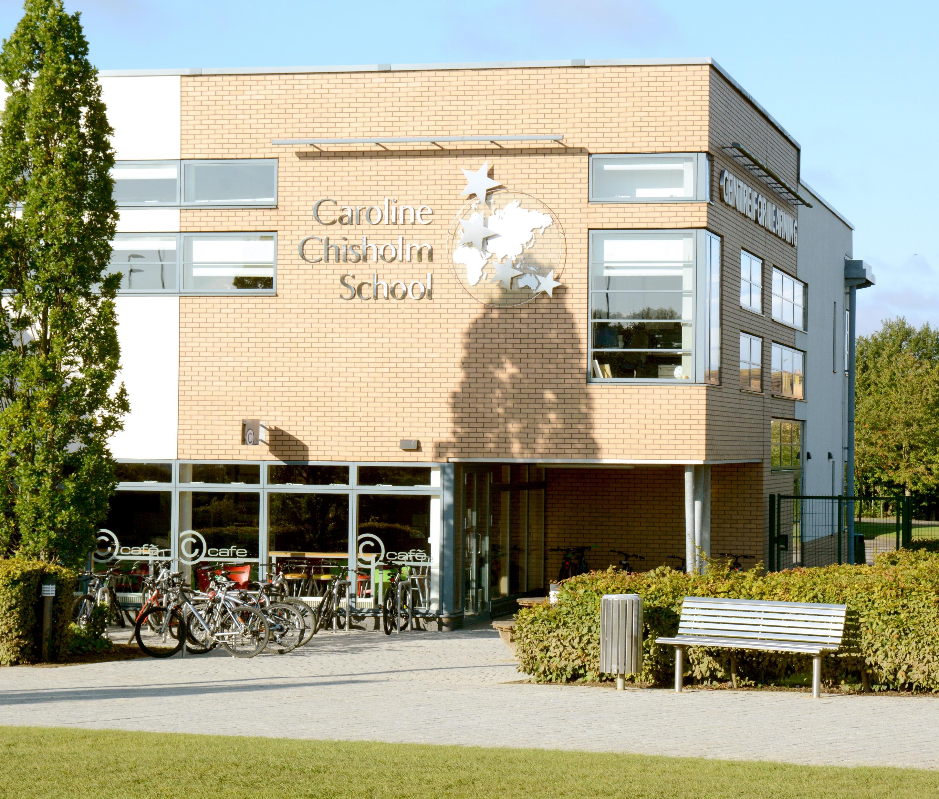
To share more ideas…
Send them on Teams to:
Year 7: HPL Ambassadors
Year 8: HPL Helpers
Year 9: HPL Captains
Or
Elizabeth Husband

