Slide 1
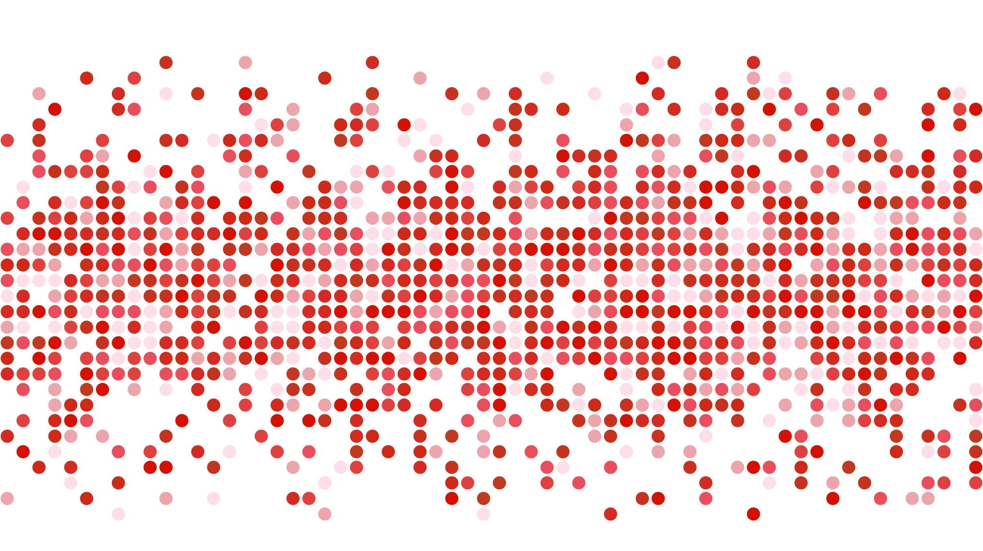
PEP Coursework Pollyanna Hawkes
Centre number – 27211
Candidate number - 6610

Slide 2
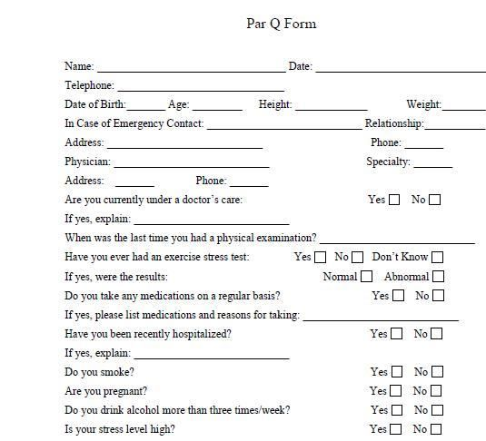
PARQ Questionnaire
Pollyanna Hawkes
17/03/2020
07711947072
15
5’9”
09.09.2004
Tamara Hawkes
Mum
17 Badger Lane, Grange Park, NN4 5DH
07836522289

Slide 3
Strength and Weakness Identification
Before starting my PEP I conducted a series of fitness tests to see where I can improve but also where my strengths lie amongst the components of fitness …
Component of Fitness | Test | Results | Level - Poor | Level - Average | Level – Excellent
Cardiovascular Fitness | 12 minute Cooper run | L4 S7
Flexibility | Sit and Reach | 45 cm
Strength | 1 Rep Max | 60KG
Muscular Endurance | Press Up Test | 36 press ups
Balance | Stork Stand Test | 38 seconds
Power | Standing Long Jump | 1.66m
Coordination | Ball and Wall Catch | 22
Agility | Illinois Agility Test | 19.34 seconds
Reaction Time | Ruler Drop Test | 7cm
Speed | Sprint Test | 4.8 seconds

Slide 4
Aims & Targets
 | Reason | SMART
Cardiovascular Endurance | I have chosen cardiovascular endurance because in netball with short bursts of intense game play whilst jumping as a defender it will help decrease the risk of early fatigue after the first quarter which could cause me to be substituted for another player. Cardiovascular training also helps improve bone density which will help prevent injury and make my bones strong if I was to fall during a match.
Muscular Endurance | My next component of fitness is muscular endurance because as a dancer I need to have good core stability and it will allow me to maintain positions for longer. This also reduces the risk of injury, as I am always trying new moves at dance if my muscles are prepared and strong it will reduce the chance of me gaining an injury.
S | M | A | R | T
Flexibility | My final component is flexibility. Even though I am already flat in both right and left leg splits; you never be to flexy. So this will be a chance to really focus on pushing and developing my flexibility. Flexibility also decreases the chance of injury as my muscles are already stretched.

Slide 5
Types of Training
Fartlek – As a netball player I can sometimes just be standing before a burst of fast moving where I have to run, jump and defend the ball. Fartlek training will help improve my speed play and how to jump between walking to a sprint on the netball court.
Circuit– This is easily adaptable to my individual needs as well as allowing me to develop an make it harder when I need to. The flexibility circuit will help loosen my hips which I can target easily.
Fitness Class – My fitness class is a body conditioning class in which is designed for dancers and their needs. This targets core stability, muscle strengthening and toning.

Slide 6
Principles of Training
Sport | Specific | Progressive Overload | Individual Needs | Reversibility | Overtraining
Netball | Making my cardiovascular training specific to netball will be using Fartlek because I can play around with speed play to mimic the same feeling that is in a game | I will make training harder by increasing the duration of time I practice for. I will also increase the amount of times I am training a week. | I will ensure my drills target defending as that is my position. I would be working on jumping, holding form and blocking | If I were to get injured I would adapt my training to low intensity circuits to limit the chances of the effects reversing | I will ensure fitted in breaks are added in my week in order to recover between training sessions
Dance | My muscular endurance will be specific to my dance training because it will include stretches and toning to help improve my core stability to ensure I can hold positions for the maximum time if not longer My flexibility will focus on improving and gaining control in movements | My training will become increasingly harder by adding more reps and training sessions. As well as increasing the time of the sessions. My training sessions will become longer and my circuit will become harder as more reps are added | My muscular endurance will focus on my abdominal muscles and toning them because core stability is very important in dance. My flexibility training will focus of hip loosening | If I were to become injured I would modify my exercises by making them easier or changing the point in which I’m focusing my exercise on. | After I have finished my class I will ensure I do a cool down to enable my muscles to rebuild the broken muscle fibres. My flexibility circuit will have fitted rest periods in between exercises

Slide 7
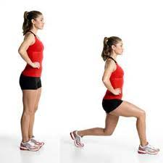
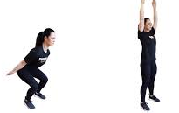
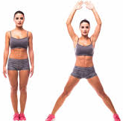
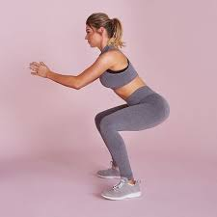
Appendix X – Warm Up
I will start by jogging on the spot, high knees and bum flicks to get my pulse raised
Next I will do walking lungs to the front, side and back in a series because dynamic stretches also increase heart rate
Finally I will do arm swings in coordination with a knee bend to mobilise the knee, should and elbow joints
Followed by jumping jacks as another pulse raiser
I will the do a series of squats and squat pulses to warm up the gluteus

Slide 8
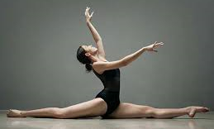
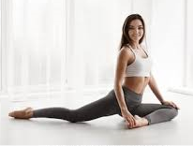
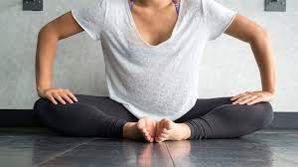
Appendix Y – Cool Down
Staring with down dog and walking out my feet to get a stretch in my gastrocnemius
Pigeon is preparing me for my splits. Then reaching forward to release tension
Finally finishing with the splits right and left leg
Then sitting in pike to stretch my hamstrings. Then flexing my feet to get a deeper stretch in my gastrocnemius
Lunging will follow. This will stretch my psoas and my hip flexor. I can also deepen the stretch by picking up the back leg.
Butterfly will help release any tension gained in my hip flexors
The stretching my box splits by reaching over to each leg before folding in the middle. This will stretch my obliques and my shoulders

Slide 9
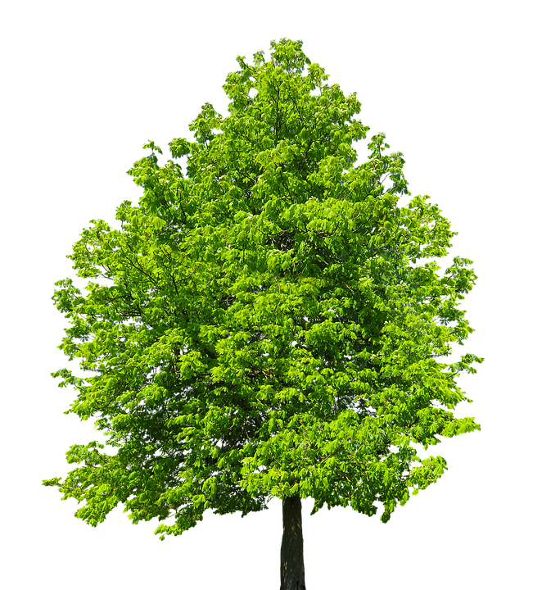
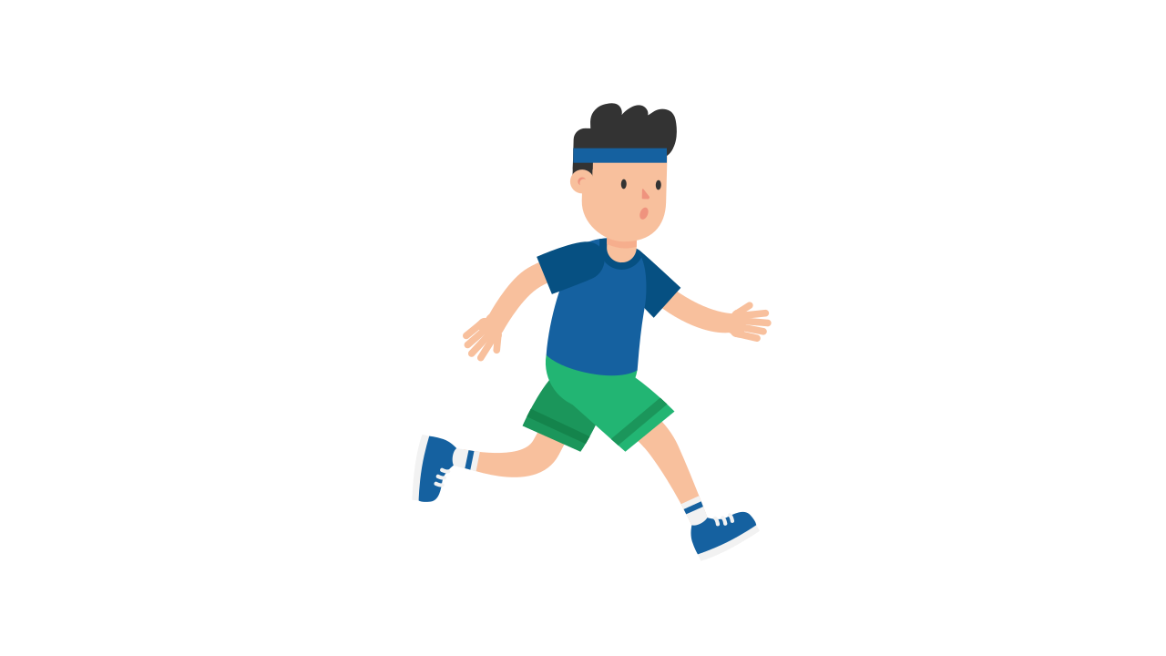
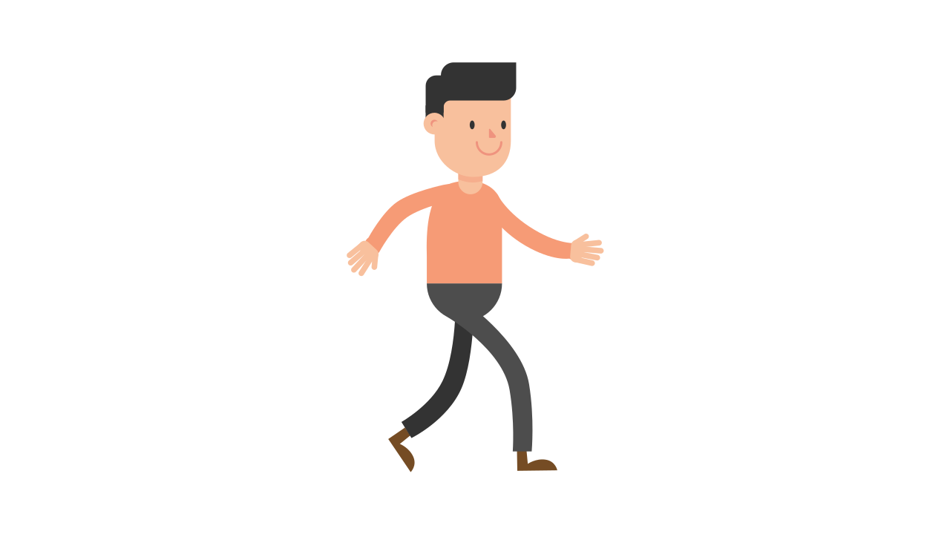
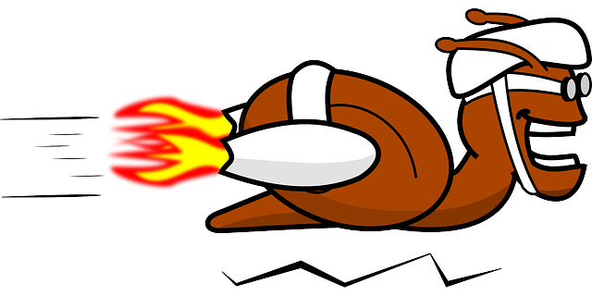
Appendix A – Fartlek Training Focus – Cardiovascular Endurance
I’ll be using the country park and will be using trees to mark out how far I need to go. The surface is nice and flat and there is loads of surrounding space to carry out my warm up
Week | Format | Distance/Time | Feedback
1 | Walk 50m, Jog 100m, Sprint 50m | Total = 200mx 2reps Time = 3minutes 10seconds | Found it ok but need to do it again to make it easier before trying to increase it
2 | Walk 50m, Jog 100m, Sprint 50m | Total = 200mx 2reps Time = 2 minute 44 seconds | Easier than last week and I completed it quicker also so can increase for next time
3 | Walk 50, Jog 100m, Sprint 50m, Jog 50m | Total = 250mx 2reps Time = 2minutes 31 seconds | Quite hard so will repeat until easier
4 | Walk 50m, Jog 100m, sprint 50m, jog 50m | Total = 250mx2reps Time = 2minutes 28 seconds | Easier than the week before so will make harder
5 | Walk 25m, Jog 125m, sprint 75m, Jog 50m | Total = 275mx1 rep Time = 2 minutes 56 seconds | This was really hard so will retry next week with an extra rep
6 | Walk 25m, Jog 125m, sprint 75m, Jog 50m | Total = 275mx2 rep Time = 2 minutes 40 seconds | This was easier than last week and I feel really good about how much I have increased on reps and distance since week 1

Slide 10
Appendix B – Circuit Focus – Flexibility
START CIRCUIT
1) Calf raises with feet in first position by a wall
12) Lie back, pull leg over to the right
6)Triangle with rocks forwards and backwards (left)
2) Lie down with legs up the wall and back up
11) Lie on back, pull leg over to the left
13) Box splits reaching over each leg and then in the middle
5) Kneeling lunge pulse (right)
7) Down dog, walking through the feet
10) Low lunge with elbows down (right)
14) Right leg splits
3) Pike stretch, walking hands forward.
4) Kneeling lunge pulse (left)
15) Left leg splits
8) Triangle with rocks forward and backwards (right)
9) Low lunge with elbows down (left)
END CIRCUIT
This can be easily adapted and made harder when necessary. This is specifically designed to improve my flexibility .
Week | Duration (per move) | Reps 1 | Feedback
1 | 20 seconds | 1 reps | Good starting point definitely increase though
2 | 25 seconds | 2 reps | A little tougher to maintain so will repeat
3 | 25 seconds | 2 reps | I felt looser so will increase farther
4 | 30 seconds | 1 rep | I will do more reps because it felt easy
5 | 30 seconds | 2 reps | Will increase for the final week
6 | 35 seconds | 2 reps | Felt really good to finish on this

Slide 11
Appendix C – Fitness Class Focus – Muscular Endurance
This fitness class is targeted at dancers and is designed to tone and train you on how to use your muscles properly
SIT UPS
Normal crunches
Table top crunches
Legs straight toe touches
Bicycles
Reverse curls legs straight up
Hold and pulse in half crunch
PUSH UPS/PLANK
30 second plank
Shoulder touches
Mountain climbers
Hip dips
Half push ups
Full push ups
TRAVELLING
Walking lunges
Walking lunge with releve and leg in passé
Picked up passé walks
Bear crawls
Walking side plank
Jumping squats (forward, backwards & side ways
Army crawl
Week | Class Duration | No of exercises
1 | 30 minutes | 20 exercises
2 | 45 minutes | 25 exercises
3 | 45 minutes | 30 exercises
4 | 45 minutes | 30 exercises
5 | 35 minutes | 25 exercises
6
FLOOR EXERCISES
Shoulder bridge
Oysters
Normal
Lift top leg
Hold and pulse top leg
Back and forward circles
Straight leg oysters
Join bottom leg to top leg
Circles back and forward
Turn in and parallel
Turn out and parallel
Ron de jambe in and outward

Slide 12
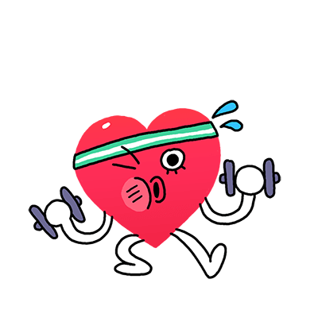
Heart Rate
For this I took my heart rate at the end of my fitness class and timed at 1 minute intervals how it came back to my resting
My resting heart rate = 65 bmp
Week one – End of class = 145bmp
1 minute = 110 bmp
2 minutes = 70
3 minutes = 64 bmp
Week three (high intensity shorter work out) – End of class = 143 bmp
1 minute = 105 bmp
2 minutes = 70 bmp
3 minutes = 63 bmp
Week three – End of class = 144 bmp
1 minute = 107 bmp
2 minutes = 74 bmp
3 minutes = 65 bmp

Slide 13
Adaptations
My fitness class was being streamed on Zoom during the lockdown period, so exercises had to be modified to fit the space available at home
My fartlek training had to be carried out in the park because it was a safe distance away from other people
My fitness lesson were less tailored because they opened the class up to some of their external students. This meant that the work out was more generalised rather than it being focused on a specific area like it would’ve been in the studio
I had to reduce the distance in my fartlek training as the space provided couldn’t be measured accurately at what I originally set the distance to be
I had to use filled up water bottles as weights as I didn’t have access to the ones, they provide at my dance studio due to quarantine

