Slide 1
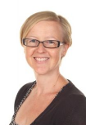
The HPL Project Team
Andy Fisher – Vice Principal
Teaching & learning
Kat Wittich-Jackson – Assistant Principal
KS4 Curriculum & House System
Liz Husband – Assistant Principal
KS3 Curriculum & Transition
Olivia Talbot
English Teacher
Emma Lynes
Lower Key Stage 2 Lead
James Wood
Year 3 Teacher
Keeley Jeffery
EYFS Lead
Katherine Patterson – Vice Principal
Primary Lead

