Slide 1
Year 6 Transition
Welcome to Drama

Slide 2
Drama at CCS
Taught in your form groups.
90 minutes per fortnight
Practical lessons.

Slide 3
Using HPL in lessons
What skills have we used today?
We will have a think after each activity

Slide 4
What do you think of when you see this symbol?

Slide 5
How about now?

Slide 6
Using HPL in lessons
What skills have we already used?
Think – pair - share
Countdown Timer (online-stopwatch.com)

Slide 7
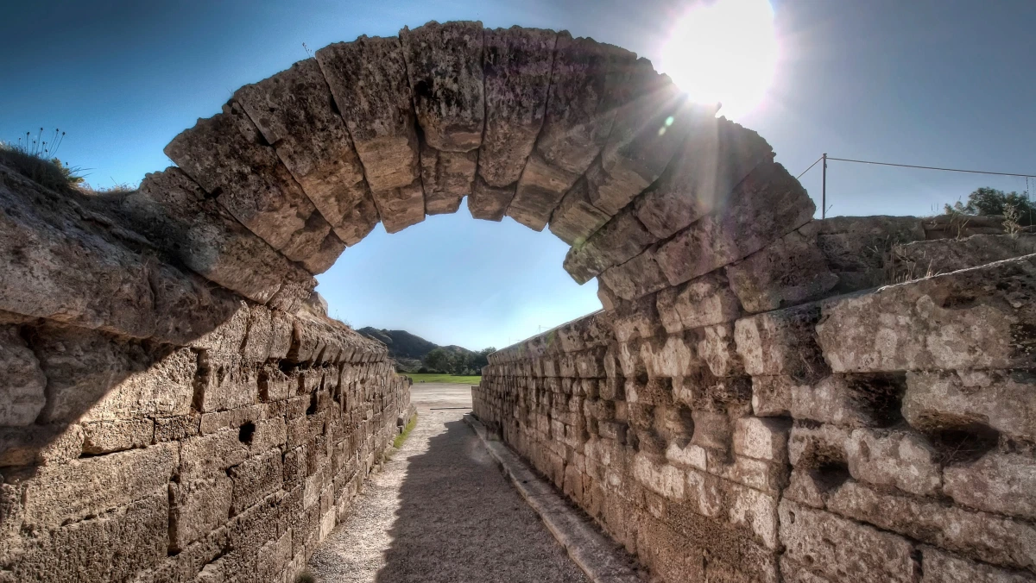
Drama at CCS

Slide 8
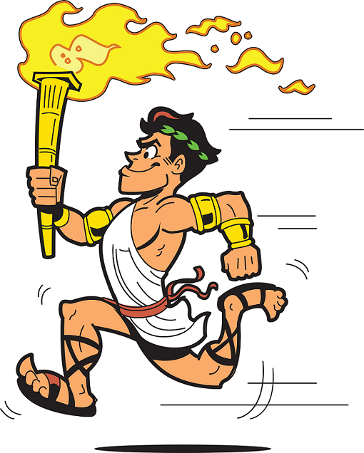
Ancient Olympic Facts
Began nearly 3000 years ago in Olympia, South West Greece
Held every four years between August 6 and September 19
It was a religious as well as sporting festival, honouring the Greek god Zeus
Men, boys and unmarried women only ones allowed to attend – if married women were caught they could be thrown off the mountainside as a punishment
There was a truce on all wars in the build up to an Olympics so people could travel safely

Slide 9
Ancient Olympic Facts
Up to 50,000 people would attend (not all would compete)
The main event at the Olympics was not a sporting event, but a sacrifice. On the third day of the games, 100 oxen were sacrificed and burnt on the Altar of Zeus.
This altar was not made from stone. Instead it was made from the leftover ash of all the sacrificed oxen. By around 200AD, the mound of ash stood six meters high!
Prizes were an olive wreath and bragging rights

Slide 10
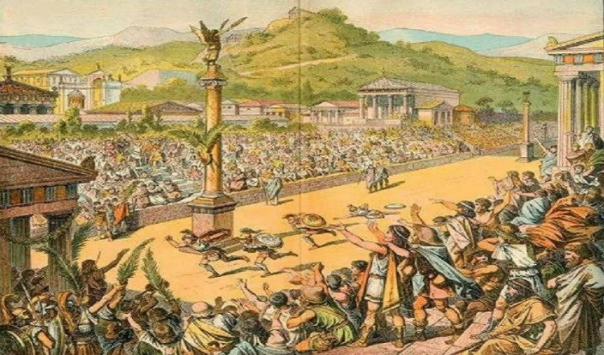
The Events

Slide 12
Groups of 6 or 7
Using your bodies as building blocks (physical theatre), create a series of still images (a captured moment in time) of the following events.
You can be the competitors, the crowd, the objects, the stadium, anything, however we must be able to tell what the event is.
For each event you must create 3 moments
The beginning of the event
A moment of ‘action’ during the event
The moment of winning

Slide 13
Event 1

Slide 14
Using HPL in lessons
What skills have we already used?
Think – pair - share
Countdown Timer (online-stopwatch.com)

Slide 15
Drama at CCS – links to HPL

Slide 16
The task – a reminder
Using your bodies as building blocks (physical theatre), create a series of still images (a captured moment in time) of the following events.
You can be the competitors, the crowd, the objects, the stadium, anything, however we must be able to tell what the event is.
For each event you must create 3 moments
The beginning of the event
A moment of ‘action’ during the event
The moment of winning

Slide 17
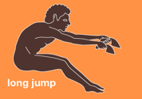
Event 2

Slide 18
The task – a reminder
Using your bodies as building blocks (physical theatre), create a series of still images (a captured moment in time) of the following events.
You can be the competitors, the crowd, the objects, the stadium, anything, however we must be able to tell what the event is.
For each event you must create 3 moments
The beginning of the event
A moment of ‘action’ during the event
The moment of winning

Slide 19
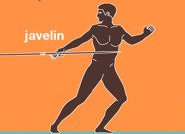
Event 3

Slide 20
The task – a reminder
Using your bodies as building blocks (physical theatre), create a series of still images (a captured moment in time) of the following events.
You can be the competitors, the crowd, the objects, the stadium, anything, however we must be able to tell what the event is.
For each event you must create 3 moments
The beginning of the event
A moment of ‘action’ during the event
The moment of winning

Slide 21
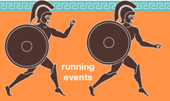
Event 4

Slide 22
The task – a reminder
Using your bodies as building blocks (physical theatre), create a series of still images (a captured moment in time) of the following events.
You can be the competitors, the crowd, the objects, the stadium, anything, however we must be able to tell what the event is.
For each event you must create 3 moments
The beginning of the event
A moment of ‘action’ during the event
The moment of winning

Slide 23
Event 5

