Slide 1


How do CCS High Performance Learners think and behave?

Slide 2
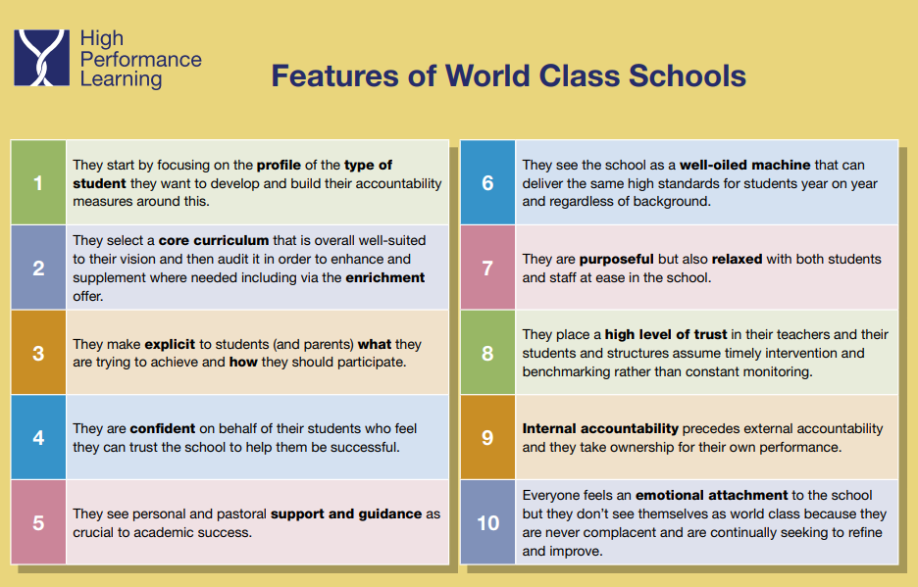

Slide 3
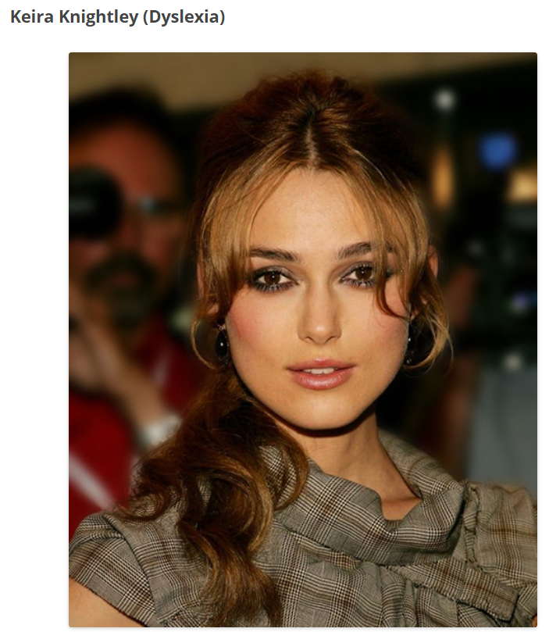



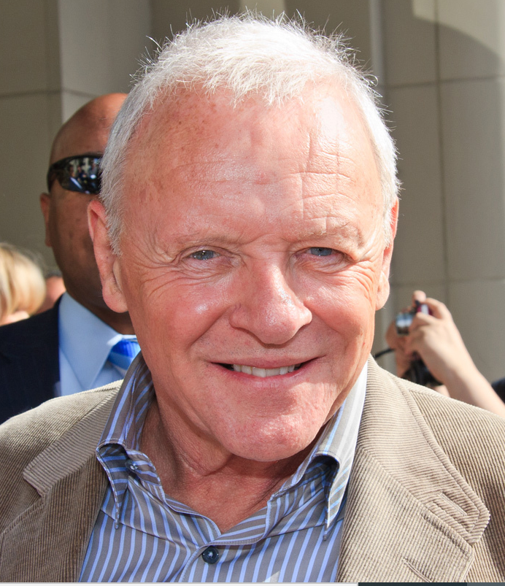


Anthony Hopkins (Asperger’s Syndrome)
Stephen Hawking (Motor Neurone)
Courtney Love (Mild Autism)

Slide 4
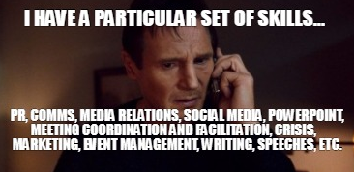
Aims and Objectives of these sessions:
To understand how and why HPL is relevant and important to all of our students.
To review our understanding of HPL philosophy and foundations.
To reflect on how HPL is
relevant to my own practice.
Documents you will need:
HPL booklet?

Slide 5
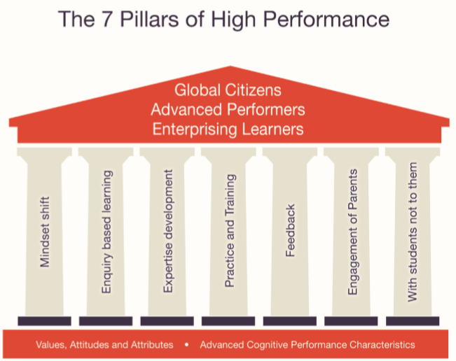
This is what we want for everyone at CCS:
Big picture thinking:
The pillars connect
the foundations – the tools – to the outcomes (the roof).
We use these foundations
to give us the thinking and behavioural tools to become global citizens, advanced performers and enterprising learners:
Notes:
1 minute reflection to consider how each pillar might fit in to your experience.

Slide 6
What do you do to support the implementation of the 7 pillars?
7 Pillars:
Example in my practice:
Mindset shift – all students can achieve and be a high-performance learner.
Enquiry learning –students need to think for themselves and develop their own conclusions.
Expertise development – students develop different thinking styles and behavioural habits suited to the subject/topic. This is achieved through perseverance and practise.
Practice and training – repeated and effortful work is needed to achieve expertise.
Feedback – knowing the goal and the students’ current ability will help us give rapid, meaningful feedback. (You could make a massive difference to a student at this point!)
Parental Engagement – involved parents has a massive impact on progress.
Students taking control of their own learning journey – being an independent learner.

Slide 7

Mindset shift
Mindset shift describes the move away from thinking of children as having finite levels of ability defined by their genetic profile and towards seeing the brain as capable of growth and hence all children as having the potential to excel.

Slide 8

Enquiry based learning
Enquiry learning is a learner-centred approach that emphasises higher-order thinking skills. It may take several forms, including analysis, problem solving, discovery and creative activities, both in the classroom and the community. Most importantly, in enquiry learning students are responsible for processing the data they are working with in order to reach their own conclusions (UNESCO).

Slide 9

Expertise development
Expertise development can be defined in layman’s terms as not just covering the curriculum but developing the habits and behaviours associated with expertise in a given domain. For example, thinking and approaching tasks like a mathematician or a historian rather than doing the maths or history course. This, of course, has significant implications for how lessons are taught. Research has given us a good understanding of how individuals develop expertise. In the acquisition of expertise, extended deliberate practice (e.g. high concentration practice beyond one's comfort zone) has been found to have a significant role. Experts become expert because they are prepared to put in the necessary work and to persevere when they meet obstacles in their subject; they are motivated to do that because they have developed a sense of the subject and that leads to a love of the subject. So, exploring the nature and conventions of a subject is key to developing expertise within it

Slide 10

Practice and training
Practice and training relates to the need to build persistence and resilience in individuals through the use of deliberate practice and training. Cognitive success does not occur by chance, it is achieved via progression through a series of developmental processes, and training needs to enable this opportunity. For many, success will not be immediate. It takes 10,000 hours to make an expert (Levitin, 2006).

Slide 11

Feedback
Feedback. Formative, timely and appropriate feedback has been identified as the single most influential factor in helping individuals to progress. It should involve an understanding of the desired goal, evidence about their present position in relation to that goal and guidance on the way to close the gap between the two. To be effective, feedback needs to be clear, purposeful, meaningful and compatible with students’ prior knowledge, and to provide logical connections (Hattie, 2009).

Slide 12

Parental Engagement
Parental engagement in their child’s learning has been found to have a profound effect on progress rates. A 10% dividend when a parent is generally interested and up to 15% when the parent shows strong interest. Parental involvement in a child’s schooling for a child between the ages of 7 and 16 is a more powerful force than family background, size of family or level of parental education. Parental involvement has a significant effect on pupil achievement throughout the years of schooling. Educational failure is increased by lack of parental interest in schooling. In particular, a father’s interest in a child’s schooling is strongly linked to educational outcomes for the child. Many parents want to be involved in their children’s education. In a recent study in England 72% of parents said that they wanted more involvement.

Slide 13

Students taking control of their own learning journey
Success is more likely if the child is motivated to learn. Motivation is increased when the child has developed the skills to be an autonomous learner – able to practice, train and learn without the teacher

Slide 14
Summary:
Mindset shift – all students can achieve and be a high-performance learner.
Enquiry based learning – we need to encourage students, and ourselves, to think for themselves and develop their own conclusions.
Expertise development – means students develop different thinking styles and behavioural habits suited to the subject/topic. This is achieved through perseverance and practise. This is applicable to all members of the school community.
Practice and training – repeated and effortful work is needed to achieve expertise.
Feedback – knowing the goal and the students’ current ability will help us give rapid, meaningful feedback. (You could make a massive difference to a student at this point!)
Parental Engagement – involved parents has a massive impact on progress.
Students taking control of their own learning journey – being an independent learner. Staff should also be the driving force in their own development.

Slide 15




Establishing the foundations ACPs and VAAs
Recall Quiz

Slide 16
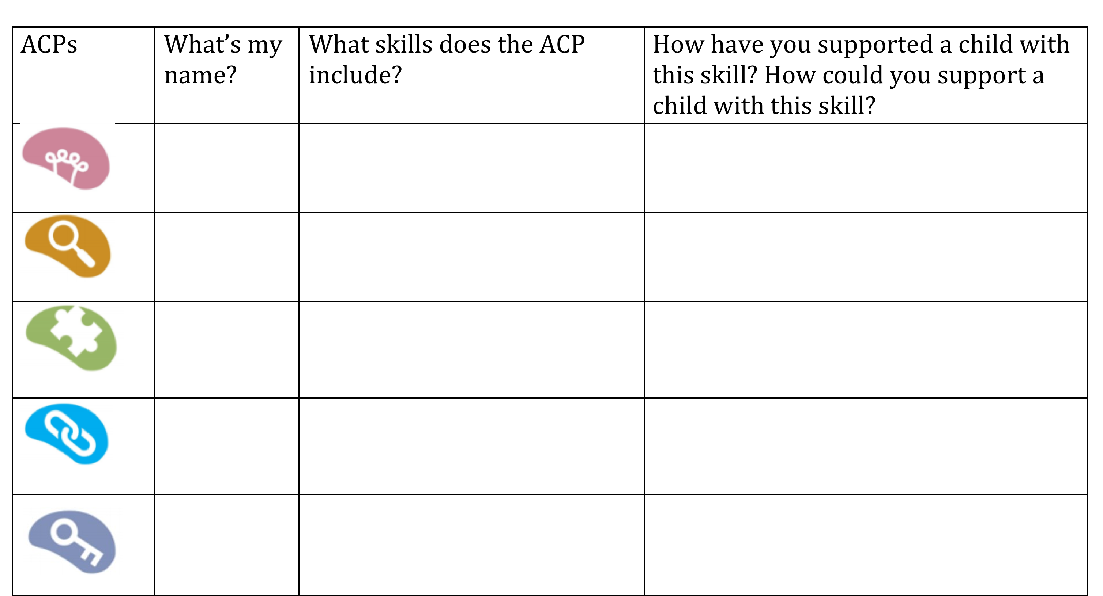
How is
How is this ACP evident in my daily work?

Slide 17
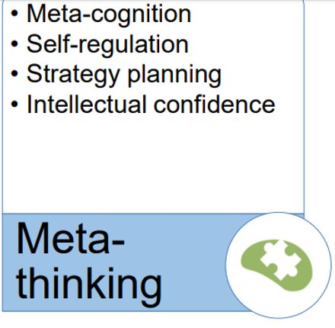
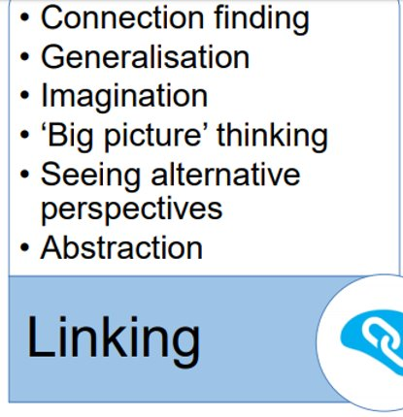
"thinking about thinking" or "knowing about knowing". Knowing when and how to use particular strategies. Having an intentional understanding of learning.

Slide 18
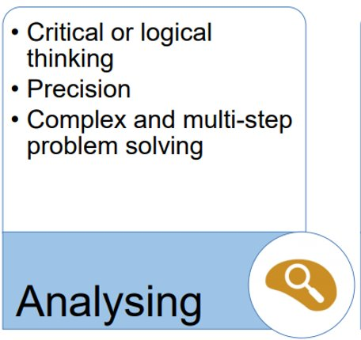
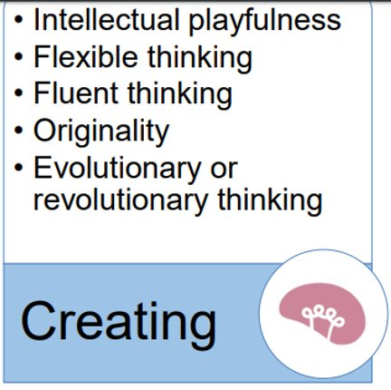

Slide 19
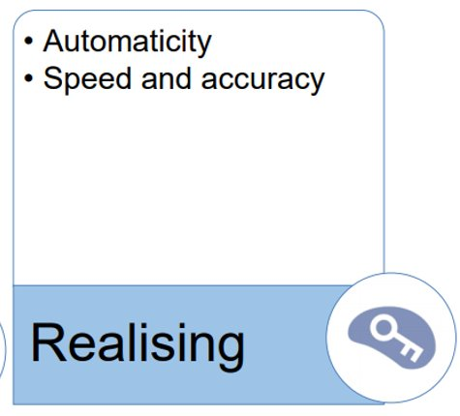

Slide 20
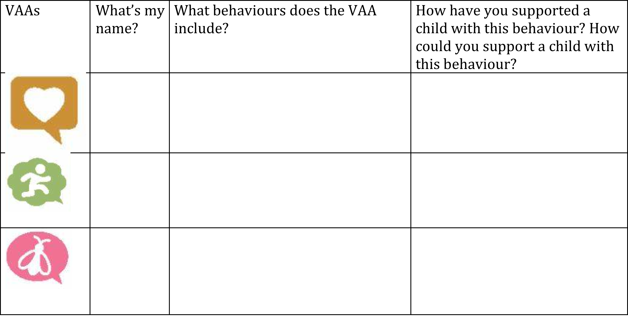
How is this VAA evident in my work?

Slide 21
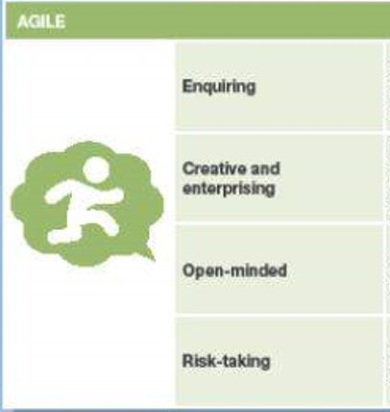
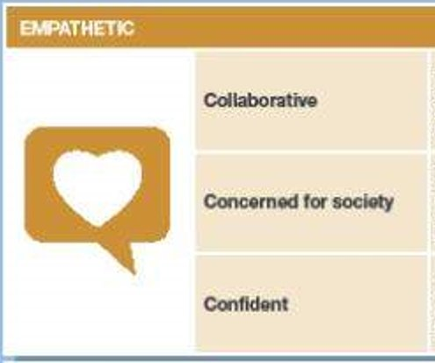
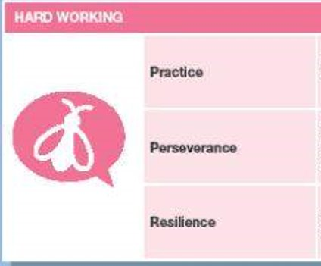

Slide 22

Thank you for your belief, perseverance and agility!

