Slide 1
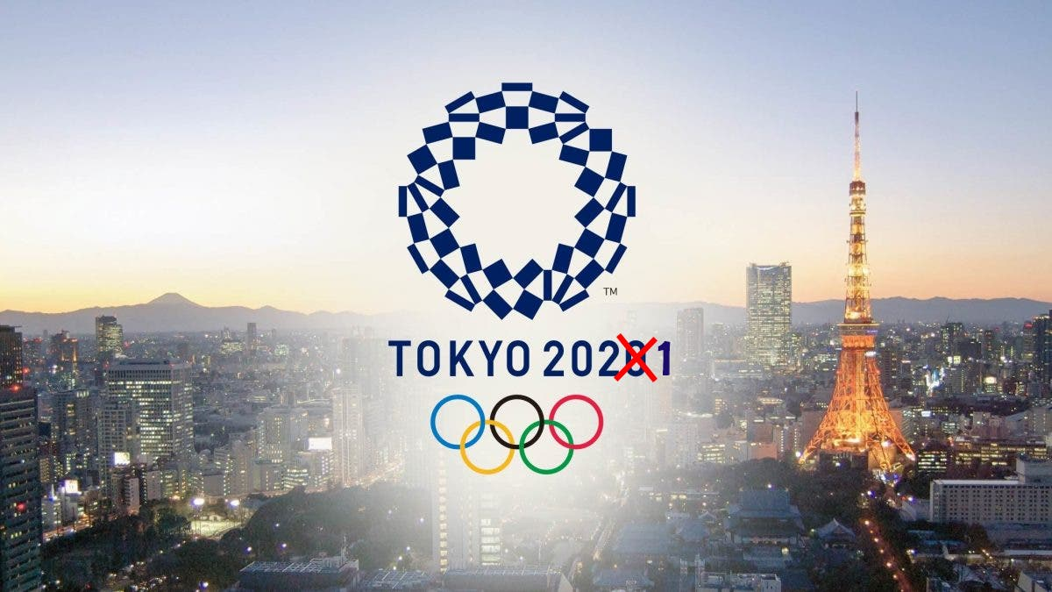
The Geography of the Olympics
LO:
To investigate the Geography behind the Olympics

Slide 2
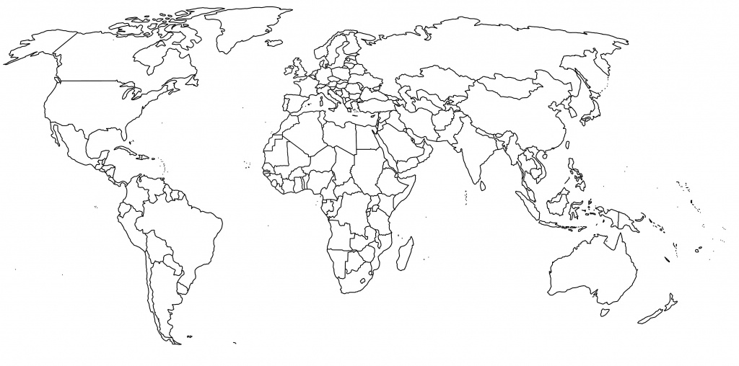
Task 1: Where is the Olympics hosted?
Host city | Year
Melbourne | 1956
Rome | 1960
Tokyo | 1964
Mexico City | 1968
Munich | 1972
Montreal | 1976
Moscow | 1980
Los Angeles | 1984
Seoul | 1988
Barcelona | 1992
Atlanta | 1996
Sydney | 2000
Athens | 2004
Beijing | 2008
London | 2012
Rio de Janeiro | 2016
Tokyo | 2020
Paris | 2024
Los Angeles | 2028
Task 1: Find and mark on the Host cities for the Olympics

Slide 3
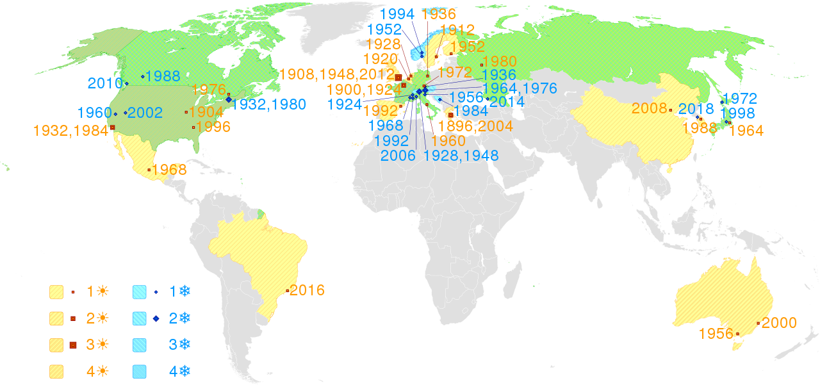
Do you notice any patterns?

Slide 4
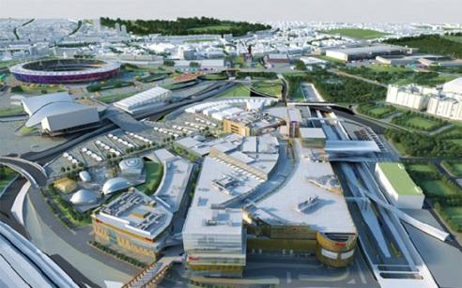
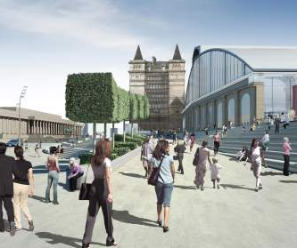
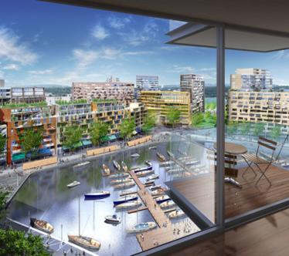
TASK 2: Why do cities want to host the Olympics?
Urban regeneration
The improvement of old buildings and the addition of amenities in an attempt to being new life into an area.

Slide 5
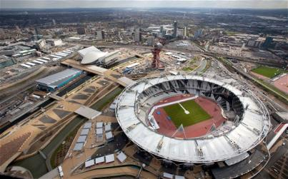
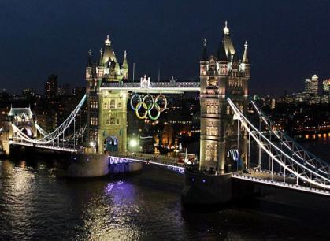
Geography at work in East London (Stratford)
AIMS of the Olympic regeneration:
Re-generating and transforming one of London’s poorest areas
Implementing sustainable principles into urban regeneration – the ‘sustainable Games’
A celebration of London’s diversity – to create a ‘Games for the world’ in one city
Inspiring young people to take part in sport
Creating a legacy which would last beyond 2012

Slide 6
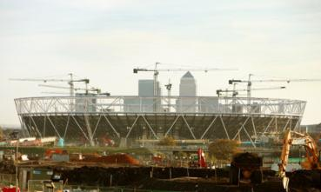
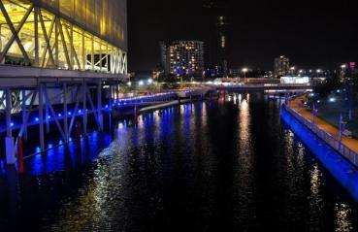
Location of the Olympic park, East Stratford
London 2012:
Location of the Olympic Park in East Stratford.
Q: Why do you think they chose this part of the city?

Slide 7
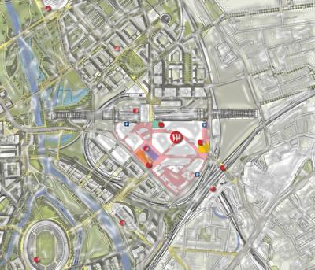
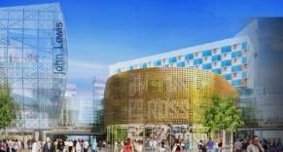
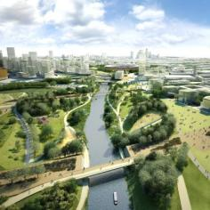
Urban Regeneration in Stratford
Video Clip: Regeneration of Stratford

Slide 8
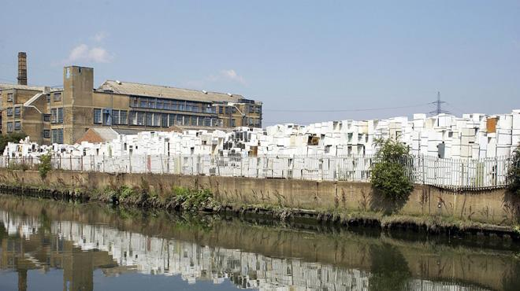
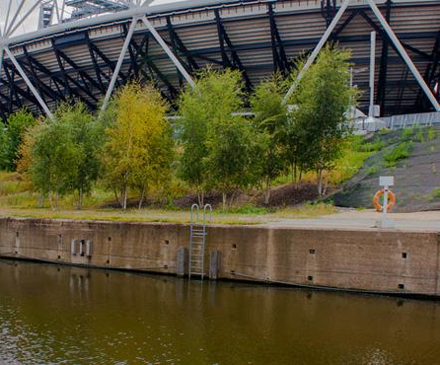
Stratford: 2005 and 2012….
In pre-Olympic times, Stratford’s 20-foot tall ‘Fridge Mountain’ was one of the area’s most iconic eyesores. Believed to be the biggest collection of discarded white goods in Europe, the pile was the first thing to be shifted when the clean-up started. There’s now an entirely different white beast in its place – the Olympic stadium.
Notes:
http://www.timeout.com/london/things-to-do/stratford-then-and-now

Slide 9
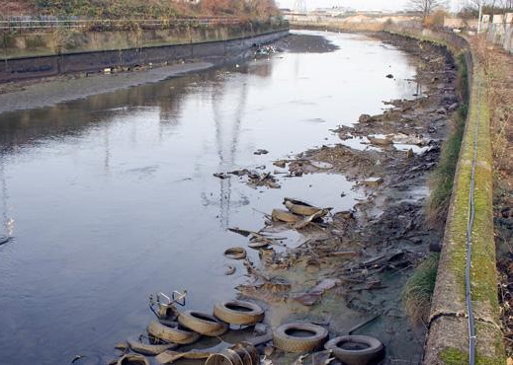
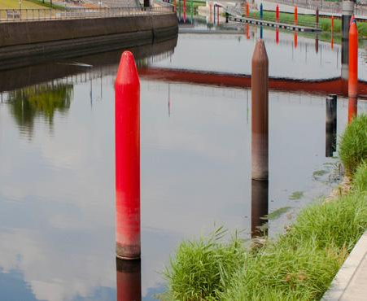
Stratford: 2005 and 2012….
You’d probably still think twice about taking a swim in them, but Stratford’s waterways have benefited hugely from Olympic regeneration. The multi-coloured sticky-up crayon things are still a mystery, but they’re certainly far easier on the eye than old car tyres and rusty bike corpses.
Notes:
http://www.timeout.com/london/things-to-do/stratford-then-and-now

Slide 10
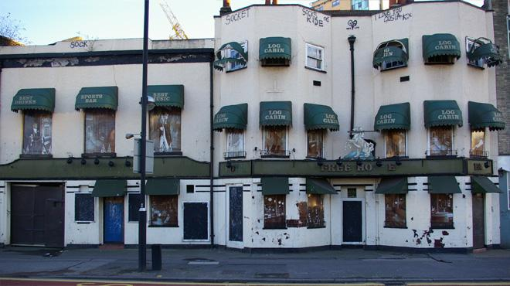
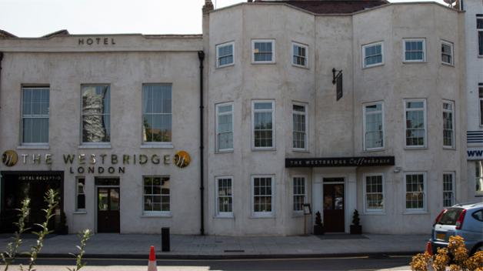
Stratford: 2005 and 2012….
After two and a half centuries as the Yorkshire Grey, this former pub on Stratford High Street lasted just five years after it became the Log Cabin in 2000. With the Olympic bid in the bag, developers seized the opportunity and it became The Westbridge, a four-star boutique hotel. Looks fancy, but don't expect a jar of pickled eggs behind the bar.
Notes:
http://www.timeout.com/london/things-to-do/stratford-then-and-now

Slide 11
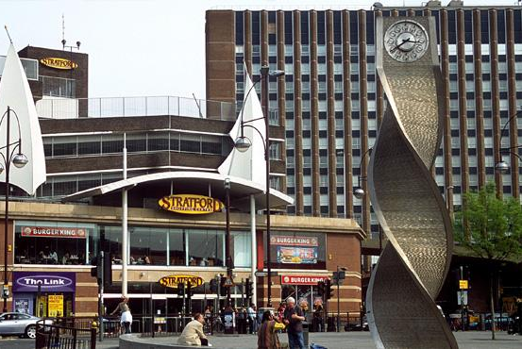
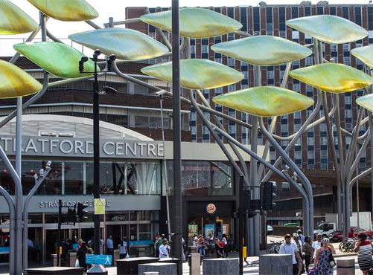
Task 3: Annotate the photo with 4 things that were improved by being part of the Olympics
Notes:
http://www.timeout.com/london/things-to-do/stratford-then-and-now

Slide 12
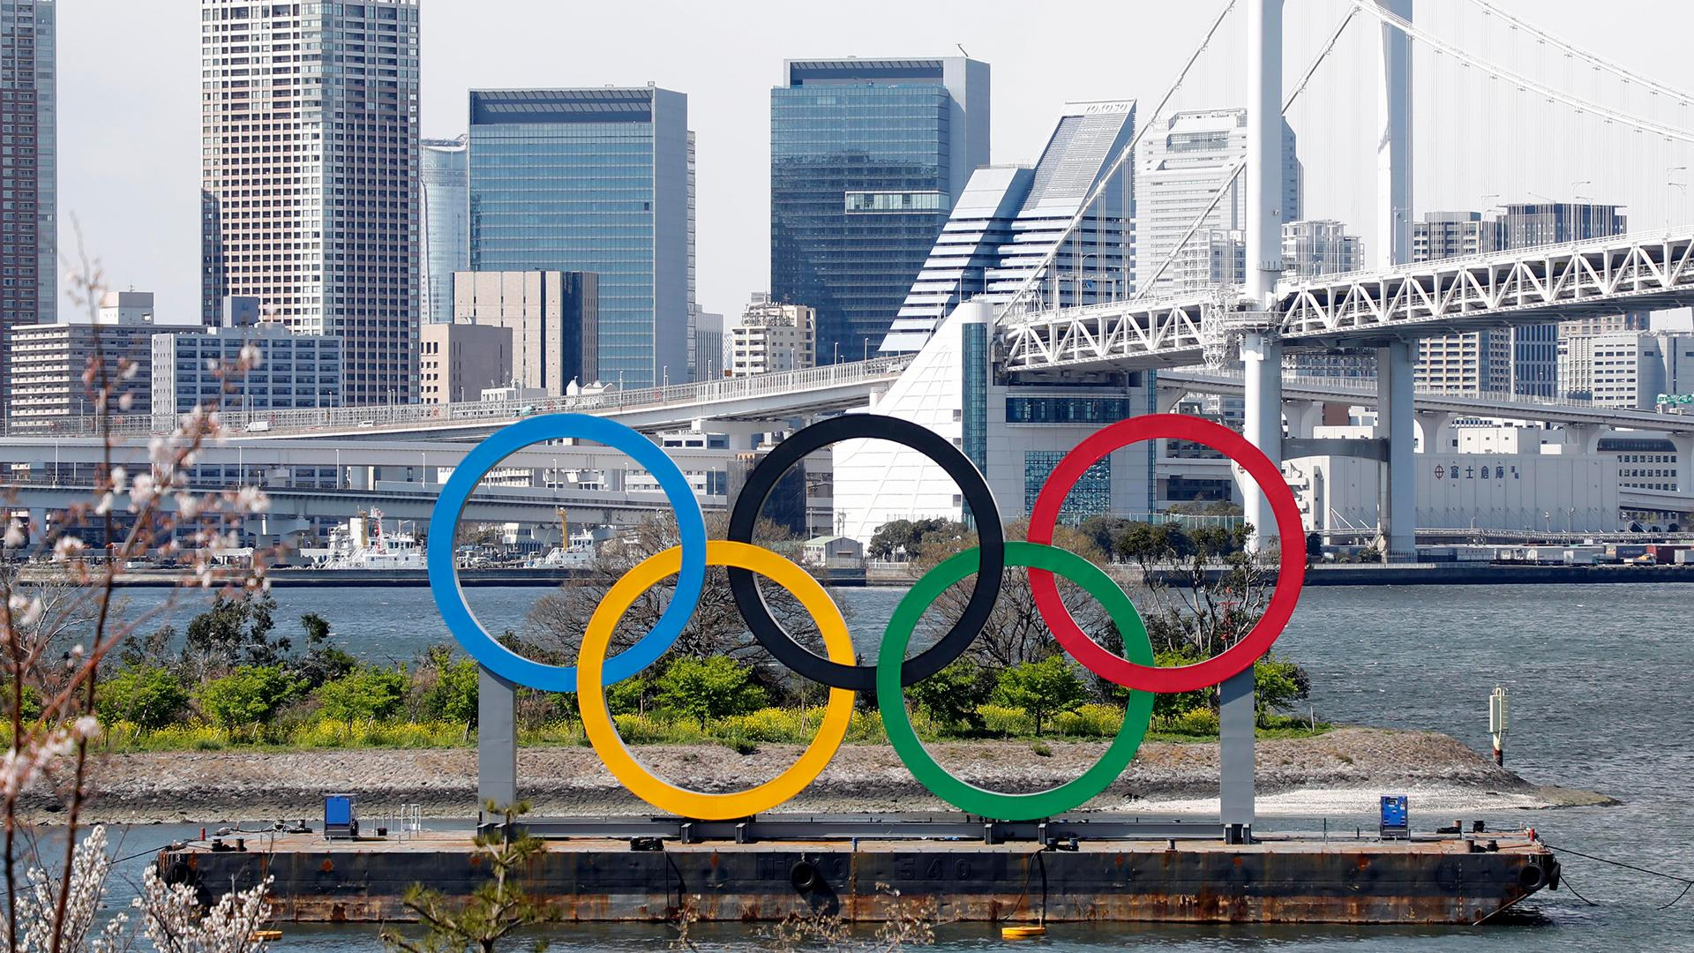
Tokyo Olympics 2021

Slide 13
Design the Olympic Village (OV)
Your challenge today is to design the Athletes’ Village which is being built on reclaimed land in the heart of Tokyo. The area of new land represents a blank canvas on which you can design the layout, buildings, spaces, and environment.

Slide 14
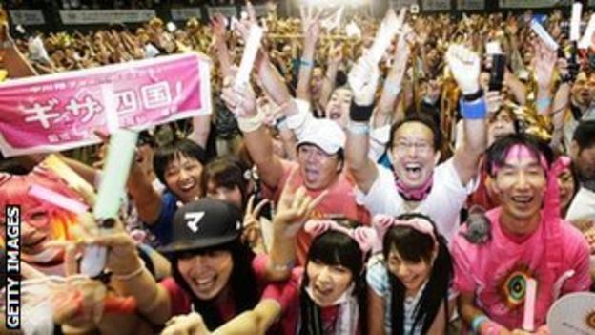
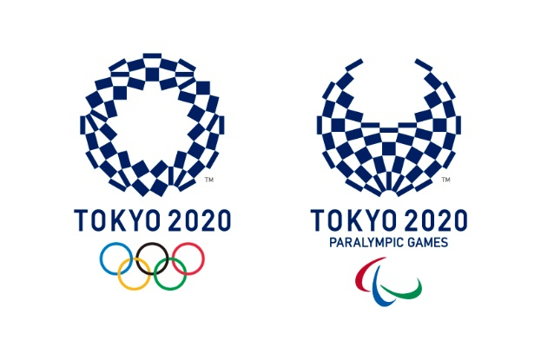
Some films clips to inspire your creativity
Promotional Film for the Tokyo bid 1 (18.55-22.30)
Promotional Film for the Tokyo bid 2 (1.33-2.35)

Slide 15
THINGS TO CONSIDER IN YOUR DESIGN
OLYMPIC VALUES / TOKYO 2020 CORE CONCEPTS
JAPANESE VALUES
ACCOMMODATION FOR 11,000
DESIGNS THAT REDUCE THE IMPACT ON THE ENVIRONMENT
CLIMATE CONSIDERATIONS
NATURAL HAZARD CONSIDERATIONS
TEAMWORK AND CO-OPERATION
INSPIRATIONAL DESIGNS
LEGACY – HOW CAN IT BE USED IN THE FUTURE
MAP QUALITY / AERIAL AND SIDE VIEWS
ANNOTATIONS – EXPLAINING DECISIONS IN DESIGN

Slide 16
The site for your plans

Slide 18
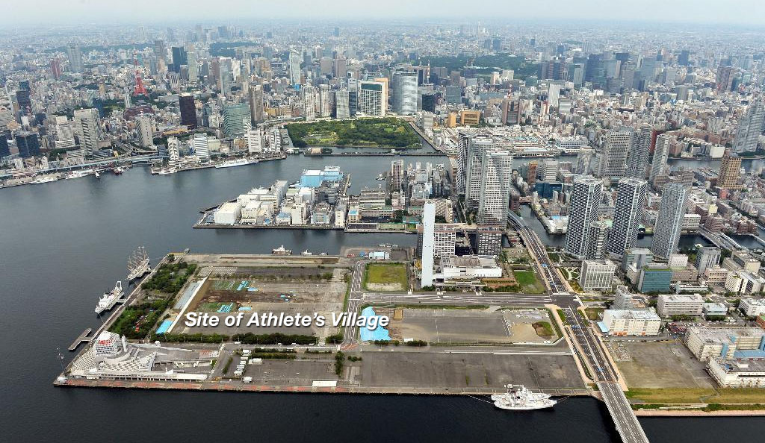

Slide 21
Rio 2016 OV

Slide 22
Some early designs…

Slide 23
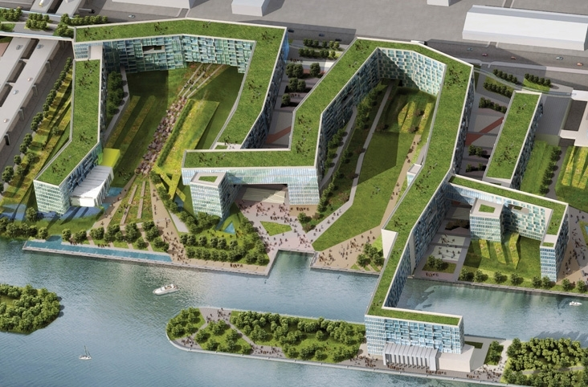

Slide 24
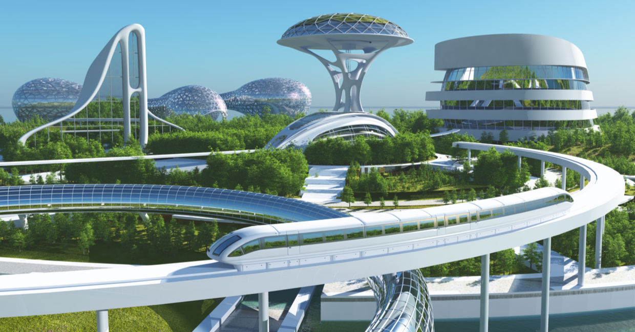

Slide 25
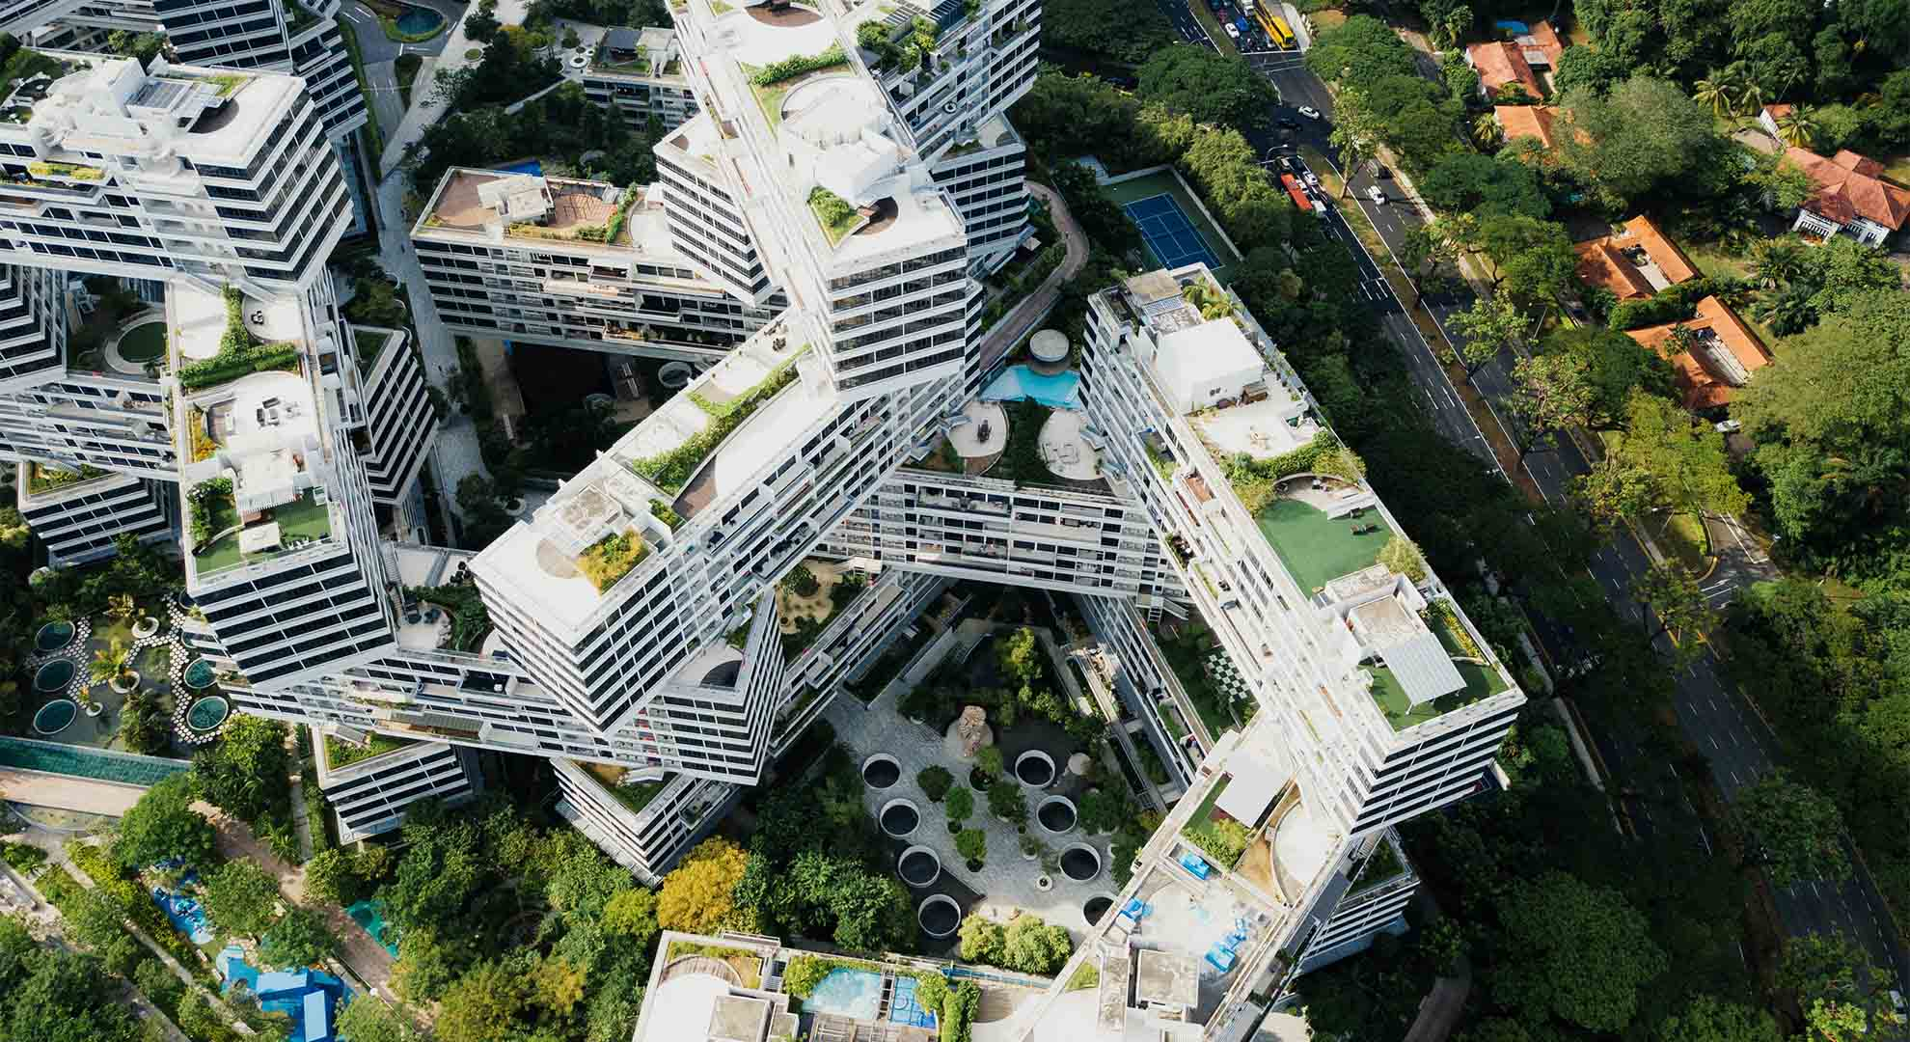

Slide 26
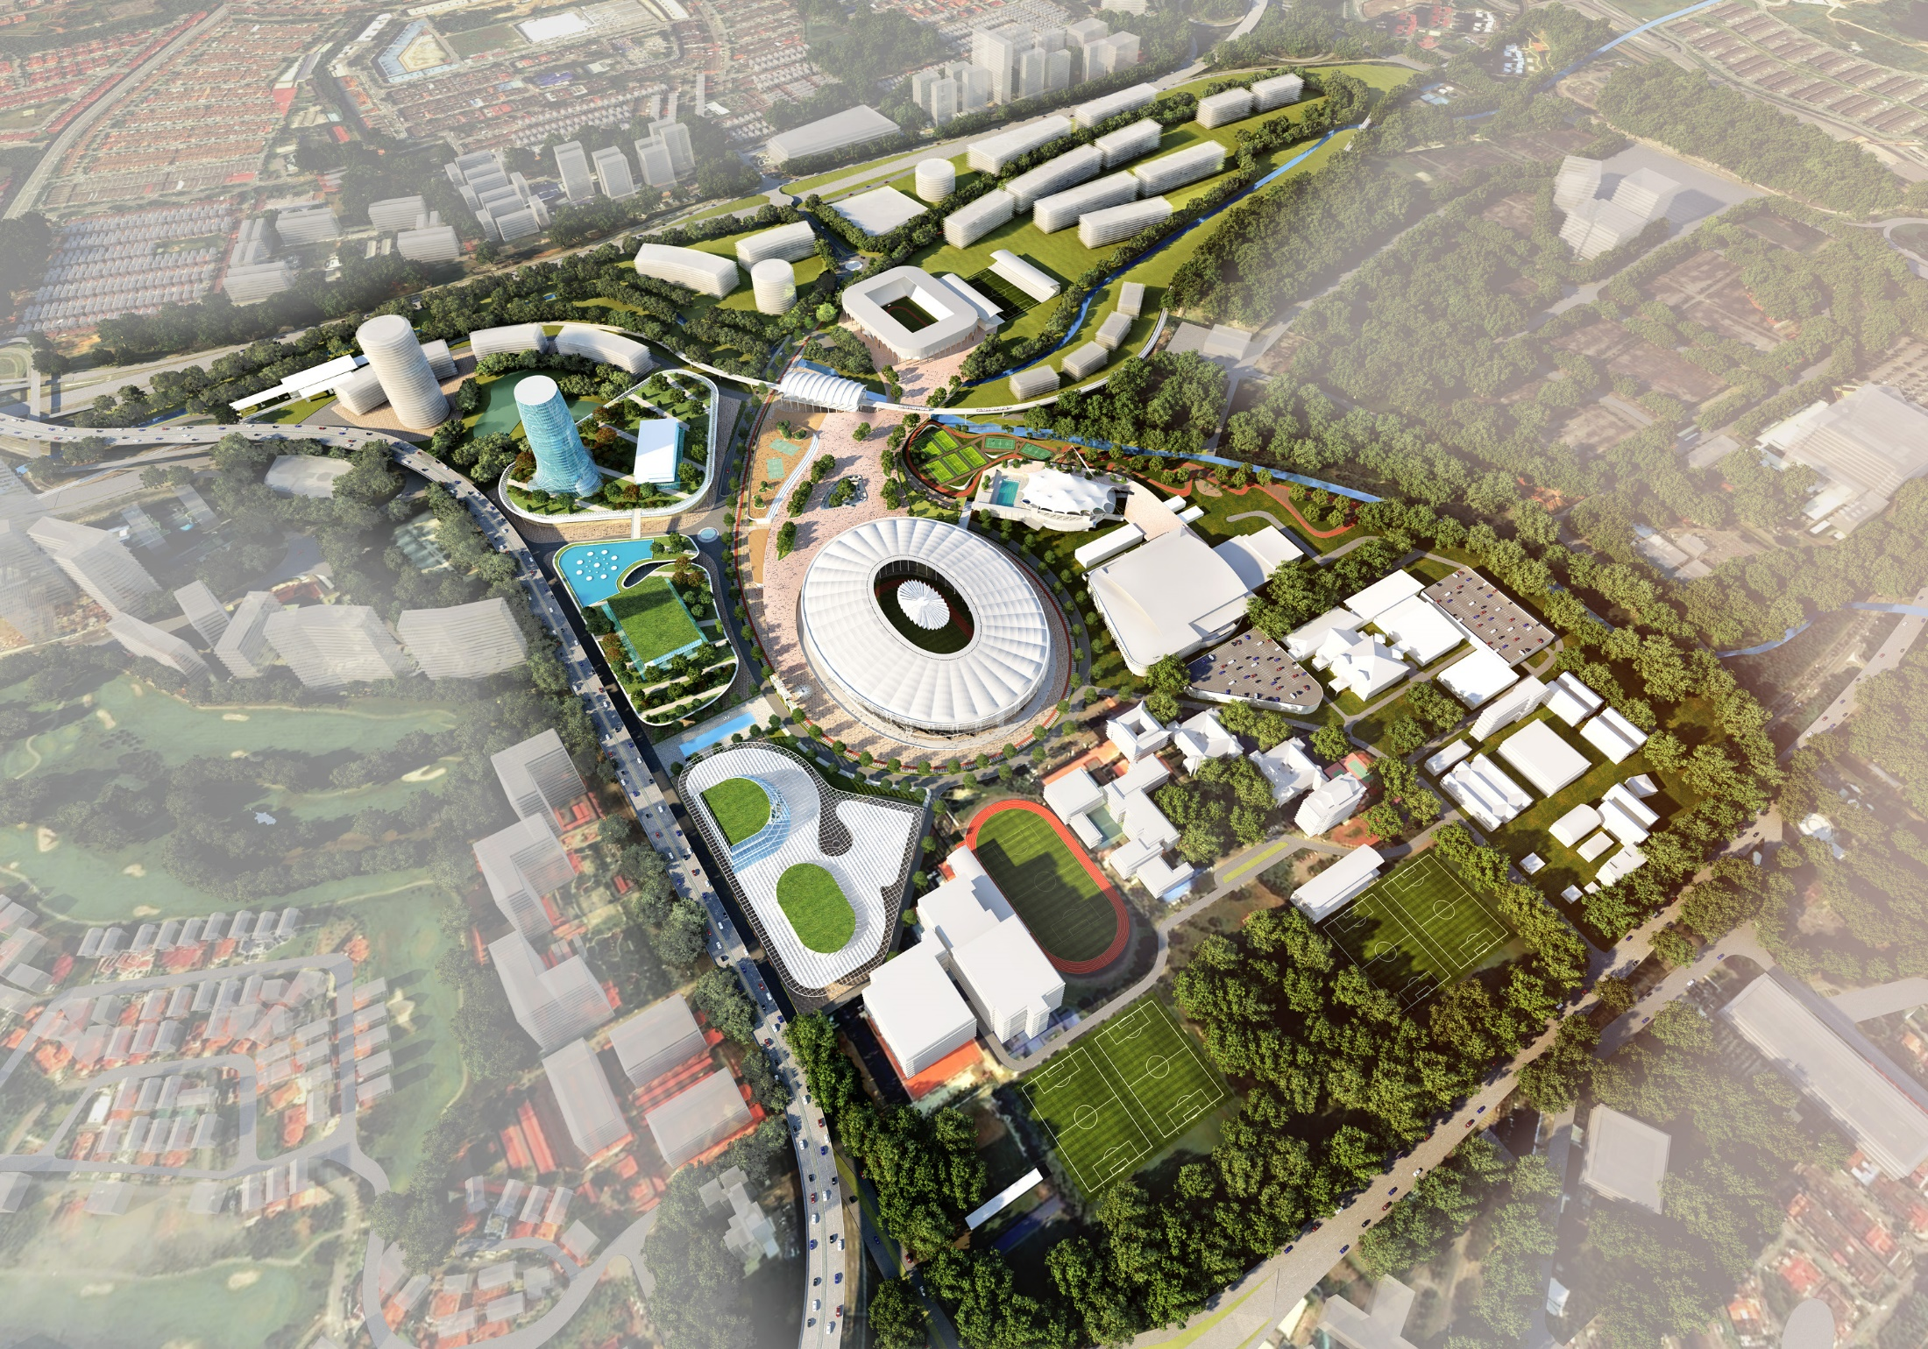

Slide 27
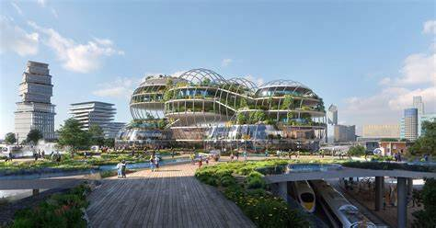

Slide 28
