Slide 1
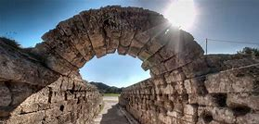
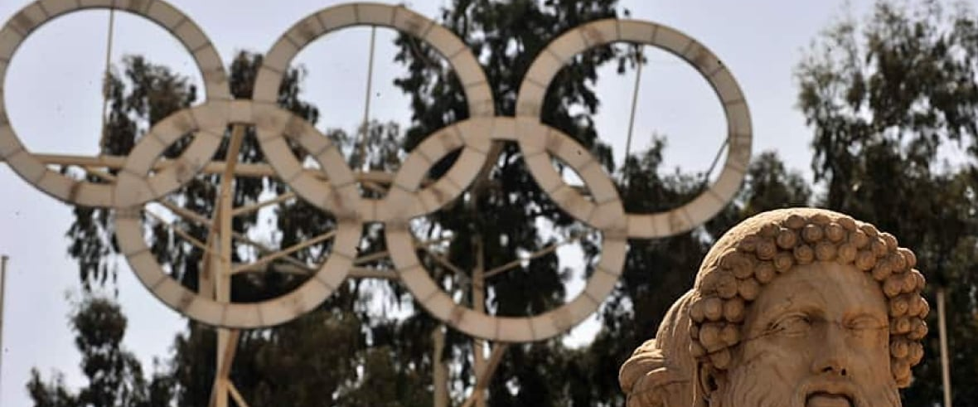
Ancient Olympics

Slide 2
Welcome to English at CCS
We hope you enjoy learning English with us at CCS
We love to read; and you will need to bring a reading book to every lesson
We will help you choose books to enjoy
We will set work on the computer and handwriting
You will come prepared and ready to learn every lesson
You will be taught in mixed groups
You will learn a mix of reading, writing and speaking and listening

Slide 3
What do you need for the lesson?
A piece of paper
Or a notebook
Or something to write on
A black pen
Or (just for today) something else to write with

Slide 4
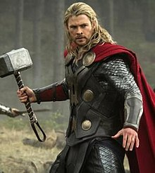
Big question: How did the Olympics start?
What is a myth or legend?
Do myths have to have any truth to them?

Slide 5
Big question: How did the Olympics start?
Name Monday July 5 2021
Big Question: How did the Olympics start?
What is a myth or legend?
Do myths have to have any truth to them?

Slide 6
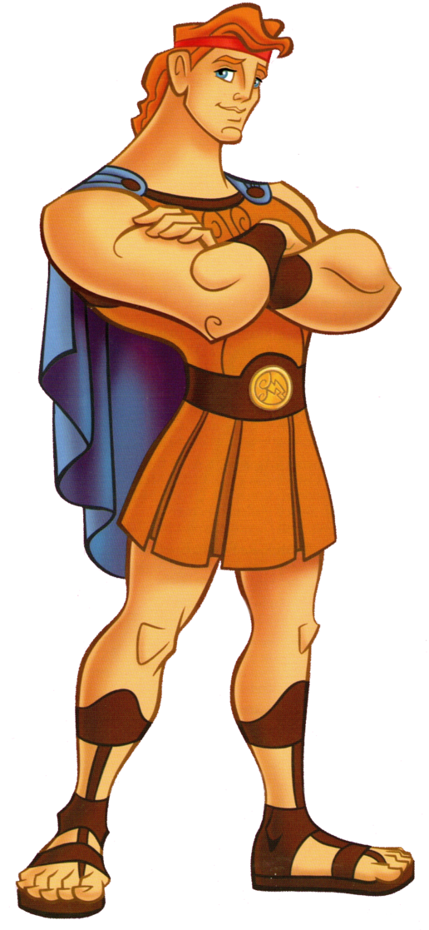
The origin of the Olympics
One of the most popular myths says that Heracles (Hercules) and his father Zeus started the Olympic Games.
After Heracles completed his twelve labours, he built the Olympic Stadium as an honour to Zeus.
Following its completion, he walked in a straight line for 200 steps and called this distance a “stadion” .

Slide 7
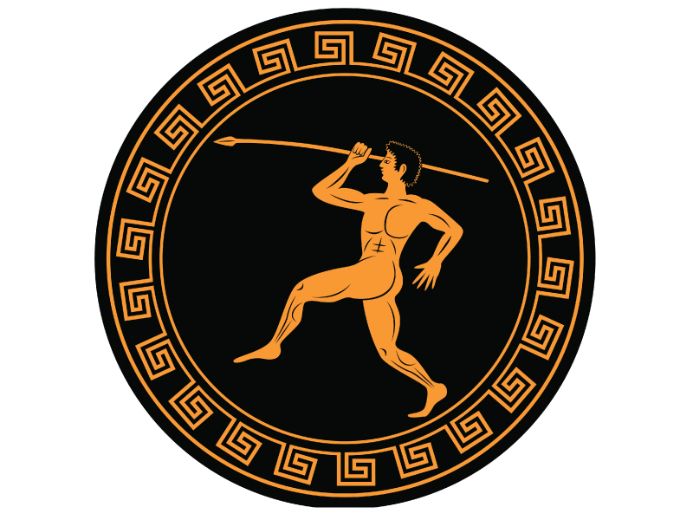
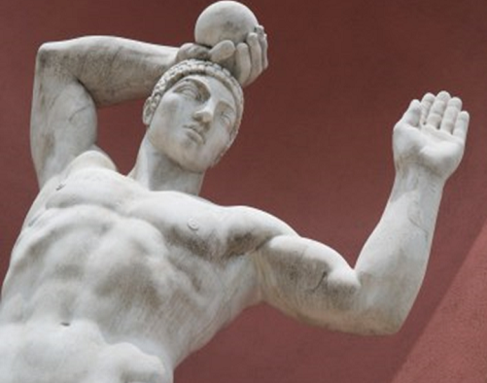
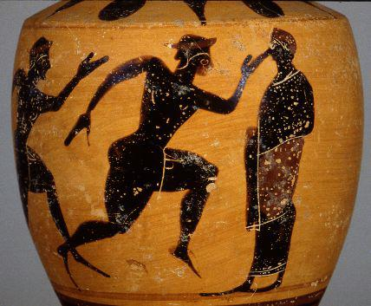
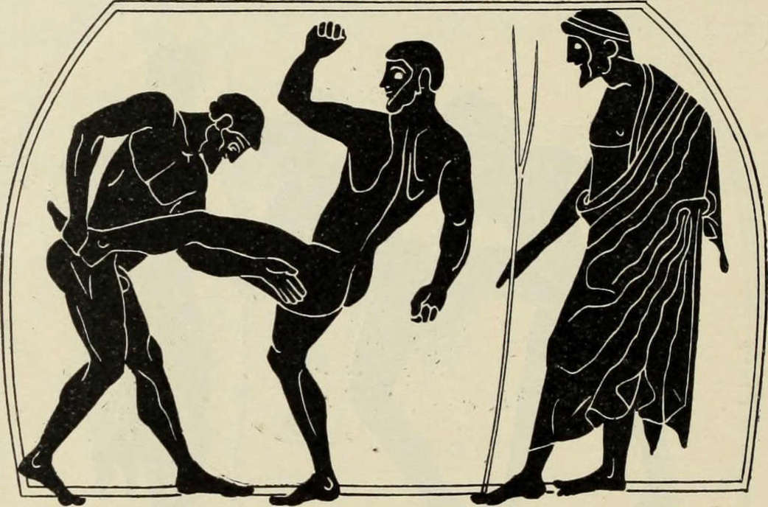
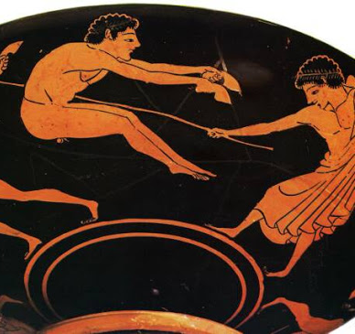
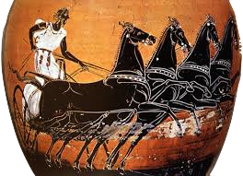
What activities do you think made up the Ancient Olympics?
The ancient Games included
running
long jump
shot put
Javelin
Boxing
pankration
equestrian events

Slide 8
What activities do you think made up the Ancient Olympics?
The ancient Games included
running
long jump
shot put
Javelin
Boxing
pankration
equestrian events

Slide 9
Can you invent your own origin myth for an Ancient Olympic Sport?
Name Monday July 5 2021
Big Question: How did the Olympics start?
My sport: shot put
My suggestion: Hercules fought a battle with the three headed monster Tristram.
He had to prove he killed it.
He had to chop off one of the monster’s heads and return it to the King of
Simrania before nightfall.
He didn’t think he was going to make it so he threw the head to the palace while he was still ten miles away.

Slide 10
Now write up your origin myth
Include:
Which sport you want to write about – it could be one from the Ancient or Modern Olympics
Paragraphs
Ambitious vocabulary
Details to make it sound like a story
Risk – taking
Can you make it sound like a real, ancient myth?
Can you include speech or more challenging punctuation?

Slide 11
Big question: How did the Olympics start?
What is a myth or legend?
Do myths have to have any truth to them?

