Slide 1

Business and Finance Faculty

Slide 2


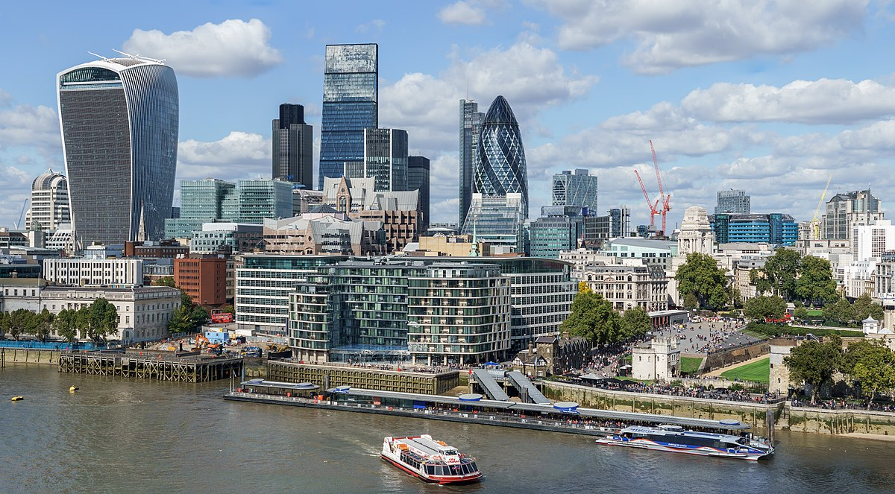

After your KS3 studies, you will be able to choose to continue your learning within our Business and Finance Faculty.
Our subjects comprise:
Business
Finance
Economics

Slide 3
Our subjects will help provide the foundation of knowledge you need to enable a successful career within multiple industries.
Finance / accounting
Business structures
Enterprise and marketing
Monetary matters
Career development

Slide 4
Business Studies
This subject will teach you about being an entrepreneur and the skills for running a business, such as managing money, advertising and employing staff.
These skills can be applied to your future career.
Choose this subject if you enjoy:
Humanities subjects
English
Design/Graphics

Slide 5
Business Studies
You will study multiple units comprising enterprise skills, marketing, business structures and more.
Your exams will be at the end of Y11. The course is designed to enable you to understand the full depth of businesses in the UK.

Slide 6
Economics (KS5 only)
Economics will help you to understand how money works in business. It helps you to understand our economy.
Why are some goods more expensive than others?
Should you pay for school?
Should footballers take a pay cut?
Choose this subject if you enjoy:
Maths
Politics
Business Studies

Slide 7
Economics (KS5 only)
Economics will enable you to explain why some people earn more than others.
Economics looks at environmental problems and how to solve them.
Economics looks at Global issues but helps explain local problems.
Economics helps people to make decisions.

Slide 8
Financial Studies
You will study financial capability in Year 7 and 8 before being able to choose Financial Studies at GCSE.
Skills learnt at KS3 will help you in later life. Skills learnt at KS4/KS5 will help you in your career.
Choose this subject if you enjoy:
Maths
Understanding money

Slide 9
Financial Studies
You will cover the fundamentals of personal finance including:
Budgeting
Types of income
Taxation
Borrowing products
Savings accounts
Interest rates and foreign exchange
Insurance products
The need for emergency funds

Slide 10
Financial Studies: what our students think
“Finance covers topics we go through in our day to day lives. It is helpful with budgeting and money management.”
“How finance affects your lives in the future.”
“To understand taxes for when I leave school.”
“The topic notes are extremely helpful and detailed and help a lot when it comes to the exams. The most interesting thing is how interest rates work and foreign exchange.”
“I enjoy learning about taxes and how they work. Also learning about mortgages and debt as it is useful to know for the future.”
“Learning about Finance which can help you in the future.”

Slide 11
Our subjects are available to all CCS students when choosing their options.
After your KS3 & KS4 studies, you will be able to transfer the skills learnt within other lessons, applying them to our world of work subjects.
More information can be sought by speaking with
Ms. D Vessey, Head of Business and Finance.

