Slide 1

A Level Geography (OCR)

Slide 2

Course outline
OCR A LEVEL
There are 3 written exams: Physical, Human and Geographical debates. You will also complete 1 piece of independent coursework based on a piece of residential fieldtrip.
The exams include a range of short answer, source based and extended questions as well as essays.
A level |  | Assessment | Weight
Unit 1 | Physical Systems | Written exam | 22% - 1 hour 30 minutes
Unit 2 | Human Interactions | Written exam | 22% - 1 hour 30 minutes
Unit 3 | Geographical debates | Written exam | 36% - 2 hour 30 minutes
Unit 4 | Investigative Geography | Externally moderated | 20%

Slide 3
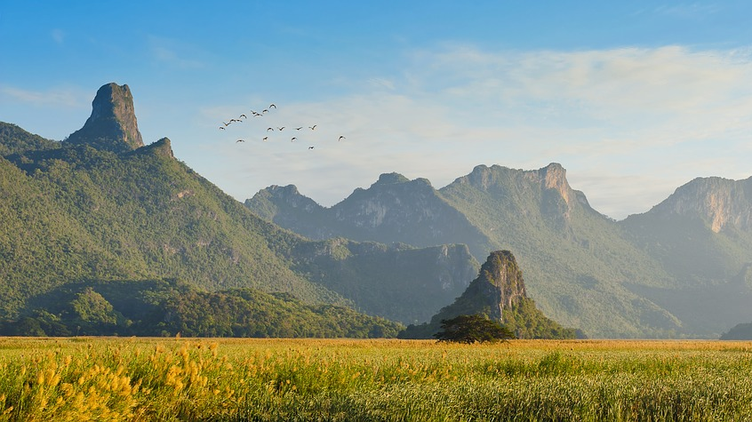
Details of each component
Unit 1 ‘Physical Systems’
Coastal Landscapes
How do you build a beach or shape a cliff? Why is the sea salty? How does sea level change affect our world? Where does all the sand on a beach come from?
Why do coastlines matter to humans? How have we unintentionally altered our landscape?
Earth’s life support systems
Where does all our water come from? How did it get there? What controls our climate & weather? How does it rain and why does it get colder as you climb up a mountain?
Why is the rainforest so full of life? Does it matter to us if Alaska starts to warm up?
Fieldwork
Geographical Skills

Slide 4
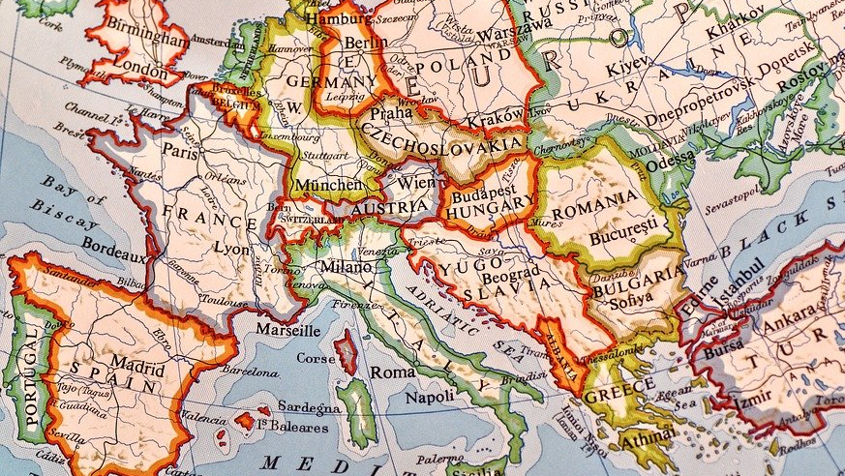
Details of each component
Unit 2 ‘Human Interactions’
Changing spaces; making places
What is place? How to places and spaces change over time?
How does migration, inequality, government, FDI or trade change what a place is like?
Global connections and Global governance
Is trade fair? Why does trade and globalisation lead to winners and who losers?
Who decides our borders? Who are the Superpowers of the world? Why did Russia invade the Ukraine or China argue over the South China Sea.
Fieldwork
Geographical Skills

Slide 5
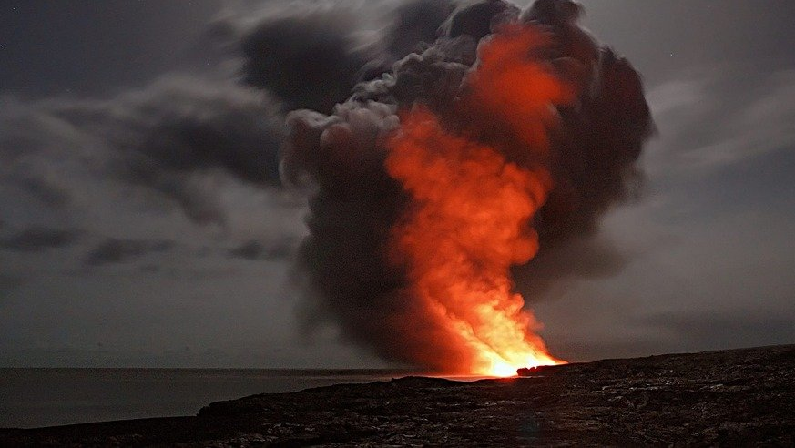
Details of each component
Unit 3 ‘Geographical Debates’
Hazardous Earth
Why do some volcanoes explode and other ooze lava? Which country is best prepared to deal with tectonic hazards? Can you predict a volcanic eruption? What is a limnic overturning event and how would it kill you?
Disease Dilemmas
What is the most dangerous disease? What controls where you find diseases? Am I safe from Ebola? How far is it possible to protect ourselves from disease?
Geographical Skills

Slide 6
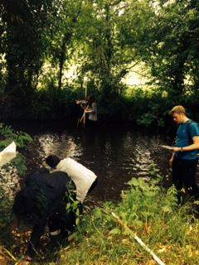
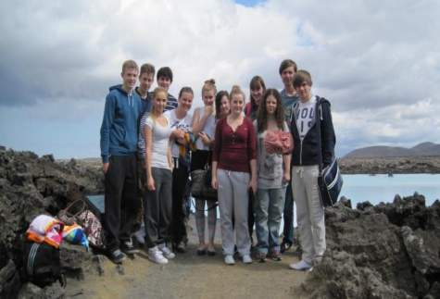
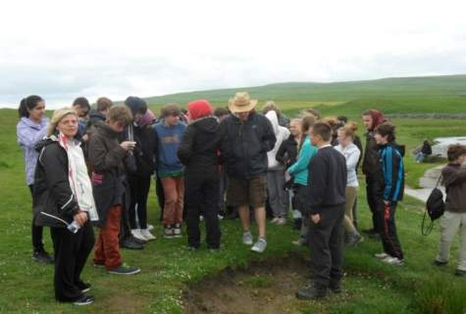
Fieldtrips
WARNING
Due to Covid 19 the planned fieldtrips to Iceland and Dorset in 2020 were postponed. This situation is unlikely to change until all travel restrictions are lifted and the school insurance becomes valid once more.
Iceland outside the Blue Lagoon
River study in Cambridgeshire
Malham & the Yorkshire Dales
Fieldwork is a key component of the A level.
OCR require all students to complete an investigation based on a residential or local piece of fieldwork. This is likely to occur towards the end of year 12.
Your coursework (NEA) is worth 20% of you’re ‘A’ level and can be based on a school trip or completed with fieldwork data collected independently during Year 13.

Slide 7

Where will A level Geography take me?
Geography and the skills it develops can be applied in many different fields of study. These often include students taking degrees in Politics, History, Geology, Earth science, Biology, Sociology as well as Geography itself. Universities regard Geography as a top rated ‘A’ level and is sometimes described as a facilitator subject.
Beyond higher education Geography ties into work with the civil service and local government, the energy and environmental sectors as well as journalism, market research, logistics and distribution and education.
Business – are enthusiastic about people who’ve done Geography, because they know how to: research; use statistical data; interpret and use geographical information systems; and how to synthesise new knowledge with the world around them.
Key message = this is a great subject to pick even if you don’t intend on carrying it on beyond A level.

Slide 8
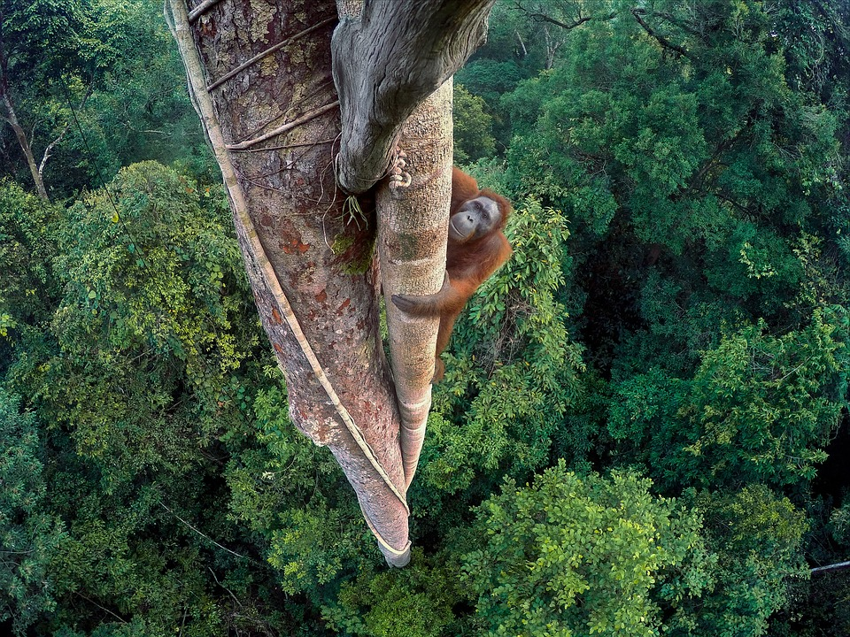
Geography A Level: Student Testimonies
For further information, please contact – Mr Purkiss or Mr Kirk: tpurkiss@ccs.northants.sch.uk or jkirk@ccs.northants.sch.uk

Slide 9


