Slide 1
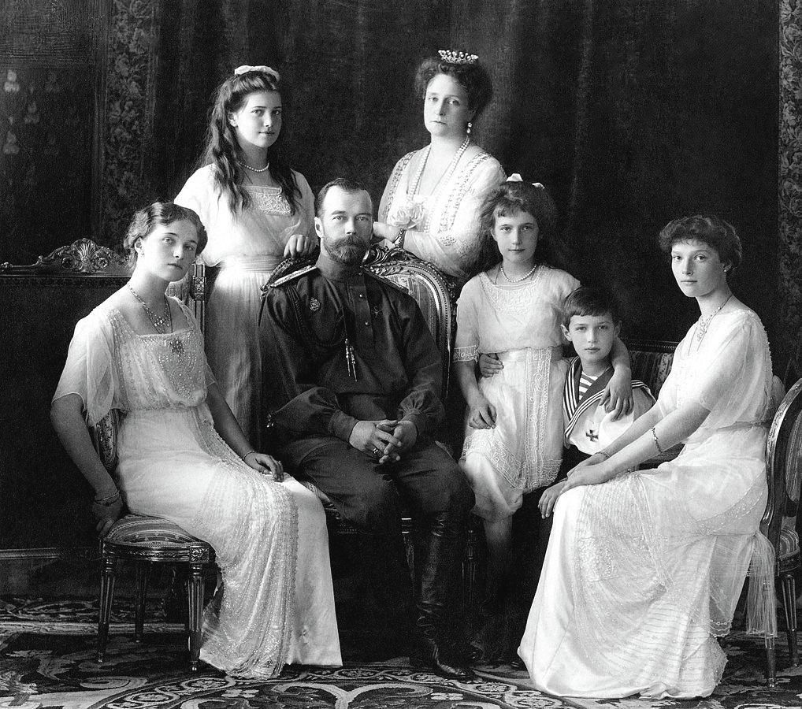
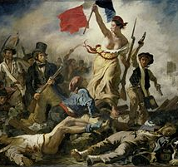
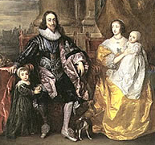
A Level History
(AQA)

Slide 2
Assessment– Stuart Britain and the Crisis of Monarchy, 1603-1702.
Exam Paper | Questions and marks | Assessment Objectives | Timing | Marks
A Level Paper 1: Breadth Study | Section A: Evaluating Historical Interpretations One compulsory question linked to three primary sources or sources contemporary to the period (30 marks) Section B: Essay writing Two from a choice of three essay questions (25 marks each) | AO3 AO1 | Written exam: 2 hours 30 minutes | 80 marks (40% of A Level)
AO1: Demonstrate, organise and communicate knowledge and understanding to analyse and evaluate the key features related to the periods studied, making substantiated judgements and exploring concepts, as relevant, of cause, consequence, change, continuity, similarity, different and significance.
AO3: Analyse and evaluate, in relation to the historical context, different ways in which aspects of the past have been interpreted

Slide 3
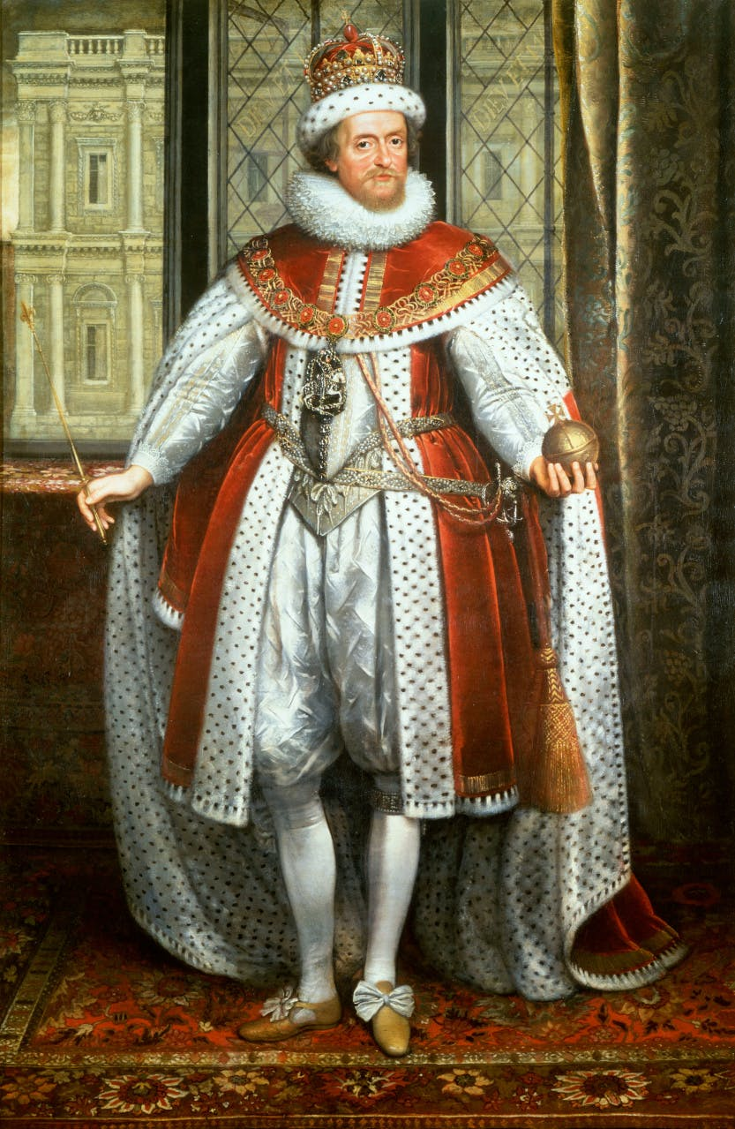
Why study Stuart Britain?
The Stuart Period saw radical changes in English history.
Studies of this period tackle political, religious and social changes that have shaped the Britain we live in today.
Starting with the accession of James I to the English throne in 1603, the period was plagued by internal and religious strife, and a large-scale civil war which resulted in the execution of King Charles I in 1649. The Interregnum, largely under the control of Oliver Cromwell, is included here for continuity, even though the Stuarts were in exile. The Cromwell regime collapsed and Charles II had very wide support for his taking of the throne in 1660. His brother James II was overthrown in 1689 in the Glorious Revolution. He was replaced by his Protestant daughter Mary II and her Dutch husband William III.
The state of monarchy is the supremest thing upon earth: for kings are not only God's Lieutenants upon earth, and sit upon God's throne, but even by God himself they are called Gods.
James I
James 1 of England and VI of Scotland

Slide 4
Course structure – Depth study
Course structure– Stuart Britain and the Crisis of Monarchy, 1603-1702
Stuart Britain
1603-1702
Part 1: Absolutism challenged: Britain, 1603–1649
Part 2 – Monarchy restored and restrained: Britain, 1649–1702
Monarchs and Parliaments, 1603–1629
Revolution, 1629–1649
From Republic to restored and limited monarchy, 1649–1678
The establishment of constitutional monarchy, 1678–1702

Slide 5
Assessment– France in Revolution, 1774-1815
Exam Paper | Questions and marks | Assessment Objectives | Timing | Marks
A Level Paper 2: Depth Study | Section A: Evaluating primary sources One compulsory question linked to three primary sources or sources contemporary to the period (30 marks) Section B: Essay writing Two from a choice of three essay questions (25 marks each) | AO2 AO1 | Written exam: 2 hours 30 minutes | 80 marks (40% of A Level)
AO1: Demonstrate, organise and communicate knowledge and understanding to analyse and evaluate the key features related to the periods studied, making substantiated judgements and exploring concepts, as relevant, of cause, consequence, change, continuity, similarity, different and significance.
AO2: Analyse and evaluate appropriate source material, primary and/or contemporary to the period, within the historical context.

Slide 6
Course structure – Depth study
Course structure – France in Revolution, 1774-1815
France in Revolution
1774-1815
Part 1 – The end of absolutism and the French Revolution, 1774-1789
Part 2 – The rise of Napoleon and his impact on France and Europe, 1795-1815
The origins of the French Revolution, 1774-1789
The experiment in constitutional monarchy, 1789-1792
The emergence and spread of the Terror, Sept 1792-1795
The Directory and Napoleon’s rise to power, 1795-1799
The impact of Napoleon’s rule on France, 1799-1815
The impact of Napoleon’s rule on Europe, 1799-1815

Slide 7


Why study the French Revolution?
The French Revolution was a turning point in French and even world history.
It was about far more than the execution of a King. In fact, the Revolution began without any thought of removing the King from power. However, as is so often in History, events turned out differently from how anyone imagined at the start.
This sense of events escalating and changing quickly, explains why these were terrifying, exciting and frequently uncertain times for the people of France.
One of the fascinations of studying the Revolution is discovering how people behaved under such extreme, rapidly-changing conditions. The Revolution brought the people to the forefront of politics.
The effects of it have continued to reverberate through world events ever since. It had an impact of the Russian Revolution in 1917 and the revolutionary anthem was sung by Polish nationalists as they fought the Soviets in 1956, and by Chinese protestors in Beijing in 1989.
Bastille day, 14th June 2016

Slide 8
Assessment – NEA Russia, 1825-1917
Exam Paper | The Historical Investigation must: | Assessment Objectives |  | Marks
A Level Non-Examined Assessment | • be independently researched and written by the student • be presented in the form of a piece of extended writing with a limit of 4500 words • draw upon the student's investigation of sources (both primary and secondary) which relate to the development or issue chosen and the differing interpretations that have been placed on this • place the issue to be investigated within a context of approximately 100 years • be an issue which does not duplicate the content of Components 1 and 2. | AO1, AO2, AO3 | • 3500–4500 words • marked by teachers • moderated by AQA | 40 marks (20% of A Level)
AO1: Demonstrate, organise and communicate knowledge and understanding to analyse and evaluate the key features related to the periods studied, making substantiated judgements and exploring concepts, as relevant, of cause, consequence, change, continuity, similarity, different and significance.
AO2: Analyse and evaluate appropriate source material, primary and/or contemporary to the period, within the historical context.
AO3: Analyse and evaluate, in relation to the historical context, different ways in which aspects of the past have been interpreted

Slide 9

Where will a study of A-level History take me?
A history degree equips you with many skills that are attractive to employers.
History is actually very practical, because it involves:
  Learning about people – how they interact, the motives and emotions that can tear people apart into rival factions or help them to work together for a common cause (useful knowledge for team-building at work!)
  Learning about countries, societies and cultures – so many of today's conflicts and alliances have their roots in the past; how can you negotiate with, trade successfully with, or report on a country if you know nothing of its history?
  Learning to locate and sift facts – to identify truth and recognise myth, propaganda and downright lies (useful in every aspect of life!)
  Presenting what you've learned in a way that makes sense to others – whether in graphs, essays or illustrated reports – and having the confidence to defend your findings.
All these skills are valuable in a whole range of jobs. So instead of only looking at ‘careers in history' you could also look at careers where it will help a lot if you've studied history.
Studying history can lead to a great number of excellent careers as diverse as the media, government, heritage organisations, conservation, teaching, archives, museums and galleries, the police and law.
More info can be found at: https://www.history.org.uk/student/resource/2914/careers-in-history

Slide 10
History A level: student testimonies
For further information, please contact –
Mrs Page: epage@ccs.northants.sch.uk

