Slide 1
KS4 – fine ARt
What to expect over the 2 year course…

Slide 2
WHY CHOOSE ART AND DESIGN?
The opportunity to explore ideas and experiment with a wide range of media to produce creative art works, both individually, and in collaboration with other students.
Broad-based projects which encourage imaginative work
The chance to discover new ways of working AND to meet and work with professional ARTISTS
Introduction to a large and diverse range of artists and designers, both traditional and contemporary

Slide 3
COURSE CONTENT AND ACTIVITIES
This course offers the opportunity to explore ideas through a wide range of 2D and 3D approaches, for example: drawing, painting, printing, sculpture, PHOTOGRAPHY, ceramics, textiles, collage, the use of computer-generated imagery and mixed-media techniques. STUDENTS WILL ATTEND Gallery visits and the chance to work with professional artists anD EXHIBIT THEIR OWN WORK. STUDENTS SUBMIT WORK TO SEVERAL NATIONAL COMPETITIONS.

Slide 4
THIS COURSE WOULD SUIT YOU IF:
You are ENTHUSIASTIC about visual art
You have some ARTISTIC SKILL
You are CREATIVE and willing to EXPLORE
You are RECEPTIVE to the ideas of others
You are able to work INDEPENDENTLY
You are RESOURCEFUL
You are HARDWORKING

Slide 5
CAREERS & FUTURE OPPORTUNITIES
Progression from GCSE to A Level fine Art, followed by either a Foundation Course in Art & Design or a
BA (Hons) Degree; specialist areas include Fine Art, Fashion and Textiles, Illustration, Jewellery, Graphics, Interior Design, Film, Photography, Animation, Sculpture, Printmaking, Architecture
Careers: Professional Artist, Film Maker, Product Designer, Architect, Photographer, Fashion Designer, illustrator/biomedical illustrator, Teacher/Lecturer, theatre designer

Slide 6
ASSESSMENT INFORMATION
All work is assessed internally by the Visual Art Team and then moderated by an external examiner. Sketchbooks will be provided for the coursework unit and the Externally Set Assignment. Sketchbook work is central to all projects, demonstrating the development of ideas, exploration of media and techniques, and reference to the work of a variety of artists and approaches, and supports final outcomes. The10 hour practical examination takes place in year 11.

Slide 7
Students complete two projects over the 2 year course
Project one – Structures (completed in Year 10)
Project two – Students choose a theme from a variety of given themes (completed in Year 11)
Coursework = 60% of overall mark awarded

Slide 8
ExamINATION – 40% of overall mark
Exam papers hand out in January – 4 months to produce preparatory studies in response to your chosen theme (examination question) which covers all 4 Assessments Objectives
School arrange a trip to support the exam – usually to galleries in London
Towards the end of April - sit a 10 hour examination (over two school days) to produce an outcome/outcomes in response to chosen theme

Slide 9
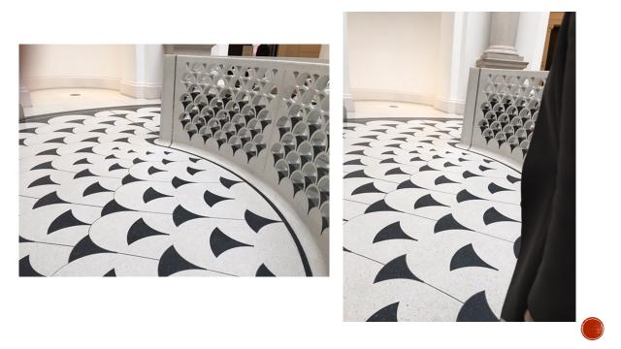
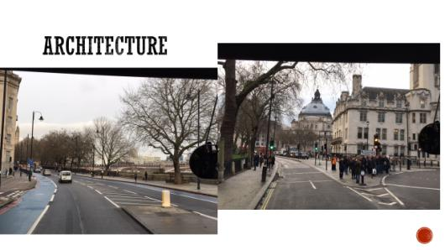
EXAM Trip to tate Britain with examples of work.

Slide 10
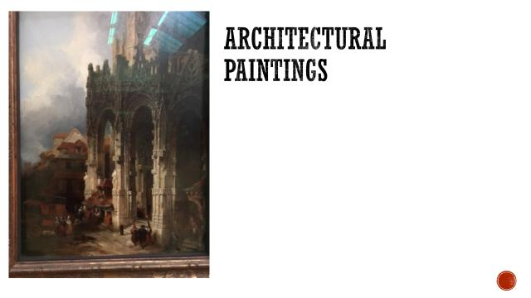
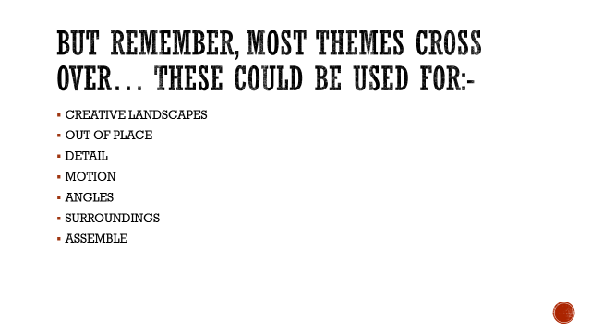

Slide 11
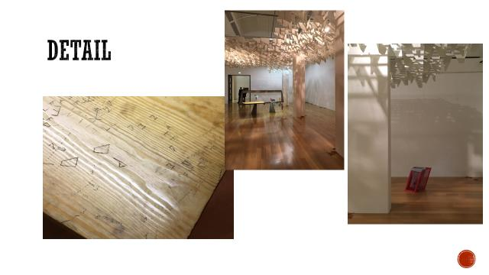
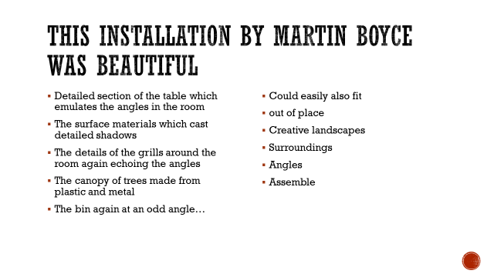

Slide 12
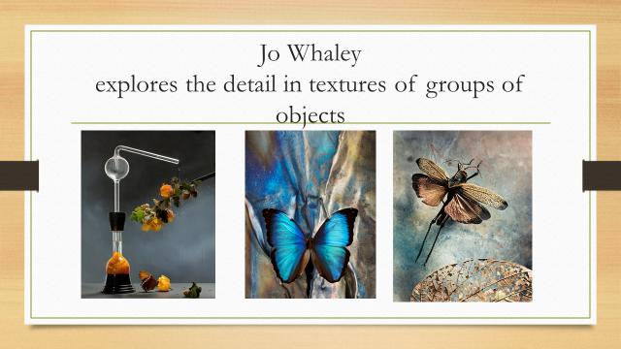
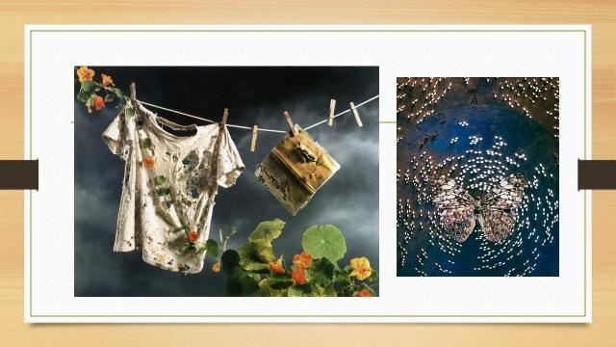

Slide 13
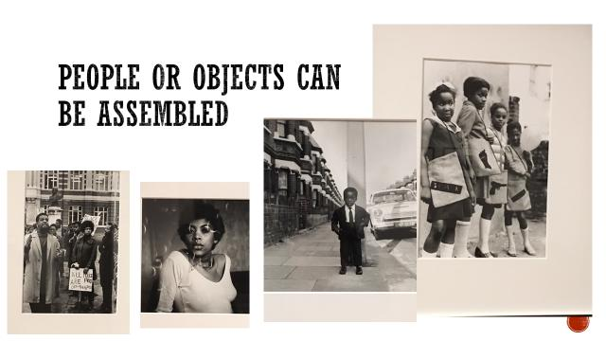
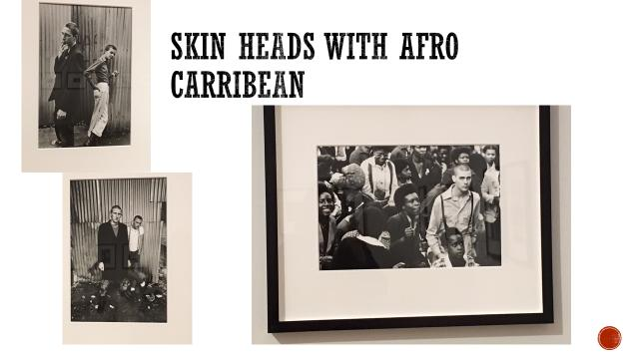

Slide 14
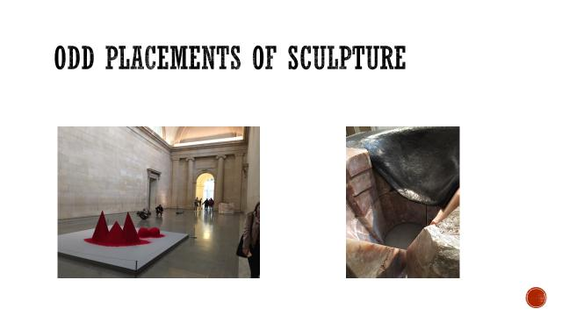
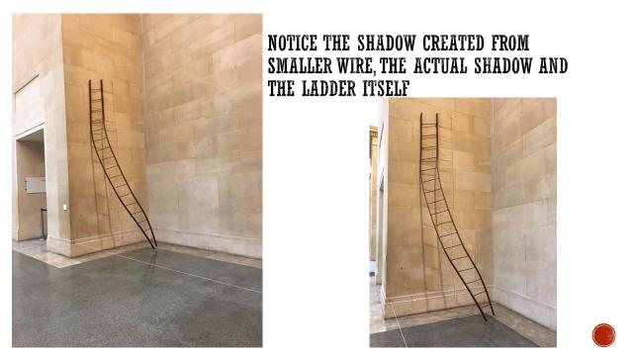

Slide 15
Examples of students examination work
Produced over 10 hours

Slide 16
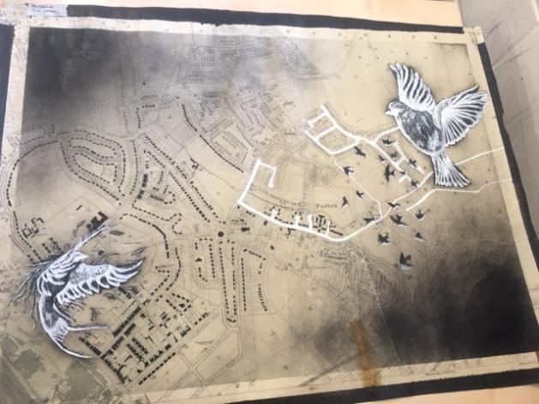
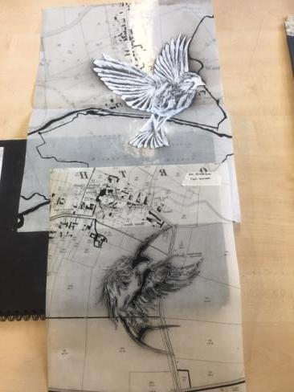

Slide 17
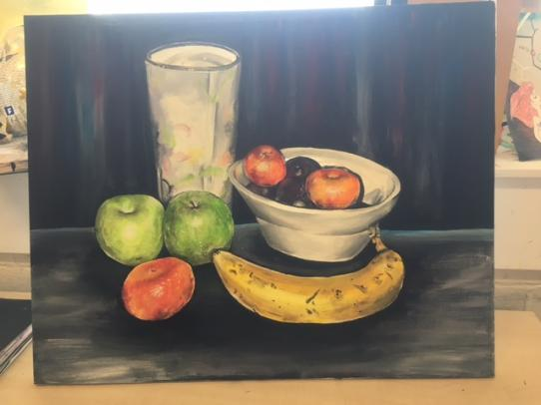
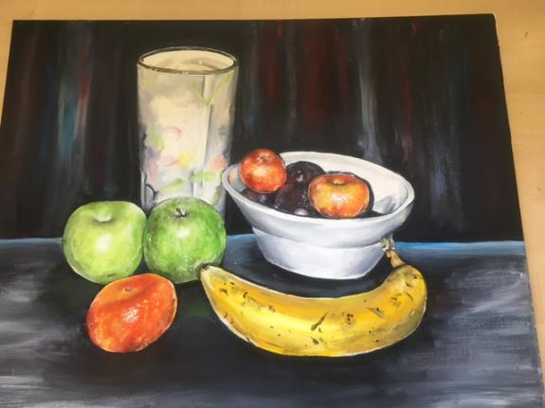

Slide 18
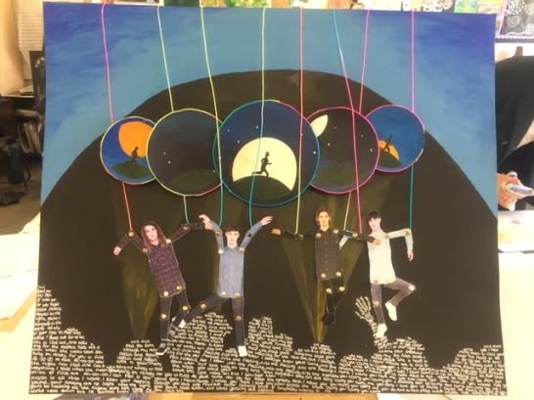
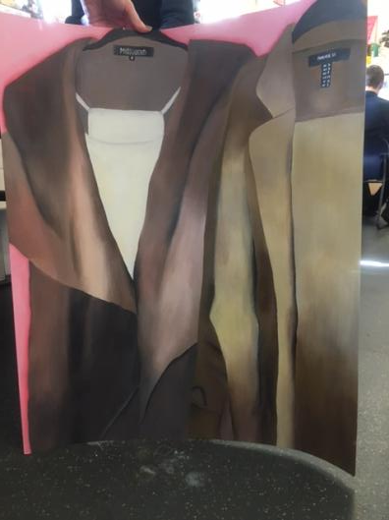

Slide 19
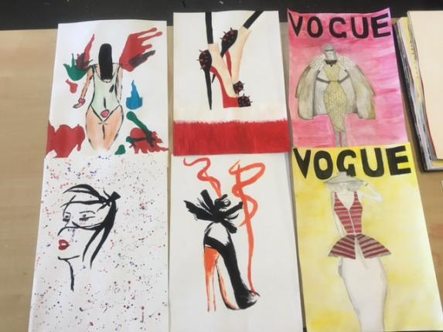
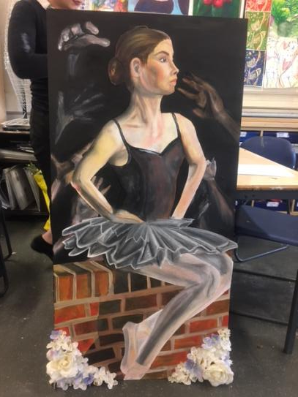

Slide 20
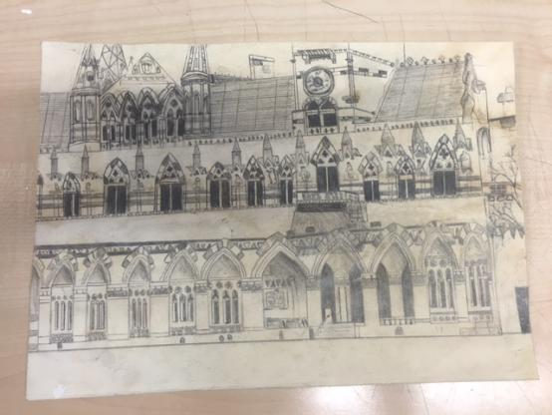
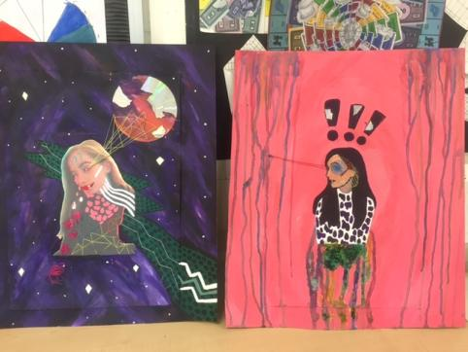

Slide 21
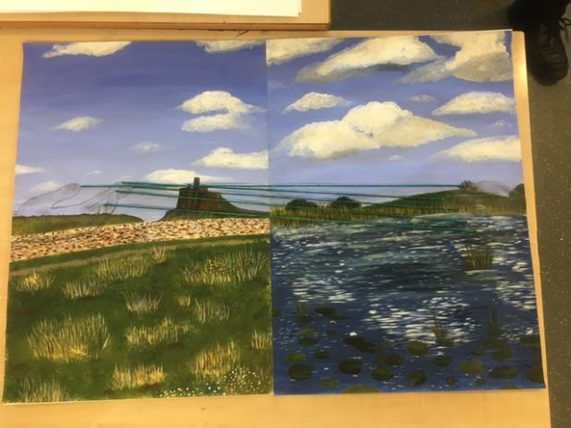
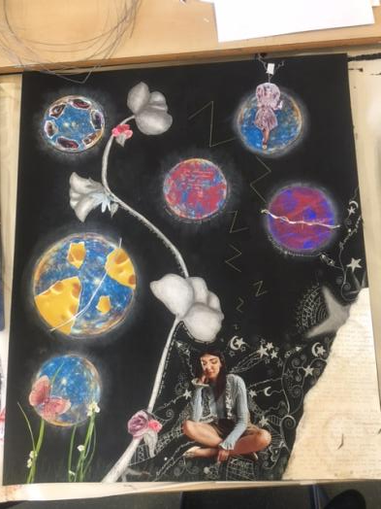

Slide 22
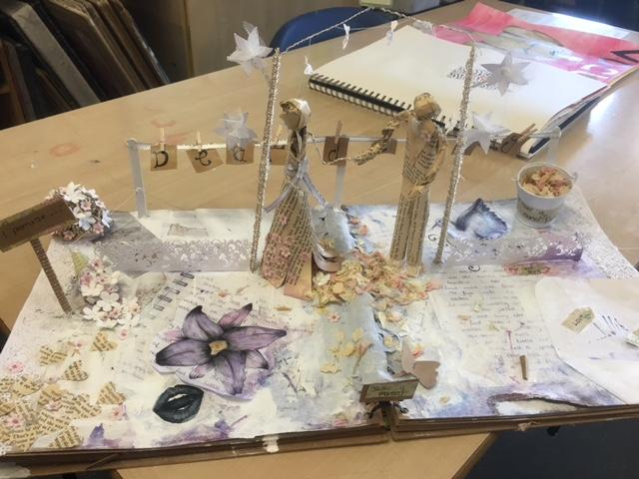
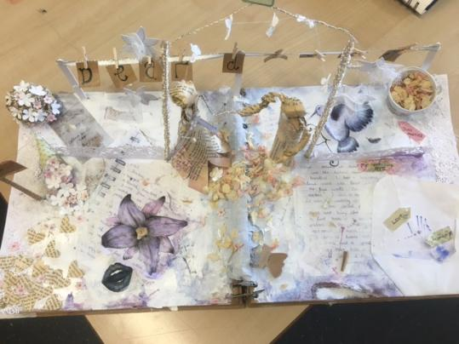

Slide 23
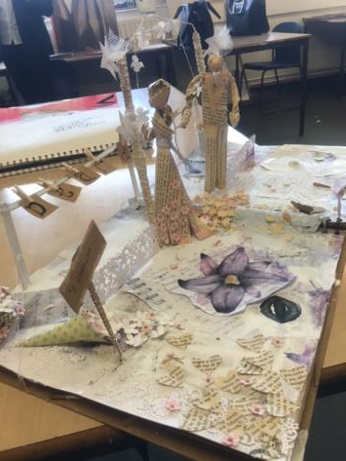
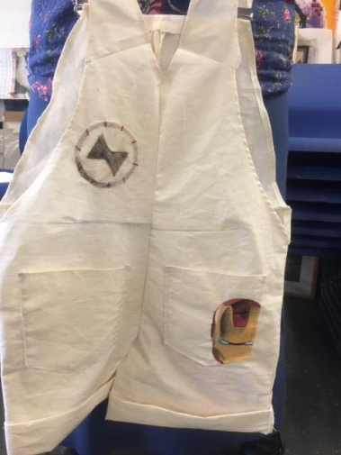
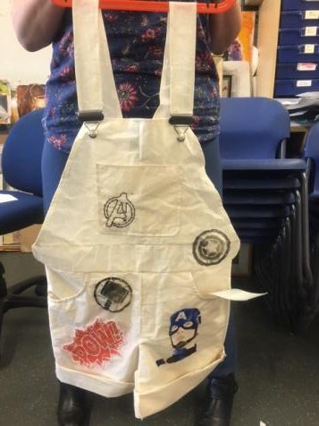

Slide 24
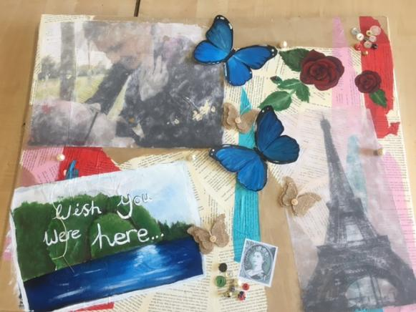
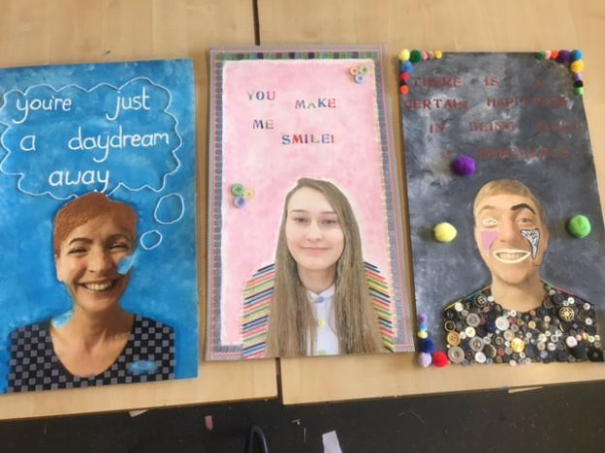

Slide 25
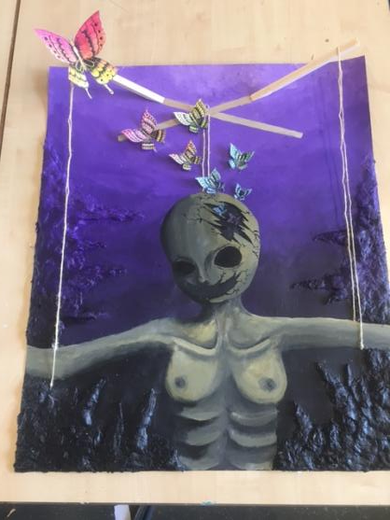
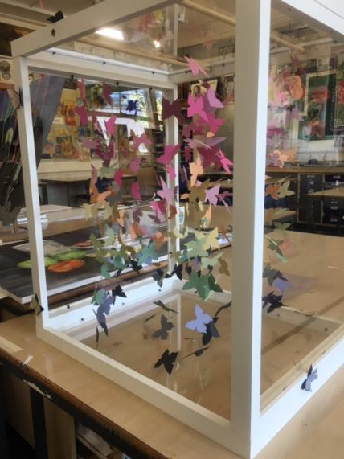

Slide 26


