Slide 1
KS4 - photography
What to expect over the 2 year course…

Slide 2
WHY CHOOSE PHOTOGRAPHY?
To discover new and exciting ways of working creatively.
The opportunity to study from broad-based projects both individually and in collaboration with other students.
The chance to meet and work with professional photographers.
Introduction to both traditional and contemporary technologies.

Slide 3
COURSE CONTENT AND ACTIVITIES
This course offers the opportunity to select from a range of starting points including: PORTRAITURE, LANDSCAPE, STILL LIFE, DOCUMENTARY PHOTOGRAPHY, FINE ART (INSTALLATION), MOVING IMAGE AND COMPUTER MANIPULATION.
STUDENTS WILL ATTEND GALLERY VISITS AND THE CHANCE TO WORK WITH PROFESSIONAL PHOTOGRAPHERS AND EXHIBIT THEIR OWN WORK. STUDENTS SUBMIT WORK TO SEVERAL NATIONAL COMPETITIONS.

Slide 4
THIS COURSE WOULD SUIT YOU IF:
You are ENTHUSIASTIC about Photography
You have some ARTISTIC SKILL
You are CREATIVE and willing to EXPLORE
You are RECEPTIVE to the ideas of others
You are able to work INDEPENDENTLY
You are RESOURCEFUL
You are HARDWORKING

Slide 5
CAREERS & FUTURE OPPORTUNITIES
Progression from GCSE to A Level Photography, followed by a BA (Hons) Degree; specialist areas include Film, studies Photography, Animation.
Careers: Film Maker, Photographer, Fashion Designer, Photo Journalist, video editor, broadcasting production, advertising, editorial work, Teacher/Lecturer.

Slide 6
ASSESSMENT INFORMATION
All work is assessed internally by the Visual Art Team and then moderated by an external examiner. folders will be provided for the coursework unit and the Externally Set Assignment. Student folder work is central to all projects, demonstrating the development of ideas, exploration of media and techniques, and reference to the work of a variety of photographers and approaches, and supports final outcomes. The 10 hour practical examination takes place in year 11.

Slide 7
Students complete two projects over the 2 year course
Project one – Structures (completed in Year 10)
Project two – Students choose a theme from a variety of given themes (completed in Year 11)
Coursework = 60% of overall mark awarded

Slide 8
Examination – 40% of overall mark
Exam papers hand out in January – 4 months to produce preparatory studies in response to your chosen theme (examination question) which covers all 4 Assessments Objectives
School arrange a trip to support the exam – usually to galleries in London
Towards the end of April - sit a 10 hour examination (over two school days) to produce an outcome/outcomes in response to chosen theme

Slide 9
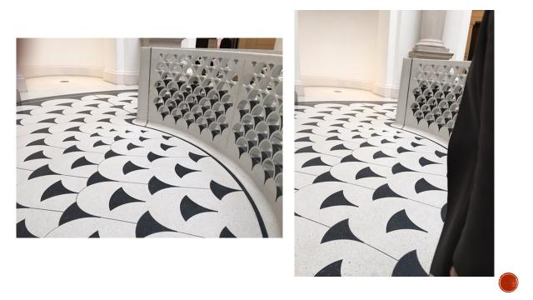
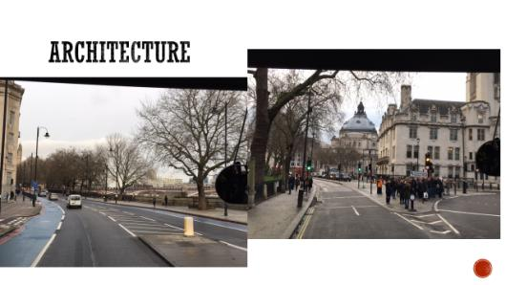
Trip to tate Britain with examples of work

Slide 10
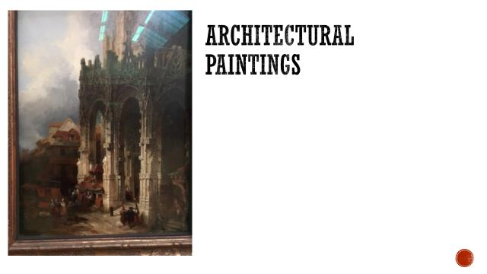
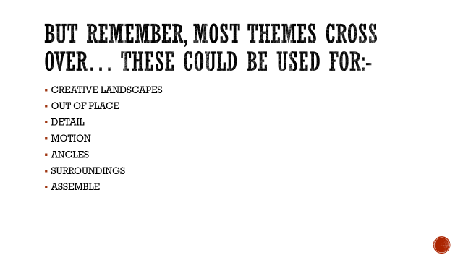

Slide 11
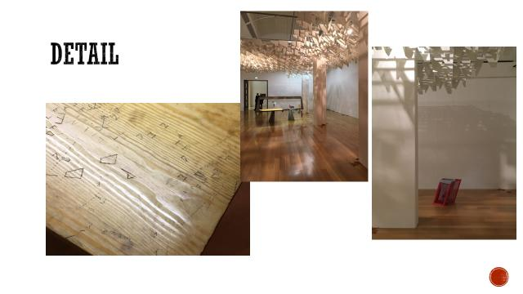
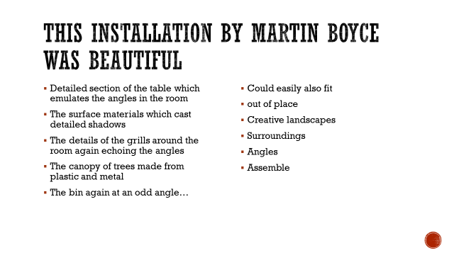

Slide 12
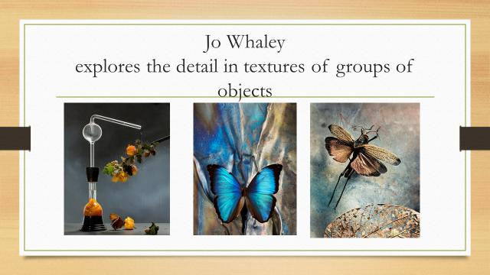
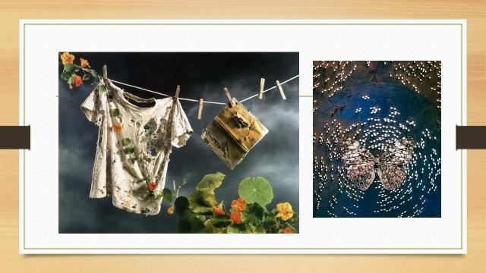

Slide 13
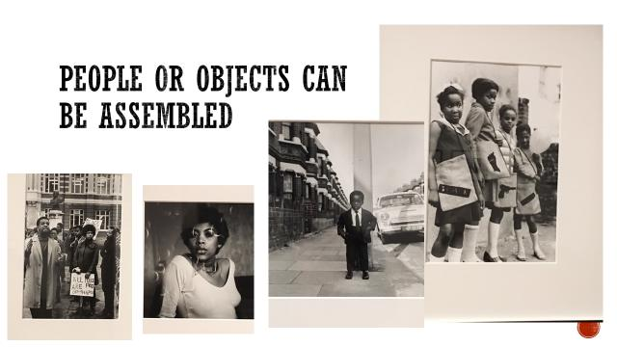
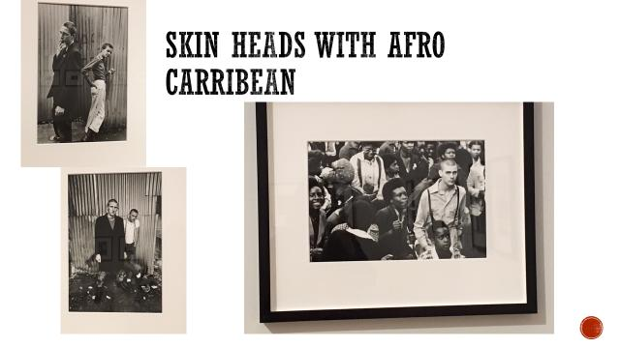

Slide 14
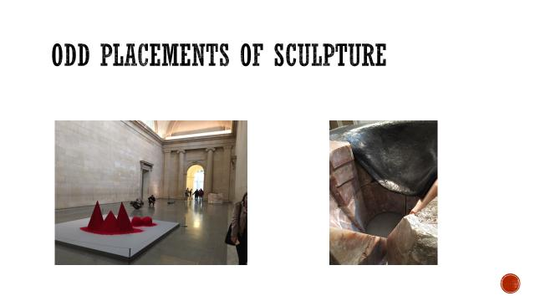
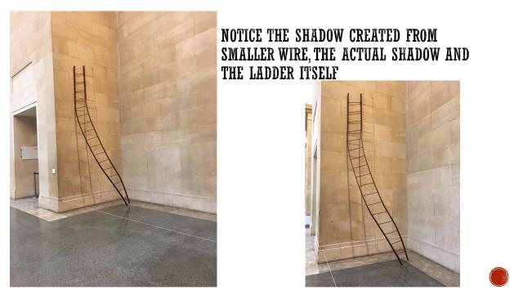

Slide 15
Examples of students exam work
Produced over 10 hours

Slide 16
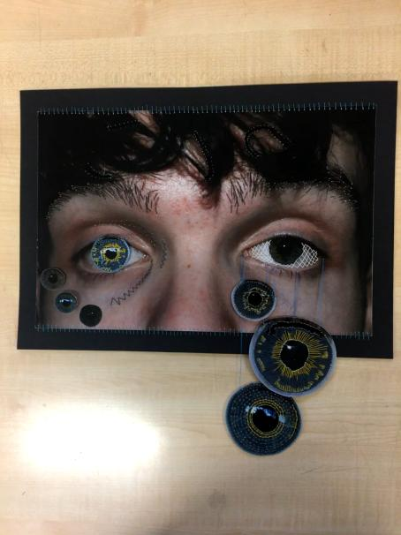
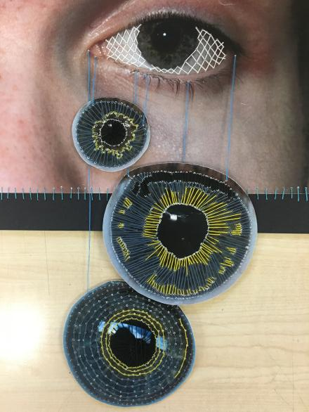

Slide 17
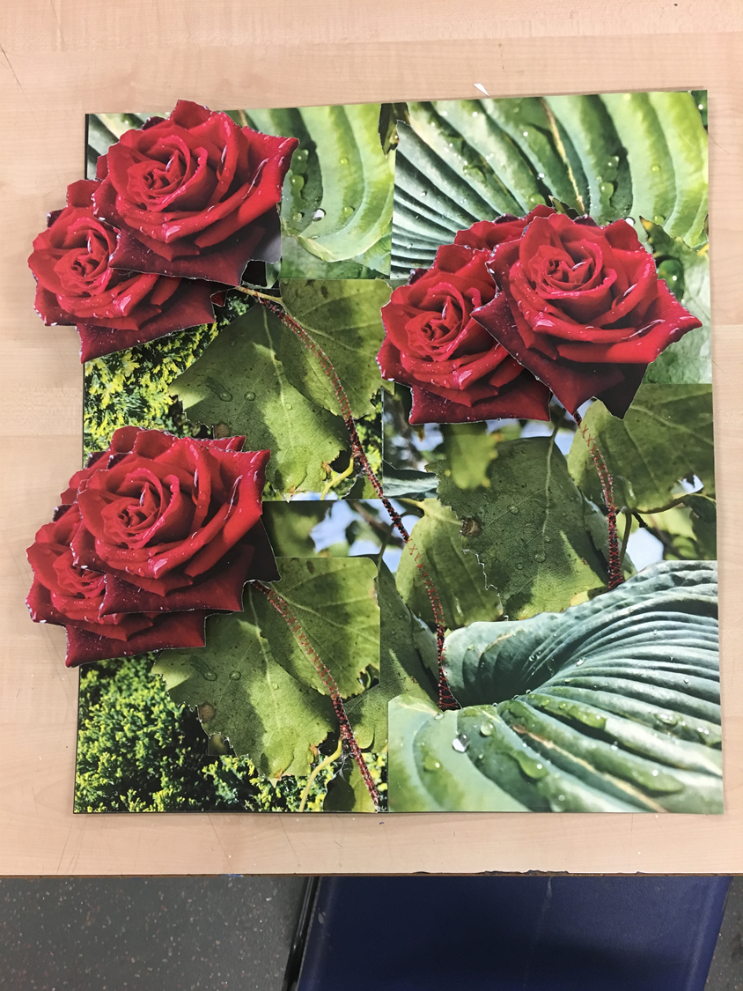
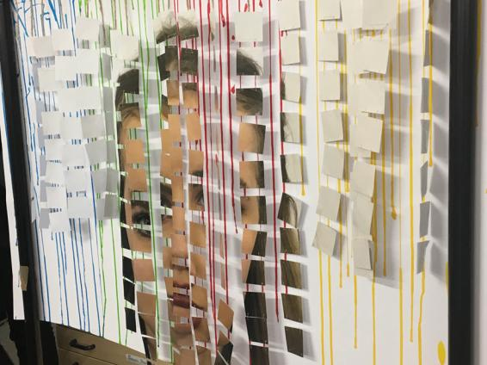

Slide 18
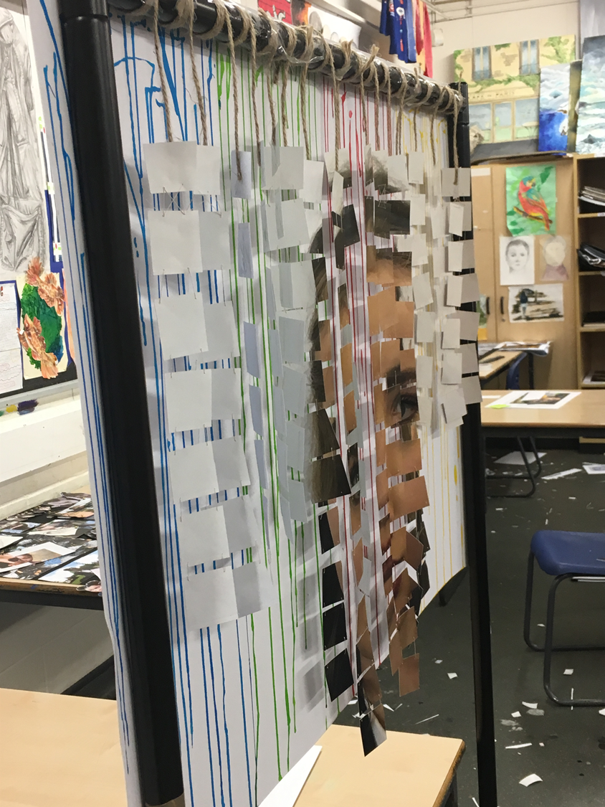
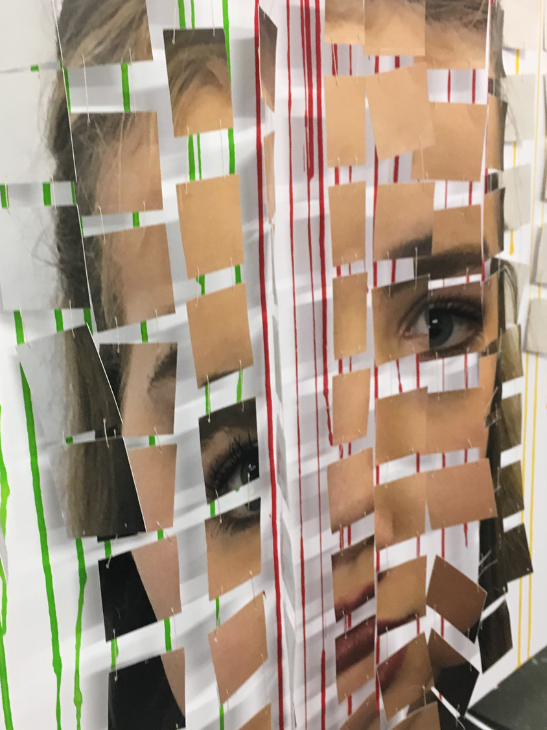

Slide 19
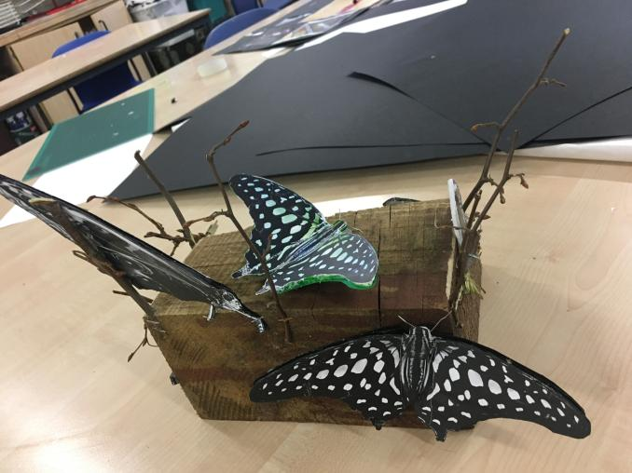
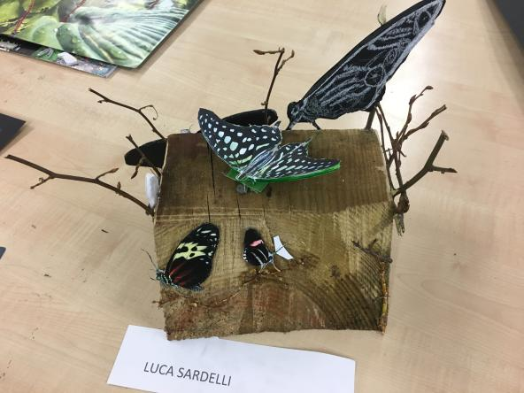

Slide 20
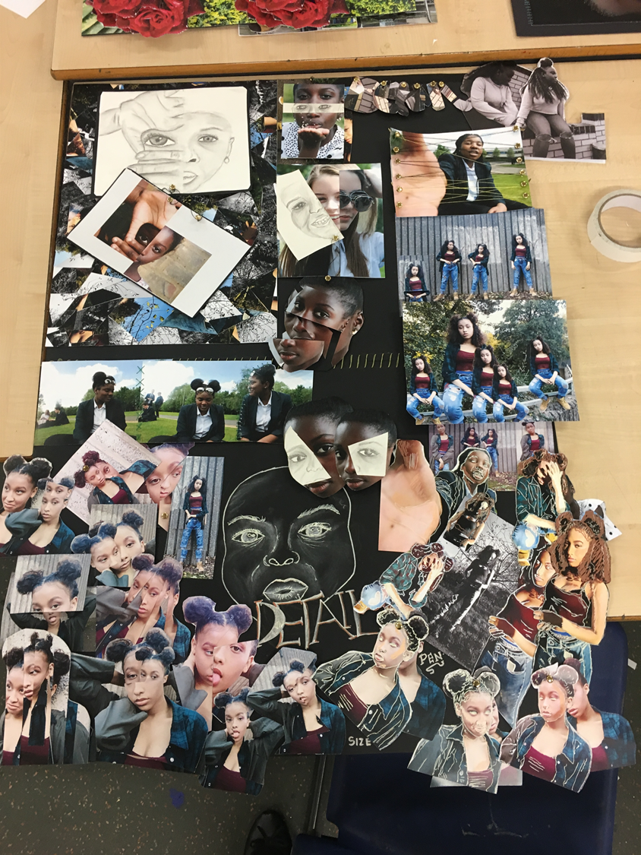
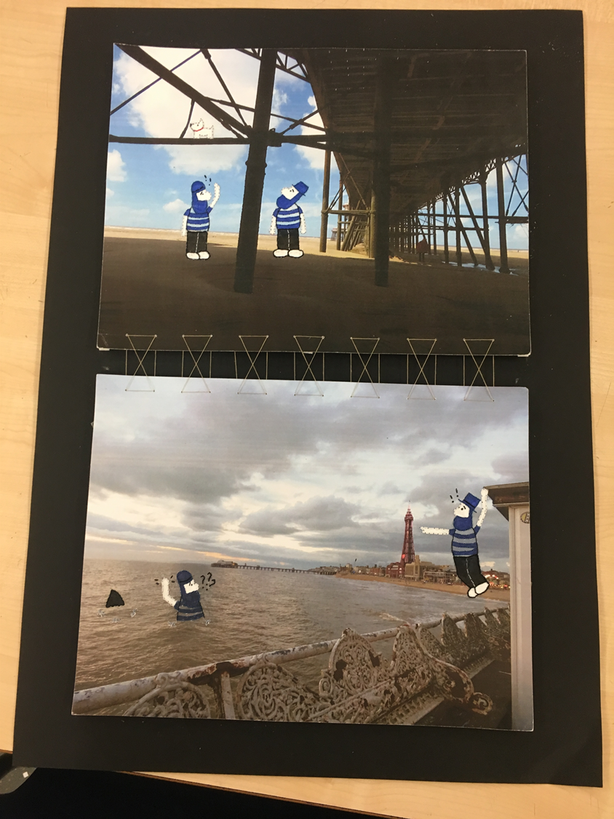

Slide 21


